Slide 1
Principles Accounting in English 1
PRINCIPLES OF ACCOUNTING
CHAPTER THREE
(Accounting Cycle)
ACCOUNTING DEPATMENT
2022-2023
CHPTER (3)
(Accounting cycle)
| P a g e - 1 -

Slide 2
PRINCIPLES OF ACCOUNTING
First: Double Entry Method:
Accounting to the double entry method, every transaction in money is recorded in accounts. Every transaction has two fundamental aspects, that of receiver or payer, profit or loss. The account that receives the value is debited and the account that gives the value is credited with the result that there is an equivalent debit for every credit.
In order to make it more understandable to locate the debit and the credit, a
discussion of the kinds of accounts will be made first. This will assist in differentiating the debit from the credit.
second: Accounting cycle:
The processes of accounting cycle consist of the following steps:
Analysis of transactions from source documents.
Journalizing transactions.
Posting from the Journal to the Ledger.
Balancing of each ledger account.
Preparation a Trial Balance.
Adjusting Entries.
Adjusted Trial Balance.
Closing Entries
Financial Statements
Debits and Credits
The terms debit and credit are directional signals: Debit indicates left,
and credit indicates right. They indicate which side of a T account a number will be recorded on. Entering an amount on the left side of an account
is called debiting the account. Making an entry on the right side is crediting the account. We commonly abbreviate debit as Dr. and credit as Cr.
Summary of Debit/Credit Rules
1. The Journal:
Companies initially record transactions in chronological order (the order in which they occur). Thus, the journal is referred to as the book of original entry. For each transaction the journal shows the debit and credit effects on specific accounts.
Companies may use various kinds of journals, but every company has the
| P a g e - 1 -

Slide 3
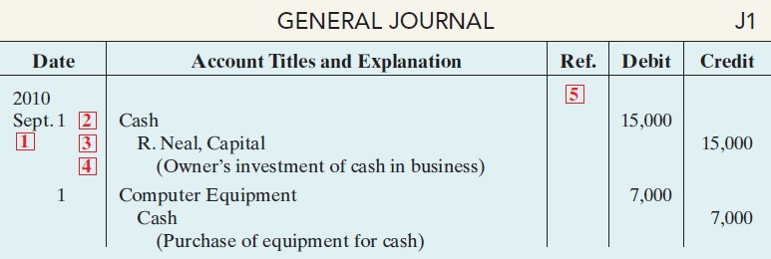
PRINCIPLES OF ACCOUNTING
most basic form of journal, a general journal. Typically, a general journal has spaces for dates, account titles and explanations, references, and two amount columns. See the format of the journal in Illustration 2-13 (on page 56). Whenever we use the term “journal” in this textbook without a modifying adjective, we mean the general journal.
The journal makes several significant contributions to the recording process:
It discloses in one place the complete effects of a transaction.
It provides a chronological record of transactions.
It helps to prevent or locate errors because the debit and credit amounts for each entry can be easily compared
JOURNALIZING
Entering transaction data in the journal is known as journalizing. Companies make separate journal entries for each transaction. A complete entry consists of: (1) the date of the transaction, (2) the accounts and amounts to be debited and credited, and (3) a brief explanation of the transaction.
The date of the transaction is entered in the Date column.
The debit account title (that is, the account to be debited) is entered first at the extreme left margin of the column headed “Account Titles and Explanation,” and the amount of the debit is recorded in the Debit column.
The credit account title (that is, the account to be credited) is indented and entered
on the next line in the column headed “Account Titles and Explanation,” and the amount of the credit is recorded in the Credit column.
A brief explanation of the transaction appears on the line below the credit account title. A space is left between journal entries. The blank space separates
individual journal entries and makes the entire journal easier to read.
The column titled Ref. (which stands for Reference) is left blank when the journal entry is made. This column is used later when the journal entries are transferred to the ledger accounts.
SIMPLE AND COMPOUND ENTRIES
Some entries involve only two accounts, one debit and one credit. (See, for example,
| P a g e - 3 -

Slide 4
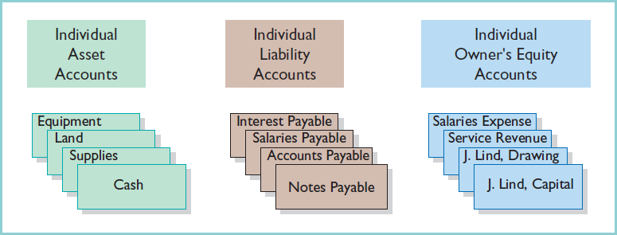
PRINCIPLES OF ACCOUNTING
the entries in Illustration below.) An entry like these is considered a simple entry. Some transactions, however, require more than two accounts in journalizing. An entry that requires three or more accounts is a compound entry. To illustrate, assume that on July 1, Butler Company purchases a delivery truck costing $14,000. It
pays $8,000 cash now and agrees to pay the remaining $6,000 on account (to be paid later).The compound entry is as follows.
The Ledger
The entire group of accounts maintained by a company is the ledger. The ledger keeps in one place all the information about changes in specific balances.
Companies may use various kinds of ledgers, but every company has a general
ledger. A general ledger contains all the asset, liability, and owner’s equity accounts,
POSTING
Transferring journal entries to the ledger accounts is called posting.
This phase of the recording process accumulates the effects of journalized transactions into the individual accounts. Posting involves the following steps.
In the ledger, in the appropriate columns of the account(s) debited, enter
the date, journal page, and debit amount shown in the journal.
In the reference column of the journal, write the account number to which the

Slide 5
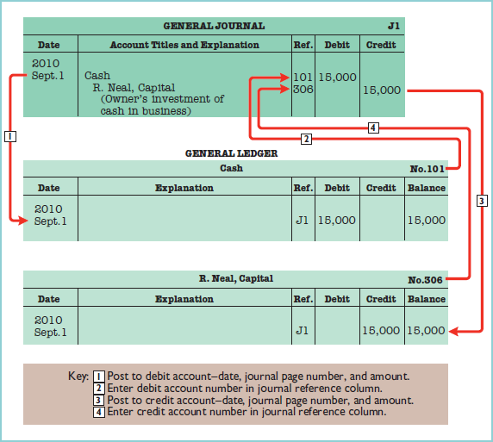
PRINCIPLES OF ACCOUNTING
debit amount was posted.
In the ledger, in the appropriate columns of the account(s) credited, enter the date, journal page, and credit amount shown in the journal.
In the reference column of the journal, write the account number to which the
credit amount was posted.
THE RECORDING PROCESS ILLUSTRATED

Slide 6
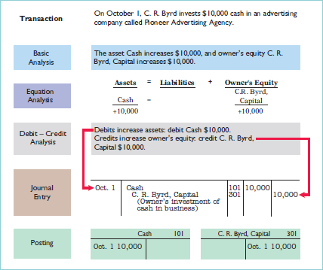
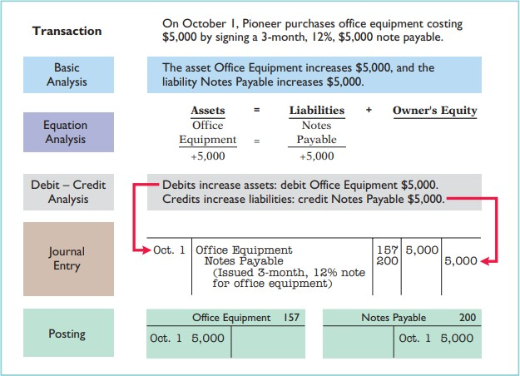
PRINCIPLES OF ACCOUNTING

Slide 7
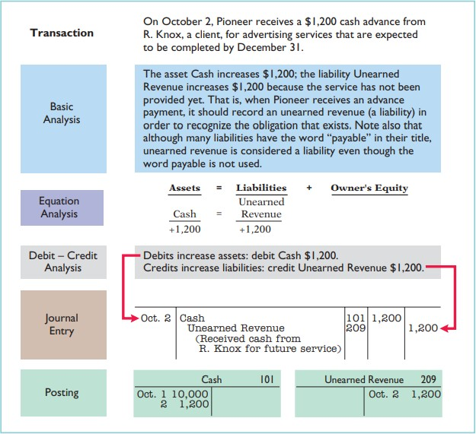
PRINCIPLES OF ACCOUNTING

Slide 8
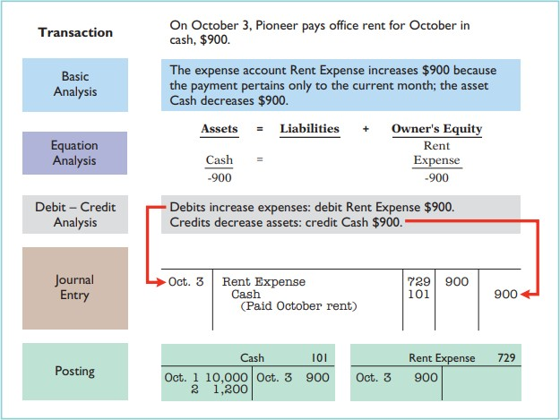
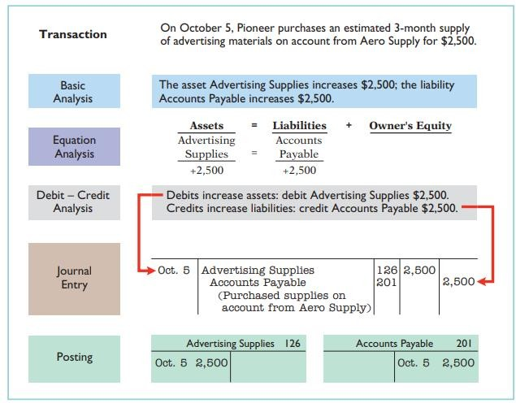
PRINCIPLES OF ACCOUNTING

Slide 9
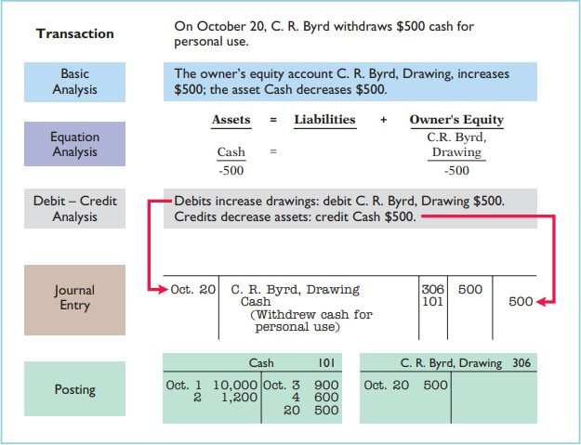
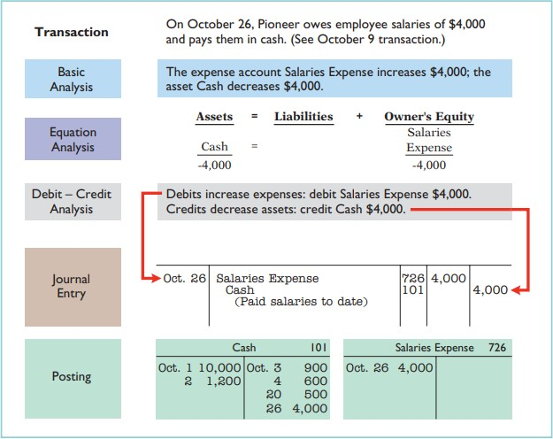
PRINCIPLES OF ACCOUNTING

Slide 10
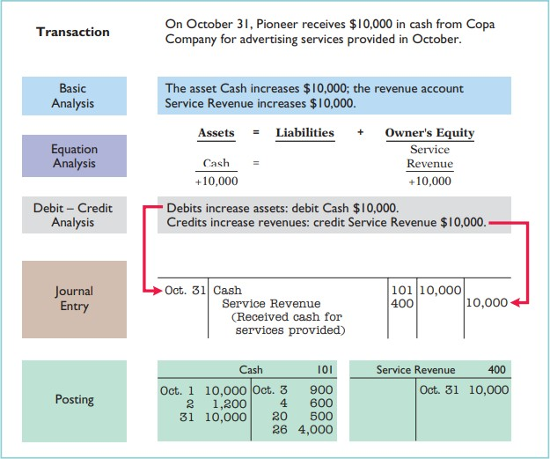
PRINCIPLES OF ACCOUNTING

Slide 11
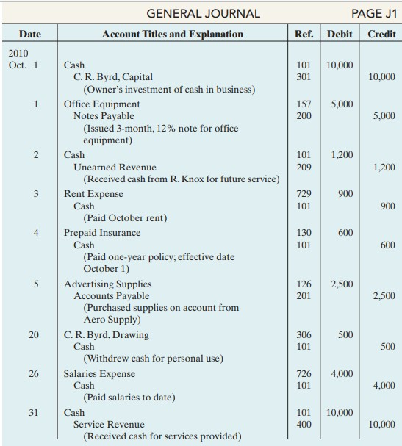
PRINCIPLES OF ACCOUNTING

Slide 12
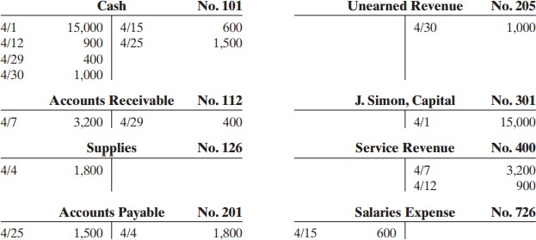
PRINCIPLES OF ACCOUNTING
Example 1 :
Bob Sample opened the Campus Laundromat on September 1, 2010. During the first month of operations the following transactions occurred.
Sept. 1 Bob invested $20,000 cash in the business.
The company paid $1,000 cash for store rent for September.
Purchased washers and dryers for $25,000, paying $10,000 in cash and signing a $15,000, 6- month, 12% note payable.
Paid $1,200 for a one-year accident insurance policy.
10 Received a bill from the Daily News for advertising the opening of the laundromat $200. 20 Bob withdrew $700 cash for personal use.
30 The company determined that cash receipts for laundry services for the month were
$6,200.
The chart of accounts for the company is the same as that for Pioneer Advertising Agency plus the following: No. 154 Laundry Equipment, No. 610 Advertising Expense, No. 301 Bob Sample, Capital; and No. 306 Bob Sample, Drawing.
Instructions (a) Journalize the September transactions. (b) Open ledger accounts and post the September transactions.
Example 2 :
Presented below is information related to Hanshew Real Estate Agency.
Oct. 1 Pete Hanshew begins business as a real estate agent with a cash investment of $15,000. 2 Hires an administrative assistant.
3 Purchases office furniture for $1,900, on account.
6 Sells a house and lot for B. Kidman; bills B. Kidman $3,200 for realty services provided. 27 Pays $700 on the balance related to the transaction of October 3.
30 Pays the administrative assistant $2,500 in salary for October.
Instructions:
Journalize the transactions.
Post to the ledger accounts.
Example 3 :
The T accounts below summarize the ledger of Simon Landscaping Company at the end of the first month of operations.

Slide 13
PRINCIPLES OF ACCOUNTING
Instructions
Prepare the complete general journal (including explanations) from which the postings to Cash were made.
Example 4 :
Frontier Park was started on April 1 by C. J. Mendez.The following selected events and transactions occurred during April.
Apr. 1 Mendez invested $40,000 cash in the business.
4 Purchased land costing $30,000 for cash.
8 Incurred advertising expense of $1,800 on account. 11 Paid salaries to employees $1,500.
12 Hired Park manager at a salary of $4,000 per month, effective May 1. 13 Paid $1,500 cash for a one-year insurance policy.
17 Withdrew $1,000 cash for personal use.
20 Received $5,700 in cash for admission fees.
25 Sold 100 coupon books for $25 each. Each book contains 10 coupons that entitle the holder to one admission to the park. 30 Received $8,900 in cash admission fees.
30 Paid $900 on balance owed for advertising incurred on April 8.
Mendez uses the following accounts: Cash, Prepaid Insurance, Land, Accounts Payable, Unearned Admission Revenue, C. J. Mendez, Capital; C. J. Mendez, Drawing; Admission Revenue, Advertising Expense, and Salaries Expense.
Instructions:
Journalize the transactions.
Post to the ledger accounts.
Example 5 :
Ray Neal decides to open a computer programming service which he names soft byte. On September 1, 2010, he invests $15,000 cash in the business.
Soft byte purchases computer equipment for $7,000 cash.
Soft byte purchases for $1,600 from Acme Supply Company computer paper and other supplies expected to last several months. Acme agrees to allow soft byte to pay this bill in October.
Soft byte receives $1,200 cash from customers for programming services it has provided.
Soft byte receives a bill for $250 from the Daily News for advertising but postpones
payment until a later date.
Soft byte provides $3,500 of programming services for customers. The company receives cash of $1,500 from customers, and it bills the balance of $2,000 on account.
Soft byte pays the following Expenses in cash for September: store salaries of employees $900, and utilities $200.
Soft byte pays its $250 Daily News bill in cash [in Transaction (5)].
rent $600,
Soft byte receives $600 in cash from customers who had been billed for services [in Transaction (6)].
Ray Neal withdraws $1,300 in cash from the business for his personal use.
Instructions:
Journalize the transactions.
Post to the ledger accounts.

