Slide 1
Principles Accounting in English 1
PRINCIPLES OF ACCOUNTING
CHAPTER FOUR
(Accounting for Merchandising Operations)
ACCOUNTING DEPATMENT 2022-2023
CHPTER (4)
(Accounting for Merchandising Operations)

Slide 2
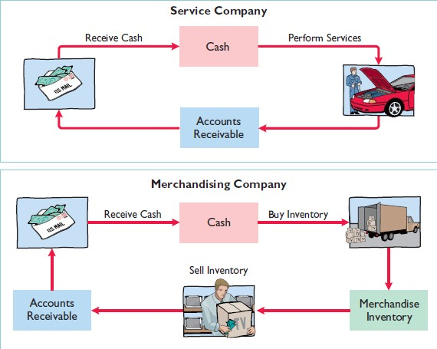
PRINCIPLES OF ACCOUNTING
Operating Cycles
periodic inventory system
In a periodic inventory system, companies do not keep detailed inventory records of the goods on hand throughout the period. Instead, they determine the cost of goods sold only at the end of the accounting period—that is, periodically. At that point, the company takes a physical inventory count to determine the cost of goods on hand.

Slide 3
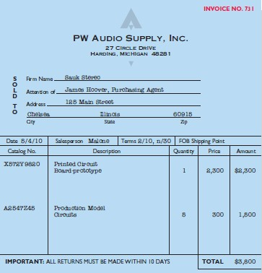
PRINCIPLES OF ACCOUNTING
Recording Purchases of Merchandise
On the basis of the sales invoice and receipt of the merchandise ordered from PW Audio Supply, Sauk Stereo records the $3,800 purchase as follows.
May 4
Purchases 3,800
Accounts Payable 3,800
(To record goods purchased on account from PW Audio Supply)
Purchases is a temporary account whose normal balance is a debit.
Freight Costs
Freight terms are expressed as either FOB shipping point or FOB destination.
The letters FOB mean free on board. Thus, FOB shipping point means buyer pays the freight costs. Conversely, FOB destination means that the seller pays the freight. For example, the sales invoice in Illustration 1 indicates FOB shipping point. Thus, the buyer (Sauk Stereo) pays the freight charges.

Slide 4
PRINCIPLES OF ACCOUNTING
For example, if Sauk pays Acme Freight Company $150 for freight charges on its purchase from PW Audio Supply on May 6, the entry on Sauk’s books is:
May 6
Freight-in (Transportation-in) 150
Cash 150
(To record payment of freight on goods purchased)
Like Purchases, Freight-in is a temporary account whose normal balance is a debit. Freight-in is part of cost of goods purchased. The reason is that cost of goods purchased should include any freight charges necessary to bring the goods to the purchaser. Freight costs are not subject to a purchase discount. Purchase discounts apply only to the invoice cost of the merchandise.
PURCHASE RETURNS AND ALLOWANCES
Sauk Stereo returns $300 of goods to PW Audio Supply and prepares the following entry to recognize the return.
May 8
Accounts Payable 300
Purchase Returns and Allowances 300 (To record return of goods purchased from PW Audio Supply)
Purchase Returns and Allowances is a temporary account whose normal balance is a credit.
PURCHASE DISCOUNTS
On May 14 Sauk Stereo pays the balance due on account to PW Audio Supply, taking the 2% cash discount allowed by PW Audio for payment within 10 days. Sauk Stereo records the payment and discount as follows.
May 14 Accounts Payable ($3,800 _ $300) 3,500
Purchase Discounts ($3,500 * 0.2) Cash
70
3,430
(To record payment within the discount period)
Purchase Discounts is a temporary account whose normal balance is a credit

Slide 5
PRINCIPLES OF ACCOUNTING
Recording Sales of Merchandise
The seller, PW Audio Supply, records the sale of $3,800 of merchandise to Sauk Stereo on May 4 (sales invoice No. 731, Illustration 5-5, page 204) as follows.
May 4
Accounts Receivable 3,800
Sales 3,800
(To record credit sales per invoice #731 to Sauk Stereo)
SALES RETURNS AND ALLOWANCES
To record the returned goods received from Sauk Stereo on May 8, PW Audio Supply records the $300 sales return as follows.
May 8
Sales Returns and Allowances 300
Accounts Receivable 300
(To record credit granted to Sauk Stereo for returned goods)
SALES DISCOUNTS
On May 14, PW Audio Supply receives payment of $3,430 on account from Sauk Stereo. PW Audio honors the 2% cash discount and records the payment of Sauk’s account receivable in full as follows.
May 14 Cash 3,430
Sales Discounts ($3,500 *0.2) 70
Accounts Receivable ($3,800 _ $300) 3,500 (To record collection within 2/10, n/30 discount period from Sauk Stereo)
Discount:
All allowances in price given by the seller to the buyer is known as discount. This deduction may be in the price of goods bought or sold or in the amount of cash to be received or paid.
Discount may be of three types:
1 - Trade discount. 2 - Cash discount.
3 - Quantity discount.
1. Trade discount:
Trade discount is a percentage reduction from a list price granted from the seller to the buyer.
The trade discount usually taken the form of a fixed or graduated percentage as
(5%, 10%, or 15%) as per the seller policy.
The trade discount is not entered or recorded in the books (accounts) by either the buyer or the seller but it will be shown only in the catalogue or list price and the results will be entered in the books since it is neither gain nor lose for the buyer or the seller.

Slide 6
PRINCIPLES OF ACCOUNTING
Example :
(Azad) bought goods worth 1000 $ by cash from (Kawa) with trade discount 5%.
Required:
Journalize this transaction .
Trade discount = 1000 x 5 % = 50
Actual price = 1000 – 50 = 950
Dr. Purchases | 950
Cr. Cash | 950
(bought goods by cash with trade discount )
Example:
(Ahmed store) sold goods worth 2000 $ by check to (Ali) with trade discount 10 % and 5 %.
Required:
Journalize this transaction to both the buyer and seller records.
First trade discount = 2000 x 10 % = 200
2000 – 200 = 1800
Second trade discount = 1800 x 5 % = 90 The actual price = 1800 – 90 = 1710 $
Buyer' record ( Ali ) |  | Seller's record ( Ahmed )
By Purchases | 1710 | By Cash in bank | 1710
To Cash in bank | 1710 | To Sales | 1710
(bought goods by check with tow trade discount 10% and 5 %) |  | (sold goods by check with tow trade discount 10% and 5 % )
2. Cash discount:
To motivate the customer (buyers) bought on credit for early payment, the seller usually grant discount on the amounts paid.
The cash discount is entered or recorded in the books (accounts) and it takes
two types or sides:
Purchases Discount.
Sales Discount.
Terms of cash discount:
term is: 2 / 10, 1 / 20,
There are many terms of cash discount but the most known
N / 30.
This is mean:
2 % discount will be allowed if the buyer pays within the first 10 days.
1 % discount will be allowed if the buyer pays within the second 10 days.
No discount will be allowed but net payment should be made within the third 10 days.

Slide 7
PRINCIPLES OF ACCOUNTING
3- Quantity discount:
For example, of the quantity discount: 1st 1000 $ no quantity discount is allowed.
2nd 1000 $ 5 % quantity discount is allowed.
3rd 1000 $ 10 % quantity discount is allowed.
4th 1000 $ and more 20 % quantity discount is allowed.
Example 1:
This information relates to Aram Co.
On April 5 purchased merchandise from Azad Company for $20,000, terms 2/10, net/30, FOB shipping point.
On April 6 paid freight costs of $900 on merchandise purchased from Azad
Company.
On April 7 purchased equipment on account for $26,000.
On April 8 returned some of April 5 merchandise, which cost $2,800, to Azad Company.
On April 15 paid the amount due to Azad Company in full.
Instructions
Prepare the journal entries to record these transactions on the books of Aram Co.
Assume that Aram Co. paid the balance due to Azad Company on May 4 instead of April 15. Prepare the journal entry to record this payment.
Example 2:
Presented below is information related to Ali Co.
On April 5, purchased merchandise from Ako Company for $22,000, terms 2/10, net/30, FOB shipping point.
On April 6, paid freight costs of $800 on merchandise purchased from Ako.
On April 7, purchased equipment on account from Erbil. Co. for $26,000.
On April 8, returned merchandise, which cost $4,000, to Ako Company.
On April 15, paid the amount due to Ako Company in full.
Instructions
Prepare the journal entries to record these transactions on the books of Ali Co. using a periodic inventory system.
Assume that Ali Co. paid the balance due to Ako Company on May 4 instead
of April 15. Prepare the journal entry to record this payment.

Slide 8
PRINCIPLES OF ACCOUNTING
Example 3:
Information related to Hawre Co. is presented below.
On April 5, purchased merchandise from Renas Company for $25,000 terms 2/10, net/30, FOB shipping point.
On April 6 paid freight costs of $900 on merchandise purchased from Renas.
On April 7, purchased equipment on account for $26,000.
On April 8, returned damaged merchandise to Renas Company and was granted a
$4,000 credit for returned merchandise.
On April 15 paid the amount due to Renas Company in full.
Instructions
Prepare the journal entries to record these transactions on the books of Hawre Co..
Assume that Hawre Co. paid the balance due to Renas Company on May 4 instead of April 15. Prepare the journal entry to record this payment.
Example 4:
At 1 / 4 / 2008 (Salim Co.) Started business with the following: Cash 10000 $ - Cash in bank 10000 $ - Goods 5000 $ - Capital?
At 3 / 4 / Purchased goods worth 3500 $ from (Salah Co.),
(1000 $ by cash – 1000 $ by check – 1000 $ by credit – 500 $ by note that due after 2 months), and paid 250 $ by cash as purchases expenses.
At 5 / 4 / Sold goods worth 1500 $ to (Noor Co.) by credit with terms 3 / 5, 2 / 10, 1 / 20, N / 30.
At 7 / 4 / Settled the account of (Salah Co.) by check.
At 15 / 4 / (Noor Co.) settled the account by cash.
Required:
Journalize the above transactions (By systematic method).
Example 5:
At 1 / 4 / 2008 (Ali Co.) started business with the following assets;
Cash 15000 $ - Cash in Bank 20000 $ - Furniture 5000 $ - Inventory (Beginning) 15000 $ - Capital?
At 3 / 4 / Sold goods to (Hasan Co.) worth 6000 $ on account with terms of
payment -2 / 10, 1 / 20, N / 30.
At 5 / 4 / Purchased goods from (Yasser Co.) worth 4000 $ by cash with trade discount 5 %, and paid purchases expenses 300 $ by check.
At 7 / 4 / We returned goods worth 250 $ to (Yasser Co.) and received the amount by cash.
At 11 / 4 / We received 3000 $ from (Hasan Co.) by cash.
Required:
Journalize the above transactions.

Slide 9
PRINCIPLES OF ACCOUNTING
Example 6:
At Sep. 1st 2008 ( kamel ) deposited 75000 $ in a bank account in the name of the company.
At Sep. 5th Purchased goods worth 15000 $ from (Hana Co.). A part payment of
5000 $ was made by check and the remaining amount on credit by terms 2 / 10 , 1 / 20 , N / 30.
At Sep. 8th Purchased office equipment from (Zana Co.) worth 1000 $ by check.
At Sep. 10th Sold goods to (Ali Co.) worth 6000 $ by cash.
At Sep. 14th Settled 5000 $ from ( Hana Co.) account by check.
At Sep. 23rd ( Ali Co.) returned goods worth 250 $ and settled the amount of this goods by cash.
Required:
Journalize the above transactions.

