Slide 1
Principles Accounting in English 1
PRINCIPLES OF ACCOUNTING
CHAPTER FIVE
(THE TRIAL BALANCE, CORRECTING ERRORS, CLOSING ENTRY)
ACCOUNTING DEPATMENT
2022-2023
CHAPTER (5)
THE TRIAL BALANCE, CORRECTING ERRORS, CLOSING ENTRY

Slide 2
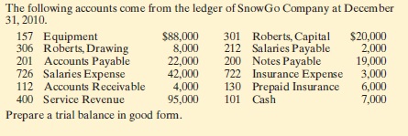
PRINCIPLES OF ACCOUNTING
THE TRIAL BALANCE
A trial balance is a list of accounts and their balances at a given time. Customarily, companies prepare a trial balance at the end of an accounting period. They list accounts in the order in which they appear in the ledger. Debit balances appear in the left column and credit balances in the right column.
The primary purpose of a trial balance is to prove (check) that the debits equal the credits after posting. The sum of the debit balances in the trial balance should equal the sum of the credit balances. If the debits and credits do not agree, the company can use the trial balance to uncover errors in journalizing and posting. In addition, the trial balance is useful in preparing financial statements.
Example 1:
Instructions:
Prepare a trial balance
Example 2:
Note payable 45000, Harper, capital 28500, Harper, drawing 1800, Service revenue 7600, Salary expense 3000, Rent expense 1500, Interest expense 400, Utilities
expense 200, Cash 31200, Accounts receivable 4000, Supplies 300, Land 40000,
Accounts payable 1300.
Instructions:
Prepare a trial balance
Example 3:
Salary payable 900, Interest payable 100, Unearned service revenue 400, Notes payable 20000, supplies 600, Prepaid rent 2000, Furniture 18000, Building 48000,
Accumulated depreciation—furniture 300, Accumulated depreciation—building 200, Cash 4800, Accounts receivable2600, Accounts payable 18200, Bright capital 35000 Instructions:
Prepare a trial balance
Preparing Closing Entries

Slide 3
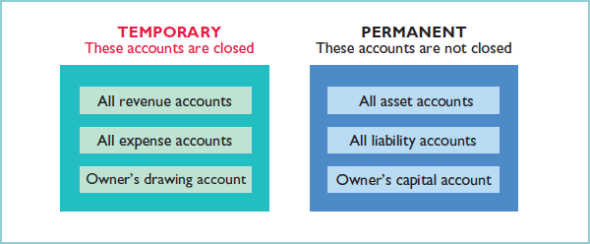
PRINCIPLES OF ACCOUNTING
Debit each revenue account for its balance, and credit Income Summary for total revenues.
Debit Income Summary for total expenses, and credit each expense account for its balance.
Debit Income Summary and credit Owner’s Capital for the amount of net income.
Debit Owner’s Capital for the balance in the Owner’s Drawing account, and credit Owner’s Drawing for the same amount.
Example 1:
The following balances are taken from C. R. Byrd company
Service Revenue | 10600
Advertising Supplies Expense | 1500
Depreciation Expense | 40
Insurance Expense | 50
Salaries Expense | 5,200
Rent Expense | 900
Interest Expense | 50
C. R. Byrd, Drawing | 500
Instruction
Prepare closing entry
Example 2:

Slide 4
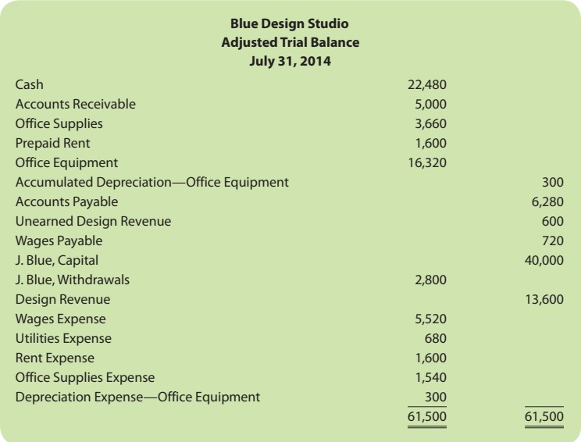
PRINCIPLES OF ACCOUNTING
Instruction
Prepare closing entry
Correcting Entries
Unfortunately, errors may occur in the recording process. Companies should correct errors, as soon as they discover them, by journalizing and posting correcting entries. If the accounting records are free of errors, no correcting entries are needed.
Errors correcting:
After finding errors they must be rectified or corrected by recording accounting entries and there are two methods for rectify or correct the errors:
1. lengthily method (Long method)
In this method we must record two entries:
Reversing wrong entry.
Correct entry.
Example: (1)
Purchased stationery worth 540 $ by cash, but the accountant record the entry with 450 $.
- Wrong entry:
Dr. Stationary
Cr. Cash
450
450

Slide 5
PRINCIPLES OF ACCOUNTING
- Reversing wrong entry:
Dr. Cash | 450
Cr. Stationary |  | 450
- Correct entry:
Dr. Stationary | 540
Cr. Cash |  | 540
Example: (2)
Purchased furniture from (Sleem Co.) worth 300 $ on credit and the accountant record the following entry:
Dr. Purchases 300
Cr. Salim Co. 300
Example: (3)
Purchased tools from (Soran Co.) worth 650 $ by credit, and the accountant record the following entry:
Dr. Tools
560
Cr. Serwan Co. 560
2. Briefly method (Short method):
In this method the correcting done by one entry only as the follow:
A. If the error was in the amount of the entry the correcting entry recorded by the deference between the correct and wrong amount.
Example 1:
Purchased stationary worth 540 $ by cash, but the accountant records the entry with 450 $.
Wrong entry:
Dr. Stationary
Cr. Cash
Correcting entry:
540 – 450 = 90 $
Dr. Stationary
Cr. Cash
450
450
90
90
B. If the mistake are in the names of accounts, the correct entry record by correct name in the correct side and the wrong account record in opposite side of the entry.
Example 2:
Purchased furniture from (Sleem Co.) worth 300 $ on credit and the accountant record the following entry:
Dr. Purchases 300
Cr. (Salim Co.) 300
C. If the mistake are in amount and the name of account.

Slide 6
PRINCIPLES OF ACCOUNTING
Example 3:
Purchased tools from (Soran Co.) worth 650 $ by credit, and the accountant record the following entry:
Dr. Tools
560
Cr. (Serwan Co.) 560
Example 4:
Correct the following entries assumed that the explanation under the entry is correct: (Using lengthily method and briefly method)
Dr. Cash 150
Cr. Furniture 150
(Being purchased furniture worth 150 $ by cash)
Dr. Purchases 200
Cr. Cash 200
(Being purchased furniture worth 2000 $ by check)
Example 5:
On May 10, Mercato Co. journalized and posted a $50 cash collection on account from a customer as a debit to Cash $50 and a credit to Service Revenue $50. The company discovered the error on May 20, when the customer paid the remaining balance in full.
Example 6:
On May 18, Mercato purchased on account office equipment costing $450. The transaction was journalized and posted as a debit to Delivery Equipment $45 and a credit to Accounts Payable $45. The error was discovered on June 3, when Mercato received the monthly statement for May from the creditor.

