Slide 1
Principles Accounting in English 2
PRINCIPLES OF ACCOUNTING
CHAPTER THREE FINANCIAL STATEMENTS
ACCOUNTING DEPATMENT
2022-2023
CHAPTER THREE
FINANCIAL STATEMENTS
| P a g e - 5 -

Slide 2
PRINCIPLES OF ACCOUNTING
Income Statement.
Owner’s Equity Statement.
Balance sheet Statement, sometimes referred to as the statement of financial position. 4- Cash flows Statement.
1- INCOME STATEMENT
The income statement is the report that measures the success of company operations for a given period of time. (It is also often called the statement of income or statement of earnings. The business and investment community uses the income statement to determine profitability, investment value, and creditworthiness. It provides investors and creditors with information that helps them predict the amounts, timing, and uncertainty of future cash flows.
Usefulness of the Income Statement
Evaluate the past performance of the company
Provide a basis for predicting future performance
Help assess the risk or uncertainty of achieving future cash flows
Limitations of the Income Statement
Companies omit items from the income statement that they cannot measure reliably.
Income numbers are affected by the accounting methods employed.
Income measurement involves judgment.
Format of the income statement
the following are the format which is used for preparation of Income Statement:
1- multiple-Step Income Statements
Company Name Income Statement
For the year ended Dec 31, 20XX
| P a g e - 5 -

Slide 3
PRINCIPLES OF ACCOUNTING
Description |  | Sub Amount | Sub Total | Grand Total
Net Revenue
 | Sales Revenue |  | ×××
- | Sales Returns |  | )××(
- | Sales Allowance |  | )××(
Net Revenue |  |  |  | ××××
Cost of goods sold
 | Beginning Inventory |  | ×××
+ | Net Purchase
 | Total Purchases | ××
 | Purchase Expense | ××
- | Purchase Allowance & return | )××(
- | Purchase Discount | )××(
Net Purchase |  |  | ×××
Available goods for sale |  |  | ×××
- | Ending Inventory |  | )××(
Cost of goods sold |  |  |  | ××××
Gross profit |  |  |  | ××××
- | Operating Expenses
 | Selling & Marketing Expenses |  | ×××
 | Administrative Expenses |  | ×××
Total of Operating Expense |  |  |  | )××××(
Operating Income |  |  |  | ××××
+ | Other Revenue & Expense |  |  | ××××
- | Other Losses & Gains |  |  | )××××(
Income Before Tax |  |  |  | ××××
- | Income Tax |  |  | )××(
Net Income |  |  |  | ××××
Equations uses for Income Statement
There are many equations which are used for preparing Income Statement, the below are these equations:
Net Sales
| P a g e - 5 -

Slide 4
PRINCIPLES OF ACCOUNTING
Net Sales = Sales Revenues – Sales Discounts – Sales Return & Allowances
Cost Of Goods Sold (COGS)
COGS = Beginning Inventory + Net Purchases – Ending Inventory
Net Purchases
Net Purchases = Purchases – Purchase Discount, Return & Allowances + Purchase Expenses
Cost of Goods Available for Sale
Cost of Goods Available for Sale= Beginning Inventory + Net Purchases
Gross Profit
Gross Profit = Net Sales – Cost of Goods Sold
Income From Operation
Income From Operation = Gross Profit – Selling Exp. – Admin Exp. + Other Gains – Other Losses
Income Before Tax
Income Before Tax = Income From Operations + or – Interests
Net Income
Net Income = Income Before Tax – Income Tax
2- Single-Step Income Statements
In reporting revenues, gains, expenses, and losses, some companies often use a format known as the single-step income statement instead of a multiple-step income statement. The single-step statement consists of just two groupings: revenues and expenses. Expenses are deducted from revenues to arrive at net income or loss, hence the expression “single-step.” Frequently, companies report income tax separately as the last item before net income to indicate its relationship to income before income tax. Illustration below shows the single-step income statement of Cabrera Company.
| P a g e - 5 -

Slide 5
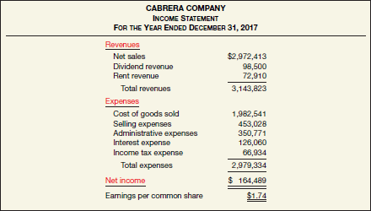
PRINCIPLES OF ACCOUNTING
Example 1:
Starr Co. had sales revenue of $540,000 in 2020. Other items recorded during the year were:
Cost of goods sold | $330,000
Salaries and wages expense | 120,000
Income tax expense | 25,000
Increase in value of company reputation | 15,000
Other operating expenses | 10,000
gain on value of patents | 20,000
Instructions
Prepare a single-step income statement for Starr for 2020. Starr has 100,000 shares of stock outstanding
Example 2:
Brisky Corporation had net sales of $2,400,000 and interest revenue of $31,000 during 2020. Expenses for 2020 were cost of goods sold $1,450,000, administrative expenses $212,000, selling expenses $280,000, and interest expense $45,000. Brisky’s tax rate is 30%. The corporation had 100,000 shares of common stock authorized and 70,000 shares issued and outstanding during 2020. Prepare a single-step income statement for the year ended December 31, 2020.
Instructions
prepare a condensed multiple-step income statement for Brisky Corporation
Example 3:
(Income Statement Items) Presented below ar |  | e certain account balances | of Paczki Products Co.
Rent revenue | $ 6,500 | Sales discounts | $ 7,800
Interest expense | 12,700 | Selling expenses | 99,400
Beginning retained earnings | 114,400 | Sales revenue | 390,000
Ending retained earnings | 125,000 | Income tax expense | 31,000
Dividend revenue | 71,000 | Cost of goods sold | 184,400
| P a g e - 5 -

Slide 6
PRINCIPLES OF ACCOUNTING
Sales returns and allowances 12,400
Administrative expenses
82,500
Allocation to noncontrolling interest 17,000
Instructions
From the foregoing, compute the following: (a) total net revenue, (b) net income, and (c) income attributable to controlling stockholders.
Example 4:
(Multiple-Step and Single-Step Statements) Two accountants for the firm of Elwes and Wright are arguing about the merits of presenting an income statement in a multiple-step versus a single-step format. The discussion involves the following 2020 information related to P. Bride Company ($000 omitted).
Administrative expense
Officers’ salaries | $ 4,900
Depreciation of office furniture and equipment | 3,960
Cost of goods sold | 60,570
Rent revenue | 17,230
Selling expense
Delivery expense | 2,690
Sales commissions | 7,980
Depreciation of sales equipment | 6,480
Sales revenue | 96,500
Income tax | 9,070
Interest expense | 1,860
Instructions
Prepare an income statement for the year 2020 using the multiple-step form. Common shares outstanding for 2020 total 40,550 (000 omitted).
Prepare an income statement for the year 2020 using the single-step form.
Which one do you prefer? Discuss.
Example 5:
(Multiple-Step and Single-Step Statements) The accountant of Latifa Shoe Co. has piled the following information from the company’s records as a basis for an income statement for the year ended December 31, 2020.
Rent revenue | $ 29,000
Interest expense | 18,000
Market appreciation on land above cost | 31,000
Salaries and wages expense (selling) | 114,800
Supplies (selling) | 17,600
Income tax | 23,100
Salaries and wages expense (administrative) | 135,900
Other administrative expenses | 51,700
Cost of goods sold | 496,000
Net sales | 980,000
Depreciation on plant assets (70% selling, 30% administrative) | 65,000
Cash dividends declared | 16,000
There were 20,000 shares of common stock outstanding during the year.
Instructions
Prepare a multiple-step income statement.
Prepare a single-step income statement.
Which format do you prefer? Discuss.

Slide 7
PRINCIPLES OF ACCOUNTING
2-Balance Sheet
The balance sheet, sometimes referred to as the statement of financial position, reports the assets, liabilities, and stockholders’ equity of a business enterprise at a specific date. This financial statement provides information about the nature and amounts of investments in enterprise resources, obligations to creditors, and the owners’ equity in net resources. It therefore helps in predicting the amounts, timing, and uncertainty of future cash flows.
Usefulness of the Balance Sheet
Liquidity describes “the amount of time that is expected to elapse until an asset is realized or otherwise converted into cash or until a liability has to be paid.
Solvency refers to the ability of a company to pay its debts as they mature
Liquidity and solvency affect a company’s financial flexibility, which measures the “Ability of an enterprise to take effective actions to alter the amounts and timing of cash flows
so it can respond to unexpected needs and opportunities.
Limitations of the Balance Sheet
Most assets and liabilities are reported at historical cost.
Companies use judgments and estimates to determine many of the items reported in the balance sheet.
The balance sheet necessarily omits many items that are of fi nancial value but that a company cannot record objectively.

Slide 8
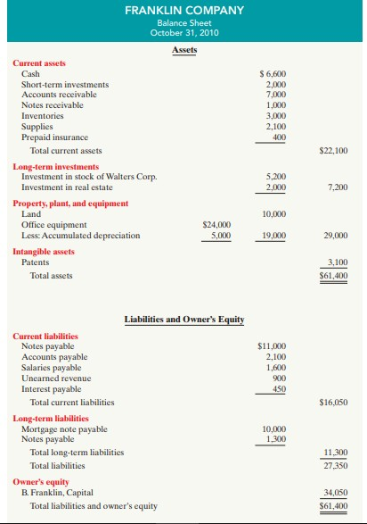
PRINCIPLES OF ACCOUNTING

Slide 9
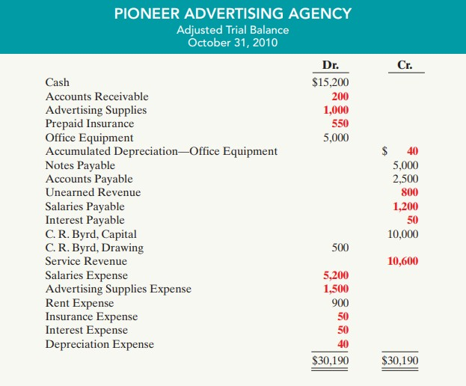
PRINCIPLES OF ACCOUNTING
Example 1:
Instructions
Prepare the financial statement

Slide 10
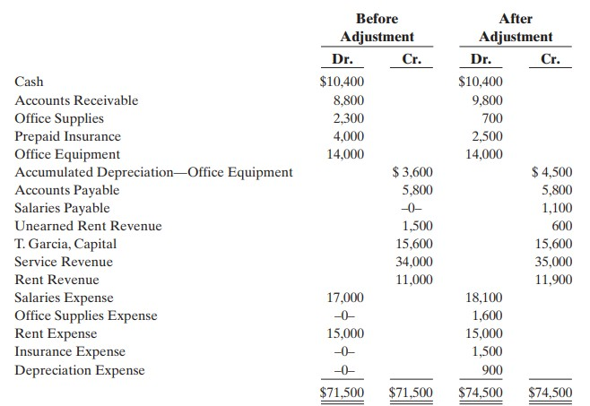
PRINCIPLES OF ACCOUNTING
Example 2:
Instructions
Prepare the financial statement

Slide 11
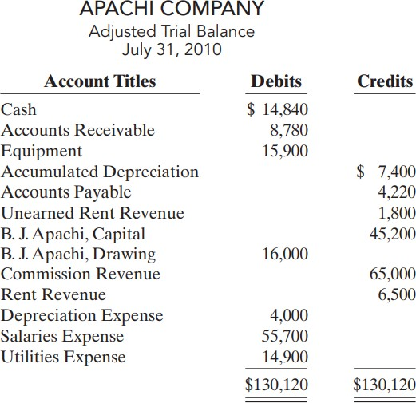
PRINCIPLES OF ACCOUNTING
Example 3:
Instructions
Prepare the financial statement

Slide 12
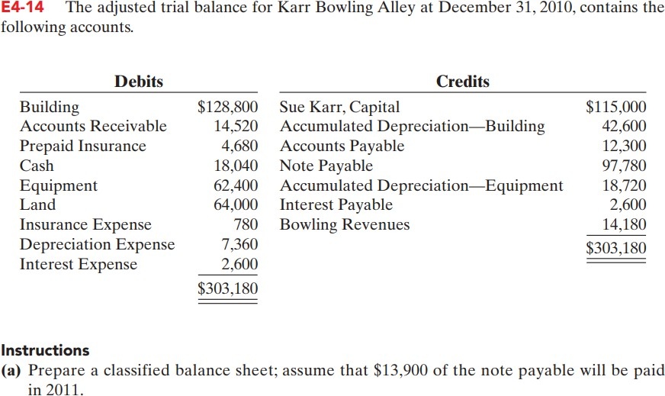
PRINCIPLES OF ACCOUNTING
Example 4:

