Slide 1
Principles Accounting in English 2
PRINCIPLES OF ACCOUNTING
CHAPTER FOUR INVENTORY
ACCOUNTING DEPATMENT
2022-2023
CHAPTER FOUR
INVENTORY

Slide 2
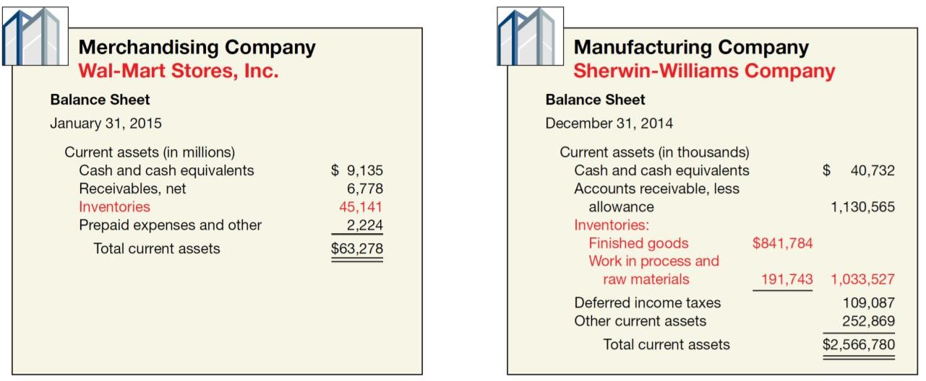
PRINCIPLES OF ACCOUNTING
Inventories are asset items that a company holds for sale in the ordinary course of business, or goods that it will use or consume in the production of goods to be sold. The description and measurement of inventory require careful attention. The investment in inventories is frequently the largest current asset of merchandising (retail) and manufacturing businesses.
TYPES OF INVENTORIES
Merchandising Inventory
Manufacturing Inventories
Raw materials
Work-in-process
Finished goods
TYPES OF INVENTORY SYSTEMS
Perpetual Inventory System
Periodic System
Comparing Perpetual and Periodic Systems
To illustrate the difference between a perpetual and a periodic system, assume that a Company had the following transactions during the current year.

Slide 3
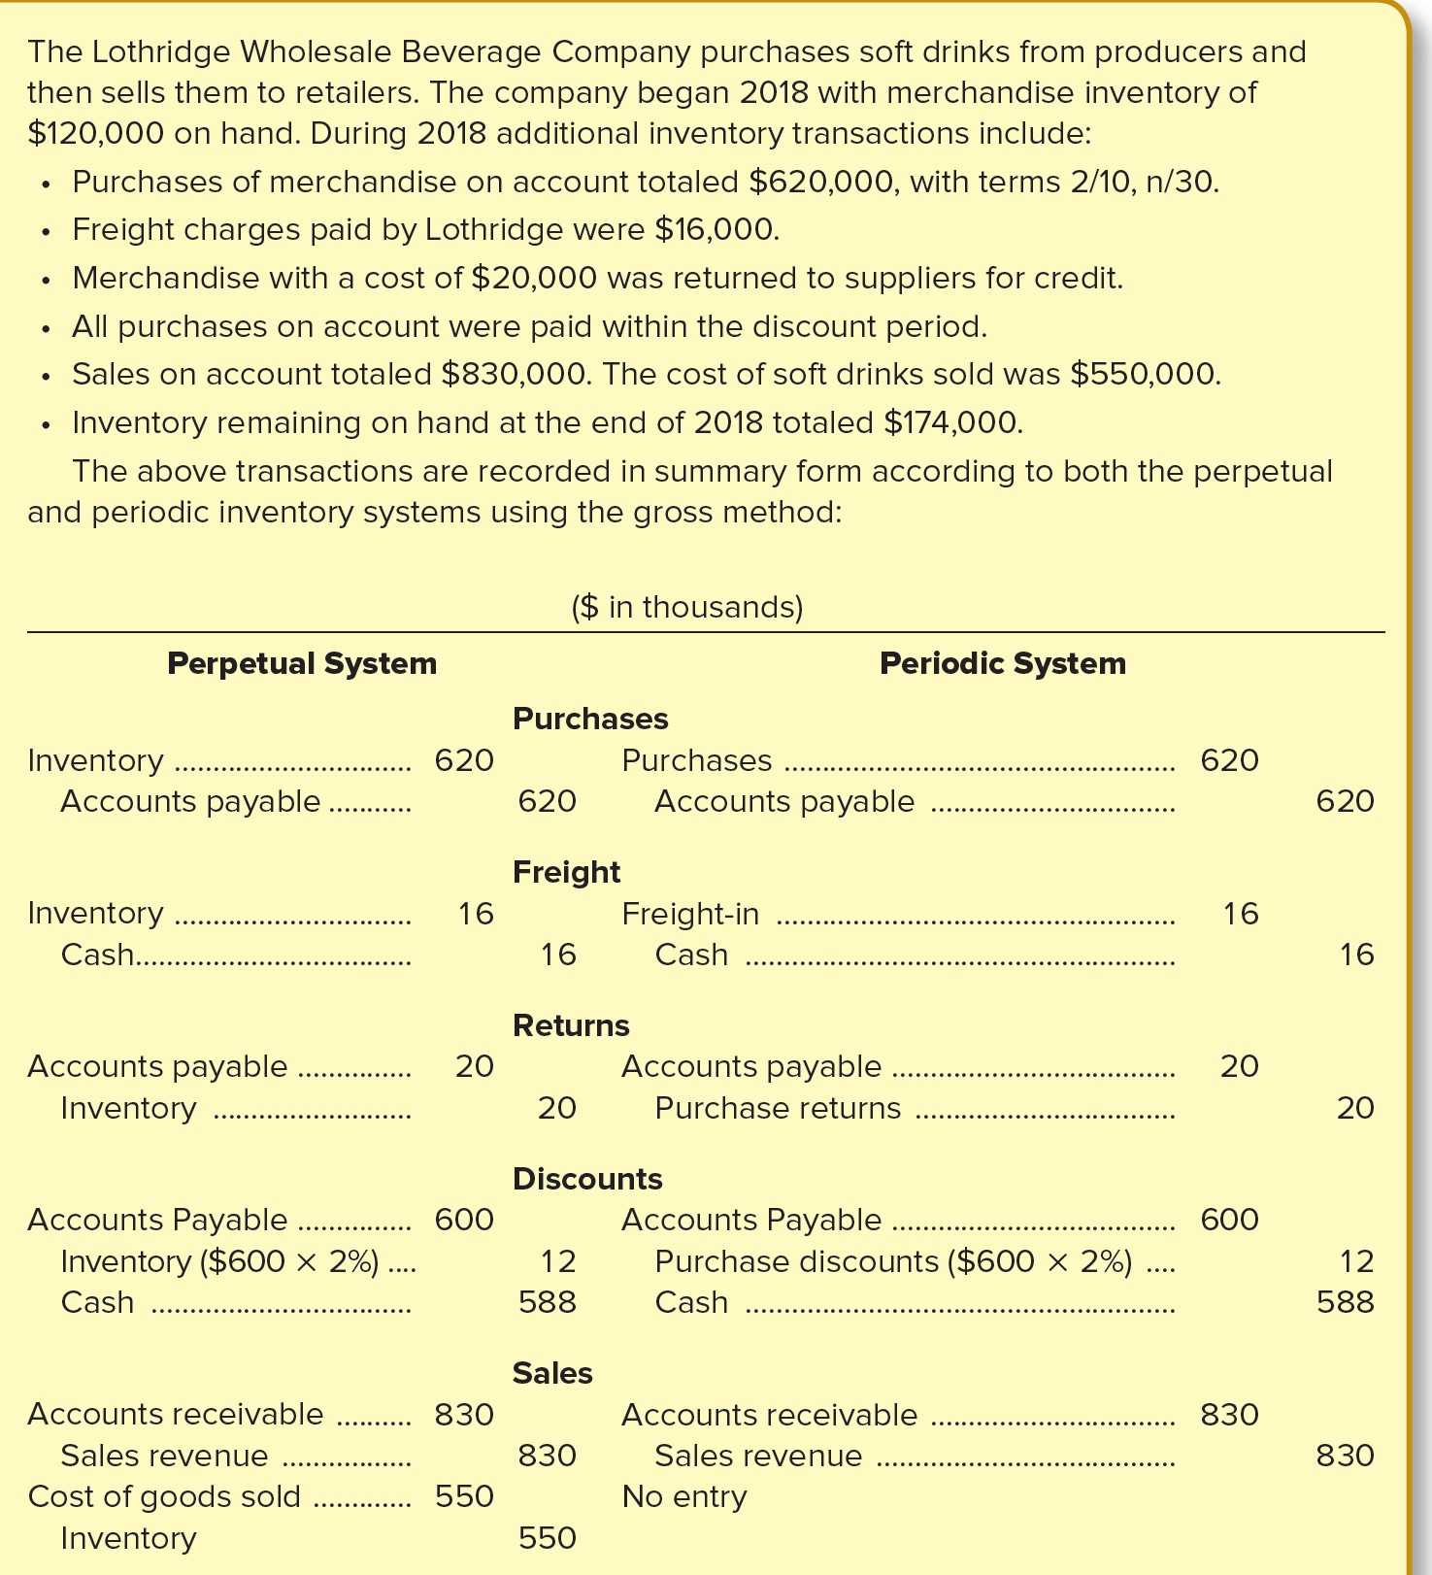
PRINCIPLES OF ACCOUNTING
And also you can see this example for Fesmire Company
Fesmire records these transactions during the current year as shown below:

Slide 4
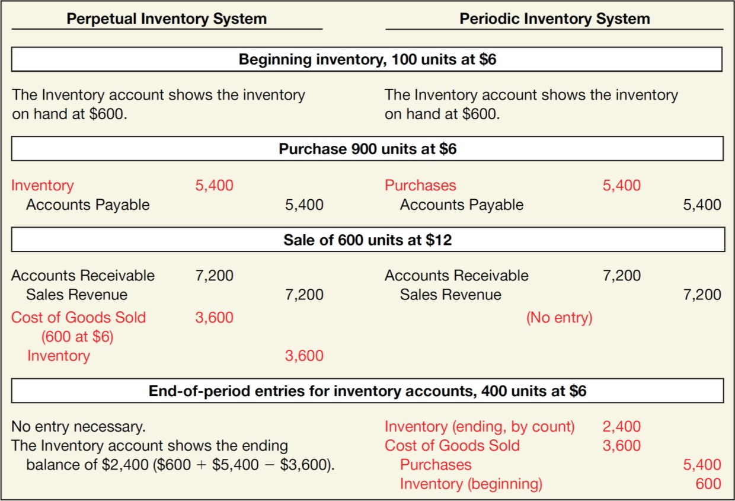
PRINCIPLES OF ACCOUNTING
Inventory Cost Flow Assumptions
Regardless of whether the perpetual or periodic system is used, it’s necessary to assign dollar amounts to the physical quantities of goods sold and goods remaining in ending inventory. Unless each item of inventory is specifically identified and traced through the system, assigning dollars is accomplished by making an assumption regarding how units of goods( and their associated costs) flow through the system. We examine the common cost flow assumptions next. In previous illustrations, dollar amounts of the cost of goods sold and the cost of ending inventory were assumed known. However, if various portions of inventory are acquired at different costs, we need a way to decide which units were sold and which remain in inventory. The below Illustration will help explain.

Slide 5
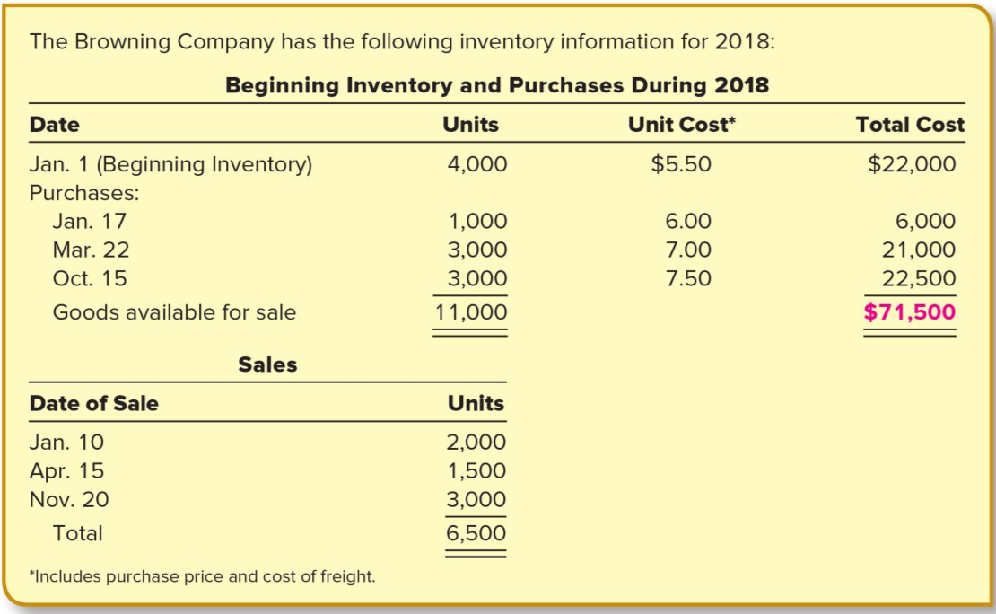
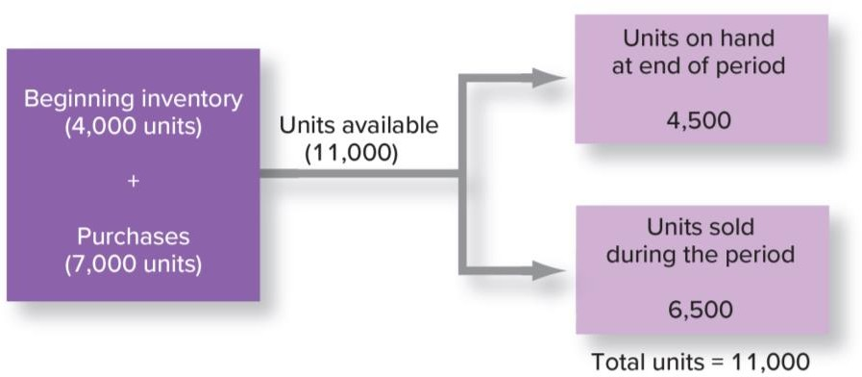
PRINCIPLES OF ACCOUNTING
Browning began the year with 4,000 units and purchased another 7,000 units, so there were 11,000 units available for sale. Of this amount, 6,500 units were sold. This means 4,500 units remain in ending inventory.
What is the cost of the 6,500 units sold? In other words, which of the 11,000 units available for sale were sold? If all units, including beginning inventory, were purchased at the same price, then the answer would be simple. However, that rarely is the case. Using the numbers given, let’s consider the question as follows:
The $71,500 in cost of goods available for sale must be allocated to ending inventory and cost of goods sold.

Slide 6
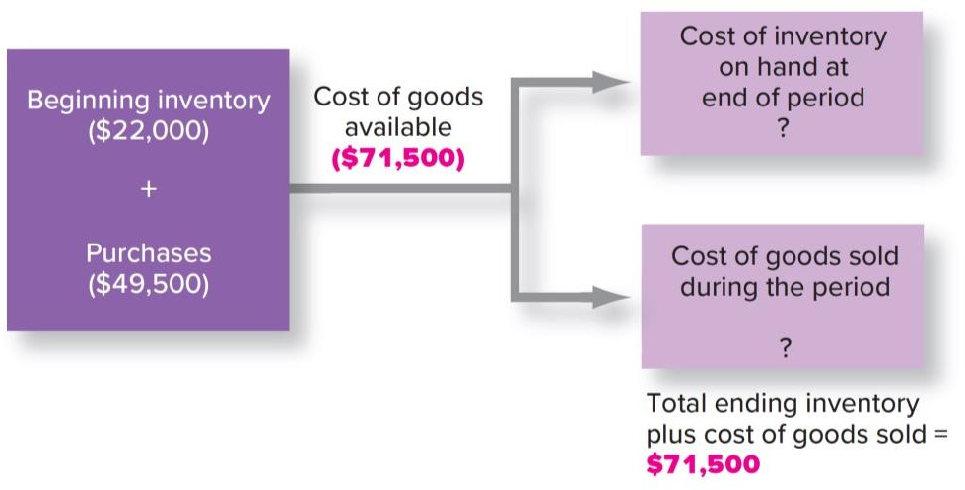
PRINCIPLES OF ACCOUNTING
Let’s turn our attention now to the various inventory methods that can be used to achieve the allocation between ending inventory and cost of goods sold.
Inventory Methods Evaluation
First-In, First-Out (FIFO)
Last-In, First-Out (LIFO)
Average Cost
Perpetual Inventory System
1- First-in First-out Method - FIFO
The ending inventory and cost of goods sold will have the same amounts in a perpetual inventory system as in a periodic inventory system when FIFO is used. This is because the same units and costs are first in and first out whether cost of goods sold is determined as each sale is made or at the end of the period as a residual amount. The application of FIFO in a perpetual system is shown in Illustration

Slide 7
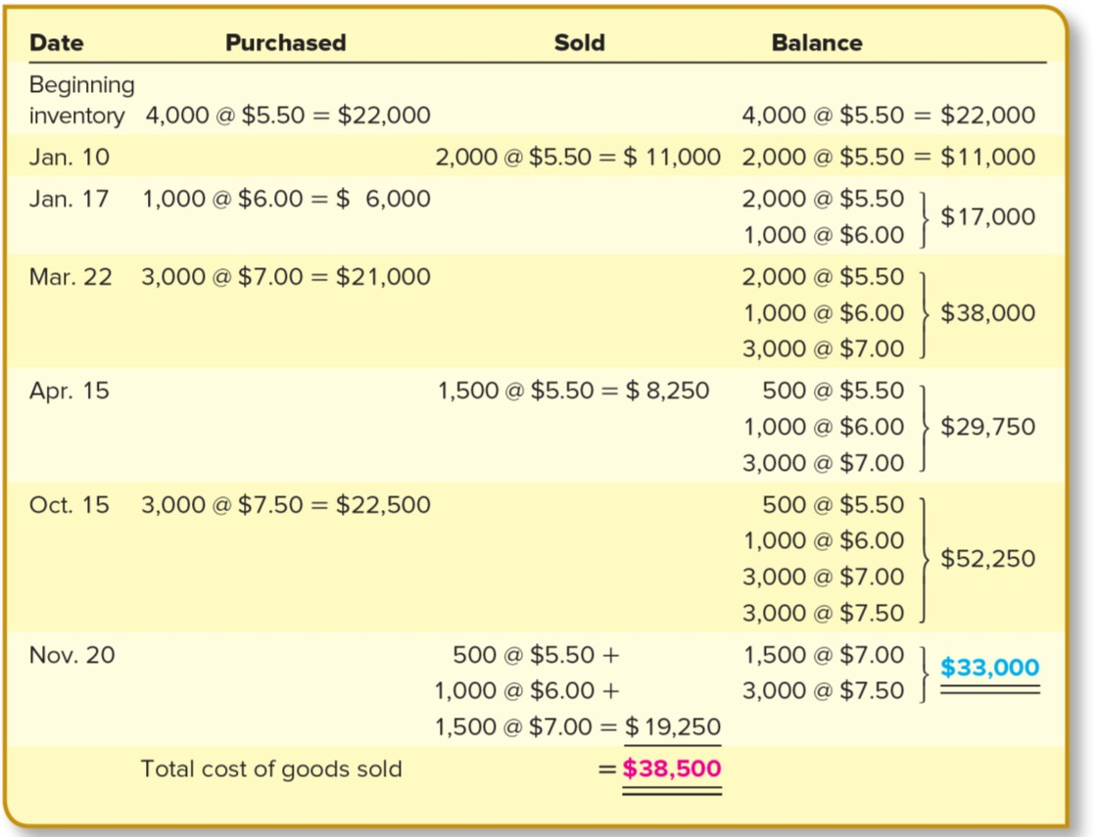
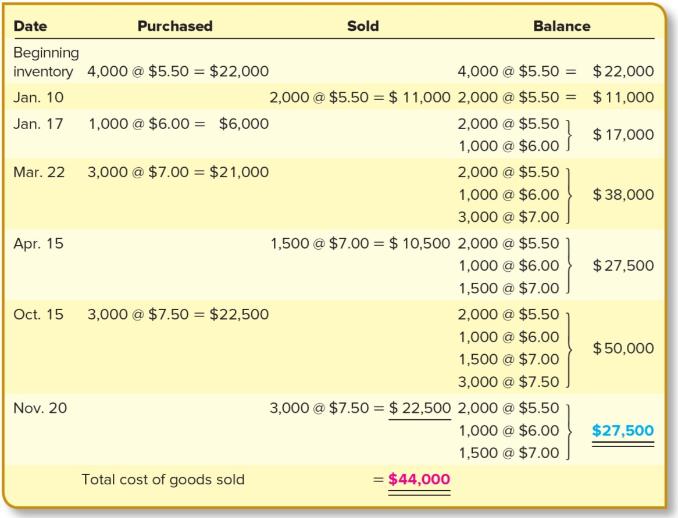
PRINCIPLES OF ACCOUNTING
2- Last-in First-out - LIFO
The application of LIFO in a perpetual system is shown in Illustration. Each time inventory is purchased or sold, the LIFO layers are adjusted.

Slide 8
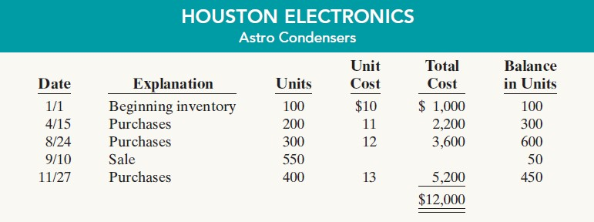
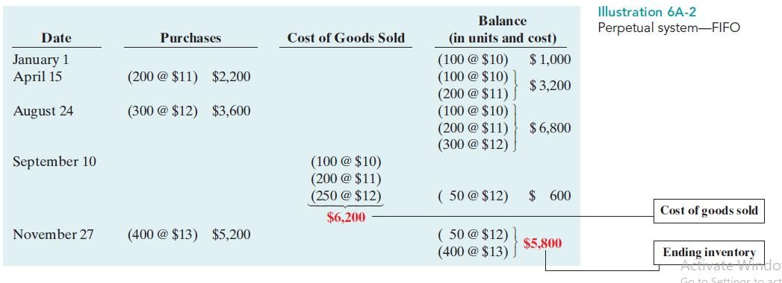
PRINCIPLES OF ACCOUNTING
3- Average Cost
The weighted-average unit cost in a perpetual inventory system becomes a moving-average unit cost. A new weighted-average unit cost is calculated each time additional units are purchased. The new average is determined after each purchase.
First-In, First-Out (FIFO)

Slide 9
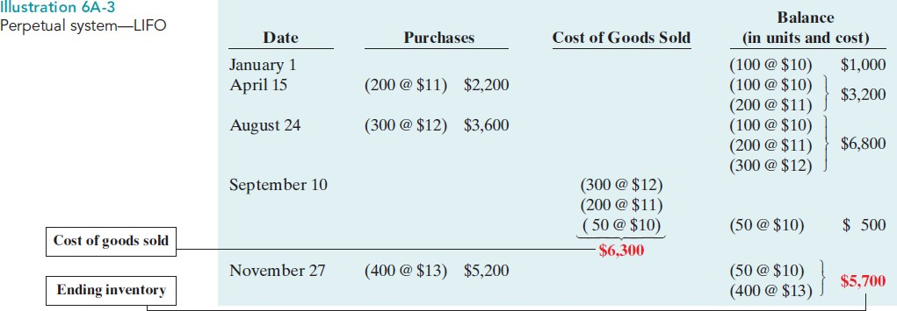
PRINCIPLES OF ACCOUNTING
Last-In, First-Out (LIFO)
Average-Cost

Slide 10
PRINCIPLES OF ACCOUNTING
EXAMPLE: 1
The company has the same inventory, purchases, and sales data for the month of March as shown earlier:
Inventory: Purchases:
March 1
March 10
March 20
March 30
March 15
March 25
200 units
500 units
400 units
300 units
500 units
400 units
@ $4.00 @ $4.50 @ $4.75 @ $5.00
$ 800
2,250
1,900
1,500
Sales:
The physical inventory count on March 31 shows 500 units on hand.
Instructions:
Under a perpetual inventory system, determine the cost of inventory on hand at March 31 and the cost of goods sold for March under (a) FIFO, (b) LIFO, and (c) average-cost.
EXAMPLE: 2
Jensen’s Department Store uses a perpetual inventory system. Data for product E2-D2 include the following purchases.
Date
May 7
July 28
Number Unit of
50
30
Units Price
$10 13
On June 1 Jensen’s sold 30 units, and on August 27, 40 more units.
Instructions:
Prepare the perpetual inventory schedule for the above transactions using (1) FIFO, (2) LIFO, and (3) moving-average cost.
EXAMPLE: 3
Boarders sells a snowboard, Xpert, that is popular with snowboard enthusiasts. Below is information relating to Boarders’s purchases of Xpert snowboards during September. During the same month, 121 Xpert snowboards were sold. Boarders uses a periodic inventory system.
Date | Explanation | Units | Unit Cost | Total Cost
Sept. 1 | Inventory | 26 | $ 97 | $ 2,522
Sept. | Purchases | 45 | 102 | 4,590
Sept. 19 | Purchases | 20 | 104 | 2,080
Sept. 26 | Purchases | 50 | 105 | 5,250
 | Totals | 141 |  | $14,442
Instructions:
Compute the ending inventory at September 30 and cost of goods sold using the FIFO and LIFO methods. Prove the amount allocated to cost of goods sold under each method.
For both FIFO and LIFO, calculate the sum of ending inventory and cost of goods sold. What do you notice about the answers you found for each method?
EXAMPLE: 4
Yount Company reports the following for the month of June.
 | Units | Unit Cost | Total Cost
June 1 Inventory | 200 | $5 | $1,000
12 Purchase | 300 | 6 | 1,800

Slide 11
PRINCIPLES OF ACCOUNTING
23 Purchase
30 Inventory
Instructions:
500
120
7
3,500
Compute the cost of the ending inventory and the cost of goods sold under (1) FIFO and (2) LIFO.
Which costing method gives the higher ending inventory? Why?
Which method results in the higher cost of goods sold? Why?
EXAMPLE:5
Jones Company had 100 units in beginning inventory at a total cost of $10,000.The company purchased 200 units at a total cost of $26,000. At the end of the year, Jones had 80 units in ending inventory.
Instructions:
Compute the cost of the ending inventory and the cost of goods sold under (1) FIFO, (2) LIFO, and (3) average-cost.
Which cost flow method would result in the highest net income?
Which cost flow method would result in inventories approximating current cost in the balance sheet?
Which cost flow method would result in Jones paying the least taxes in the first year?
EXAMPLE:6
Klugman Appliance uses a perpetual inventory system. For its flat-screen television
sets, the January 1 inventory was 3 sets at $600 each. On January 10, Klugman purchased 6 units at
$660 each. The company sold 2 units on January 8 and 4 units on January 15.
Instructions:
Compute the ending inventory under (1) FIFO, (2) LIFO, and (3) moving-average cost.
EXAMPLE:7
Yount Company reports the following for the month of June.
Date | Explanation | Units | Unit Cost | Total Cost
June 1 | Inventory | 200 | $5 | $1,000
12 | Purchase | 300 | 6 | 1,800
23 | Purchase | 500 | 7 | 3,500
30 | Inventory | 120
Instructions
Calculate the cost of the ending inventory and the cost of goods sold for each cost flow assumption, using a perpetual inventory system. Assume a sale of 400 units occurred on June 15 for a selling price of $8 and a sale of 480 units on June 27 for $9.
How do the results differ from E6-6 and E6-8?
Why is the average unit cost not $6 [($5 _ $6 _ $7) _ 3 = $6]?
EXAMPLE: 8
Information about Boarders is presented in E6-4. Additional data regarding Boarders’
sales of Xpert snowboards are provided below. Assume that Boarders uses a perpetual inventory system.
Date |  | Units | Unit Price | Total Cost
Sept. 5 | Sale | 12 | $199 | $ 2,388
Sept. 16 | Sale | 50 | 199 | 9,950
Sept. 29 | Sale | 59 | 209 | 12,331
 | Totals | 121 |  | $24,669
Instructions:

Slide 12
PRINCIPLES OF ACCOUNTING
Compute ending inventory at September 30 using FIFO, LIFO, and moving-average cost.
Compare ending inventory using a perpetual inventory system to ending inventory using a periodic inventory system (from E6-4).
Which inventory cost flow method (FIFO, LIFO) gives the same ending inventory value under both periodic and perpetual? Which method gives different ending inventory values?

