Slide 1
Salahaddin University- Erbil / College of Science /
Earth Sciences and Petroleum Department
Volcanic Impact on Environment
Lab -5- 4th Class B.Sc.
2022-2023
Masoud.hamed@su.edu.krd
http://scmoodle.su.edu.krd/course/view.php?id=862

Slide 2
What is a volcano?
During an eruption, melted rock called magma leaves the magma chamber and moves up the conduit. The magma leaves the conduit at the vent.
Magma is called lava after it leaves the vent.

Slide 3
Volcanoes vary
The shapes of volcanoes depend on the composition of the magma that formed them.
Volcanoes can look like wide, flat mounds (shield volcanoes), like tall cones (composite volcanoes), or like a heap of rock bits (cinder cones).

Slide 4
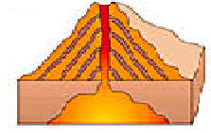
Classify Volcanoes
Composite
Cinder
Shield
Active
Intermittent
Dormant
Extinct
Constant
Regular
Sleeping
Never

Slide 5
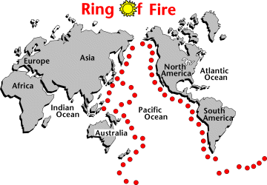
The Ring of Fire
Subduction zones
Name the plate

Slide 6
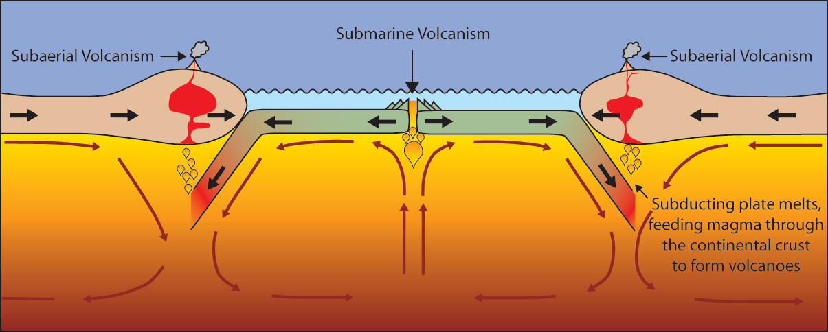
Volcanoes are formed by:
- Subduction - Rifting - Hotspots
Notes:
Volcanoes can be formed in three ways:
Via subduction. The subducting slab dehydrates to form new melt that will rise through the crust to be erupted at the surface.
Via rifting. When two plates pull apart magma rises, producing volcanic eruptions at the surface.
At “Hotspots”….hotspot do not necessarily occur along a plate boundary. So hotspot volcanoes can form in the middle of tectonic plates….Click for example.

Slide 7
Where you find volcanoes
The Ring of Fire is found where the oceanic crust of the Pacific Plate is subducting under nearby plates.
Most volcanoes are located along plate boundaries.
Volcanoes, like those in Hawaii are also present along divergent boundaries and within plates.

Slide 8
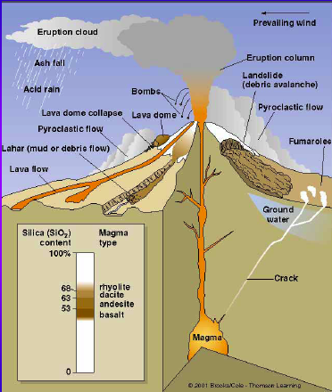
The Main Volcanic HAZARDS
Pyroclastic flows
Lava flows
Ash falls
Gases
Tsunamis

