Slide 1

Geotectonics
Salahaddin University- Erbil / College of Science /
Earth Sciences and Petroleum Department
Lec.3 - Class B.Sc.
2023-2024
Masoud.hamed@su.edu.krd
https://www.scmoodle.su.edu.krd/course/view.php?id=572

Slide 2
Overview on this course
Plate motions, earthquakes, volcanoes, mountain building, landslides, floods and many others phenomena have interacted over long time to sculpt our present-day landscape. In this course, we present the impact of some of these phenomena, what each of them is, and what causes them. We will be mainly focusing on plate tectonics -the grand unifying theory of geology- to explain how the location of out plate (Arabian plate), which we are part of now, has changed radically over geologic time, and why present-day geologic activities including earthquakes and volcanic occur where they do. These all together would help us to understand the context of the environment and sustainability challenges we will face in the future.

Slide 3
Objective of this lecture:
Students after this lecture will be able to
Explain the role of the lithosphere and the asthenosphere in the motion of the plates.
Explain the relationship between theories of continental drift and plate tectonics.
Explain the mechanism of Paleomagnetism and its usage in measuring the age of sea-floor spreading and movement orientation of tectonic plates.

Slide 4
Why does understanding plate tectonic matter?
In Modern day geologic science, understanding plate behaviors helps scientists to better estimate landscape development in the feature based on how plates have acted in the past.
Understanding plate tectonics can give us clue why most of the earthquakes are located on Iraq-Iran-Turkey border! In short, it helps geologists in predicting earthquakes and then its precuation!
Plate tectonic theory can explain causes of volcanicity.
Plate tectonics explains why and where mountains/basins are formed.

Slide 5
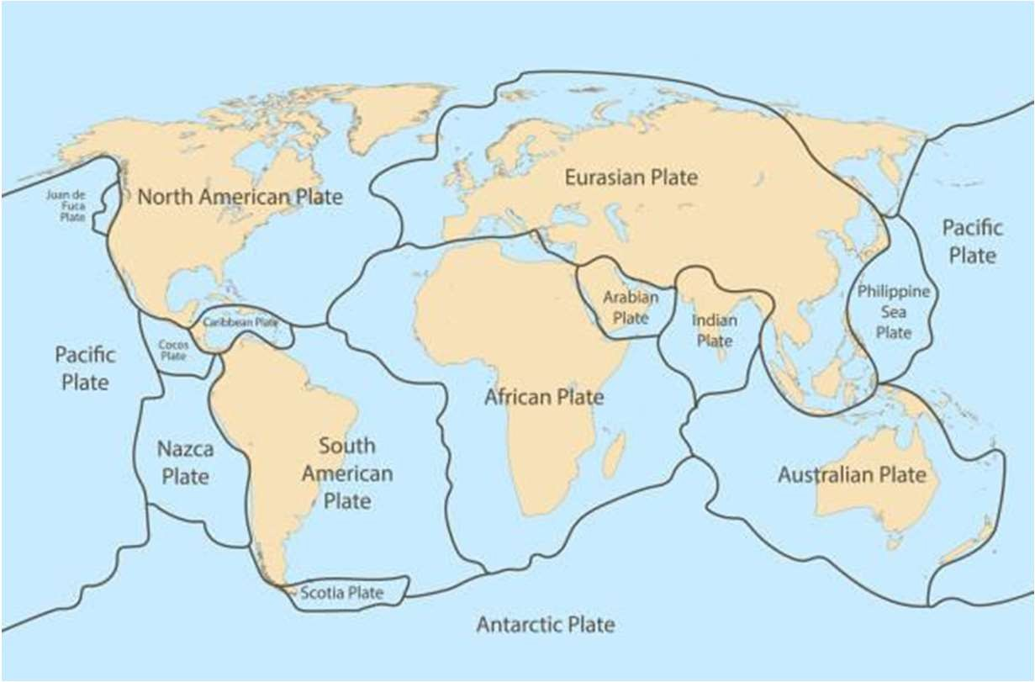
What is a tectonic plate?
A tectonic plate (also called lithospheric plate) is a massive, irregularly shaped slab of solid rock, generally composed of both continental and oceanic lithosphere.
Plate size can vary greatly, from a few hundred to thousands of kilometers across.
Be careful the borders of African plate are not the edges of the African continent!
Which plate are we (Iraqi-Kurdistan) part of?
How do these massive slabs of solid rock float despite their tremendous weight?
To answer this question we have to go over the internal structure of the Earth!

Slide 6
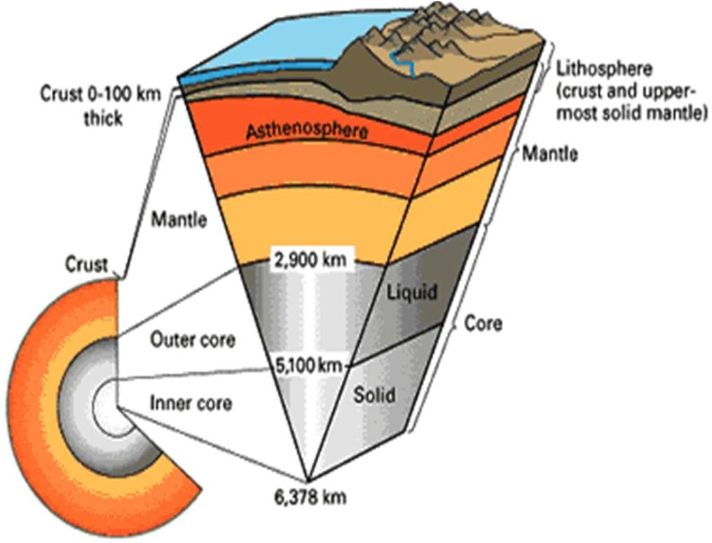
Lets do a quick review of Structure of the Earth
We all know that Earth has been divided to different layers, see the picture!
Layers of different compositions:
Core (Iron)
Mantle
Crust
Layers of different strength:
  Mesosphere
  Asthenosphere
  Lithosphere
Do these layers sound familiar to you? Hopefully YES!

Slide 7


A quick question (polishing up previous knowledge!)
Is the mantle solid or Liquid?
A- solid
B-Liquid
Discuss it with your pal.
White tack is solid! Lithosphere is like white tackLiitnhosbpehheraeviisotrhsin!. When we
pulled,it, it brakes! It is brittle! However Asthenosphere,
beneath but well and flow
lithosphere, is still sold
deformed! It is bended
when we put pressure
on it!
Asthenosphere is hotter, it moves around nicely! BUT IT IS NOT LIQUID!
So, that is the structure of the deep interior of the Earth! But we live on the surface!

Slide 8
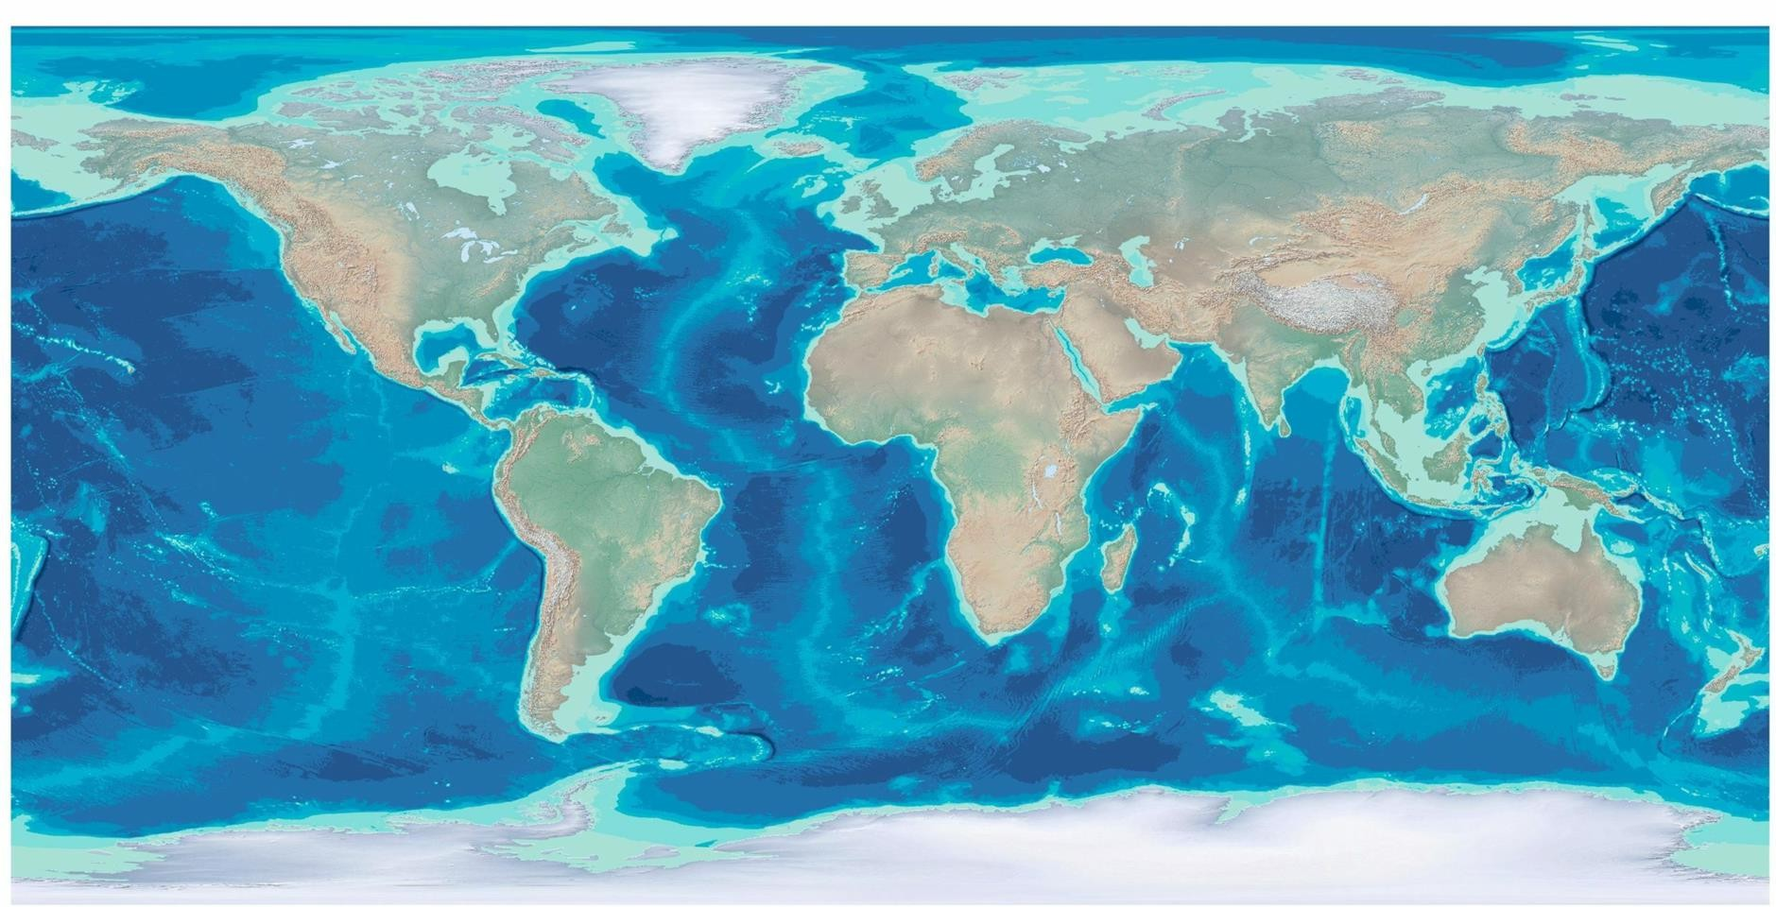
How do we explain patterns and features on the surface of the Earth?
What are the two types of crust we have? Or
What are the two biggest distinctions that you can see here on the surface?

Slide 9
Common questions that we (geologists) have been struggling of to explain!
Why are the continents where they are? Why are the oceans where they are?
Why do earthquakes and volcanoes occur in similar places?
Why do we get different kind of rocks together in some specific places?
Why does Iraq-Iran-Turkey border has the most complex content geologywise!? Why do this zone has the highest mountains? Why Hawler does not has any mountains? Have you ever asked yourself as a geologist?
Such questions motivated earlier scientist to think about a mechanism to explain all of these questions, So plate tectonic theory was born!

Slide 10
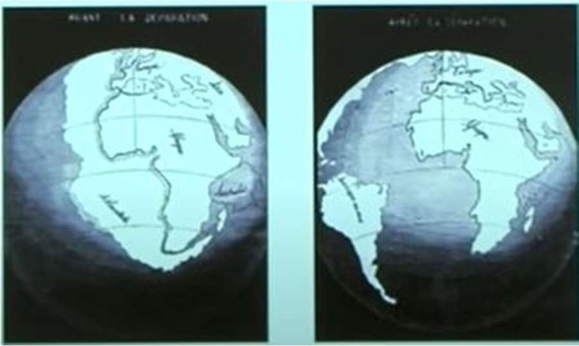
Continental Drift-an old idea
1596: Dutch map maker Abraham Ortelius Thesaurus Geographics:
“Americas were ‘torn away from Europe and Africa………By earthquakes and floods’!
1858: maps by geographer Antonio Snider-Pellegrini
1914: Alfred Wegener proposed “Continental Drift”
10

Slide 11
Continental Drift-evidence
Let say you were Alfred Wegener and wanted to prove that the continents were once joined together, and had moved around, what sort of evidence would you look for? Or, what kind of evidence you think he looked for? Write them down here:
11

Slide 12
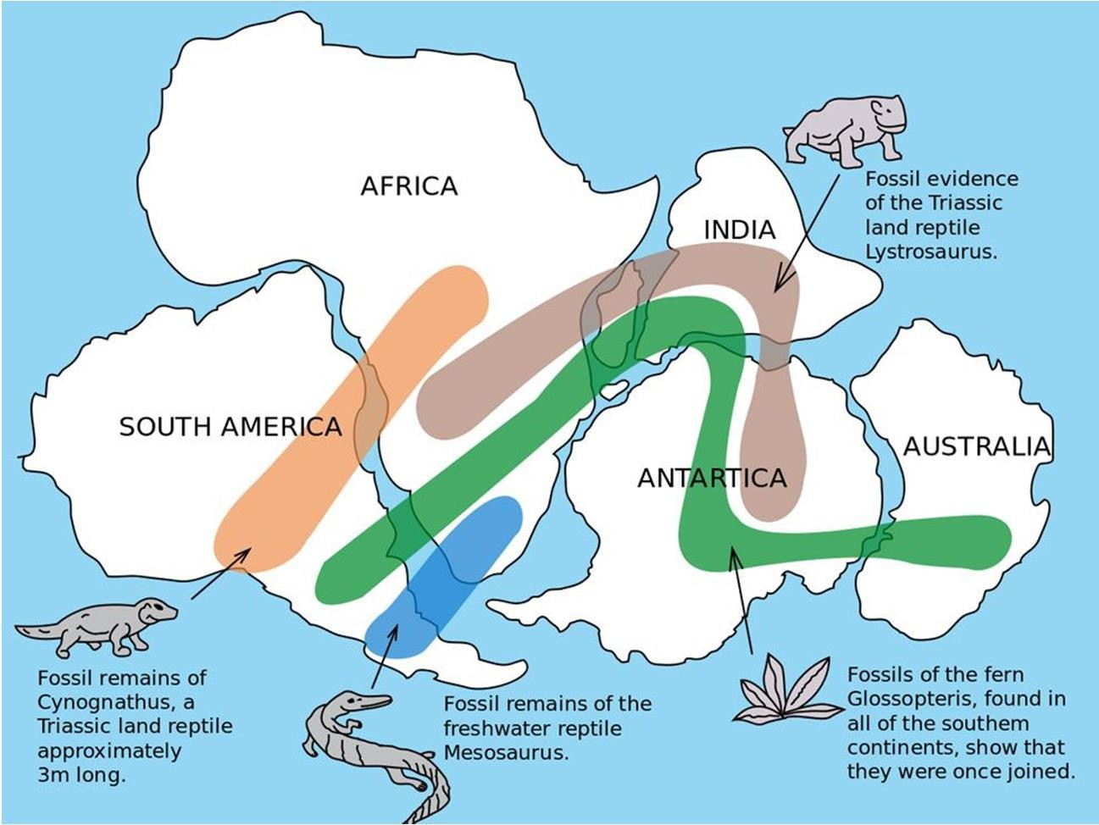
Continental Drift-evidence
Wegener’s evidence
Continental shorelines seems to fit together!
Matching fossils on land masses far apart.
Matching rocks and structures on the edges of continents.
Evidence from fossils and rocks showing climate zones did not match current continent positions.
12

