Slide 1
Agricultural Engineering Practices
Lecture 1
3rd Stage
By:
Miss Media Nofel M. Fawzi
2021-2022

Slide 2
Outline of presentation:
Introduction To Agricultural Engineering.
Agricultural Engineering & Agriculture engineers.
Agricultural Machinery.
Agricultural Operations.

Slide 3
Introduction To Agricultural Engineering
The level of mechanization of agriculture determines the development of agriculture and the development of human society.
Undeveloped agriculture depends on hand tools farm activities labour intensive.

Slide 4
Introduction To Agricultural Engineering
It takes large team of farmers and field hands to cultivate small area for farmers to feed the people.
Agricultural Engineering was recognized as a discipline, which coincided with a rapid advancement of mechanization.

Slide 5
Agricultural Engineering
What is Agricultural Engineering?
It is the application of engineering principles to any process associated with producing agriculturally based goods and management of natural resources.
It is concerned with the development of: labour saving farm machines, farm buildings, irrigation and drainage systems.

Slide 6
Agricultural Engineering
It include processes for preserving and converting agricultural produce to useful food, feed and fiber products.
Part agriculture and part Engineering.
Agricultural Engineering is a science on its own.

Slide 7
Agricultural Engineering
Covering:
Farm machinery and power.
Agricultural processes and Agro machinery.
Soil and water conservation.
Farm irrigation, tube well pumping and drainage.

Slide 8
Agricultural Machinery/Power
Agricultural power deals with tractors, equipment and all forms of power in agriculture.
Harvest and post harvest equipment.
Power tiller, Sheller, lawn mower and leaf blower.

Slide 9
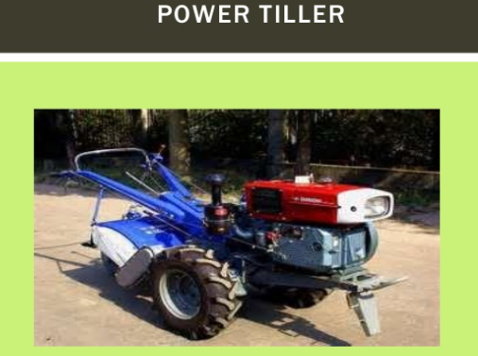
Agricultural Machinery/Power

Slide 10
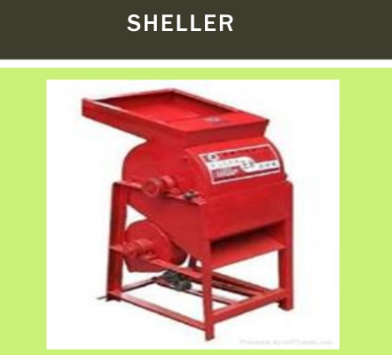
Agricultural Machinery/Power

Slide 11
Agricultural Operations
The operations on a farm can be classified as:
Tractive work such as land preparation, cultivation, harvesting and transportation.
Stationary work: cutting feed, handling& storing, grinding and lifting of irrigation water.

Slide 12
Agricultural Operations
Sources of power:
Human and animal.
Human and machines.

Slide 13
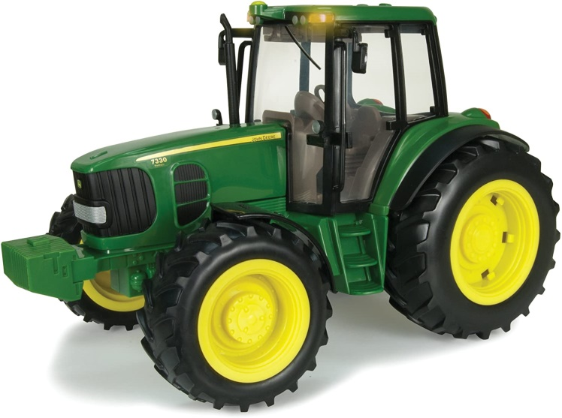
Tractor
A tractor is an engineering vehicle specifically designed to deliver a high effort at slow speeds, for the purposes of hauling a trailer or machinery used in agriculture or construction.

Slide 14
Tractor & PTO
PTO: Power Take-off.
It is part of the tractor transmission system.
It is provided with a standard splined shaft at rear of the tractor to operate the PTO operated machines like mowers and harvesters.

Slide 15
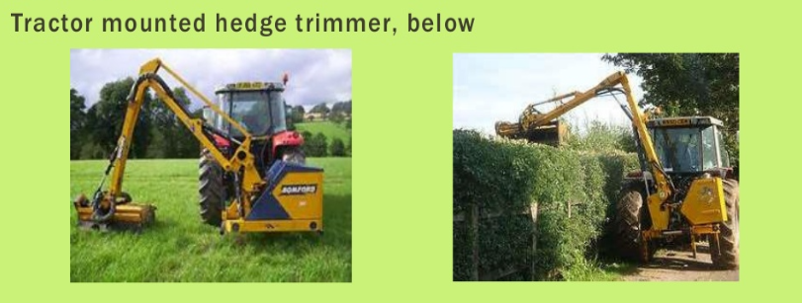
Tractor & PTO

Slide 16


