Slide 1
Agricultural Engineering Practices Lecture 3 3rd Stage
By:
Miss Media Nofel M. Fawzi
2021-2022

Slide 2
Outline of presentation:
Introduction to Agricultural Land Surveying
Surveying
Measurements in survey
Units of measurement in survey

Slide 3
Introduction
Effective farm project or undertaken on mechanized scale started with site selection and survey. Site selection has to do with making a choice of land based on feasibility studies, soil conditions, topography, physical conditions etc. this can only be authenticated through land survey.
Land survey is carried out for the determination of relative horizontal and vertical position, such as that used for the process of mapping and the establishment of marks.

Slide 4
Surveying
Webster’s dictionary defined surveying as “the science of determining the location, form or boundaries of a tract of land by measuring the lines and angles in accordance with the principles of geometry and trigonometry”.
defined a Surveyor as “a professional person with the academic qualification and technical expertise to practice the science of measurement, to assemble and assess land and geographic related information.

Slide 5
Measurements in survey
Only four types of measurements are determined thus:
1. Horizontal distance: Horizontal lengths or distances are measured in short, straight sections, which together are practically equivalent to an arc everywhere perpendicular to gravity.
2. Vertical lengths: Vertical lengths or differences in height or elevation measurements are used as reference point. A level surface, with respect to the earth is a curved surface everywhere perpendicular to gravity such as the surface of still water.
3. Horizontal angles: Horizontal angles measured in planes horizontal at the vertex while
4. Vertical angles: These are measured in vertical planes.

Slide 6
Units of measurement in survey
The meter is the fundamental unit of length used throughout the world. In 1959 it was agreed by the representatives of the English speaking nations to base the foot on the meter according to the exact ratio 1ft = 0.3048m.
Today, the only unit of length used in surveying in addition to metric unit is the foot e.g. (1 station = 100ft).
In optical tooling, the inch and decimals of an inch are used exclusively e.g. 20ft = 240in.

Slide 7
Surveying equipment
The following are the fundamental surveying instruments required in any survey activity:
Steel tape (100-meter): this is the basic means of measuring distance. It consists of graduated steel ribbons or flat wire with handle at each end. Its length is taken as the straight-line distance between the line and marks measured at room temperature, 68º F (20º C).

Slide 8
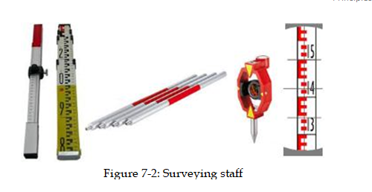
Surveying equipment
2. Staff: Examples of staff graduation include; metric, upright, E-type, pattern staff. Before using a staff, check the accuracy of the scale using a steel tape because some staff faces may be out by one or more centimeters.

Slide 9
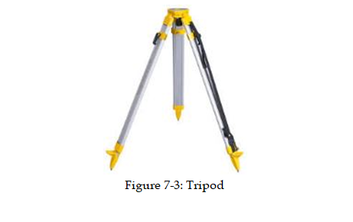
Surveying equipment
3. Wood or aluminum tripod: A wooden tripod is preferred to a metal tripod as it is not subject to as much vibration in windy conditions. The tripod should be long enough to use the instrument without stooping.

Slide 10
Surveying equipment
4. Compass: A compass is a navigational instrument that shows directions in a frame of reference that is stationary relative to the surface of the Earth. The compass can be used to set magnetic north on the level and allow recordings to be taken from it.
Two types of compasses are commonly used in survey. These are; Box compasses and circular compasses.

Slide 11
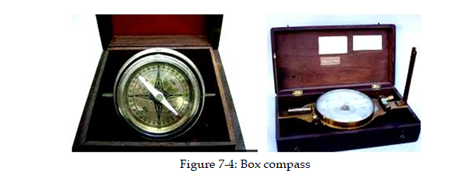
Surveying equipment
Box compasses must be used with angle measuring instruments, as they operate only when the line of sights point toward magnetic north. The bearing desired must then be measured from this direction.

Slide 12
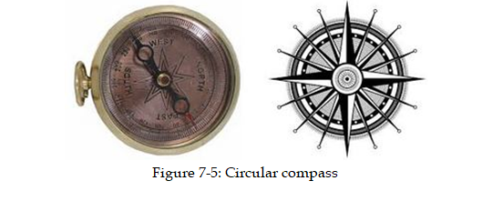
Surveying equipment
Circular compasses can be mounted on theodolite and are often permanently mounted on transits. When provide with open sights, they can be used alone either mounted on high tripods or held in the hand.

Slide 13
Surveying equipment
5. Pegs/hammer: Pegs, preferably painted white, are required especially for marking out a grid survey or temporary marks.
6. Record/notebook: A notebook is required to record all measurements and other information required to make sense of the survey work completed in the field.
7. Pencil/eraser: A pencil and eraser are preferable to an ink or biro type pen in the field. Mistakes can be easily remedied, pencils will not run out as an ink pen will and a pencil will still function even if the paper becomes a little wet through perspiration.

Slide 14
Surveying equipment
8. Theodolite (transit type):
Theodolites are designed to measure or set out both horizontal and vertical angles. It often has a compass for determining magnetic bearings and a spirit level containing a bubble in a liquid attached to the telescope for establishing a horizontal plane and for running levels.
The objective lens of the telescope forms an image on the plane of the reticule, where a pattern, etched on glass, or cross hairs mark a point. An eye-piece (ocular) magnifies both the image and the cross hairs so that the observer sees the cross hairs on the object sighted on the line of sight, while the view is magnified about 20 - 30 centimeters.

Slide 15
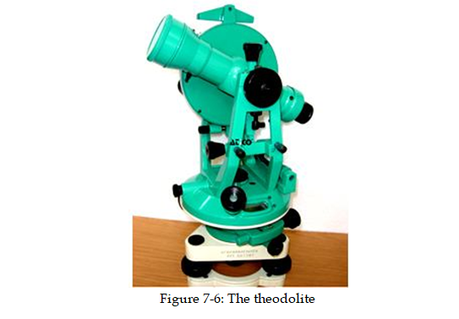
Theodolite

Slide 16
Theodolite
The telescope turns vertically through 360 º on a horizontal (elevation) axis established by bearing in two uprights (standards). A graduated vertical circle turns with the telescope past an index on a standard and thus measures vertical angles. The standards are mounted on a horizontal plate, which carries one spirit level, or two at right angles, and usually two indices 180 º apart for reading a horizontal graduated circle.
The plate is mounted on a vertical spindle that allows it to turn in a horizontal plane about a vertical axis (azimuth axis) and the horizontal axis is adjusted so that it is perpendicular to the vertical axis. The parts so far described are called collectively the alidade.

Slide 17
Theodolite
The spindle turns in a bearing at the base or leveling head, and the graduated horizontal circle for measuring horizontal angles turns in a separate bearing also on the leveling head.
A clamp and a tangent screw that permits slow motion controls the rotation of the alidade with respect to the level head.
The alidade index is set at zero by operating the upper motion. Using the lower motion, the line of sight can be turned to the target that marks the first side of the angle without disturbing the zero setting.

Slide 18
Theodolite
When the telescope is turned to the second side or the angle, by means of the upper motion the alidade index will read the valve of the angle. The same process is repeated some number of times and the values obtained are divided by the number of turns to get the accurate angle.
The base of the leveling head of theodolite or a transit is crewed on a tripod or some other support. Three- screw leveling head are much easier and faster to use, but they sometimes allow the circle to rotate a little.
A plumb bob or a vertical sighting device is used to place the instrument center over the point of observation. The instrument can be shifted laterally for final positioning.

Slide 19
Any questions?

