Slide 1
Plant Physiology lecture 1 3rd Stage
By:
Miss Media Nofel M. Fawzi
2020-2021

Slide 2
What is the Plant?
Is multicellular
Is non-motile
Has eukaryotic cells have distinct membrane- bound organelles

Slide 3
d. Has cell walls comprised of cellulose
e. Is autotrophic capable of sustaining itself
f. Exhibits alternation of generations- has the diploid (2n) spore producing phase of the life cycle of an organism, and haploid (n) gamete-producing phase of the life cycle of an organism.

Slide 4
What is Plant Physiology?
Plant Physiology is a study of the plant way of life, which include various aspects of the plant lifestyle and survival including: metabolism, water relations, mineral nutrition, development, movement, irritability (response to the environment), organization, growth and transport processes.
Plant Physiology is a lab science.
Plant Physiology is an experimental science.
Plant Physiology relies heavily on chemistry and physics.

Slide 5
Why we study Plant Physiology?
Food.
Economically important products.
Applications to other disciplines(i.e., agriculture, forestry, horticulture).
Theoretical importance (like a mountain).
Jobs.

Slide 6
Plant Structure and Function
There are two plant groups, the Monocots and the Dicots.
 | Monocots | Dicots
Floral Arrangement | 3’s | 4’s and 5’s
Leaf Venation | Parallel | Net
Vascular bundles | Scattered | Ring
Habit | Herbaceous | Herbaceous + Woody
Roots | Fibrous | Taproot
Growth | Primary only | Primary and secondary
Examples | Grass, Palm, orchid | Oaks, Roses, Sunflowers

Slide 7
Plant Structure and Function
A plant has two organ systems:
The shoot system; includes the organs such as leaves, buds, stems, flowers and fruits.
The root system; includes those parts of the plant below ground such as the roots, tubers and rhizomes.

Slide 8
Plant Cell
Cells are the foundation to plants. Like the bones in the body, the cell wall provides the framework for the plant.
The walls of the cells actually create the structure of the plant.

Slide 9
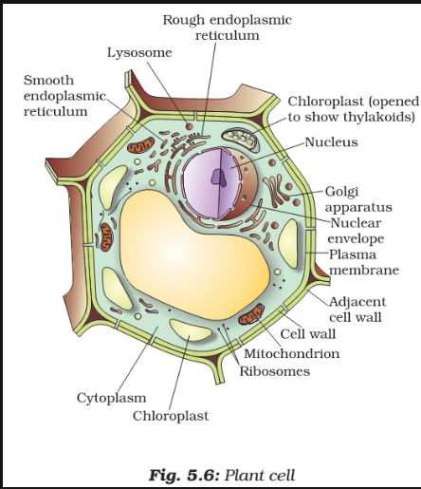
Plant Cell

