Slide 1
Plant Physiology lecture 4
3rd Stage
By:
Miss Media Nofel M. Fawzi
2020-2021

Slide 2
Plant Water Relations
Importance of Water:
Water is absolutely essential for all living organisms
Why is water important?
Living cells are composed of 70-95% water.
Life absolutely depends on the properties of water.
Life probably evolved in water.
Water is a good medium for biochemical reactions.
Limiting resource for crop productivity.

Slide 3
Diffusion
Diffusion it is the movement of molecules or ions of a solute or a solvent from the region of its higher concentration to that of its lower concentration, the net movement stops when a dynamic equilibrium is achieved.

Slide 4
Diffusion
Factors Affecting Diffusion:
Diffusion gradient
Temperature
Density

Slide 5
Imbibition
Imbibition it is defined as the adsorption of water by colloidal materials.
Imbibition in plants is a characteristic of hydrophilic colloids.

Slide 6
Osmosis
Osmosis is a specialized case of diffusion, it represents the diffusion of a solvent (water) across a membrane.
For osmosis to occur there must be:
A selectively permeable membrane between two water solutions.
The concentration of solute in the two solutions must be unequal.
The membrane must be impermeable to the solute, but permeable to water.

Slide 7
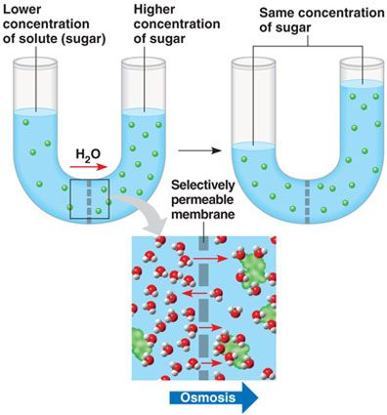
Osmosis

Slide 8
Osmotic Pressure
It is the hydrostatic pressure produces by the difference of concentration between the sides of a surface such as a semi-permeable membrane.

Slide 9
Turgidity
As water absorbed by a cell and resulting In its accumulation in the vacuole a certain pressure is exerted on the surrounding protoplasm and the cell wall. A cell thus charged with water with its wall in a state of tension is said to be turgid and the condition is designated as Turgidity.
In a fully turgid cell two pressures are involved such as, outward pressure (turgor pressure) and inward pressure (wall pressure).

Slide 10
Plasmolysis
The shrinking in volume of the protoplasm of a cell and the separation of the protoplasm from the cell wall due to loss of water via osmosis.

Slide 11
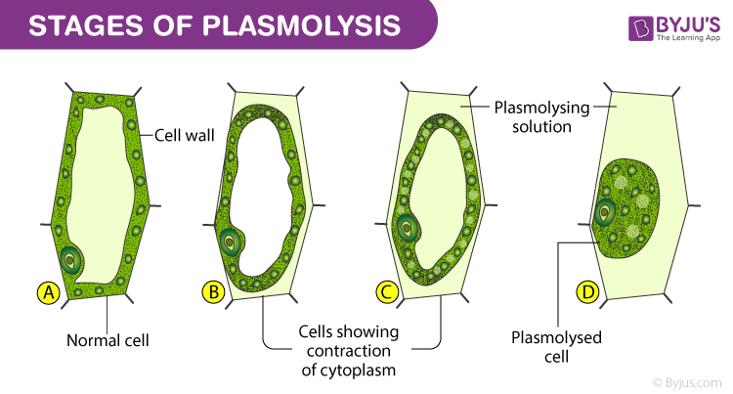
Plasmolysis

Slide 12
Plasmolysis
Isotonic: if the concentration of both the solution and the protoplasm is the same.
Hypertonic: if the concentration of the solution is higher than that of the protoplasm.
Hypotonic: if the concentration of the solution is lower than that of the protoplasm.

Slide 13
Colloidal System
Colloids and colloidal systems are essential to life. They function in every body cell, in the blood and in all body fluids.
Colloidal chemistry deals with both organic and inorganic substances affected by:
Size of particles.
Particle dispersion in a medium.

Slide 14


