Slide 1
Plant Physiology lecture 5 3rd Stage
By:
Miss Media Nofel M. Fawzi
2020-2021

Slide 2
Water Absorption
Water makes up most of the mass of plant cells, each cell contains a large water-filled vacuole. Water typically constitutes 80 to 95% of the mass of growing plant tissues.
The soil water though the soil particles lay close to each other yet some angular spaces is always present there, all such spaces in soil called pore space.

Slide 3
Water Absorption
Types of water:
Plant Available Water (PAW).
Saturation Water Content (SWC).
Field Capacity (FC).
Permanent Wilting Point (PWP).
Plant Available Water (PAW).
Readily Available Water (RAW).

Slide 4
Organ of Water Absorption
Elongation roots usually, possess four regions: the root cap, the meristematic region, the region of cell elongation and the region of differentiation and maturation.
The root cap is composed of loosely arranged cells and is usually well defined. Because it has no direct connection with the vascular system, it probably has no role in absorption.

Slide 5
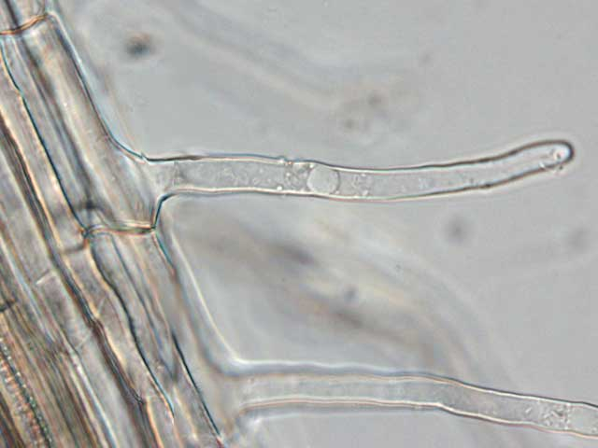
Organ of Water Absorption
Root Cap

Slide 8
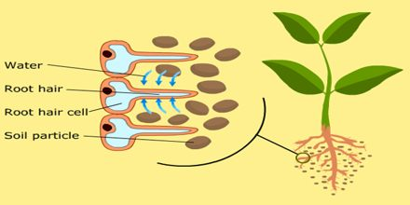
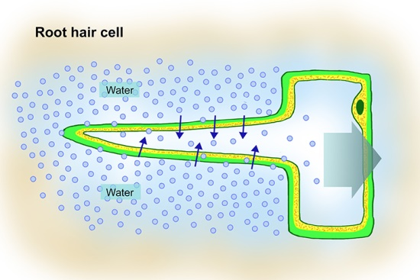
Root Hair Cells

Slide 9
Water Moves
There are three pathways through which water can flow:
The apoplast pathway.
The transmembrane pathway.
The symplast pathway.

Slide 10
Mechanisms of water Absorption
Different mechanisms involved in water absorption by root hairs:
Passive Absorption.
Active Absorption.
The active absorption is carried out by two theories which are:
Active osmotic water absorption.
Active non-osmotic water absorption.

Slide 11
Mechanisms of water Absorption
Factors affecting Water Absorption by Roots:
Soil water content (Available Soil-Water).
Soil temperature.
Soil aeration and flooding.
Concentration of soil solution.
Root system.

