Slide 1
Agricultural Engineering Practices Lecture 4 3rd Stage
By:
Miss Media Nofel M. Fawzi
2022-2023

Slide 2
Outline of presentation:
Types of surveying and equipment.
Types of levels.
Using a water level on the field.
Survey accuracy.

Slide 3
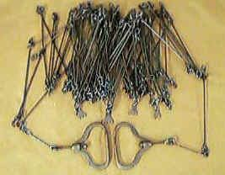
Types of surveying and equipment
1. Chain surveying:
In a chain survey, the area to be surveyed is enclosed by one or more triangles whose sides are measured and recorded. Then the perpendicular distance from the side of a triangle to each point of detail such as trees, buildings, boundaries, etc. is measured.
Figure 7-7: The survey chain

Slide 4
Types of surveying and equipment
2.Leveling:
Leveling is a survey procedure that determines the relative heights of points on the earth’s surface. The telescope of an optical level, or laser beam on a laser system, provides a horizontal line of collimation or line of sight.

Slide 5
Types of levels
The three different types of levels used for most agricultural surveying work are water levels, optical levels and laser levels.
a. Water levels:
Water levels are an effective way of measuring different elevations over relatively short distances. Importantly, care must be taken to make sure that air bubbles do not get trapped in the line. Water levels are very easy and cheap to make but require an operator at both ends.
Figure 7-8: Using a water level on the field

Slide 6
Types of levels
Using a water level on the field:
1.Fill a clear plastic water pipe with water.
2.Make sure that there are no bubbles trapped in the hose.
3.Start the process by placing the staff or measuring pole at one point in the field.
4.Move only one end at a time and record the height at both ends of the hose.
5.The change in height is calculated by recording the difference in height between each station.
6. This operation requires two people to perform and is relatively slow.

Slide 7
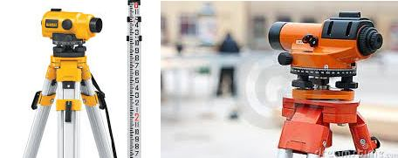
Types of levels
b.Optical levels:
Automatic optical levels are now readily available, relatively cheap and reduce operator error. Optical surveying requires two people: one person to hold the staff and the other to operate the level. Builder’s optical levels, which are readily available, are not applicable for agricultural surveying.
Figure 7-9: Using a water level on the field

Slide 8
Types of levels
Most of the surveying work done in an agricultural situation does not require highly sophisticated or expensive optical equipment. The features required in an agricultural type level are:
· Easy to change the permanent adjustment as required
· An upright image that makes reading the staff easier
· An ability to read the staff at 150 meters in poor conditions
· A standard deviation over 1 kilometer of no more than 3 millimeters
· Damping of the compensator to prevent fluttering in the wind
· A magnification between 26 and 32 times

Slide 9
Types of levels
Figure 7-10: Leveling field experience

Slide 10
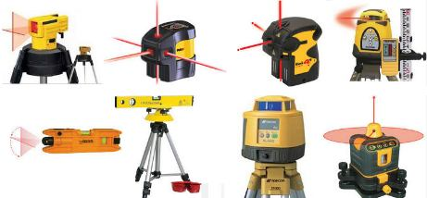
Types of levels
c. Laser levels:
Laser levels are now widely used for surveying purposes in the construction industry. They are very simple to use and readily available in most countries. Recordings can often be taken in a radius of 300 meters from the transmitter. Laser levels can be operated by one person.
Figure 7-11: Laser levels

Slide 11
Types of levels
Benefits of laser levels. The benefits over other land leveling methods include the following:
More level and smooth soil surface
Reduction in time and water required to irrigate the field
More uniform distribution of water in the field
More uniform moisture environment for crops
More uniform germination and growth of crops
Reduction in seeds, fertilizer, chemicals and fuel used in cultural cooperation
Improved field traffic ability (for subsequent operations)

Slide 12
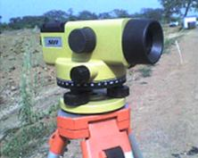
Types of levels
d. Surveyor leveling instrument:
The surveyor level is an instrument that establishes a line of sight that is nearly perpendicular to gravity at the instrument and maintains this angle without change in whatever direction it is pointed. At equal distances from the instrument the line of sight marks the position of a certain level surface.
Figure 7-16: Leveling equipment

Slide 13
Survey accuracy
To check the accuracy of a survey, the survey must be closed. A survey is closed by completing new set-ups and readings, until we return to the first point surveyed. It will be impossible for the first reading and the last reading taken during the survey to be identical. The level of variation will depend on the equipment being used and the skill of the operator.

Slide 14
Any questions?

