Slide 1
Meteorology and Dispersion Modeling Air Quality and Meteorology
•
Primary Metrological Parameter
–Wind speed, Wind Direction, Atmospheric Stability
Secondary Metrological Parameter
sunlight
temperature
precipitation and humidity
Topography
Energy from the sun and earth’s rotation drives
atmospheric circulation
•

Slide 2
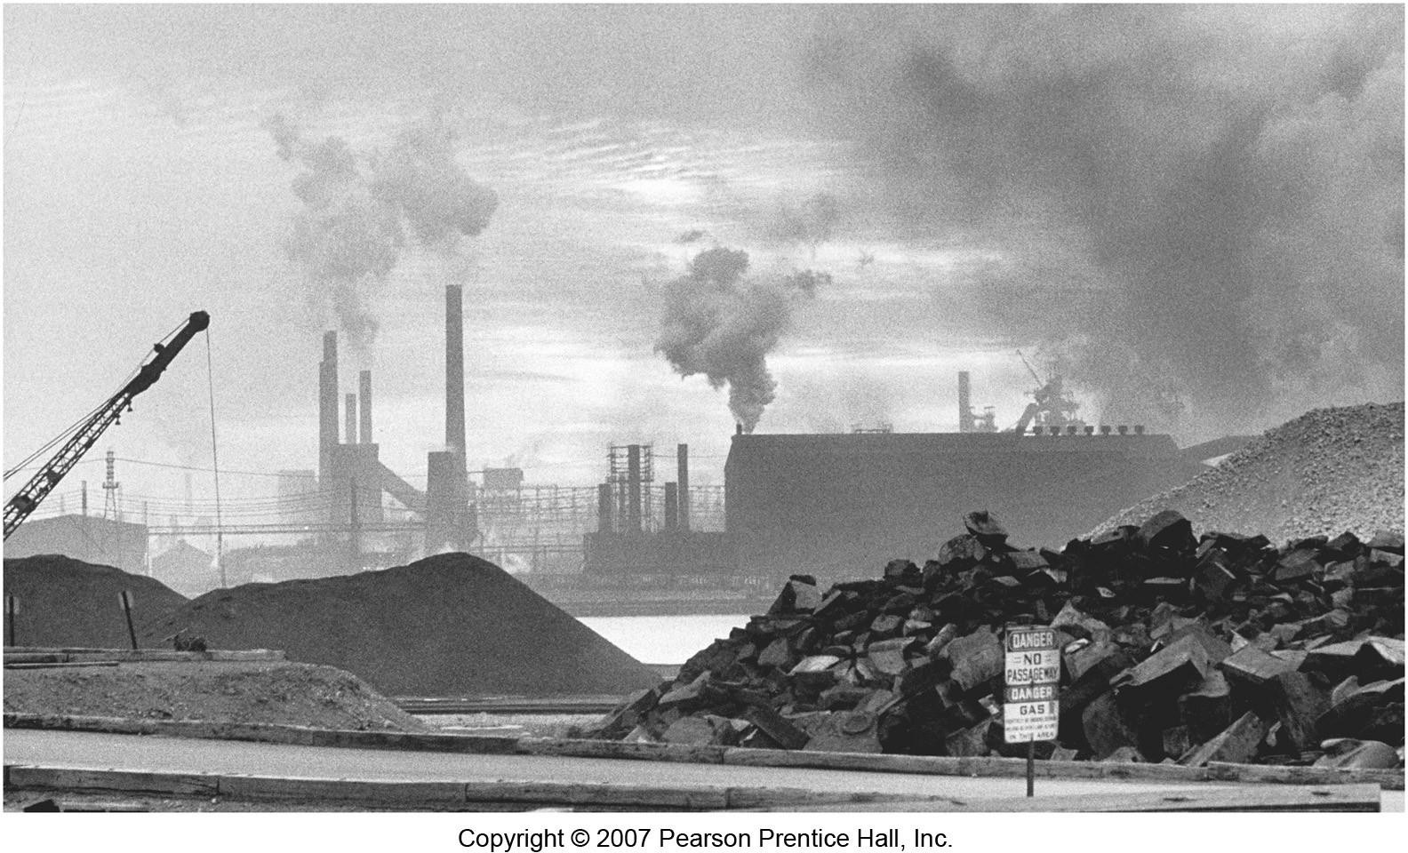
Chicago ca. 1950

Slide 3
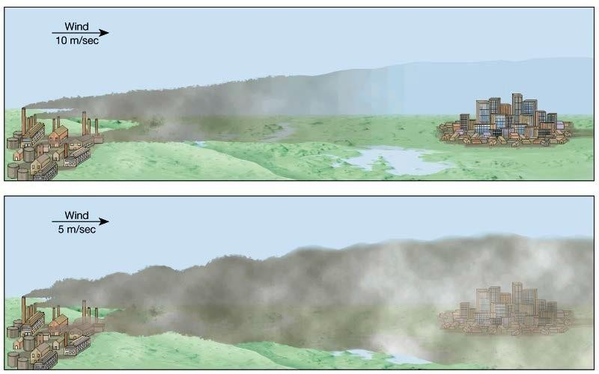
Wind as a Factor
Strong winds blow the pollution away (to someone else's backyard)
The stronger the wind, the more turbulent the air, and the better the mixing of the contaminants with the wind.

Slide 4
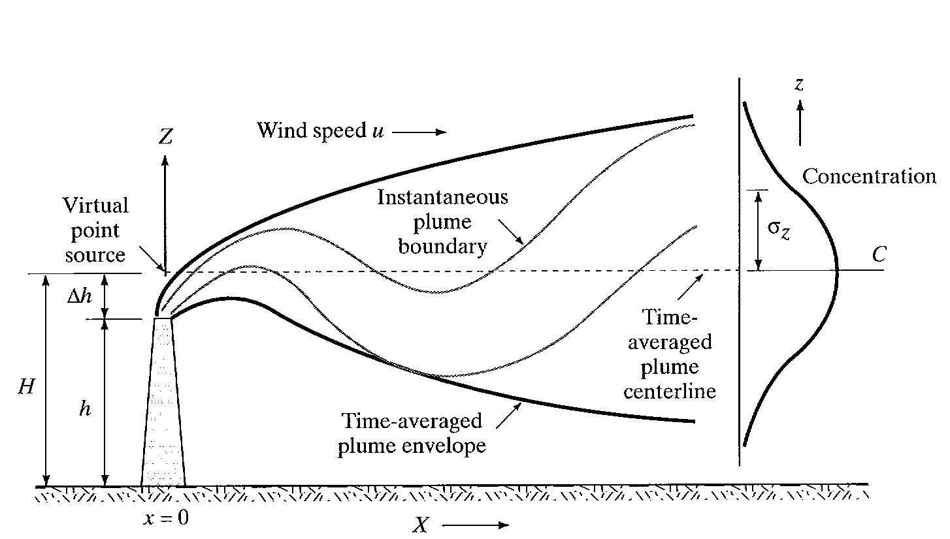
Point Source Gaussian Plume Model

Slide 5
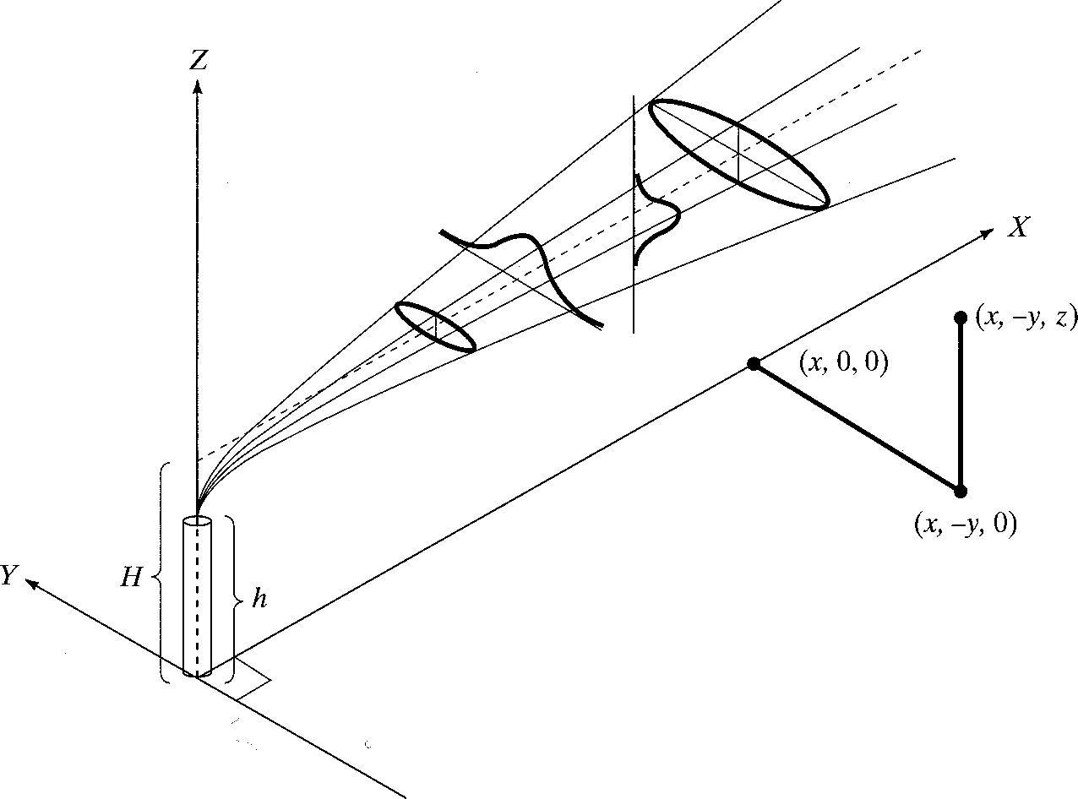
Point Source Gaussian Plume Model

Slide 6
Point Source Gaussian Plume Model
Model Structure and Assumptions
pollutants released from a “virtual point source”
advective transport by wind
dispersive transport (spreading) follows normal (Gaussian) distribution away from trajectory
constant emission rate

Slide 7
Point Source Gaussian Plume Model
Model Structure and Assumptions (cont)
wind speed constant with time and elevation
pollutant is conservative (no reaction)
pollutant is “reflected by ground”
terrain is flat and unobstructed
uniform atmospheric stability

Slide 8
Point Source Gaussian Plume Model
1 𝑦
2 𝑆𝑦
2
1 𝐻
2 𝑆𝑧
2
X(x,y,0,H)= ^{𝐸}
𝑒𝑥𝑝 −
𝑒𝑥𝑝 −
л 𝑆𝑦 𝑆𝑧 𝑢

Slide 9
Point Source Gaussian Plume Model
Where χ = downwind concentration at
ground level (g/m³)
E = emission rate of pollutant (g/s)
s_{y},s_{z} = plume standard deviations (m)
u = wind speed (m/s)
x, y, z, H = distances (m)

Slide 10
Point Source Gaussian Plume Model – Effective Stack Height
H = h + ΔH
where
H = Effective stack height (m)
h = height of physical stack (m)
ΔH = plume rise (m)

Slide 11
Point Source Gaussian Plume Model – Effective Stack Height
Holland’s formula
𝑉𝑠 𝑑 𝑇𝑠 − 𝑇𝑎
Δ𝐻 = 1.5 + 2.68 ⨯ 10⁻² ⨯ 𝑝
𝑑
μ 𝑇𝑠
where v_{s} = stack velocity (m/s) d = stack diameter (m) u = wind speed (m)
P = pressure (kPa)
T_{s} = stack temperature (ºK)
T_{a}= air temperature (ºK)

Slide 12
Point Source Gaussian Plume Model – Stability Categories
A Extremely Unstable B Moderately Unstable C Slightly Unstable
D Neutral
E Slightly Stable
F Moderately Stable

Slide 14
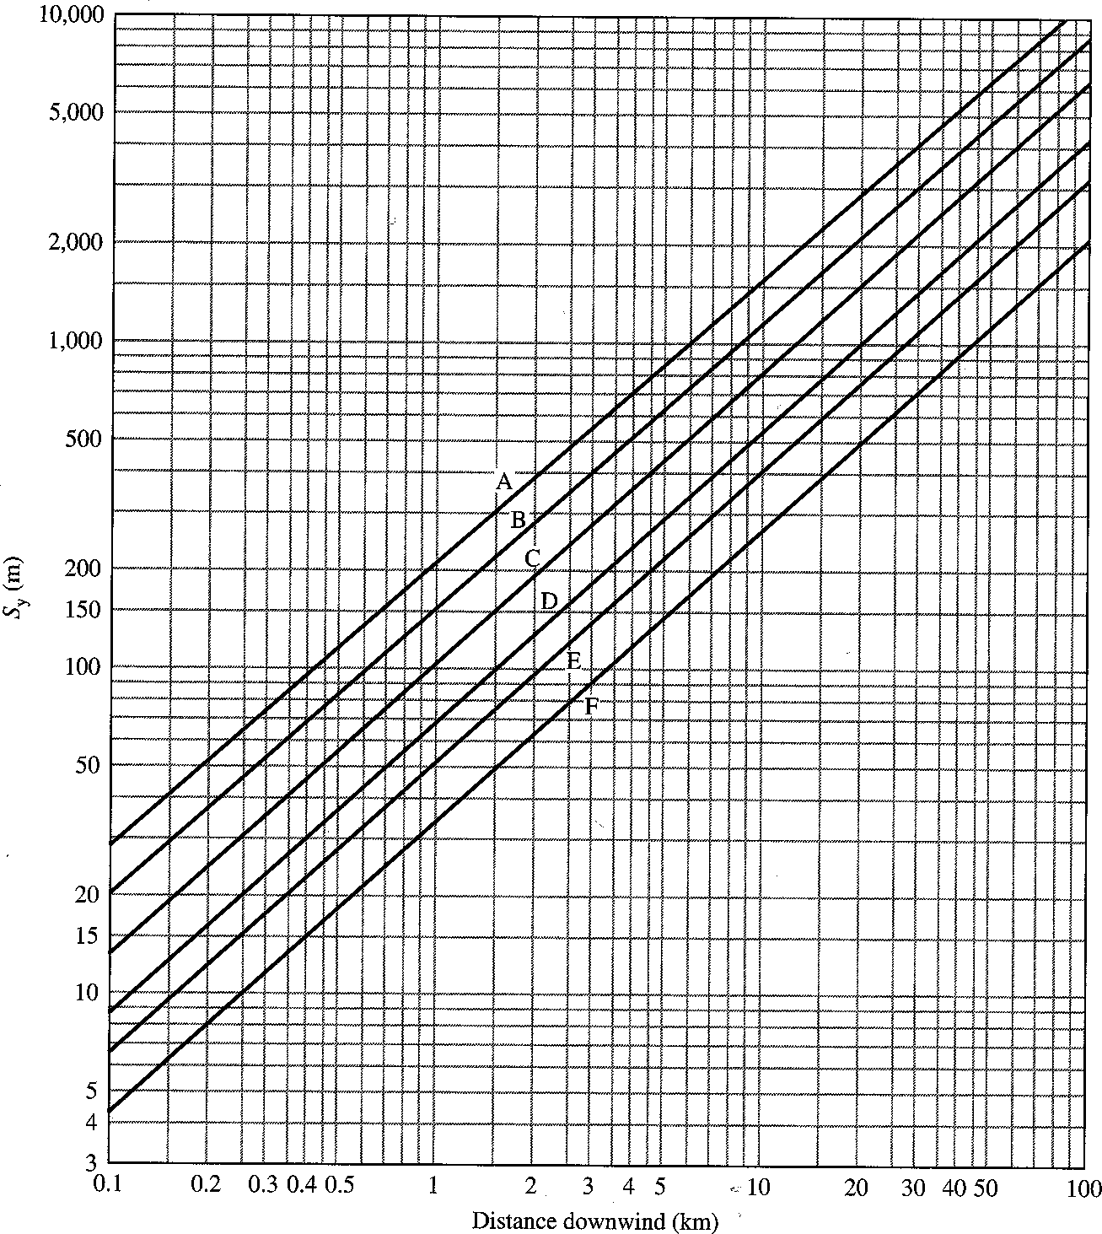
Point Source Gaussian Plume Model – Horizontal Dispersion

Slide 15
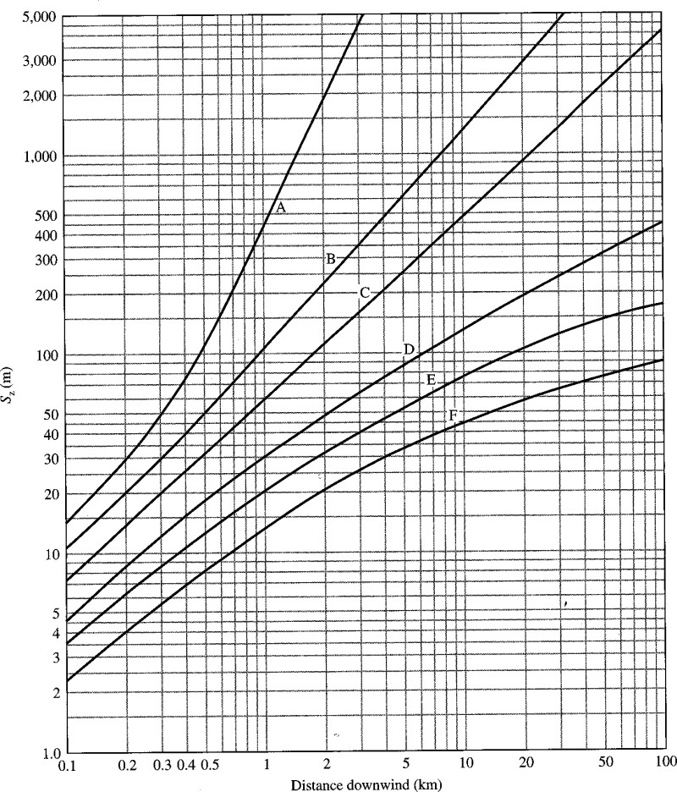
Point Source Gaussian Plume Model – Vertical Dispersion

Slide 16
Point Source Gaussian Plume Model – Wind Speed Correction
Unless the wind speed at the virtual stack height is known, it must be estimated from the ground wind speed
𝑍2
𝑝
where u = wind speed at
𝑈2 = 𝑈1
2
𝑍1
elevation z
2
p = empirical constant

Slide 17
Example
A stack in an urban area is emitting 80 g/s of NO. It has an effective stack height of 100 m. The wind speed is 4 m/s at 10 m. It is a clear summer day with the sun nearly overhead. Estimate the ground level concentration at a) 2 km downwind on the centerline and
b) 2 km downwind, 0.1 km off the centerline.

Slide 18
Example
1. Determine stability class
Assume wind speed is 4 km at ground surface. Description suggests strong solar radiation.
Stability class B

Slide 19
Example
2. Estimate the wind speed at the effective stack height
Note: effective stack height given – no need to calculate using Holland’s formula
_{⎛100 ⎞}0.15
⎛ z ⎞ ^{p}
u₂ = u₁⎜ ² ⎟ = 4⎜
⎟
= 5.65m/s
⎝ ^{z}1 ⎠
⎝ 10 ⎠

Slide 20
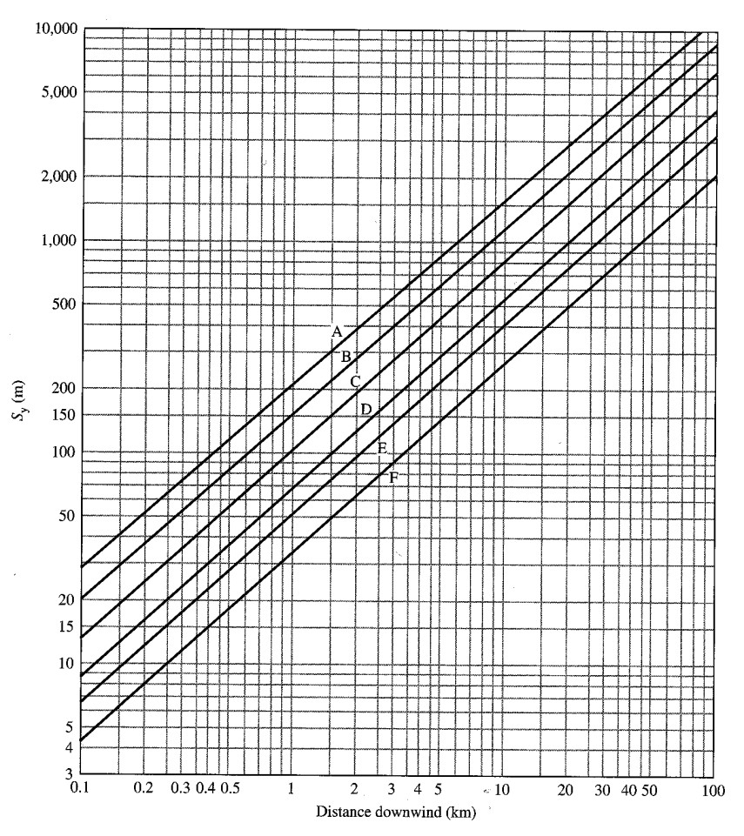
Example
3. Determine σ_{y}and σ_{z} σ_{y}= 290
σ = 220
z
220
290

Slide 21
Example
4. Determine concentration using Eq a. x = 2000, y = 0
⎡
⎞2 ⎤
⎡
80
1 ⎛ 0
1 ⎛ 100 ⎞^{2 ⎤}
⎜
⎟ ⎥ exp⎢−
⎜ ⎟ ⎥
^{C(2000,0) =} π (290)(220)(5.6) ^{exp⎢−}
⎢⎣ 2 ⎝ 290 ⎠ ⎥⎦
⎢⎣ 2 ⎝ 220 ⎠ ⎥⎦
C(2000,0) = 6.43×10⁻⁵ g/m³ = 64.3 μg/m³

Slide 22
Example
b. x = 2000, y = 0.1 km = 100 m
80
⎡
1 ⎛ 100 ⎞^{2 ⎤}
⎡
1 ⎛ 100 ⎞^{2 ⎤}
C(2000,100) = _{π (290)(220)(5.6)} exp⎢−
⎜
⎟ ⎥ exp⎢−
⎜ ⎟ ⎥
⎢⎣ 2 ⎝ 290 ⎠ ⎥⎦
⎢⎣ 2 ⎝ 220 ⎠ ⎥⎦
C(2000,100) = 6.06 ×10⁻⁵ g/m³ = 60.6 μg/m³

