Slide 1
History of Agriculture Extension and terminology
Lecture -1- Agricultural Extension
Third – Stage / Animal Resources

Slide 2
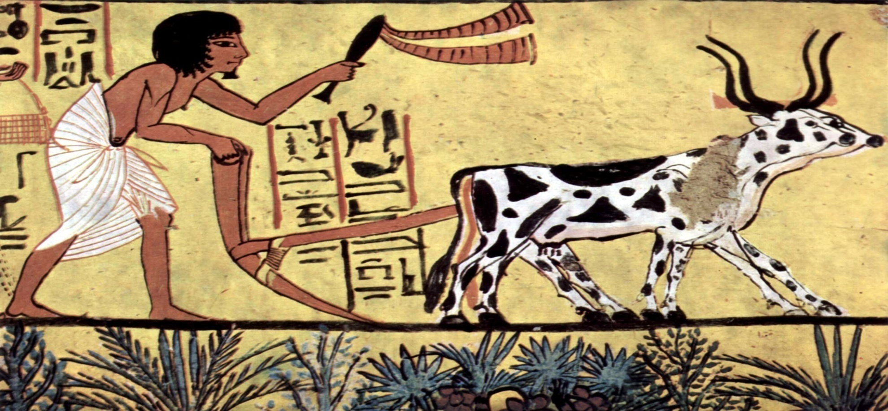
Introduction:
Agricultural communities developed approximately 10000 years ago when humans began to domesticate plants and animals.By establishing domesticity,families and larger groups were able to build communities and transition from a nomadic hunter-gatherer lifestyle dependent on foraging and hunting for survival.

Slide 3
What is the history and origin of agriculture?
Farming started in the predynastic period at the paleolithic,after 10000 BC.Staple food crops were grains such as wheat and barley,alongside industrial crops such as flax and papyrus.In India ,Wheat,Barley and jujube were domesticated by 9000 BC,soon followed by sheep and goats.
Who first started agriculture?
Epyptians: Were among the first peoples to practice agriculture on a large scale,starting in the pre-dynastic period from the end of the paleolithic into the Neolithic,between around 10000 BC and 4000 BC.
What are the stages of agriculture history?
Humans invented agriculture between 7000 and 10000 years ago,during the Neolithic ear,or the New Stone Age.

Slide 4
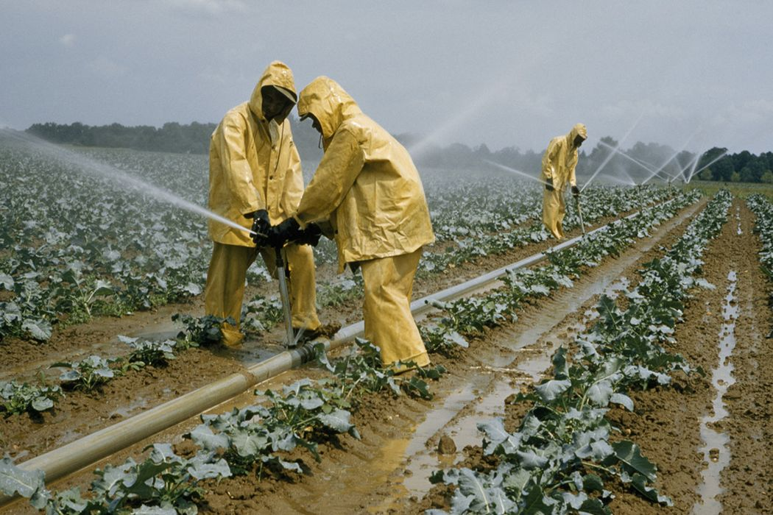
Who is called agriculture?
Agriculture is the art and science of cultivating the soil,growing crops and raising livestock.It includes the preparation of plant and animal products for people to use and their distribution to markets.Agriculture provides most of the world is food and fabrics.

Slide 5
What are the 7 types of agriculture?
The different types of farming are as follows:
1-Daiey Farming.
2-Commercial Farming.
3-Plantation Farming.
4-Commercial grain Farming.
5-Commercial mixed Farming.
6-Primitive subsistence Farming.
7-Intensive subsistence.
There exist four main branches of agriculture,namely;
1-Livestock production.
2-Crop production.
3-Aricultural economics.
4-Aricultural engineering.

Slide 6
What are 5 important of agriculture?
Ariculture impacts society inmany ways,including:supporting livelihoods ,through food ,habitat,and jobs;providing raw materials for food and other products;and building strong economies through trade.Source:The balance small business.
The 7 steps involved in agricultural practices are mentioned below:
1-ploughing.
2-Sowing.
3-Adding nutrients.
4-Irrigation.
5-Protecting plants.
6-Harvesting.
7-Storage.

Slide 7
Reference:
1-PW Bidwell,JI Falconer-1925-Carnegie Institution of Washington.
2-JW Jones,JM Antle,B Basso,KJ Boote,RT Conant…Agricultural systems,2017-Elsevier.
3-SEJ Russell-A History of Agricultural Science in Great Britain…,1966-cabdirect.org

