Slide 1
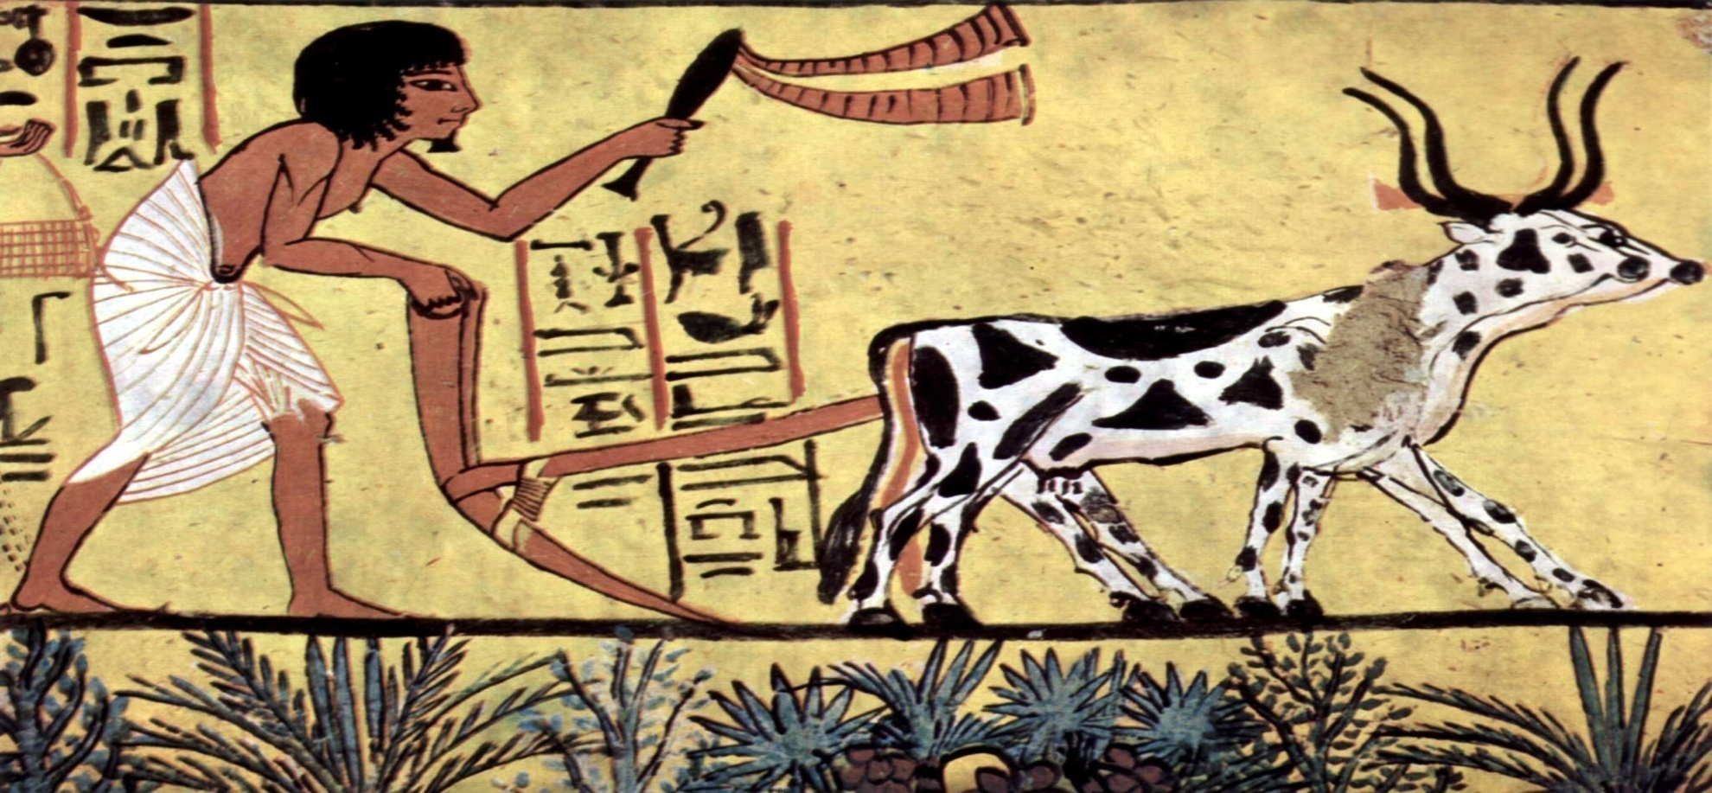
History of Agriculture Extension and Terminology
• Terminology
• The term ‘extension’ was first used to describe as education programme in England in the second half of the 19th Century. When traveling teachers used the programmes to extend the work of universities beyond the campus and into neighbouring communities
• In the United State of America, applying specifically to agriculture, while in Britain the idea change to ‘advisory service’ in the 20th
Arabic: Al-Ershad (“guidance”)
Spanish: Capacitación (“training” "capacity building")
Persian: Tarvij and Gostaresh (“to promote and to extend”) - ترویج و گسترش

Slide 2
Definition of agriculture extension
Maunder, 1973: Extension is a service which assist farm people, through educational procedures in improving farming methods and techniques, increasing production efficiency and income, bettering their levels of living and lifting social and educational standards.
Adams, 1982: Agricultural Extension: assistance to farmers to help them identify and analyse their production problems and become aware of the opportunity for improvement.
Röling, 1988: Extension is a professional communication intervention deployed by an institution to induce change in behaviours.
2006: Extension is the process of enabling change in individuals, communities and industries involved in the industry sector and in natural resource management.

Slide 3
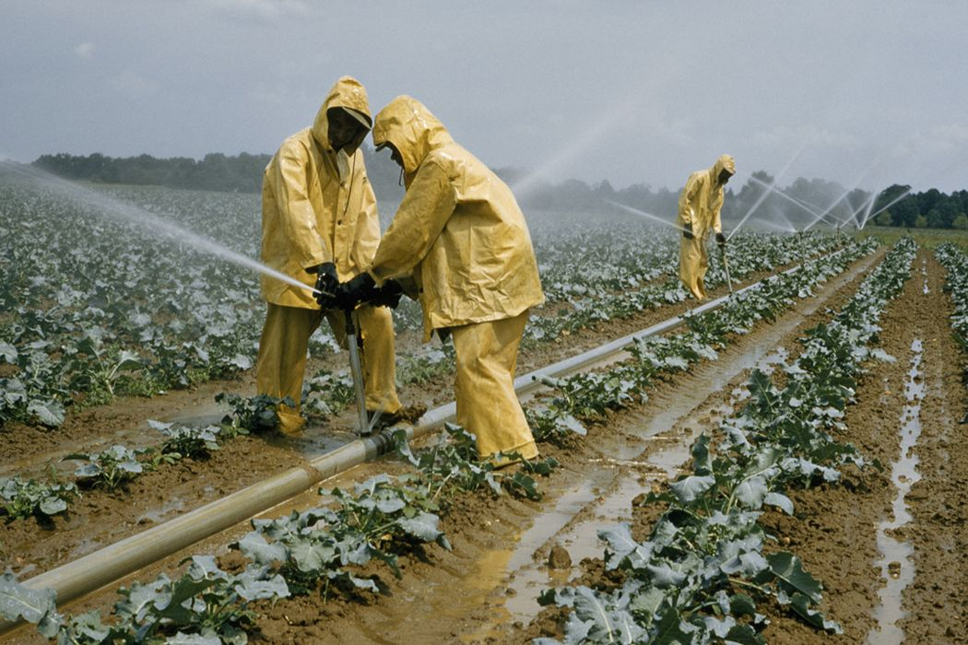
Who is called agriculture?
Agriculture is the art and science of cultivating the soil,growing crops and raising livestock.It includes the preparation of plant and animal products for people to use and their distribution to markets.Agriculture provides most of the world is food and fabrics.

Slide 4
Modern agricultural extension services
• The first agricultural extension service of a modern kind came into presence as the result of a problem. The problem was the outbreak of potato disease in Europe in 1845. In Ireland its effects were particularly severe because the predominantly farmer population relied on potatoes in their diet, and "the potato famine" continued until 1851.
• in 1847, the Earl of Clarendon, wrote a letter to the president Agricultural Improvement of Ireland, This letter, was about to urge the president to appoint traveling lecturers to travel around the most troubled areas to inform and show small farmers, in simple terms, how to improve their cultivation and how to grow nutritious root crops other than potatoes.

