Slide 1
- Lecture 2: Adv. Animal Breeding.
-

Slide 2
Genetics?
The science of genetics is concerned with determining the modes of inheritance or the
transmission of biological properties from generation to generation.
Genetics: is the study of genes and inheritance in living organisms.
The particulates that determine the modes of inheritance are called genes.
The genes or hereditary factors are contained in bodies called chromosomes.

Slide 3
Cont..
The science of genetics deals with the transmission of individual characteristics of both parents to the offspring through the mechanism of heredity.
Poultry breeding utilizes genetic principles to accomplish the goals of poultry producers for meat or egg production.

Slide 4
Cont..
All plants and animals are made of small building blocks called cells.
An individual cell contains a cell wall (membrane) and a nucleus within the membrane.
The cellular material, cytoplasm, is found between the nucleus and membrane.

Slide 5
Cont..
The chromosomes:contained within the nucleus, carry genetic material called genes (units of inheritance).
In chickens, it is 39 and the number of chromosomes varies for different species.
In all animals, including birds, the body cells contain one pair of sex chromosomes since they relate to the animal's sex.

Slide 6
Cont..
The chromosomes are threadlike structures located in the nuclei o f microscopic cells which make up the bodies of all higher organisms.
Chromosomes exist in every living cell
Transmission of hereditary characters is only through sex cells.
The manipulation of genes is the basis for all breeding programs, and DNA may be considered as building blocks of the genetic foundation of an animal.

Slide 7
Cont..
They are referred to as the X and chromosomes with the X being larger than the Y.
In humans and farm animals, the male is XY (heterogametic) and the female is XX (homogametic).
In birds, the males are ZZ (homogametic) and the females ZW (heterogametic).

Slide 8
Cont..
As the chromosomes exist in pairs the genes also exist in pairs.
On each chromosome there could be thousands of genes.
Phenotype : The external appearance or some other observable or measurable characteristic of an individual.

Slide 9
Poultry breeding compared to other livestock.
Poultry breeding has achieved a level of practical application that is not even approached in large-animal breeding.
Selection and crossbreeding techniques have enabled the production of a laying fowl which will provide up to 300 eggs a year with many reasons.
Generation interval:
High reproductive rate:

Slide 10
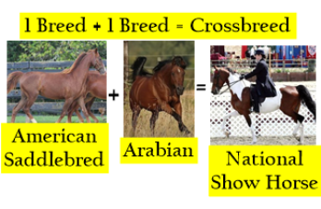
crossbreeding

Slide 11
The role o f inbreeding and crossbreeding
These unique biological advantages (high reproductive rate, their relatively low cost and short generation interval) of chicken have made it possible to develop inbred lines.
Intense inbreeding increases the chance of expression of deleterious recessive genes and perhaps death of chicks.
In addition affected animals will be culled, this will reduce the frequency of detrimental genes in the offspring generation.

Slide 12
Cont..
The cost of removing even large number of
animals with undesirable genes is relatively small in poultry and fee remaining could easily multiply to produce adequate number of replacements.

Slide 13
Sex chromosomes and sex-linked genes.
Birds differ from mammals in certain characteristics associated with inheritance.
One of the major differences is the genetics mechanism by which sex of the offspring is determined.
In mammals, sex of offspring is determined by the male gametes, but in birds it is determined by the female gametes.

Slide 14
Cont..
Basically this procedure depends on the number of complete sex chromosomes (Z) in each tissue cell.
In birds there are two complete sex chromosomes in the male but the female possesses only one.

Slide 15
Chicken breeds
White leghorn:
White leghorn is a breed of chicken originating in central Italy. White leghorns are commonly used as layer chicken.
White Leghorn is the best layer of white eggs,
are used most often in tropical Africa among the pure poultry strains.
The White Leghorn is a strain with great tolerance for tropical climatic condition such as heat and humidity.

Slide 16
White leghorn:

Slide 17
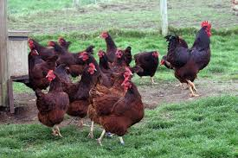
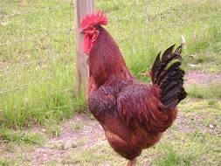
Rhode island red

Slide 18
Cont..
The Rhode Island Red is a breed of chicken(Gallus gallus domesticus), raised for meat and eggs. They are a popular choice for backyard flocks because of their egg laying abilities and hardiness.
A breed created in Rhode Island State in the USA from a cross between Asiatic and Mediterranean breeds.
This breed occupies one of the very top places
both as the pure breed and in commercial crosses.
It is a breed well adapted to commercial rearing and to tropical conditions.

Slide 19
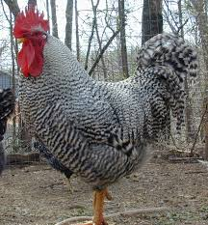
Plymouth rock or Barred rock

Slide 20
Cont..
Plymouth Rock, often called simply Rocks or Barred Rocks(after their most popular color), is a chicken breed that originated in the United States.

Slide 21
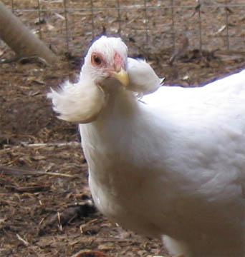
Araucana breed

Slide 22
Cont..

Slide 23
Cont..
The Araucana, also known in the United States as a South American Rumpless is a breed of chicken originating from Chile. It is the only breed to combine 3 unique traits. It is completely rumples. It has feathers or “tufts” sticking out of the sides of its face and lays a blue egg.

Slide 24
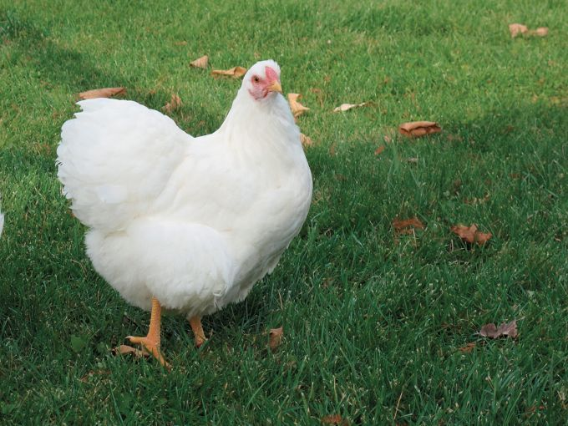
White Wayandotte:

Slide 25
Cont..
A hen of American origin, created towards the end of the 19th century, it enjoyed first place in that country before spreading through Europe. Its color is white, the beak and feet are yellow.

Slide 26
Cont..
White Wayandotte is a very hardy breed adapting to all climates and of mixed aptitude (dual purpose breed).
Thus it is very profitable up to the time of culling,

Slide 27
Commercial crosses
Commercial crosses are strains developed by selecting within breeds for several generations
and crossing the breeds in different ways.
In the naming of the crosses the male strain is the first named.
Pure breeds or pure strains: are strains which are crossed between themselves to produce commercial crosses that will be used to produce eggs or meat (or both for the mixed breeds).

Slide 28
SELECTION AND CULLING
Selection:
Selection is the process of deciding which animals in a generation will be allowed to become parents of the next generation and how many progeny they will be permitted to leave.
Selection is of two types,

Slide 29
2 types of selections
Natural selection: is a type of selection where natural factors influence the ability of an individual to survive and produce offspring for future generation.
Artificial selection: is a type of selection where man decides the animals that should be parents of the next generation.

Slide 30
Cont..
As Layers:
To obtain maximum number of saleable eggs
per hen housed at low feed cost per egg
or per kg egg mass and the eggs should have
optimal internal and external qualities.
Stock should have low mortality and high adaptability to different environments.”

Slide 31
Cont..
Breeders today select for :
the age at sexual maturity,
the rate of lay,
livability,
egg weight,
body weight,
feed conversion,
shell color,
shell strength,
albumen height,
egg inclusions (blood and meat spots),

Slide 32
Selection base on
Individual selection: Selection based on an individual performance is called individual selection or performance testing.
Pedigree selection:
Pedigree selection could be practiced if the record of the parents of a bird along with their performance is available.
Progeny selection: When a performance record of a progeny is used to predicted the breeding worth of either or both parents we call this progeny testing.

Slide 33
Culling?
Culling which involves identifying and removing non-laying and low producing hens from a flock is an indirect method of applying breeding knowledge to the production of poultry stock.
Culling should take place throughout the year. When chicks are started, all obviously weak
birds should be culled. As the flock get older,

Slide 34
Cont..
slow-growing pullets should be eliminated.
slow-maturing birds should be removed.
flock owners should remove the sick, lame, or injured birds.
heavy culling should not be necessary during the first eight to nine months of lay.
The degree of culling is relatively high in small poultry flocks particularly if they are kept for a second or third production year.

Slide 35
In general, there are four reasons for culling:-
1) Salvage the poor producer before the bird becomes too emaciated for market or before she dies.
2) Increase the efficiency of production, which is reflected as a higher percent production of the flock.
3) Increase the amount of floor and feeder space available for the good producers, with a resulting increase in efficiency of space and labor required.
4) Control spread of disease.

Slide 36
How to decide?
When a hen is examined to determine whether to “cull” her or “keep” her in the laying flock, there are five things you want to know about the individual:

Slide 37
Cont..
Ability to lay. Body capacity, stamina, general health, and alert appearance.
This may be determined before production begins or anytime during the first production year.
2. Present production. This may be determined at any season of the year to distinguish
between those birds that are laying and those that are resting at the time of handling.

Slide 38
Cont..
3) Indication of past performance:
These characteristics are usually not apparent in the pullet that has just started to lay, since it depends upon the length of time a bird has
been in production. However, these can and should be used for measuring the worth
of a bird any time after she starts laying.

Slide 39
Cont..
4) Rate of production: The number of eggs laid in a given length of time is important;
the higher the rate of production, the more valuable the hen.
5) Health and vitality: The ability of the birds to withstand the strain of egg production
may be determined anytime before or after the egg-laying period.

Slide 40
Steps ?
When planning to cull or select birds in a laying flock.
look over the entire flock before handling any of the birds to get an overall picture.
Note the health and vitality of the bird
before you pick it up.
Then look at the gross structure of the individual.
her posture, body shape, and general appearance.

Slide 41
Environmental adaptation
Indigenous birds are better adapted to local environment and local feedstuffs.
low level of feeding, heat stress and also are more disease resistance than imported breeds.
they are more tolerant to high ambient temperature and perhaps have a higher feed conversion efficiency due to their smaller maintenance requirement.

Slide 42
Reference list
Parkhurst.,Carmen R .& Mountney ., George J. (1988). Poultry meat and egg production. New York.
Daghir., Nuhad J. (2008). POULTRY PRODUCTION IN HOT CLIMATES.

