Slide 1
Regression
For classification the output(s) is nominal
In regression the output is continuous
  Function Approximation
Many models could be used – Simplest is linear regression
  Fit data with the best hyper-plane which "goes through" the points
y
dependent
variable
(output)
x – independent variable (input)

Slide 2
Regression
For classification the output(s) is nominal
In regression the output is continuous
  Function Approximation
Many models could be used – Simplest is linear regression
  Fit data with the best hyper-plane which "goes through" the points
y
dependent
variable
(output)
x – independent variable (input)
Notes:
Show generalization

Slide 3
Regression
For classification the output(s) is nominal
In regression the output is continuous
  Function Approximation
Many models could be used – Simplest is linear regression
  Fit data with the best hyper-plane which "goes through" the points
  For each point the difference between the predicted point and the actual observation is the residue
y
x
Notes:
Non-linear regression models later
linear regression like perceptron for classification

Slide 4
Simple Linear Regression
For now, assume just one (input) independent variable x, and one (output) dependent variable y
  Multiple linear regression assumes an input vector x
  Multivariate linear regression assumes an output vector y
We "fit" the points with a line (i.e. hyperplane)
Which line should we use?
  Choose an objective function
  For simple linear regression we use sum squared error (SSE)
    Σ (predicted_{i} – actual_{i})² = Σ (residue_{i})²
  Thus, find the line which minimizes the sum of the squared residues (e.g. least squares)
  This exactly mimics the case assuming data points were sampled from an actual target hyperplane with Gaussian noise added
Notes:
Hyperplane for multiple linear regression

Slide 5
How do we "learn" parameters
For the 2-d problem (line) there are coefficients for the bias and the independent variable (y-intercept and slope)
To find the values for the coefficients (weights) which minimize the objective function we can take the partial derivates of the objective function (SSE) with respect to the coefficients. Set these to 0, and solve.
Notes:
Betas are weight/coefficients

Slide 6
Multiple Linear Regression
There is a closed form for finding multiple linear regression weights which requires matrix inversion, etc.
There are also iterative techniques to find weights
One is the delta rule. For regression we use an output node which is not thresholded (just does a linear sum) and iteratively apply the delta rule – For regression net is the output
Where c is the learning rate and x_{i} is the input for that weight
Delta rule will update until minimizing the SSE, thus solving multiple linear regression
There are other regression approaches that give different results by trying to better handle outliers and other statistical anomalies
Notes:
Note target really is the point being regressed to each time. Now makes better sense since net is the output and we want to minimize error of the target.

Slide 7
SSE and Linear Regression
SSE squares the difference of the predicted vs actual
Don't want residues to cancel each other
Could use absolute or other distances to solve problem
  Σ |predicted_{i} – actual_{i}| : L1 vs L2
SSE leads to a parabolic error surface which is great for gradient descent
Which line would least squares choose?
  There is always one “best” fit with SSE (L2)
  An L1 error can have multiple best fits
Notes:
Would choose middle 9+9 < 49

Slide 8
SSE and Linear Regression
SSE leads to a parabolic error surface which is great for gradient descent
Which line would least squares choose?
  There is always one “best” fit
7
Notes:
Show error for each line. 49
Not Euclidean distance to line, but just in the input dimension(s) as shown

Slide 9
SSE and Linear Regression
SSE leads to a parabolic error surface which is great for gradient descent
Which line would least squares choose?
  There is always one “best” fit
7
5

Slide 10
SSE and Linear Regression
SSE leads to a parabolic error surface which is great for gradient descent
Which line would least squares choose?
  There is always one “best” fit
Note that the squared error causes the model to be more highly influenced by outliers
  But is the best fit assuming Gaussian noise error from true target
7
3
5
3
Notes:
Would choose middle 9+9 < 49
NOW TRY L1 error (absolute value), different results (which are not as good), multiple lines with minimal error

Slide 11
SSE and Linear Regression Generalization
In generalization all x values map to a y value on the chosen regression line
7
5
3
3
y – Input Value
1
0 1 2 3
x – Input Value
Notes:
Would choose middle 9+9 < 49
NOW TRY absolute value, less good results, multiple tied best lines, etc.

Slide 12
Linear Regression - Challenge Question
Assume we start with all weights as 1 (don’t use bias weight though you usually always will – else forces the line through the origin)
Remember for regression we use an output node which is not thresholded (just does a linear sum) and iteratively apply the delta rule – thus the net is the output
What are the new weights after one iteration through the following training set using the delta rule with a learning rate c = 1
How does it generalize for the novel input (-.3, 0)?
After one epoch the weight vector is:
  1 .5
  1.35 .94
  1.35 .86
  .4 .86
  None of the above
x₁ | x₂ | Target y
.5 | -.2 | 1
1 | 0 | -.4

Slide 13
Linear Regression - Challenge Question
Assume we start with all weights as 1
What are the new weights after one iteration through the training set using the delta rule with a learning rate c = 1
How does it generalize for the novel input (-.3, 0)?
x₁ | x₂ | Target | Net | w₁ | w₂
 |  |  |  | 1 | 1
.5 | -.2 | 1
1 | 0 | -.4
w₁ = 1 +

Slide 14
Linear Regression - Challenge Question
Assume we start with all weights as 1
What are the new weights after one iteration through the training set using the delta rule with a learning rate c = 1
How does it generalize for the novel input (-.3, 0)?
  -.3*-.4 + 0*.86 = .12
x₁ | x₂ | Target | Net | w₁ | w₂
 |  |  |  | 1 | 1
.5 | -.2 | 1 | .3 | 1.35 | .86
1 | 0 | -.4 | 1.35 | -.4 | .86
w₁ = 1 + 1(1 – .3).5 = 1.35

Slide 15
Linear Regression Homework
Assume we start with all weights as 0 (Include the bias!)
What are the new weights after one iteration through the following training set using the delta rule with a learning rate c = .2
How does it generalize for the novel input (1, .5)?
x₁ | x₂ | Target
.3 | .8 | .7
-.3 | 1.6 | -.1
.9 | 0 | 1.3

Slide 16
Intelligibility (Interpretable ML, Transparent)
One advantage of linear regression models (and linear classification) is the potential to look at the weights to give insight into which input variables are most important in predicting the output
The variables with the largest weight magnitudes have the highest correlation with the output
  A large positive weight implies that the output will increase when this input is increased (positively correlated)
  A large negative weight implies that the output will decrease when this input is increased (negatively correlated)
  A small or 0 weight suggests that the input is uncorrelated with the output (at least at the 1st order)
Linear regression/classification can be used to find best "indicators"
  Be careful not to confuse correlation with causality
  Linear models cannot detect higher order correlations! The power of more complex machine learning models!!
Notes:
Dependent (output) variable rain. Independent (input) variable: Clouds, umbrella open, etc. Open-Umbrella is correlate, not causal.
Humans are already pretty good at finding lower order combinations.

Slide 17
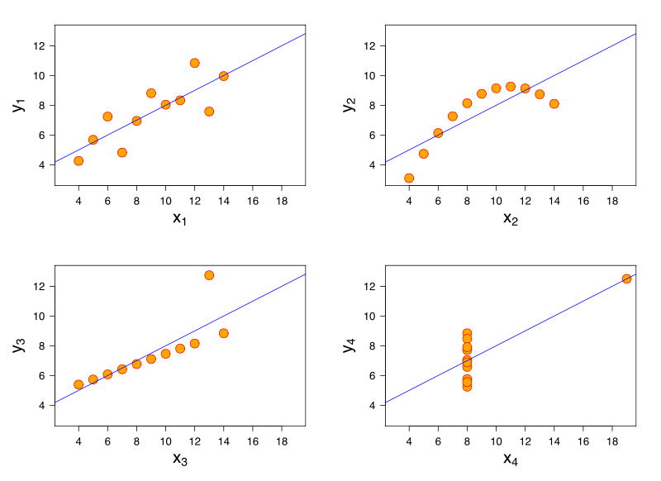
Anscombe's Quartet
What lines "really" best fit each case? – different approaches
Notes:
Standard LR gives same line for each
If Gaussian error is #4 likely?, But in actual data set with human error, etc.?
Some approaches fit bottom two, but which is best? Noise vs exception

Slide 18
Delta rule natural for regression, not classification
Consider the one-dimensional case
The decision surface for the perceptron would be any point that divides the instances
Delta rule will try to fit a line through the target values which minimizes SSE and the decision point is where the line crosses .5 for 0/1 targets. Looking down on data for perceptron view. Now flip it on its side for delta rule view.
Will converge to the one optimal line (and dividing point) for this objective
x
1
z
0
x
Notes:
looking down on data for perceptron view. Now flip it on its side for delta rule view

Slide 19
Delta Rule for Classification?
1
z
0
x
1
z
0
x
What would happen in this adjusted case for perceptron and delta rule and where would the decision point (i.e. .5 crossing) be?

Slide 20
Delta Rule for Classification?
1
z
0
x
1
z
0
x
Leads to misclassifications even though the data is linearly separable
For Delta rule the objective function is to minimize the regression line SSE, not maximize classification

Slide 21
Delta Rule for Classification?
1
z
0
x
1
z
0
x
1
z
0
x
What would happen if we were doing a regression fit with a sigmoid/logistic curve rather than a line?

Slide 22
Delta Rule for Classification?
1
z
0
x
1
z
0
x
1
z
0
x
Sigmoid fits many binary decision cases quite well with a probability. This is what logistic regression does.

Slide 23
Observation: Consider the 2 input perceptron case without a bias weight. Note that the output z is a function of 2 input variables for the 2 input case (x₁, x₂), and thus we really have a 3-d decision surface (i.e. a plane accounting for the two input variables and the 3rd dimension for the output), yet the decision boundary is still a line in the 2-d input space when we represent the outputs with different colors, symbols, etc. The Delta rule would fit a regression plane to these points with the decision line being that line where the plane went through .5. What would logistic regression do?
1
0
Notes:
Logistic Regression will put a 3-d sigmoidal to fit the points with the decision boundary being the line going through the .5 of the sigmoidal – skip?

Slide 24
Logistic Regression
One commonly used algorithm is Logistic Regression
Assumes that the dependent (output) variable is binary which is often the case in medical and other studies. (Does person have disease or not, survive or not, accepted or not, etc.)
Like Quadric, Logistic Regression does a particular non-linear transform on the data after which it just does linear regression on the transformed data
Logistic regression fits the data with a sigmoidal/logistic curve rather than a line and outputs an approximation of the probability of the output given the input
1
z
0
x
Notes:
No longer cover this here since Stat 330 – Intro to regression is now required for ML students

Slide 25
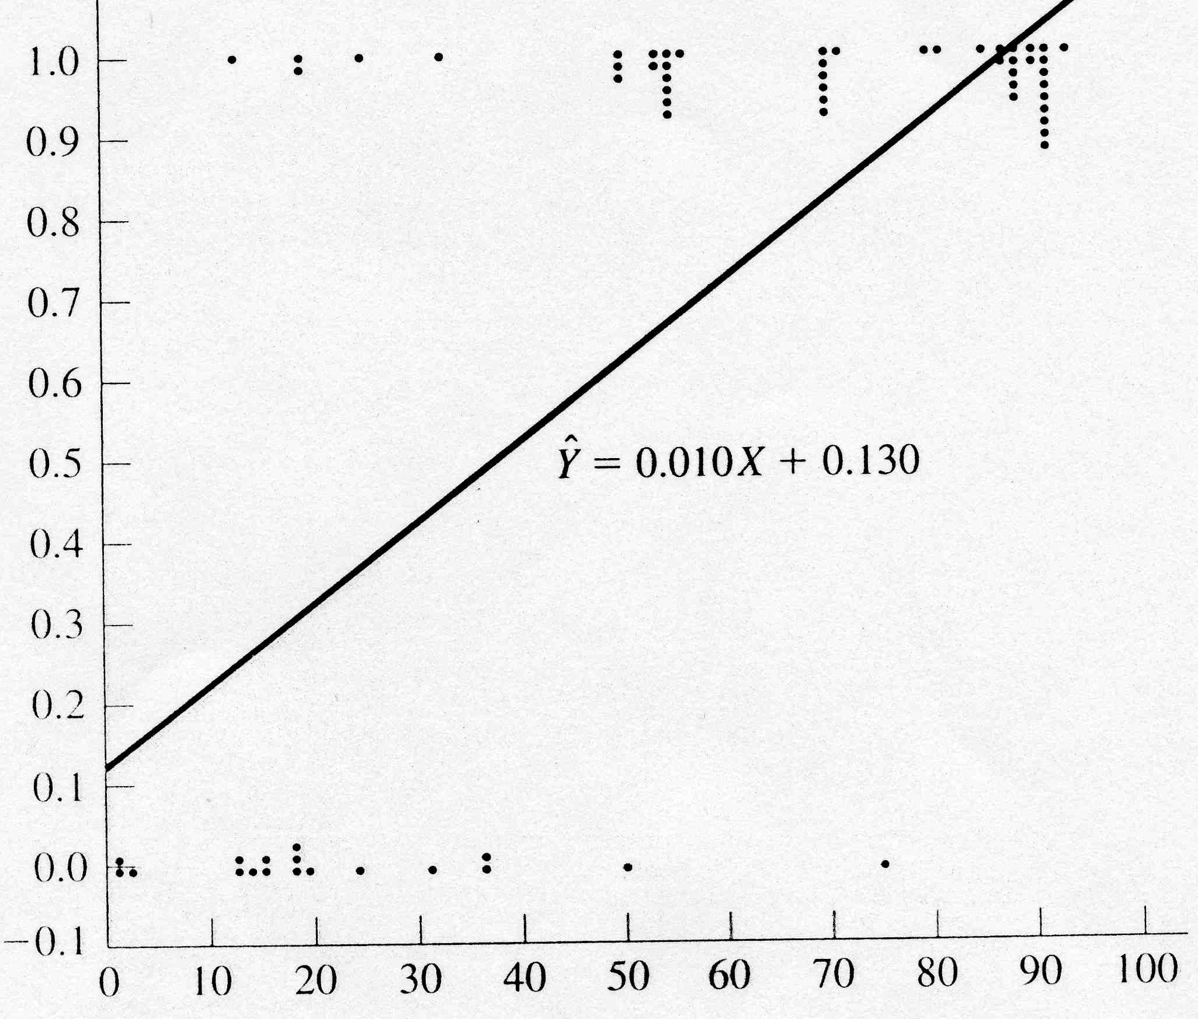
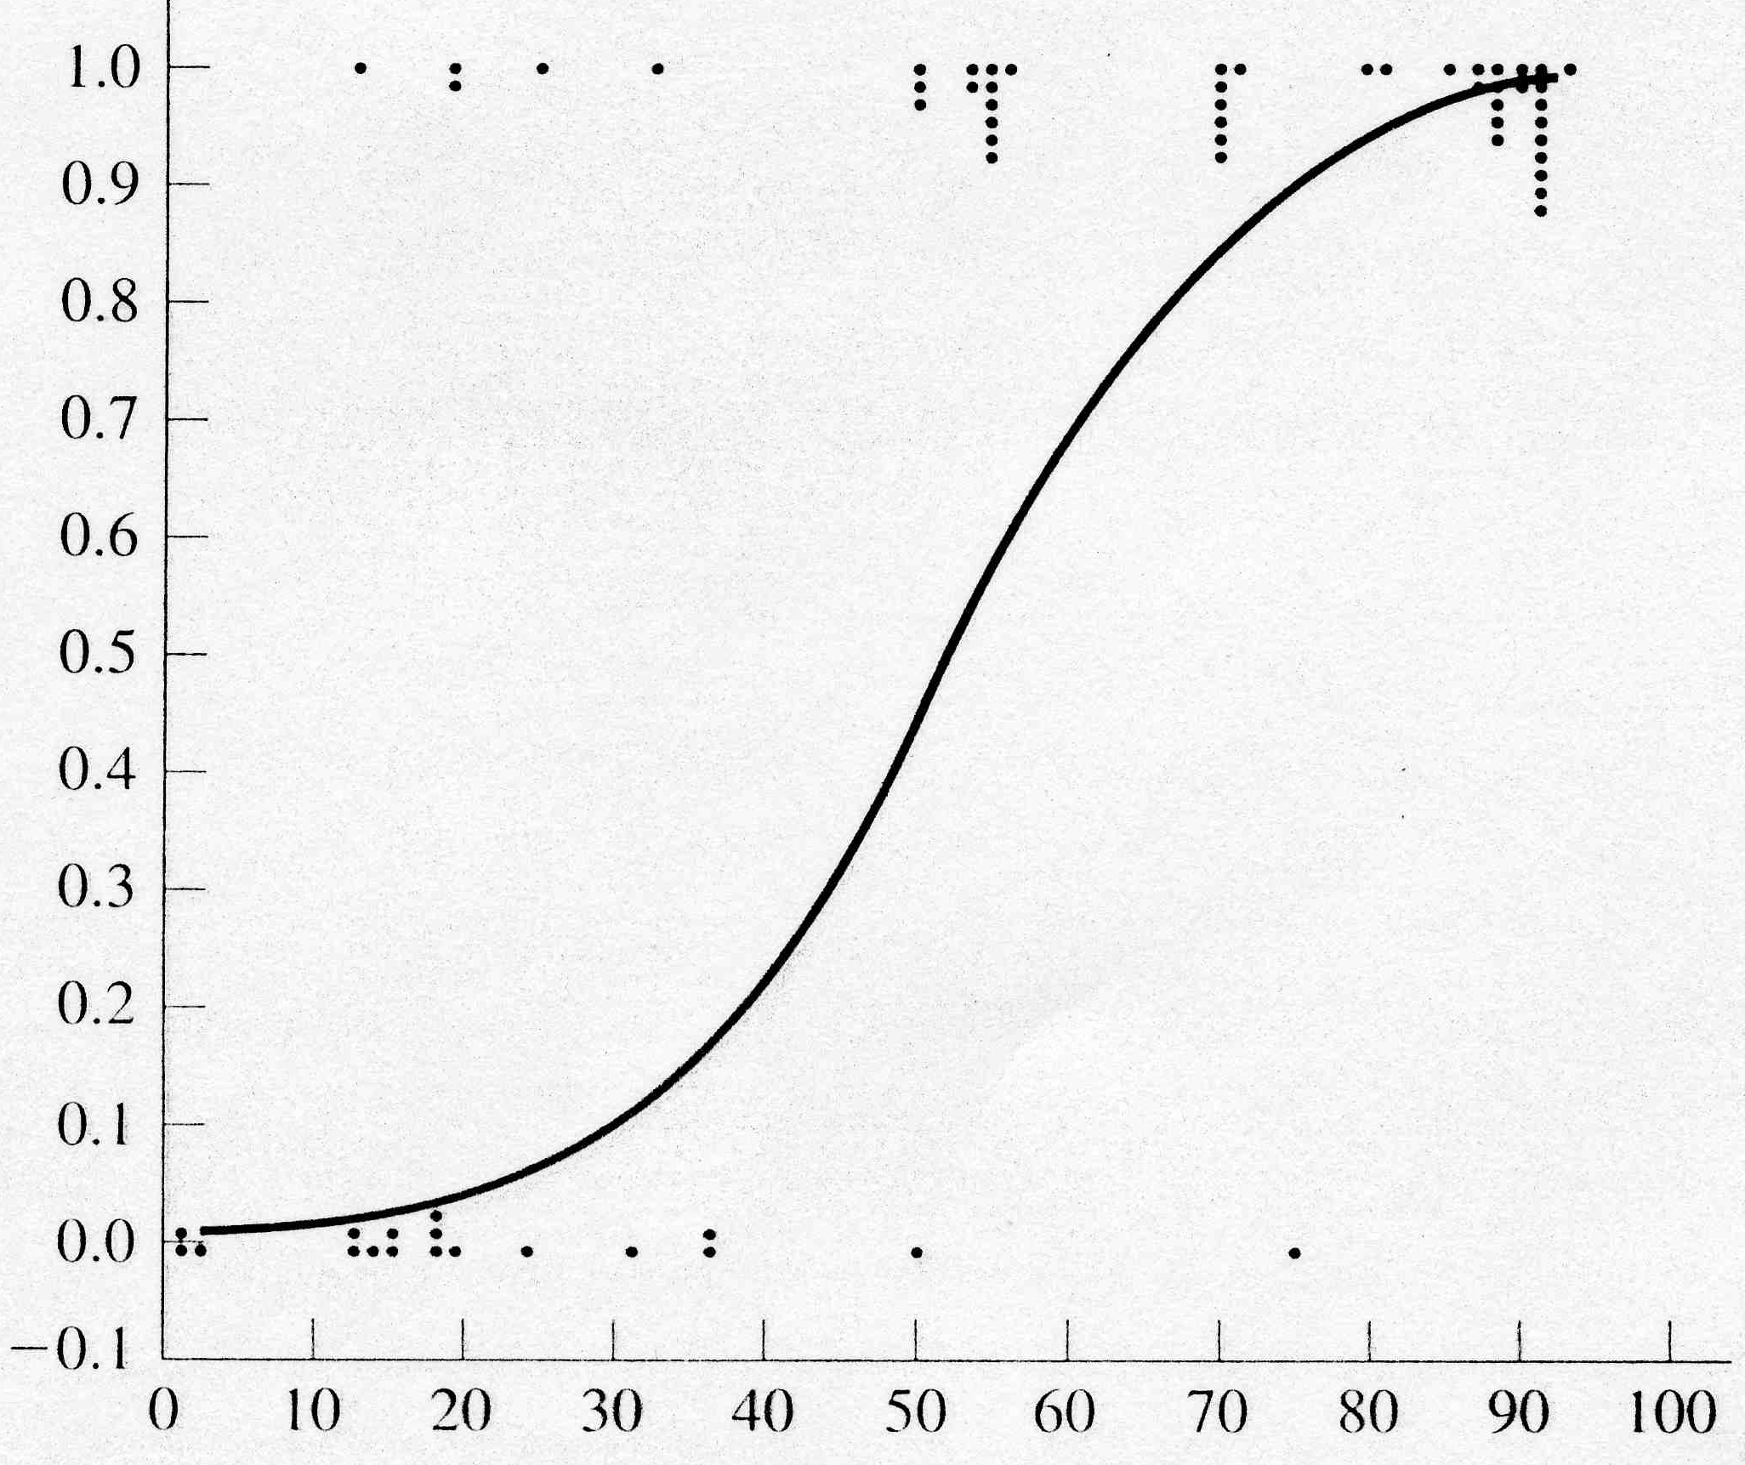
Logistic Regression Example
Age (X axis, input variable) – Data is fictional
Heart Failure (Y axis, 1 or 0, output variable)
If use value of regression line as a probability approximation
  Extrapolates outside 0-1 and not as good empirically
Sigmoidal curve to the right gives empirically good probability approximation and is bounded between 0 and 1

Slide 26
Logistic Regression Approach
Learning
Transform initial input probabilities into log odds (logit)
Do a standard linear regression using the logit values
  This effectively fits a logistic curve to the data, while still just doing a linear regression with the transformed input (ala quadric machine, etc.)
Generalization
Find the value for the new input on the logit line
Transform that logit value back into a probability
Notes:
Do this slide, then just skim through the rest - Covered in Regression class now

Slide 27
Non-Linear Pre-Process to Logit (Log Odds)
Medication Dosage | # Cured | Total Patients | Probability: # Cured/Total Patients
20 | 1 | 5 | .20
30 | 2 | 6 | .33
40 | 4 | 6 | .67
50 | 6 | 7 | .86
Cured
1
prob.
Cured
Not Cured
0
0 10 20 30 40 50 60
0 10 20 30 40 50 60
Notes:
If just 1/0 we would divide at about 35
Go to next slide after probability column and then come back

Slide 28
Non-Linear Pre-Process to Logit (Log Odds)
Medication Dosage | # Cured | Total Patients | Probability: # Cured/Total Patients
20 | 1 | 5 | .20
30 | 2 | 6 | .33
40 | 4 | 6 | .67
50 | 6 | 7 | .86
Cured
1
prob.
Cured
Not Cured
0
0 10 20 30 40 50 60
0 10 20 30 40 50 60
Notes:
If just 1/0 we would divide at about 35
Go to next slide after probability column and then come back

Slide 29
Logistic Regression Approach
Could use linear regression with the probability points, but that would not extrapolate well
Logistic version is better but how do we get it?
Similar to Quadric we do a non-linear pre-process of the input and then do linear regression on the transformed values – do a linear regression on the log odds - Logit
1
1
prob.
Cured
prob.
Cured
0
0
0 10 20 30 40 50 60
0 10 20 30 40 50 60

Slide 30
Non-Linear Pre-Process to Logit (Log Odds)
Medication Dosage | # Cured | Total Patients | Probability: # Cured/Total Patients | Odds: p/(1-p) = # cured/ # not cured | Logit Log Odds: ln(Odds)
20 | 1 | 5 | .20 | .25 | -1.39
30 | 2 | 6 | .33 | .50 | -0.69
40 | 4 | 6 | .67 | 2.0 | 0.69
50 | 6 | 7 | .86 | 6.0 | 1.79
Cured
1
prob.
Cured
Not Cured
0
0 10 20 30 40 50 60
0 10 20 30 40 50 60
Notes:
explain odds with the 40 dosage – ration of wins/losses
mid sigmoid runs through .5 prob = 0 logit = ln(1)
Ln gives us the curve

Slide 31
Regression of Log Odds
Medication Dosage | # Cured | Total Patients | Probability: # Cured/Total Patients | Odds: p/(1-p) = # cured/ # not cured | Log Odds: ln(Odds)
20 | 1 | 5 | .20 | .25 | -1.39
30 | 2 | 6 | .33 | .50 | -0.69
40 | 4 | 6 | .67 | 2.0 | 0.69
50 | 6 | 7 | .86 | 6.0 | 1.79
+2
0
-2
0 10 20 30 40 50 60
1
prob.
Cured
0
y = .11x – 3.8 - Logit regression equation
Now we have a regression line for log odds (logit)
To generalize, we use the log odds value for the new data point
Then we transform that log odds point to a probability: p = e^{logit(x)}/(1+e^{logit(x)})
For example assume we want p for dosage = 10
Logit(10) = .11(10) – 3.8 = -2.7
p(10) = e^{-2.7}/(1+e^{-2.7}) = .06 [note that we just work backwards from logit to p]
These p values make up the sigmoidal regression curve (which we never have to actually plot)
Notes:
yellow point is a generalization example

Slide 32
Logistic Regression Homework
No longer a required homework
You don’t actually have to come up with the weights for this one, though you could do so quickly by using the closed form linear regression approach
Sketch each step you would need to learn the weights for the following data set using logistic regression
Sketch how you would generalize the probability of a heart attack given a new input heart rate of 60
Heart Rate | Heart Attack
50 | Y
50 | N
50 | N
50 | N
70 | N
70 | Y
90 | Y
90 | Y
90 | N
90 | Y
90 | Y

Slide 33
Non-Linear Regression
Note that linear regression is to regression what the perceptron is to classification
  Simple, useful models which will often underfit
The more powerful classification models which we will be discussing going forward in class can usually also be used for non-linear regression
  MLP with Backpropagation, Decision Trees, Nearest Neighbor, etc.
They can learn functions with arbitrarily complex high dimensional shapes

Slide 34
Summary
Linear Regression and Logistic Regression are nice tools for many simple situations
  But both force us to fit the data with one shape (line or sigmoid) which will often underfit
Intelligible results
When problem includes more arbitrary non-linearity then we need more powerful models which we will introduce
  Yet non-linear data transformations (e.g. Quadric perceptron) can help in these cases while still using a linear model for learning
These models are commonly used in data mining applications and also as a "first attempt" at understanding data trends, indicators, etc.

