Slide 1
English Department
Hygiene and Safety Committee

Slide 2
Common Colds
What are the first signs of a cold?
Sore throat and runny nose are usually the first signs of a cold,
followed by coughing and sneezing.
Most people recover in about 7-10 days.

Slide 3
Common Colds
You can help reduce your risk of getting a cold:
1. wash your hands often,
2. avoid close contact with sick people,
3. and don’t touch your face with unwashed hands.

Slide 4
Common Colds
Common Colds are the main reason that :
1. children miss school
2. and adults miss work
Each year in the United States, there are millions of cases of the common cold.
Adults have an average of 2-3 colds per year, and children have even more.

Slide 5
Common Colds
Most people get colds in the winter and spring, but it is possible to get a cold any time of the year.
Symptoms usually include:
sore throat ( painful, often red)
runny nose (producing a lot of liquid)
coughing
sneezing
headaches
body aches

Slide 6
Common Colds
Most people recover within about 7-10 days.
However, people with:
weakened immune systems,
asthma,
or respiratory conditions
may develop serious illness, such as:
bronchitis (التهاب القصبات)
or pneumonia ((ذات الرئة

Slide 7
Common Colds
How to protect yourself:
Viruses that cause colds can spread from infected people to others through the air and close personal contact.
You can also get infected through contact with stool (poop) or respiratory secretions from an infected person.
This can happen when you shake hands with someone who has a cold, or touch a surface, like a doorknob, that has respiratory viruses on it, then touch your eyes, mouth, or nose.

Slide 8
Common Colds
You can help reduce your risk of getting a cold:
Wash your hands often with soap and water.
Wash them for 20 seconds, and help young children do the same. If soap and water are not available, use an alcohol-based hand sanitizer.
Viruses that cause colds can live on your hands, and regular hand washing can help protect you from getting sick.

Slide 9
Common Colds
2. Avoid touching your eyes, nose, and mouth with unwashed hands:
Viruses that cause colds can enter your body this way and make you sick.
3. Stay away from people who are sick.
Sick people can spread viruses that cause the common cold through close contact with others.

Slide 10
Common Colds
How to Protect Others:
If you have a cold, you should follow these tips to help prevent spreading it to other people:
Stay at home while you are sick and keep children out of school or daycare while they are sick.
Avoid close contact with others, such as hugging, kissing, or shaking hands.
Move away from people before coughing or sneezing.
Cough and sneeze into a tissue then throw it away, or cough and sneeze into your upper shirt sleeve, completely covering your mouth and nose.

Slide 11
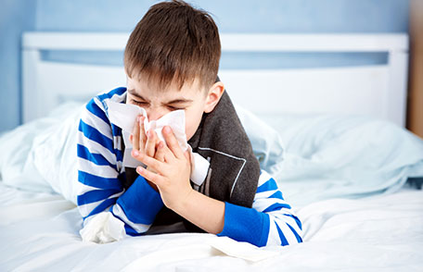

Slide 12
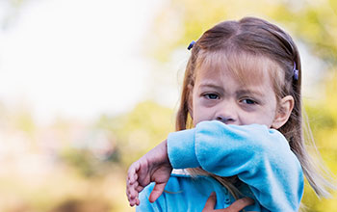

Slide 13
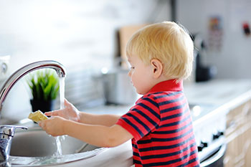
Common Colds
Wash your hands after coughing, sneezing, or blowing your nose.
Disinfect frequently touched surfaces and objects, such as toys and doorknobs.

Slide 14
Common Colds
There is no vaccine to protect you against the common cold.
How to Feel Better:
There is no cure for a cold.
you should get lots of rest
drink plenty of fluids
Over-the-counter medicines may help ease symptoms but will not make your cold go away any faster

Slide 15
Common Colds
Know the Difference between Common Cold and Flu
The flu, which is caused by influenza viruses, also spreads and causes illness around the same time as the common cold.
Because these two illnesses have similar symptoms, it can be difficult (or even impossible) to tell the difference between them based on symptoms alone.

Slide 16
Common Colds
In general, flu symptoms are worse than the common cold and can include fever or feeling feverish/chills, cough, sore throat, runny or stuffy nose, muscle or body aches, headaches and fatigue (tiredness)
Flu can also have very serious complications.
CDC (Centers for Disease Control ) recommend a yearly flu vaccination as the first and best way to prevent the flu. If you get the flu, antiviral drugs may be a treatment option.

