Slide 1
Lecture 3
Water Potential

Slide 2
Water Potential
Water potential is a measure of the energy state of water. This is important concept because it determines the direction and movement of water.
Water potential (Ψw) - chemical potential of water, compared to pure water at the same temperature and pressure. The units are in pressure because:
(a) plant cells are under pressure (remember the wall); and
(b) it is easier to measure pressure.
Pressure is measured in MPa (megapascals).
1 MPa = 10 bars = 10 atm.
1 atm = 760 mm Hg = 14.7 lbs. sq. in⁻¹).
Lb(s): pound= 454 g: Lb is an abbreviation of the Latin word Libra.

Slide 3
Equation for water potential:
Water potential is the sum of the contributions of the various factors that influence water potential
Ψw = Ψp + Ψs + Ψg + Ψm
where Ψw = water potential; Ψp = pressure potential; Ψs = solute or osmotic potential; and Ψg = gravity potential and Ψm matric potential.

Slide 4
Solute (or osmotic) potential (Ψs)
This is the contribution due to dissolved solutes. Solutes always decrease the free energy of water, thus their contribution is always negative. The solute potential of a solution can be calculated with the Van’t Hoff equation:
Ψs = - miRT
where m = molality (moles/1000 g); i = ionization constant (often 1.0); R = gas constant (0.0083 liter x MPa/mol deg); and T = temperature (K).
Deg= degree, K= Kelvin (0 K = −273.15 °C).
Solute potential is also called the osmotic potential because solutes affect the direction of osmosis.
Ψs of any solution at atmospheric pressure is always negative – why? Answer = less free water molecules to do work.

Slide 5
2. Pressure or Pressure Potential (Ψp)
Due to the pressure build up in cells thanks to the wall. It is usually positive, although may be negative (tension) as in the xylem. Pressure can be measured with an osmometer.
3. Matric potential (Ψm)
This is the contribution to water potential due to the force of attraction of water for colloidal, charged surfaces. It is negative because it reduces the ability of water to move. In large volumes of water it is very small and usually ignored. However, it can be very important in the soil, especially when referring to the root/soil interface.
Matric potential is limited in cells, and because the height of the cell in the lab is negligible.

Slide 6
4. Gravity potential (Ψg)
Gravity causes water to move downward unless the force of gravity is opposed by an equal and opposite force. The term Ψg depends on the height (h) of the water above the reference-state water, the density of water (rw), and the acceleration due to gravity (g). In symbols, we write the following:
Ψg = rwgh
where rwg has a value of 0.01 MPa m^{–1}. Thus a vertical distance of 10 m translates into a 0.1 MPa change in water potential. When dealing with water transport at the cell level, the gravitational component (Ψg) is generally omitted because it is negligible compared to the osmotic potential and the hydrostatic pressure.

Slide 7
The water potential expression simplifies to:
Ψw = Ψs + Ψp Ψ = psi
Pure water in an open container has a water potential of zero at one atmosphere of pressure.

Slide 8
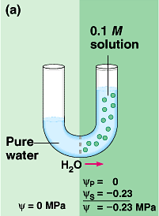
Water Potential
(a) addition of solutes on right side reduces water potential.
Ψ_{S} = -0.23
from hi Ψ on left to lo Ψ on right

Slide 9
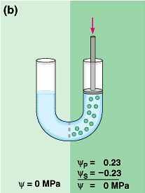
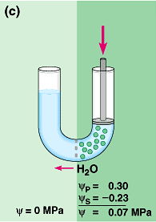
Water Potential
(b) adding +0.23 pressure with plunger → no net flow of water
(c) applying +0.30 pressure increases water potential solution now has Ψ of +0.07
Water moves right to left

Slide 10
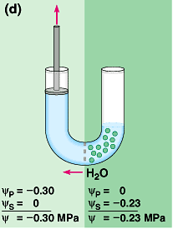
Water Potential
(d) negative pressure or tension using plunger decreases water potential on the left.
Water moves from right to left

Slide 11
Permeability: Permeability is a property of membrane. The extent to which a membrane permits or restricts the entry or movement of a substance is called membrane permeability. It depends upon the composition, size and chemical nature of solute. It can be measured by determining the rate at which solute passes through a membrane under specific condition. The membrane may be permeable, semi-permeable and impermeable.

Slide 12
Turgidity and plasmolysis:
A cell in a hypotonic solution, i.e. one with a lower solute concentration and therefore a more positive osmotic potential than the cell cytoplasm will take up water, generating a hydrostatic pressure (turgor pressure) in the cell. In such a cell, the cell contents exert a pressure on the cell wall and the cell is turgid. A cell in a hypertonic solution (i.e. one with a higher solute concentration, and therefore a more negative osmotic potential than the cell cytoplasm) will tend to lose water, until the hydrostatic potential becomes negative.

Slide 13
At this point, the plasma membrane will pull away from the cell wall and the cell will be plasmolysed (flaccid). The point of incipient plasmolysis occurs when the plasma membrane is in contact with the cell wall, but no hydrostatic (turgor) pressure is generated.

Slide 14
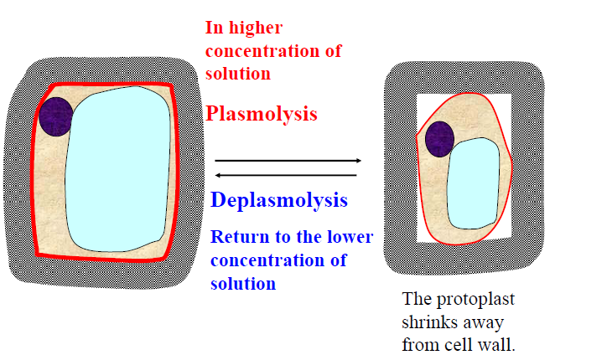
Plasmolysis & Deplasmolysis

Slide 15
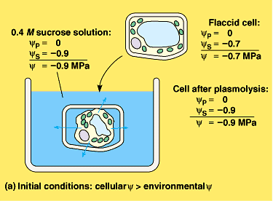
Plasmolysis cell shrinking
(a) Flaccid cell placed in hypertonic solution →Water potential is out of cell → plasmolysis

Slide 16
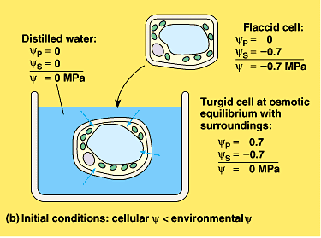
Turgor Pressure cell swelling
(b) Flaccid cell in pure water → Water potential is into cell→ cell becomes turgid

Slide 17
Short-Distance Transport
Involves simple diffusion, osmosis and active transport.
Routes
Cell-to-Cell Across Cell Membranes
Symplast (involves cytoplasm and plasmodesmata)
Apoplast (transport through porous cell walls)

Slide 18
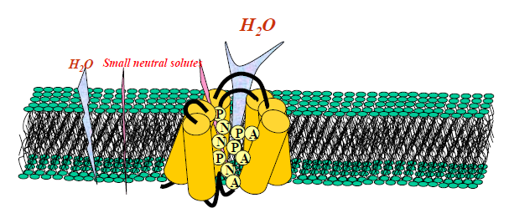
Aquaporins
Are series proteins which located in plasma membrane or tonoplast play important role in water transport because they have less resistance to water and speed up water transport across membrane. Aquaporins facilitate the diffusion of water and small neutral solutes across plant cell membranes.

