Slide 1
Globalization THE RISE AND ORIGIN OF GLOBALIZATION
3rd year: lecture 1

Slide 2
THE RISE AND ORIGIN OF GLOBALIZATION
Globalization is a combination of economic, technological, sociocultural and political forces and it refers in general to the worldwide integration of humanity.
Globalization has a long history; it appeared when the European big economic powers occupied Asia, Africa, and America. Globalization was developed in the twentieth century but it became recognized as a research phenomenon about three decades ago.

Slide 3
What is globalization
Globalization is not a single concept that can be defined and included within a set time frame, nor is it a process that can be defined clearly with a beginning and an end. Furthermore, it cannot be expounded upon with certainty and be applicable to all people and in all situations. Globalization involves:
Economic integration;
The transfer of policies across borders;
The transmission of knowledge;
Cultural stability;
The reproduction, relations, and discourses of power;
It is a global process, a concept, a revolution, and “an establishment of the global market free from sociopolitical control.

Slide 4
Hidden Agendas of Globalization
Globalization encompasses all of these things. It is a concept that has been defined variously over the years, with some connotations referring to progress, development and stability, integration and cooperation, and others referring to colonialism, and destabilization.
Despite these challenges, this term brings with it a multitude of hidden agendas.
An individual’s political ideology,
Geographic location,
Social status,
Cultural background,
Ethnic and religious affiliation provide the background that determines how globalization is interpreted.

Slide 5
DIFFERENT VIEWS ON GLOBALIZATION
Globalization is colonization. (losers)
Globalization is the process of world shrinkage, of distances getting shorter, things moving closer. Connecting people with each other. (winners)

Slide 6
RESULTS OF GLOBALIZATION
Increased international trade
A company operating in more than one country
Greater dependence on the global economy
Freer movement of capital, goods, and services
Recognition of companies such as McDonalds in LEDCs

Slide 7
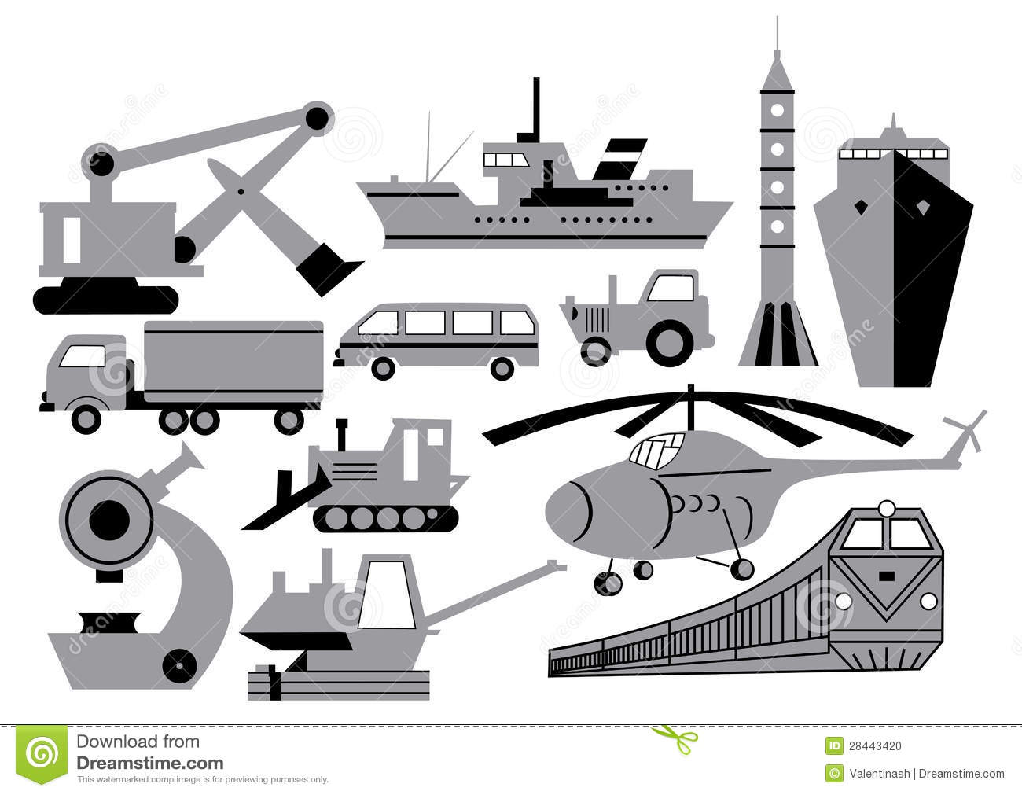
Reasons for globalization
Improvements in transportation
Freedom of trade
Improvements of communications
Labour availability and skills

Slide 8
Approaches to conceptualizing globalization
Materialist: globalization is a substantive process of increasing worldwide connectivity
Constructivist: Globalization is conceived in ideational terms as a principally discursive phenomenon which has no objective or permanent meaning, but rather is ‘what we (or they) make of it’
Ideological: Globalization is conceived as a political and economic project and ideology advanced by the most powerful (states and elites) to fashion the world order according to their interests.

Slide 9
Definitions of Globalization
Fredric Jameson: GLOBALIZATOION IS A cultural process
the explosion of a plurality of mutually intersecting,
individually syncretic,
local differences; the emergence of new, hitherto suppressed identities;
the expansion of a world-wide media and technology
popular democratization.
As economic process…the assimilation or integration of markets, of labor, of nations.”

Slide 10
Definitions of Globalization
Globalization refers to the
growing economic interdependence of countries worldwide through the increasing volume and variety of cross-border transactions in goods and services and of international capital flows, and also through the more rapid and widespread diffusion of technology

Slide 11
Definitions of Globalization
George Modelski, “…globalization is a process along four dimensions:
1. economic globalization, (McDonald, covid 19 vaccine)
2. formation of world opinion, (human right/climate change)
3. democratization, (political participation/Arab Spring )
4. political globalization (COP27)

Slide 12
TO SUM UP
Globalization is the process by which the world is becoming increasingly interconnected as a result of massively increased trade and cultural exchange.
Globalization has increased the production of goods and services.
Globalization has been taking place for hundreds of years, but has sped over the last half-century. (NEXT LECTURE)

