Slide 1
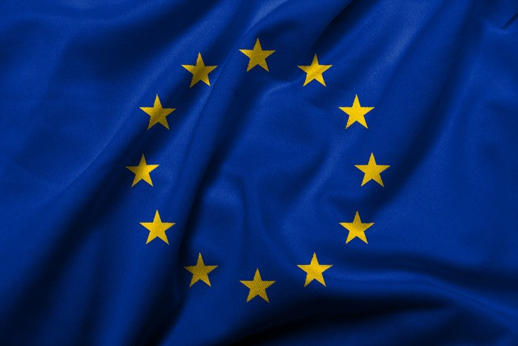
Foreign policy of European Union
Third stage
Mohammed Ahmed
Mohammed.majeed1@su.edu.krd

Slide 2
Fundamental Principles of the European Union
Some principles introduced by the Maastricht Treaty
The Union shall respect the national identities of its Member States, whose systems of government are founded on the principles of democracy.
The Union shall respect fundamental rights, as guaranteed by the European Convention for the Protection of Human Rights and Fundamental Freedoms signed in Rome on 4 November 1950.

Slide 3
Principles listed in 1997 by the Amsterdam Treaty
The Union is founded on the principles of liberty, democracy, respect for human rights and fundamental freedoms, and the rule of law, principles which are common to the Member States.

Slide 4
Principles transformed into values by the Lisbon Treaty
The Union is founded on the values of respect for human dignity, freedom, democracy, equality, the rule of law and respect for human rights, including the rights of persons belonging to minorities.
These values are common to the Member States in a society in which pluralism, non-discrimination, tolerance, justice, solidarity and equality between women and men prevail.

Slide 5
Aims of the European Union
The aims of the European Union within its borders are:
promote peace, its values and the well-being of its citizens.
offer freedom, security and justice without internal borders, while also taking appropriate measures at its external borders to regulate asylum and immigration and prevent and combat crime.
establish an internal market.
achieve sustainable development based on balanced economic growth and price stability and a highly competitive market economy with full employment and social progress.
protect and improve the quality of the environment.
promote scientific and technological progress.
combat social exclusion and discrimination.
promote social justice and protection, equality between women and men, and protection of the rights of the child.
enhance economic, social and territorial cohesion and solidarity among EU countries.
respect its rich cultural and linguistic diversity.
establish an economic and monetary union whose currency is the euro.

Slide 6
The aims of the EU within the wider world are:
uphold and promote its values and interests
contribute to peace and security and the sustainable development of the Earth
contribute to solidarity and mutual respect among peoples, free and fair trade, eradication of poverty and the protection of human rights
strict observance of international law

Slide 7
Values of European Union
The European Union is founded on the following values:
1) Human dignity
Human dignity is inviolable. It must be respected, protected and constitutes the real basis of fundamental rights.
2) Freedom
Freedom of movement gives citizens the right to move and reside freely within the Union. Individual freedoms such as respect for private life, freedom of thought, religion, assembly, expression and information are protected by the EU Charter of Fundamental Rights.

Slide 8
3)Democracy
The functioning of the EU is founded on representative democracy. A European citizen automatically enjoys political rights. Every adult EU citizen has the right to stand as a candidate and to vote in elections to the European Parliament. EU citizens have the right to stand as a candidate and to vote in their country of residence, or in their country of origin.
4)Equality
Equality is about equal rights for all citizens before the law. The principle of equality between women and men underpins all European policies and is the basis for European integration. It applies in all areas. The principle of equal pay for equal work became part of the Treaty of Rome in 1957.

Slide 9
5) Rule of law
The EU is based on the rule of law. Everything the EU does is founded on treaties, voluntarily and democratically agreed by its EU countries. Law and justice are upheld by an independent judiciary. The EU countries gave final jurisdiction to the European Court of Justice - its judgments have to be respected by all.
6) Human rights
Human rights are protected by the EU Charter of Fundamental Rights. These cover the right to be free from discrimination on the basis of sex, racial or ethnic origin, religion or belief, disability, age or sexual orientation, the right to the protection of your personal data, and the right to get access to justice.

Slide 10
The main criteria for a country to join the European Union
The main criteria for a country to join the European Union
There are some criteria that countries have to take into account when they want to join the European Union. Especially, in 1992, the European Union set three criteria for any country to join the EU:
Establishing a democratic system and the rule of law.
Functioning market economy and belief in the free market.
Having ability to implement EU laws (and accepting and promoting EU values).

Slide 11
Thank you

