Slide 1
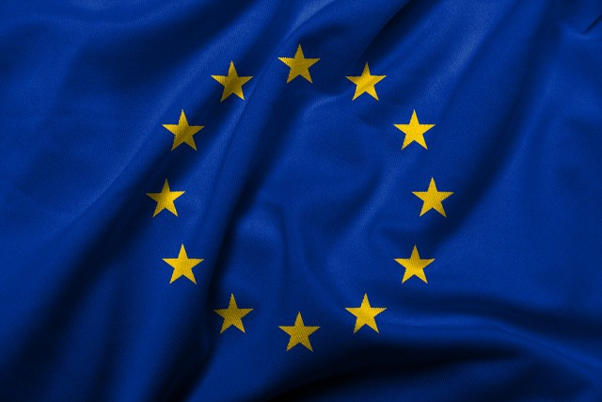
Foreign policy of European Union
Third stage
Mohammed Ahmed
Mohammed.majeed1@su.edu.krd

Slide 2
The main institutions of the European Union
The European Union has different political and economic institutions and bodies such as:
European Parliament
European Council
Council of the European Union
European Commission
Court of Justice of the European Union (CJEU)
European Central Bank (ECB)
European Court of Auditors (ECA)
European External Action Service (EEAS)
European Economic and Social Committee (EESC)
European Committee of the Regions (CoR)
European Investment Bank (EIB)
European Data Protection Supervisor (EDPS)
European Data Protection Board (EDPB)

Slide 3
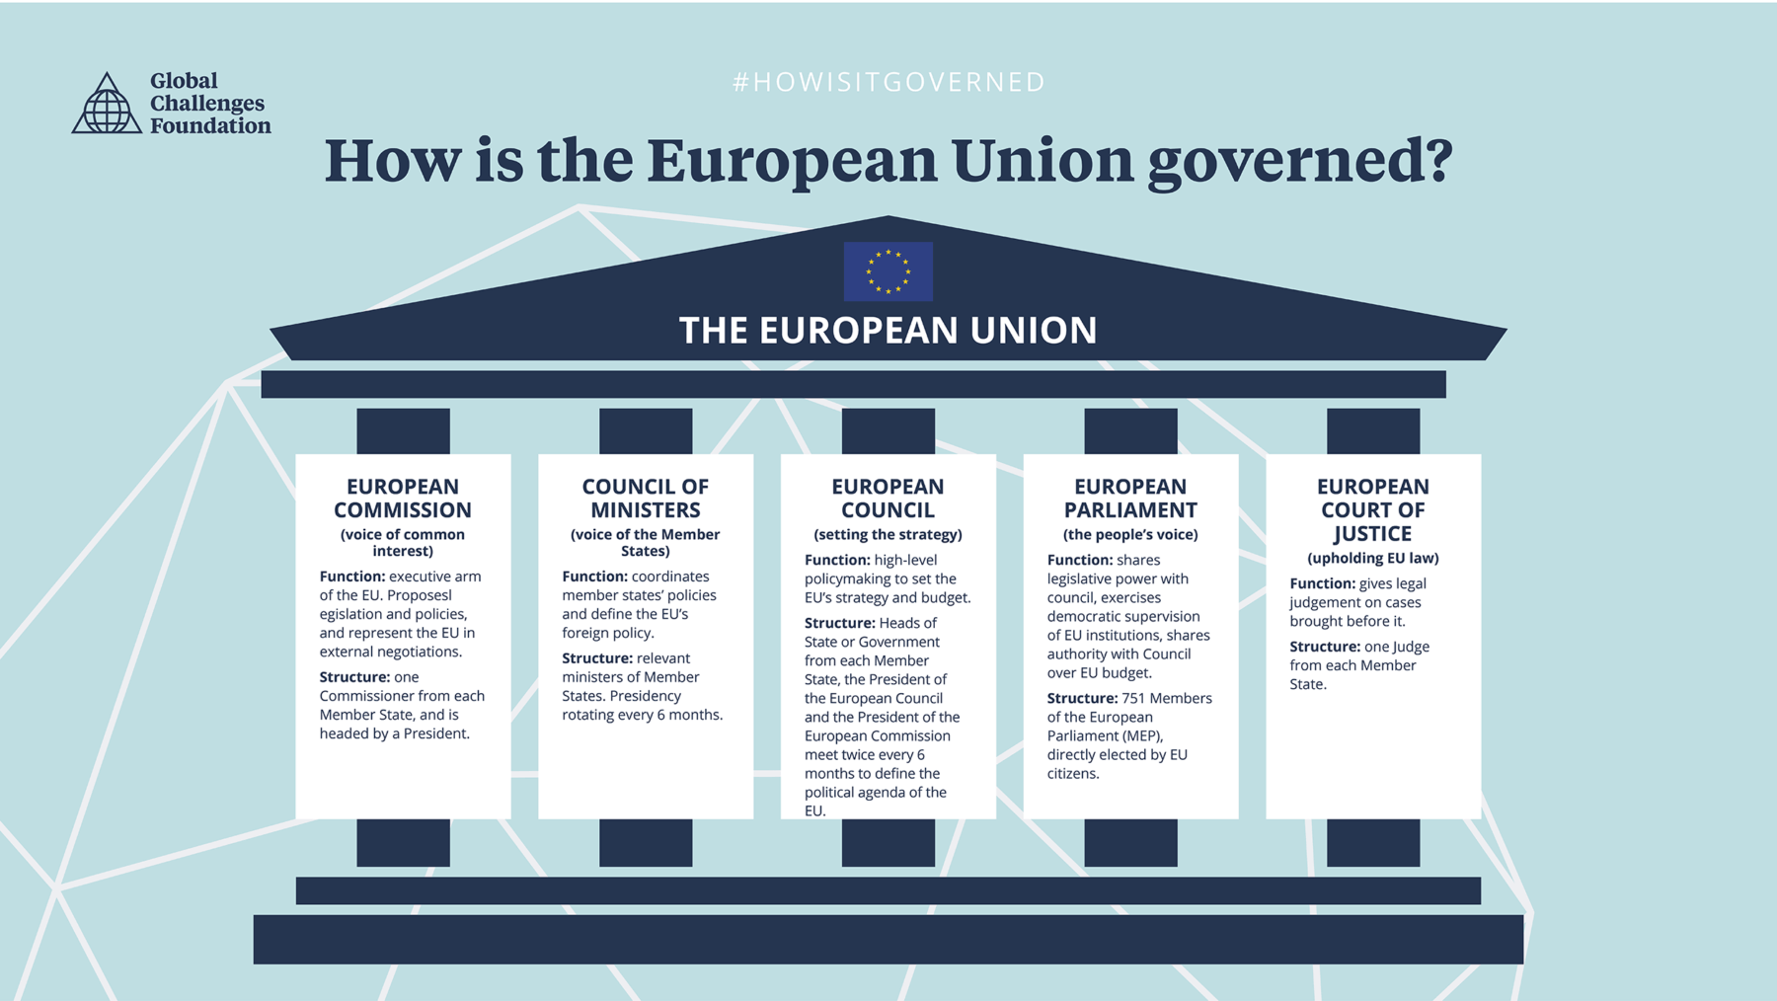
There are several official EU institutions, which can be roughly grouped by their executive, legislative, judicial, and financial functions.

Slide 4
European Parliament
The European Parliament is an important forum for political debate and decision-making at the EU level. The Members of the European Parliament are directly elected by voters in all Member States to represent people’s interests with regard to EU law-making and to make sure other EU institutions are working democratically. Unlike traditional legislatures, it can’t propose legislation, but laws can’t pass without its approval. It also negotiates and approves the EU budget and oversees the commission.

Slide 5
European Council
In 1974 The European Council was created as an informal forum for discussion between heads of state or government of the EU member states.
Therefore the EU council represents the highest level of political cooperation between Member States. At their meetings, the leaders decide by consensus on the overall direction and priorities of the Union. The European Council does not adopt legislation. It is the highest level of policymaking body in the European Union, which is why its meetings are often called ‘summits’.

Slide 6
The EU Council has various duties such as:
Decides on the EU's overall direction and political priorities – but does not pass laws
Deals with complex or sensitive issues that cannot be resolved at lower levels of intergovernmental cooperation
Sets the EU's common foreign & security policy, taking into account EU strategic interests and defense implications
Nominates and appoints candidates to certain high profile EU level roles, such as the ECB and the Commission
On each issue, the European Council can: ask the European Commission to make a proposal to address it, and pass it on to the Council of the EU to deal with

Slide 7
The European Commission
The Commission is composed of the College of Commissioners from 27 EU countries. Together, the 27 Members of the College are the Commission's political leadership during a 5-year term. They are assigned responsibility for specific policy areas by the President.
The European Commission, the EU’s primary executive body, wields the most day-to-day authority. It proposes laws, manages the budget, implements decisions, issues regulations, and represents the EU around the world at summits. The members of the commission are appointed by the European Council and approved by the European Parliament

Slide 8
In general, The European Commission has four main roles:
1-Proposes legislation to the Parliament and the Council
2-Manages and implement EU policies and the budget
3-Enforces European law (Jointly with the Court of Justice)
4-Represents the Union around the world (Represents the EU internationally).

Slide 9
Council of the European Union
The Council of the European Union, also known as the Council of Ministers to avoid confusion, is a second legislative branch whose approval is also needed for legislation to pass. This council consists of the government ministers from all EU members, organized by policy area. For instance, all EU members’ foreign ministers meet together in one group.
Duties of the Council of the European Union:
Negotiates and adopts EU laws
Coordinates member states' policies
Develops the EU's common foreign and security policy
Concludes international agreements
Adopts the EU budget

Slide 10
Court of Justice of the European Union (CJEU)
The Court of Justice of the European Union (CJEU) is the EU’s highest judicial authority, interpreting EU law and settling disputes. The CJEU consists of the European Court of Justice, which clarifies EU law for national courts and rules on alleged member state violations, and the General Court, which hears a broad range of cases brought by individuals and organizations against EU institutions.

Slide 11
European External Action Service (EEAS)
The European External Action Service (EEAS) is the EU's diplomatic service. It aims to make EU foreign policy more coherent and effective, thus increasing Europe's global influence.
The EEAS has various jobs such as:
Supports the EU High Representative in conducting EU foreign and security policy
Manages diplomatic relations & strategic partnerships with non-EU countries
Works with the national diplomatic services of EU countries, the UN and other leading powers

Slide 12
But in practical examples its duties include:
Peace building – through political, economic and practical support.
Ensuring security – under the Common Security & Defense Policy.
Maintaining good relations with the EU's immediate neighbors through the European Neighborhood Policy.
Development and humanitarian aid and crisis response.
Tackling climate change and human rights issues.

Slide 13
How do the institutions relate to each other?
These EU institutions form a complex web of powers and mutual oversight. At base they draw their democratic legitimacy from elections in two ways: First, the European Council, which sets the bloc’s overall political direction, is composed of democratically elected national leaders. Second, the European Parliament is composed of representatives—known as members of the European Parliament, or MEPs—who are directly elected by the citizens of each EU member state. The European Council and Parliament together determine the composition of the European Commission—the council nominates its members and Parliament must approve them. The commission has the sole authority to propose EU laws and spending, but all EU legislation requires the approval of both Parliament and the Council of Ministers.

Slide 14
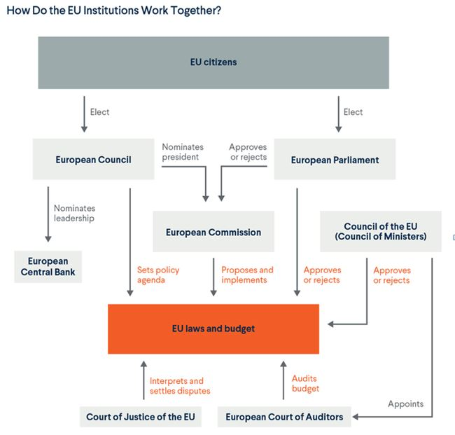

Slide 15
Thank you

