Slide 1
Foreign policy of Russia Explaining Variability in Foreign Policy Behavior
Fourth stage
Mohammed Ahmed
Mohammed.majeed1@su.edu.krd

Slide 2
we can identify five broad underlying factors that collectively explain much of the change and variability in Russian foreign policy.
1. The change in the structure of the international system;
2. The decline in Russian military capability
3. Russia’s transformation from a command economy to a market economy;
4. Russia’s integration into the global economy
5. Russia’s political leadership and domestic politics

Slide 3
International System
What impact does the structure of the international system have upon foreign policy and international politics?

Slide 4
With the collapse of the Warsaw Pact and the disintegration of the Soviet Union, the international system was no longer bipolar. Though the United States became the most powerful state in the world, with unrivaled military strength and a defense budget larger than that of all of its potential competitors combined, it did not dominate world politics in a way that would create a “unipolar” world.
The cold war has ended. The bipolar system has disappeared. Positive trends toward the formation of a multipolar world are developing

Slide 5
Russian military capability
Post-soviet Russia is another story. Following the collapse of the Warsaw Pact in 1991, Soviet and then Russian military capability steadily declined.
If there were any doubt about the military collapse, the performance of Russian forces in secessionist Chechnya in 1994–1996 removed it.
The Georgian war and the weak perfomance of the Russian army.
After the war, From 2009 until 2014, Russia’s defense budgets rose steadily, with investments going not toward greater troop strength but to increased training and professionalism, improved combat readiness, and updating of equipment.

Slide 6
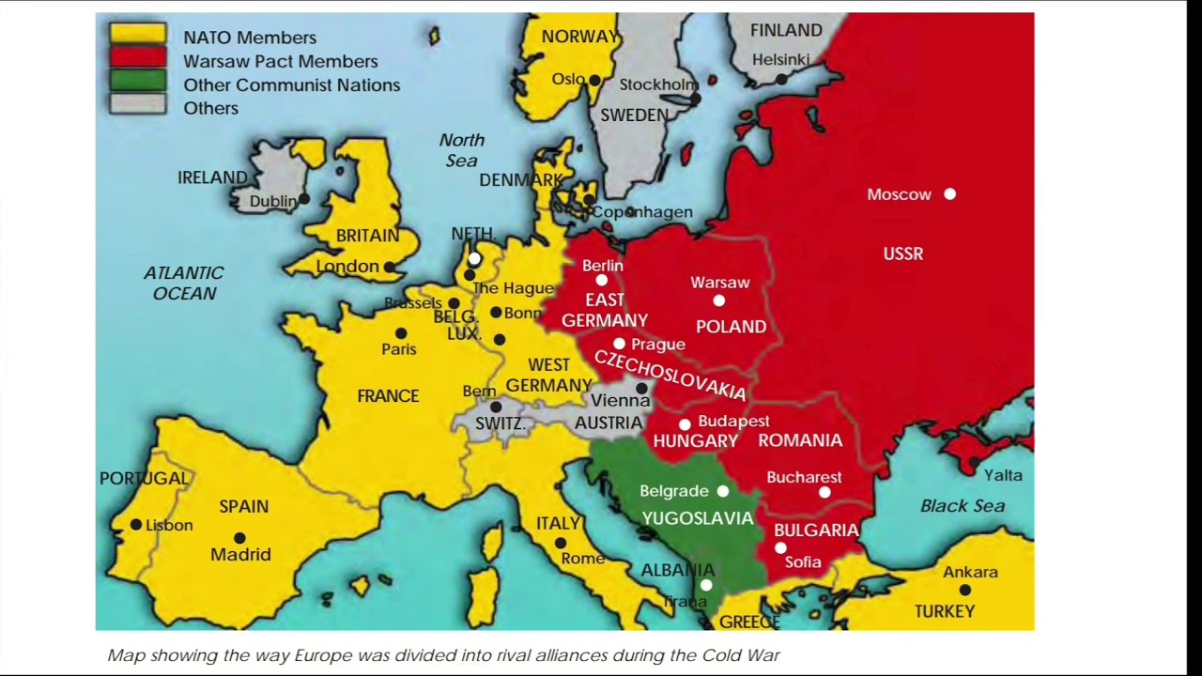

Slide 7
Transition from a command economy to a market economy
Although that transformation has been mired in controversy in both Russia and the West, there is a general consensus that the old system has now been replaced by the new.
Russia’s economic declined during 1991-2000.
Russia’s economy began to grow in the early years of the new century and foreign investment.
The Ukraine crisis and Russia’s economic 2014.

Slide 9
The growing linkage of Russia’s economy to the global economy
Post-soviet Russia has gone a long way toward joining the global economy.
In 2015 Russia ranked thirteenth among the world’s nations in the volume of its exports.
Russia has joined international institutions such as the International Monetary Fund (IMF) and the World Bank as a means for promoting macroeconomic stabilization.

Slide 10
The role of political leadership
The study of leadership, personality, and politics has been a preoccupation of social scientists.
Boris Yeltsin: “place at the table”
Boris Yeltsin’s primary aim in foreign policy was to create a non-threatening external environment that would be most beneficial to his country’s internal economic and political development.
Vladimir Putin: “restore Russia’s standing as a great power”
Putin pursued an authoritarian course in domestic politics. This was reflected in his centralization of power, the suppression of Chechnya’s insurgency, his control of parliament and the suppression of human rights activists.
Dmitry Medvedev
He was widely viewed as tilting on the more liberal side, though he was not only a protégé of Putin but subject to the influence of the most popular leader of the nation.

Slide 11
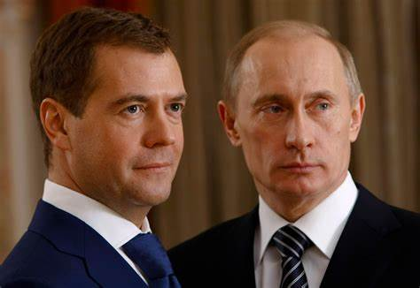

Slide 12
Thanks

