Slide 1
Stages of Russian foreign policy
Foreign policy of Russia
Fourth stage
Mohammed Ahmed
Mohammed.majeed1@su.edu.krd

Slide 2
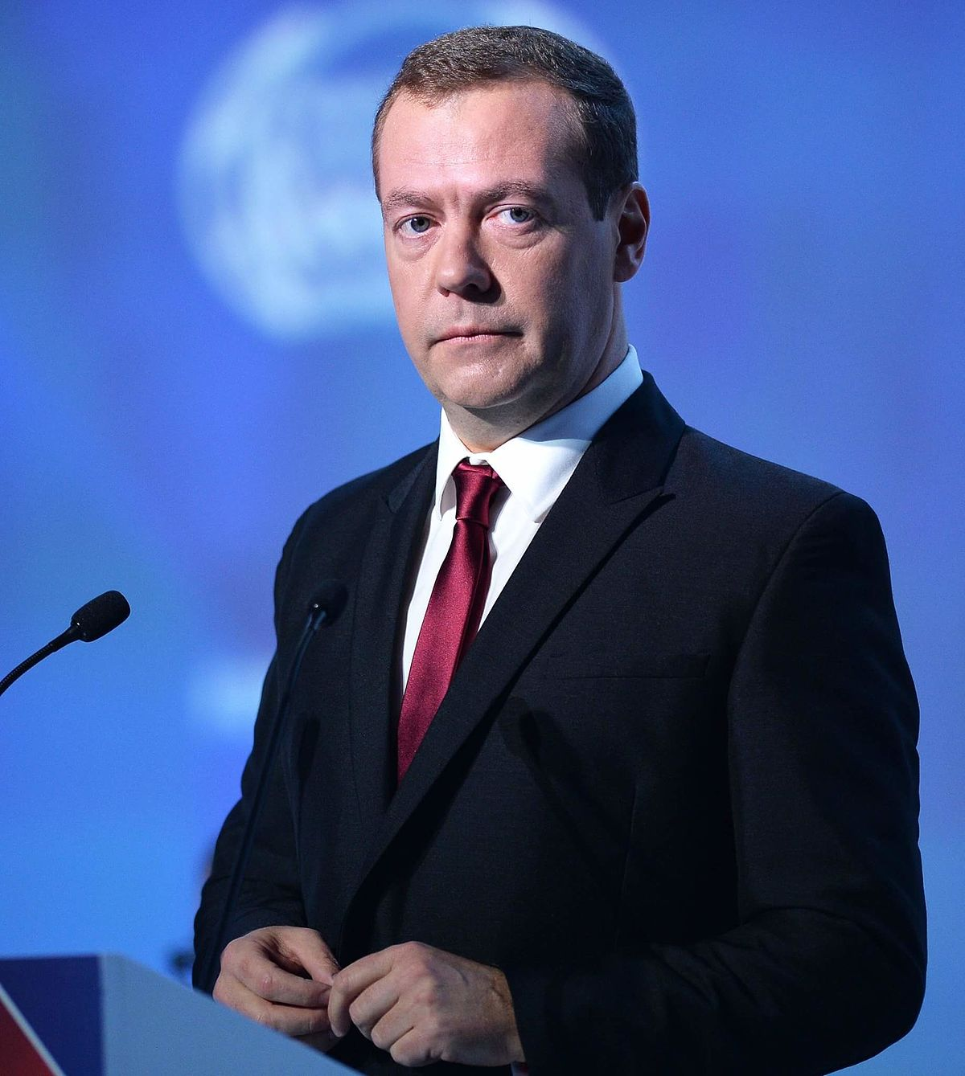
Medvedev as the 3rd President 2008-12
Who is Medvedev?
West depicted him as pro-western.

Slide 3
Russian foreign policy during Medvedev's presidency
invade some parts of the Georgia and shocked the world.
Russia's relations with countries are based on recognition of Russian privileges.
condemn the “NATO-centric approach” and emphasis on multipolarity.

Slide 4
Medvedev Doctrine
First: recognize the primacy of the fundamental principles of international law
Second: the world should be multipolar
Third: Russia does not want confrontation with any other country
Fourth: protecting the lives and dignity of Russian citizens
Fifth: there are regions in which Russia has privileged interests.

Slide 5
End of partnership policy for some reason
Firstly, Russian leaders are disappointed with the results of the cooperation with the West.
Secondly, shift in the global economic balance

Slide 6
Thanks

