Slide 1
Dr. Mohammed Zrary
Kurdistan Region- Iraq
Ministry of Higher Education and Scientific Research Salahaddin University- Erbil
IGNEOUS PETROLOGY
Classification of Igneous Rocks
Department of Earth Sciences & Petroleum
2nd Year
2022- 2023

Slide 2
Igneous Rock Classification
Igneous rocks can be classified according to composition, mineralogy, texture and/or locality.

Slide 3
Igneous Rock Classification
I- Occurrence Classifications
The first step in igneous rock description should be to determine whether the rock falls into one of the following three categories:
a- Plutonic, or intrusive.
shallow crust (intrusive hypabyssal)
deep crust (intrusive plutonic).
Notes:
1- Phaneritic the majority of crystals that compose the rock are readily visible with the naked eye (> ~0.1 mm).
2- Aphanitic Most of the crystals are too small to be seen readily with the naked eye (< ~0.1 mm).
3- Fragmental The rock is composed of pieces of disaggregated igneous material, deposited and later amalgamated.
Volcanic: rocks are classified as those whose mineralogy cannot be determined by the unaided eye.
Plutonic: If the minerals can be identified by the unaided eye the rock is plutonic.

Slide 4
Igneous Rock Classification
I- Occurrence Classifications
b- Aphanitic : volcanic, or extrusive.

Slide 5
Igneous rock Classification
II- Chemical Classifications
Silica and alumina contents are quite important in controlling the mineral composition of igneous rocks.

Slide 6
II- Chemical Classifications
1- Silica saturation
a- Oversaturated: rocks contain Q (quartz)

Slide 7
II- Chemical Classifications
1- Silica saturation
b- Undersaturated: Rocks with minerals such as nepheline that are incompatible with the silica minerals reflect an undersaturated chemistry.

Slide 8
II- Chemical Classifications
1- Silica saturation
c- Saturated rocks contain Hy, but no Q, Ne, or Ol (no quartz, feldspathoid, or olivine), such as diorite and andesite.

Slide 9
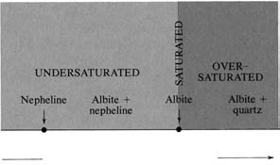
Ratio of SiO₂/Na₂O increasing
Degree of silica saturation in a model system consisting only of SiO₂, Al₂O₃, and Na₂O.

Slide 10
II- Chemical Classifications
2- Alumina saturation
Al to make up the Feldspars.
Al₂O₃ occurs in feldspars in a ratio of 1 Al to 1 Na, 1K, or 1 Ca:
KAlSi₃O₈ -- 1/2K₂O : 1/2Al₂O₃
NaAlSi₃O₈ -- 1/2Na₂O : 1/2Al₂O₃
CaAl₂Si₂O₈ -- 1CaO : 1Al₂O₃
Notes:
Alumina (Al₂O₃) Saturation
Feldspars are, in general, the most abundant minerals that occur in igneous rocks.
The concept of alumina saturation is based on whether or not there is an excess or lack of Al to make up the Feldspars.
Al₂O₃ occurs in feldspars in a ratio of 1 Al to 1 Na, 1K, or 1 Ca:
KAlSi₃O₈ -- 1/2K₂O : 1/2Al₂O₃
NaAlSi₃O₈ -- 1/2Na₂O : 1/2Al₂O₃
CaAl₂Si₂O₈ -- 1CaO : 1Al₂O₃

Slide 11
II- Chemical Classifications
2- Alumina saturation
a- Peraluminous: Al₂O₃ > CaO + Na₂O + K₂O
Muscovite, biotite, topaz, corundum, garnet, tourmaline.
(Cordierite, Sillimanite, Andalusite) these mineral appear as norm mineral
Notes:
This condition is expressed chemically on a molecular basis as:
Al₂O₃ > (CaO + Na₂O + K₂O)
In peraluminous rocks we expect to find an Al₂O₃-rich mineral present as a modal mineral - such as muscovite [KAl₃Si₃O₁₀(OH)₂], corundum [Al₂O₃], topaz [Al₂SiO₄ (OH,F)₂], or an Al₂SiO₅- mineral like kyanite, andalusite, or sillimanite.
Peraluminous rocks will have corundum [Al₂O₃] in the CIPW norm and no diopside in the norm.

Slide 12
II- Chemical Classifications
2- Alumina saturation
b- Metaluminous:
CaO + Na₂O + K₂O > Al₂O₃ > Na₂O + K₂O
These rocks are rich in mafic minerals
Melilite, biotite, pyroxene, hornblende.
Notes:
2. Metaluminous rocks
are those for which the molecular percentages are as follows:
Al₂O₃ < (CaO + Na₂O + K₂O) and Al₂O₃ > (Na₂O + K₂O)
These are the more common types of igneous rocks.
They are characterized by lack of an Al₂O₃-rich mineral and lack of sodic pyroxenes and amphiboles in the mode.

Slide 13
2- Alumina saturation
II- Chemical Classifications
c- Peralkaline: Na₂O + K₂O > Al₂O₃
Sodic pyroxenes (aegirine, aegirine-augite, jadeite) & Alkali amphiboles (riebeckite, richterite) in which Fe2O3 and TiO2 substitute for Al2O3. Peralkaline rocks contain normative acmite (NaFeSi2O6) or sodium metasilicate and lack normative Anorthite.
Notes:
3. Peralkaline rocks
are those that are oversaturated with alkalies (Na₂O + K₂O), and thus undersaturated with respect to Al₂O₃. On a molecular basis.
these rocks show:
Al₂O₃ < (Na₂O + K₂O)
Peralkaline rocks are distinguished by the presence of Na-rich minerals like aegirine [NaFe⁺³Si₂O₆], riebeckite [Na₂Fe₃⁺²Fe₂⁺³Si₈O₂₂(OH)₂], arfvedsonite [Na₃Fe₄⁺²(Al,Fe⁺³)Si₈O₂₂(OH)₂ ], or aenigmatite [Na₂Fe₅⁺²TiO₂Si₆O₁₈] in the mode.
In the CIPW norm, acmite [NaFe⁺³Si₂O₆] and/or sodium metasilicate Na₂SiO₃ will occur as normative minerals.

Slide 14
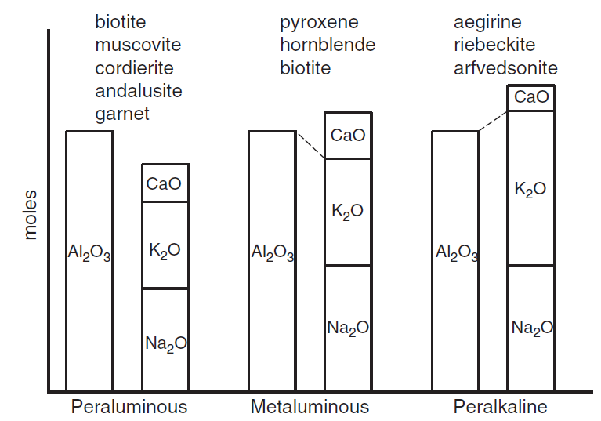
Alumina saturation classes based on the molar proportions of Al₂O₃/(CaO+Na₂O+K₂O) (“A/CNK”)
Common non-quartzo-feldspathic minerals for each type are included.
Notes:
FIGURE 2 Alumina saturation classes based on the molar proportions of (“A/CNK”), after Shand (1927). Common non-quartzo-feldspathic minerals for each type are indicated. After Clarke (1992).
Subaluminous: molecular proportion of Al2O3is approximately equal to the sum of Na2O and K2O. These rocks tend to form alkali feldspar and a little Ca plagioclase and usually contain olivine and orthopyroxenes.

Slide 15
3- Silica content SiO₂
II- Chemical Classifications
2- Alumina saturation
Silica (SiO₂) is the principal oxide constituent of magmatic rocks and serves as a basis for broadly defined classifications.

Slide 16
3- Silica content SiO₂
SiO₂ (wt. %) | Group Name | Names of Typical Rocks
< 45% | Ultrabasic rocks | Peridotite, dunite, Iherzolite
45-52% | Basic rocks | Basalt, gabbro
52-66% | Intermediate rocks | Alkali syenite, quartz monzonite, quartz diorite,…… .
>66% | Acid rocks | Rhyolite, granite,

Slide 17
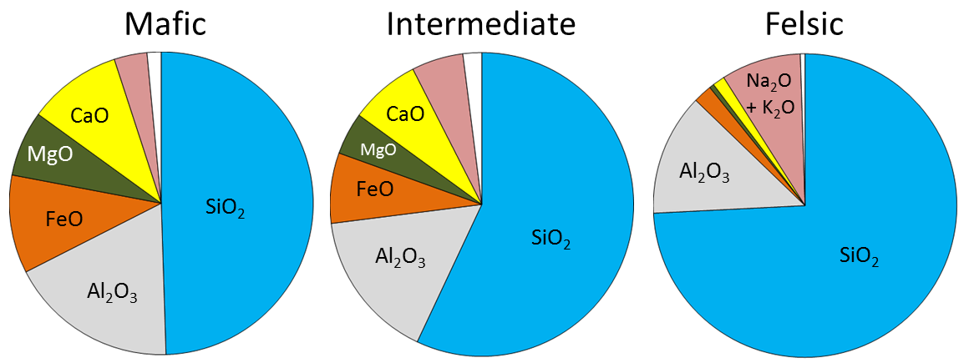
Notes:
Figure 7.10 Chemical compositions of typical mafic, intermediate, and felsic magmas. Source: Karla Panchuk (2018) CC BY 4.0 modified after Steven Earle (2016) CC BY 4.0 view source

Slide 18
CIPW Norm Normative and Modal analysis
Norm is a calculated “idealized” mineralogy from chemical composition and calculate Wt% of minerals.

Slide 19
CIPW Norm Normative and Modal analysis
Normative analysis is defined as the calculation of a theoretical assemblage of standard minerals for a rock based, on the whole rock chemical composition as determined by analytical techniques.
Mode is the volume % of minerals seen

Slide 20
III-Mineralogical Classification
1- Color index
Color index It is the percentage of mafic or ferromagnesian minerals observed in a rock.
Color index values, which range from 0 to 100
Note: that color indices are written without the percent sign %.

Slide 21
III-Mineralogical Classification
1- Color index
Mafic denotes minerals typically dark in color and low in silica that are rich in magnesium and iron. (Olivine, Pyroxene, Hornblende, Biotite)

Slide 22
III-Mineralogical Classification
1- Color index
Felsic refers to light-colored silicate minerals such as: (feldspar [plagioclase & A-feldapar], feldspathoid, quartz, muscovite).

Slide 23
III-Mineralogical Classification
1- Color index
IUGS- Streckeisen (1976) | Shand (1949)
0-5 holo-leucocratic | 0-30 leucocratic
5-35 leucocratic | 30-60 mesotype
55-65 mesocratic | 60-90 melanocratic
65-90 melanocratic | 90-100 hypermelanic
90-100 ultramafic

Slide 24
2-Mineralogical and Modal Composition
III-Mineralogical Classification
Mineralogic Classification depend on factors:
1- Occurrence or absence of quartz, feldspathoid.
2- Type and ratio feldspar.
3- Type and ratio of mafic minerals.
4- Mode of occurrence

Slide 25
A
B
C

Slide 26
A
B
C

Slide 27
A
B
C

Slide 28
A
B
C

Slide 29
Classification of Igneous Rocks
Olivine
Dunite
Harzburgite
Wehrlite
Lherzolite
40
Olivine orthopyroxenite
Olivine clinopyroxenite
Olivine
Websterite
orthopyroxenite
clinopyroxenite
Websterite
Orthopyroxene
clinopyroxene
A classification of igneous rocks.
(ultrabasic) ultramafic rocks.

Slide 30
Classification of Igneous Rocks
Olivine
Dunite
Harzburgite
Wehrlite
Lherzolite
40
Olivine orthopyroxenite
Olivine
Websterite
Olivine clinopyroxenite
Orthopyroxenite
Clinopyroxenite
Websterite
Orthopyroxene
Clinopyroxene
A classification of igneous rocks.
(ultrabasic) ultramafic rocks.

Slide 31
2-Mineralogical and Modal Composition
a- Ultramafic rocks
are defined as those with M greater than 90 these rocks generally consist of olivine, orthopyroxene, clinopyroxene, hornblende, sometimes biotite they also generally contain small amounts of garnet and spinel
Peridotites contain more than 40 % olivine whereas
Pyroxenites have olivine less than this amount within the periotite field, four rock types are recognized
Dunite > 90 % olivine

Slide 32
2-Mineralogical and Modal Composition
in the Pyroxenite field, there are six important rock types that have been defined
Olivine orthopyroxenite: olivine < orthopyroxene
Websterite: clinopyroxene + orthopyroxene
Olivine websterite: olivine < orthopyroxene +clinopyroxene
Olivine clinopyroxenite: olivine < clinopyroxene
Orthopryoxenite: orthopyroxene > 90 %
Clinopyroxenite: clinopyroxene > 90 %

Slide 33
2-Mineralogical and Modal Composition
Plagioclase
Anorthosite
Leuco
65
gabbronorite
Olivine
gabbro
norite
troctolite
Gabbroid
35
Mela
Plag-bearing ultramafic rock
Pyroxene
Olivine
A classification of the phaneritic igneous rocks.
(Basic) mafic rocks.

Slide 34
2-Mineralogical and Modal Composition
Plagioclase
Anorthosite
Leuco
65
gabbronorite
Pyroxene
hornblende
gabbro
norite
Hornblende gabbronorite
Gabbroid
35
Mela
Plag-bearing ultramafic rock
Pyroxene
Hornbende
A classification of the phaneritic igneous rocks.
(Basic) mafic rocks.

Slide 35
2-Mineralogical and Modal Composition
b. Mafic Rocks (gabbroic group)
in the anhydrous Ol-px-pl triangular, the largest volume of the tetrahedra is occupied by mafic rocks containing between 10 and 100 % plagioclase
gabbro: clinopyroxene + plagioclase
norite: plagioclase + orthopyroxene
troctolite: plagioclase + olivine
Notes:
pyroxene hornblende gabbro gabbronorite norite

Slide 36
2-Mineralogical and Modal Composition
gabbronorite: plagioclase with almost equal amounts of clinopyroxene and orthopyroxene.
Orthopyroxene gabbro: plagioclase + clinopyroxene with minor orthopyroxene.

Slide 37
2-Mineralogical and Modal Composition
Clinopyroxene norite: orthopyroxene + plagioclase with minor clinopyroxene.
Hornblende gabbro, which consists of plagioclase + hornblende with less than 5 % pyroxene.

Slide 38
2-Mineralogical and Modal Composition
Rocks that contain greater than 90 % plagioclase are called anorthosites
If they are fine-grained, gabbros are called diabase or dolerite.
Above 65% plagioclase, the rock name is modified by given the prefix leuco to rock contain plagioclase above 65%, the rock contain below 35% plagioclase, given the prefix mela.

Slide 39
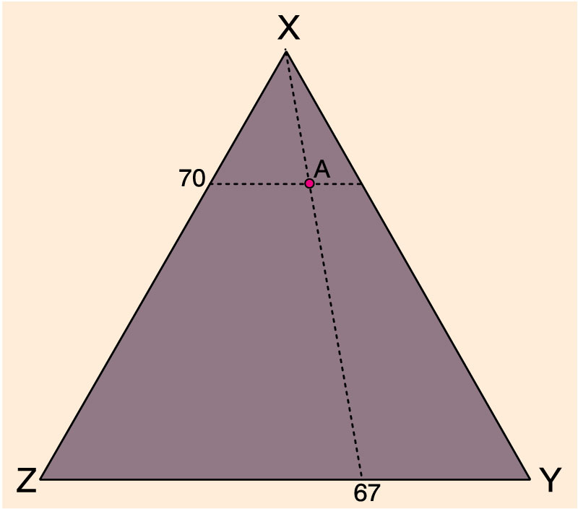
2-Mineralogical and Modal Composition
Method #2 for plotting a point with the components: 70% X, 20% Y, and 10% Z on triangular diagrams

Slide 40
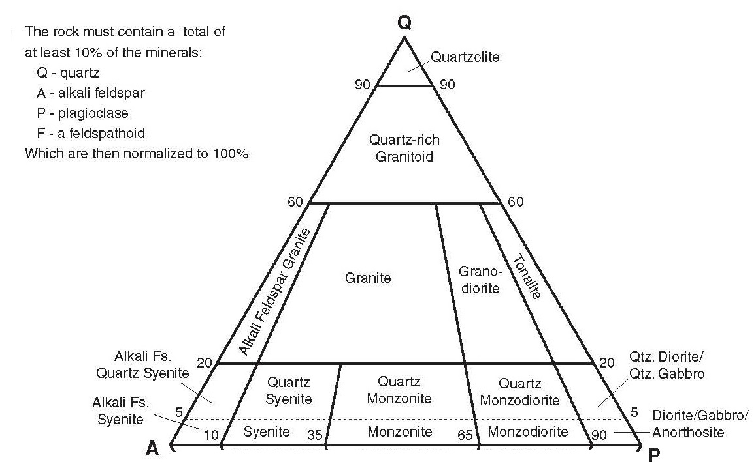
2-Mineralogical and Modal Composition

Slide 41
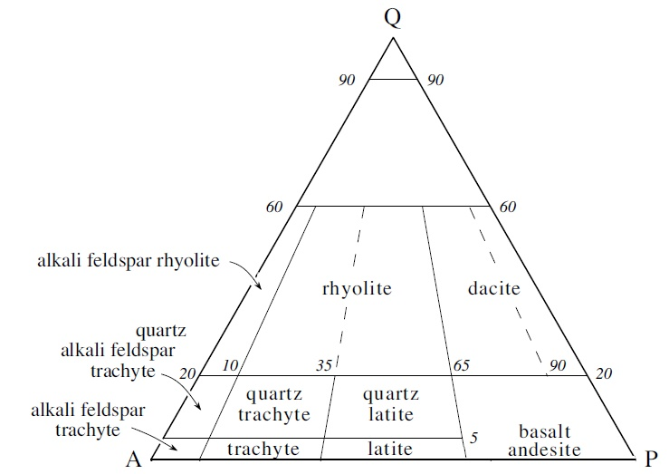
2-Mineralogical and Modal Composition
A classification and nomenclature of volcanic rocks.

Slide 42
2-Mineralogical and Modal Composition
c- Intermediate rock: 0 to <20 % modal quartz
alkali syenite these rocks contain plagioclase minor amounts relatively to alkali feldspar,, the mineralogically equivalent volcanic rock is an alkali trachytes
syenite have more alkali feldspar than plagioclase trachytes
monzonite has an alkali feldspar/plagioclase ratio near one and is the volcanic analog of latite
diorite, expanded plagioclase-rich with less than 5% quartz the volcanic equivalent of diorite is andesite
if the rock has between 5 and 20% quartz, rock name is given the modifier quartz, e.g. quartz syenite.

Slide 43
2-Mineralogical and Modal Composition
d- Acidic rock: >20 % modal quartz
when alkali feldspar is greater than plagioclase, the rock is an alkali feldspar granite (alkali feldspar rhyolite if volcanic)
Granites where alkali feldspar is more abundant than plagioclase. (rhyolite if volcanic) this rock divided into Monzogranite, Syenogranite
Syenogranite where alkali feldspar is more abundant than plagioclase, (rhyolite if volcanic).
Monzogranite (rhyolite if volcanic).
granodiorite have plagioclase as the dominant feldspar. (dacite if volcanic)
Tonalite if plagioclase is very much greater than alkali feldspar. (dacite if volcanic)

Slide 44
E- Undersaturated (feldspathoid) rocks
In these rocks we should find minerals that, in general, do not occur with quartz. Such minerals are:
Nepheline- NaAlSiO₄ | Forsteritic Olivine - Mg₂SiO₄
Leucite- KAlSi₂O₆ | Sodalite- 3NaAlSiO₄.NaCl
Nosean- 6NaAlSiO₄.Na₂SO₄ | Perovskite-CaTiO₃
Melilite- (Ca,Na)₂(Mg,Fe⁺²,Al,Si)₃O₇ | Melanite- Ca₂Fe⁺³Si₃O₁₂

Slide 46
E- Undersaturated (feldspathoid) rocks
Phonolite: alkali feldspar greater than 90 % with less than 10 % plagioclase the dominant feldspathoid should be included as part of the rock name, leucite phonolite mafic minerals commonly present in such rocks include olivine augite or aegirine-augite and sodic amphibole.

Slide 47
E- Undersaturated (feldspathoid) rocks
At greater than 90 % feldspathoid, feldspar is nearly absent and the rock is called foidite to distinguish it from its plutonic equivalent the foidilite.

Slide 48
F- Glassy Igneous Rocks
Obsidian: Mass of solid felsic glass; conchoidal fracture
Pumice: glassy felsic volcanic rock that contains abundant open pores called vesicles (lt grey to tan in color). Occasionally less dense than water (it floats!)
Scoria: glassy mafic volcanic rock with abundant vesicles (>30%). Grey, black, or red in color.
Typically has larger and rounder vesicles than pumice
Vesicle: a open space left over from a gas bubble in a lava or magma

Slide 49
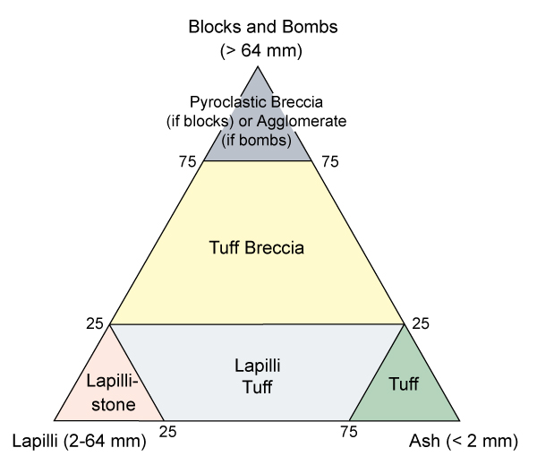
Classification of Igneous Rocks Pyroclastic rocks
Classification of the pyroclastic rocks, based on the size of the material.

Slide 50
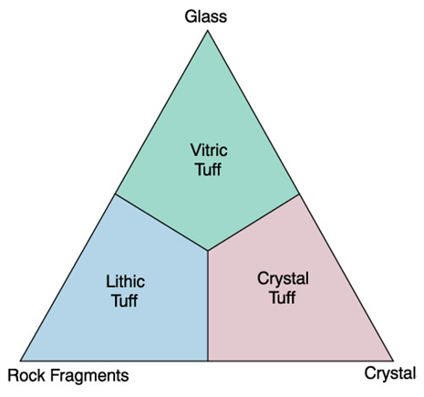
Classification of Igneous Rocks Pyroclastic rocks
Classification of the pyroclastic rocks, based on the size of the material.

Slide 51
Classification of Igneous Rocks Pyroclastic rocks
Pyroclasts are defined based on their size which is the major criteria for classification in the IUGS system the size classes are:
a. > 64 mm diameter
Bombs
Blocks
b. 2–64 mm Lapilli
c. < 2 mm Ash
i-coarse ash: 2 to 1/16 mm
ii- fine ash or dust: < 1/16 mm

Slide 52
Classification of Igneous Rocks Pyroclastic rocks
a) pyroclastic rocks predominantly consolidated
b) tephra represents unconsolidated pyroclasts
b) pyroclastic breccia: average pyroclastic size exceeds 64 mm and particles are angular in shape
c) lapilli tuff: average pyroclast is between 64 mm and 2 mm
d) tuff or ash tuff consist of rocks with the average diameter of the pyroclasts is less than 2 mm with following further subdivisions

Slide 53
What's your question?

