Slide 1
Dr. Mohammed Zrary
Kurdistan Region- Iraq
Ministry of Higher Education and Scientific Research Salahaddin University- Erbil
IGNEOUS PETROLOGY
Textures of Igneous Rocks
Department of Geology
2nd Year
2023- 2024

Slide 2
Textures of Igneous Rocks
Igneous textures involve degree of crystallinity, granularity, shape and the geometric arrangement of individual mineral grains.
Notes:
A geometric pattern or arrangement is made up of shapes such as squares, triangles, or
A geometric pattern or arrangement is made up of shapes such as squares, triangles, or rectangles:
The texture of a rock is a result of various processes that controlled the rock’s genesis and, along with mineralogy and chemical composition, provides information that we may use to interpret the rock’s origin and history.
It is thus important for us to be able to recognize and describe the textures of a rock and to understand how they are developed.

Slide 3
Textures of Igneous Rocks
The texture of a rock is a result of various processes that controlled the rock’s genesis and, along with mineralogy and chemical composition, provides information that we may use to interpret the rock’s origin and history.

Slide 4
Factors that determine the texture of an igneous rock:
The cooling rate (dT/dt).
The diffusion rate - the rate at which atoms or molecules can move (diffuse) through the liquid.
The rate of nucleation of new crystals.
The rate of growth of crystals.

Slide 5
Cooling Rate
The rate of cooling of magma depends largely on the environment in which the magma cools.
Rapid cooling takes place on the Earth's surface where there is a large temperature contrast between the atmosphere/ground surface and the magma.

Slide 6
Cooling Rate
Cooling time for material erupted into air and water can be as short as several seconds.
For lava flows cooling times are on the order of days to weeks.
Shallow intrusions cool in months to years and large deep intrusions may take millions of years to cool. Mag

Slide 7
Texture Origin
The textures that you observe in an igneous rock result from a number of processes and can be grouped into:
Primary textures occur during igneous crystallization and result from interactions between minerals and melt.
Secondary textures are alterations that take place after the rock is completely solid.

Slide 8
1-Primary texture:
The formation and growth of crystals, either from a melt or in a solid medium (metamorphic mineral growth), involves three principal processes:
(1) Initial nucleation of the crystal.
(2) Crystal growth.
(3) Diffusion of chemical ions (and heat) through the surrounding medium to and from the surface of a growing crystal.

Slide 9
Nucleation is a critical initial step in the development of a crystal.
Once a nucleus forms, the chemical constituents must diffuse through the liquid to arrive at the surface of the growing crystal.
The crystal can then grow until it runs into other crystals or the supply of chemical constituents is cut off.
M.G.

Slide 10
Oxides (such as magnetite or ilmenite) generally nucleate more easily (with less undercooling) than does olivine, followed by pyroxene, plagioclase, and alkali feldspar.
This may explain why oxides are typically small and numerous, whereas alkali feldspars generally grow quite large.

Slide 11
Simple structures nucleate more easily
Oxides easier > Olivine > Px. > Pl. > Kfs
So oxides small & numerous, K-spars few but larger

Slide 12
Crystal growth involves the addition of ions onto existing crystals or crystal nuclei. Crystals with simple structures tend to nucleate more easily than those with more complex structures.

Slide 13
Undercooling is the degree to which temperature falls below the melting point (which is also the crystallization temperature when we consider cooling) before crystallization occurs.

Slide 14
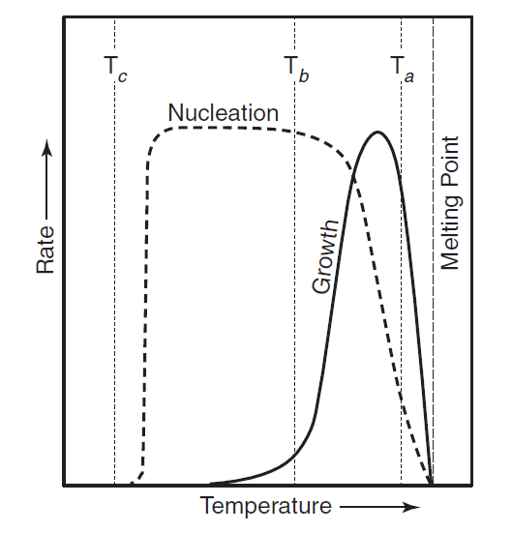
Hypothetical nucleation and growth rate curves based on experiments in simple systems.
If the cooling rate is low, only slight undercooling will be possible (such as at temperature T_{a}). At this temperature, the nucleation rate is very low, and the growth rate is high. Fewer crystals thus form, and they grow larger, resulting in the coarse-grained texture common among slow cooled plutonic rocks.

Slide 15
Hypothetical nucleation and growth rate curves based on experiments in simple systems.
If rocks are undercooled to T_{b}, the nucleation rate exceeds the growth rate. This will result in many crystals all growing rapidly, but because there are so many small crystals are formed, resulting in the very fine-grained texture of volcanic rocks.

Slide 16
Hypothetical nucleation and growth rate curves based on experiments in simple systems.
Very high degrees of undercooling (T_{c}) may result in negligible rates of nucleation and growth, such that the liquid solidifies to a glass with very few or no crystals.

Slide 17
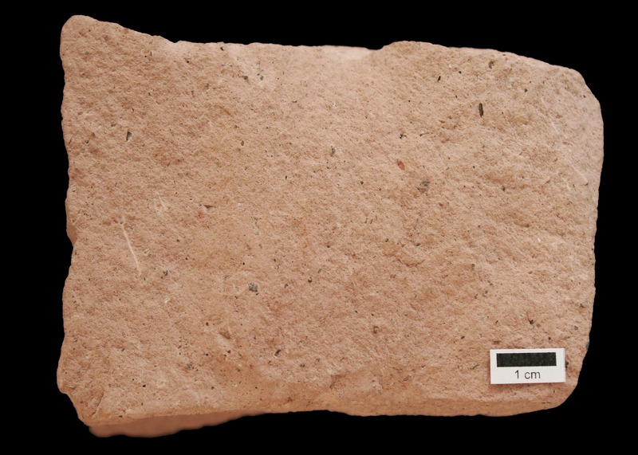
Fast cooling on the surface results in many small crystals gives crystals cannot be distinguished with the naked eye, or obsidian (volcanic glass).

Slide 18
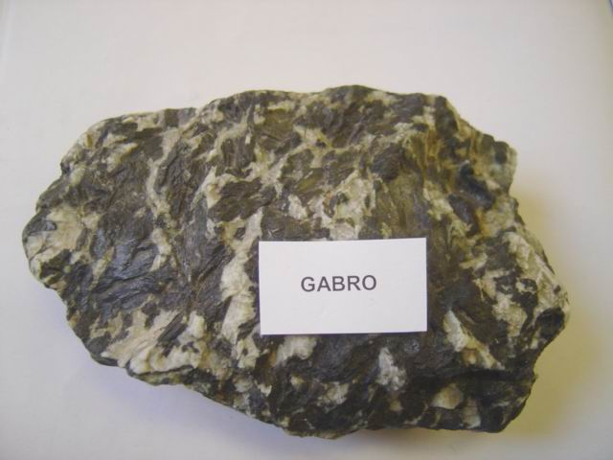
Slow cooling at depth in the earth results in fewer much larger crystals, gives coarse crystalline rocks.

Slide 19
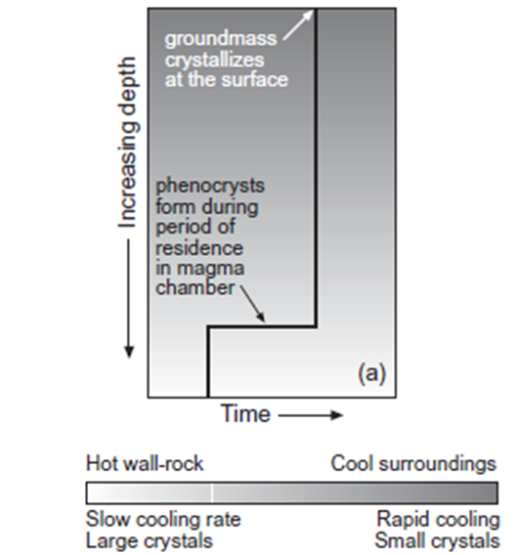
Cooling Stage
Two-stage cooling can create a bimodal distribution of grain sizes.

Slide 20
Cooling Stage
Slow cooling followed by rapid cooling might occur when crystallization began in a magma chamber, followed by the opening of a channel and migration of magma to the surface forming porphyritic texture.

Slide 21
Description of igneous textures:
I- Crystallinity: is proportion of crystals in a glassy rock or in magma. The modal percentage of mineral grains relative to glass their crystallinity ranges from 0% to 100% in magmatic rocks.

Slide 22
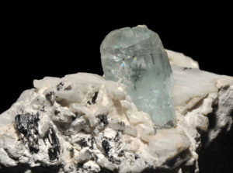
Description of igneous textures:
I- Crystallinity:
Holocrystalline refers to a rock composed entirely of crystalline material.

Slide 23
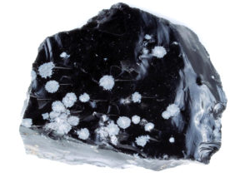
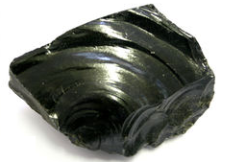
Description of igneous textures:
I- Crystallinity:
Holohyaline refers to a rock composed entirely of glassy material.
snowflake obsidian.
Notes:
The "snowflakes" in snowflake obsidian are quartz crystals that have formed through devitrification of the original obsidian. The crystals that develop through devitrification cause obsidian to lose its conchoidal fracture and glassy texture.

Slide 24
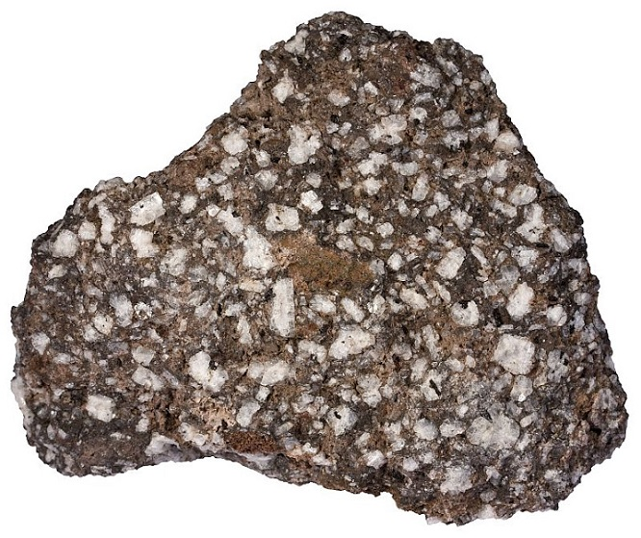
Description of igneous textures:
I- Crystallinity:
Hypocrystalline refers to a rock composed of both crystals and glassy material, but amount of crystals is greater than glassy material.

Slide 25
Description of igneous textures:
I- Crystallinity:
Hypohyaline refers to a rock composed of both crystals and glass material but amount of glass is greater than crystals.

Slide 26
II- Granularity:
In igneous rocks, crystal size is controlled by the interaction of the following factors:
Cooling rate of the magmatic melt.
The rate of nucleation.
Chemical composition of the liquids.
Existence and composition of a dissolved or free fluid phase.
Notes:
Surface energy of the faces
Diffusion rate
If cooling rate is constant, the largest crystals will usually be those with the most plentiful or fastestdiffusing components
Diffusion rate of a chemical species is faster at higher temperature, and in lower viscosity
Small ions with low charge diffuse better than large polymerized complexes
Microtextures of Igneous and Metamorphic Rocks 1986 J. P. Bard (auth.) ((41))
3- The existence of volatile constituents not only lowers the melting point of hydrated magmas, but also causes a retrograde boiling towards the end of crystallization, which vaporises the rest of the residual liquids and frees the dissolved fluid phase, thus separating it. The composition of this phase affects the development and size of some
Vernon
3.5.10 Aplites
The common occurrence of fine-grained aplites (Fig. 3.48) adjacent to compositionally similar pegmatites suggests that both rock-types can crystallize simultaneously at the same temperature. The aplites may result from rapid loss of water and/or other volatile components, consequent on pressure release (‘pressure quenching’) by fracturing, as suggested by Jahns & Tuttle (1962). This would increase the proportion of O–Si and O–Al bonding in the melt, and hence increase the formation of feldspar and quartz nuclei, resulting in larger N/G. However, a sudden drop in pressure (Webber et al., 1999) or extraction of boron from the melt by crystallization of tourmaline (Rockhold et al., 1987) can also produce conditions favourable for development of aplite. Presumably these factors also account for the fine grain size of the groundmass in microgranite dykes formed by rapid cooling at high crustal levels.

Slide 27
II- Granularity:
i- Phaneritic : crystals visible to the naked (hand lens if necessary).
Pegmatitic: crystals > 30mm.
Coarse-grained: crystal (5-30mm).
Medium grained crystals (1-5mm).
Fine-grained: crystals < 1mm.

Slide 28
II- Granularity:
ii-Aphanitic: crystals not visible to the naked eye. It May be
a- Microcrystalline: composed of grains which are individually visible with a microscope.
b- Cryptocrystalline - composed of grains not individually visible with a microscope, but crystalline.
c- Glassy - composed essentially of glass.

Slide 29
What's your question?

