Slide 1
Dr. Mohammed Zrary
Kurdistan Region- Iraq
Ministry of Higher Education and Scientific Research
Salahaddin University- Erbil
Igneous Petrography
Department of Earth Sciences & Petroleum
3rd Year
2023- 2024

Slide 2
Igneous petrography
Igneous Petrography: description and classification of igneous rocks by mineralogy and texture under polarized microscope.
1- Mineral Composition:
I) primary minerals, which crystallize directly from magma.
(1) essential primary minerals that are in relatively high abundance (>5% of the rock), and has the influence of rock name.
(2) accessory minerals primary minerals that are in relatively low abundance (<5% of the rock), and hasn’t the influence of rock name.
II) Secondary minerals, which form at temperatures below those at which any melt can't exist.

Slide 3
1) Point counter 2) Visual estimation and Chart
Estimation of Mineral Percentage:
Determination of the volumetric proportions of the minerals that make up a rock—its modal composition or mode—can be done by various techniques.

Slide 4
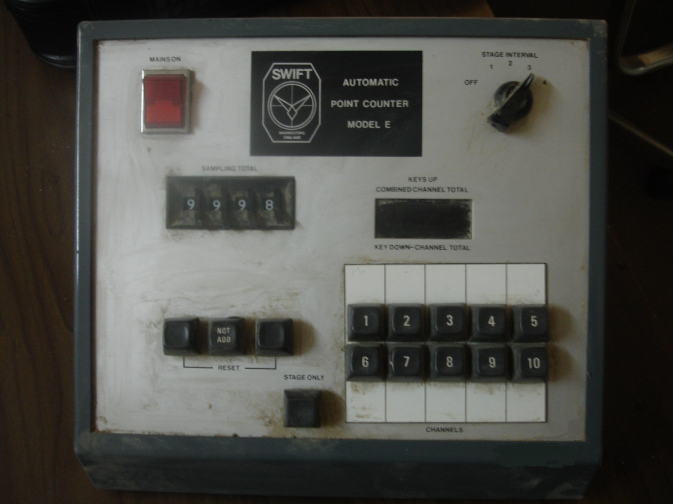
1) Point counter

Slide 5
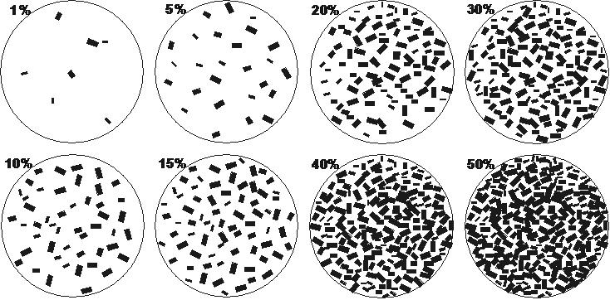
2) Chart and Visual estimation

Slide 6
2- Texture
Texture Comprises the degree of crystallization or crystallinity, the grain size or granularity and the shape, distribution, and mutual relationships of crystalline and amorphous materials in a rock.

Slide 7
I- Crystallinity
i- Holocrystalline refers to a rock composed entirely of crystalline material.

Slide 8
I- Crystallinity
ii- Holohyaline refers to a rock composed entirely of glassy material.

Slide 9
iii- Hypocrystalline refers to a rock composed of both crystals and glassy material, but amount of crystals is greater than glassy material.
I- Crystallinity

Slide 10
iv- Hypohyaline refers to a rock composed of both crystals and glass material but amount of glass is greater than crystals.
I- Crystallinity

Slide 11
II- Granularity : Textures referring to the grain size:-
i- Phaneritic - composed of grains distinguishable with the naked eye
a- fine-grained - < 1 mm

Slide 12
II- Granularity : Textures referring to the grain size:-
ii-Aphanetic - composed of grains not distinguishable with the naked eye

Slide 13
II- Granularity : ii-Aphanitic
a- Microcrystalline
composed of grains which are individually visible with a microscope

Slide 14
II- Granularity : ii-Aphanitic
b- Cryptocrystalline - composed of grains not individually visible with a microscope, but crystalline .

Slide 15
II- Granularity : ii-Aphanitic
c- Glassy - composed essentially of glass.

Slide 16
III- Mutual Relationship between Crystals
i-Equigranular refers to an igneous rock texture in which the diameters of component minerals approach to another (similar in size)

Slide 17
ii- Inequigranular
This textures originate in different ways: That is, they are polygenetic. Probably the most common origin for porphyritic aphanitic and vitrophyric textures involves a two-stage or more cooling history for the melt. An initial episode of slow cooling rate (small undercooling) yields few nuclei just below liquidus temperatures in a thermally insulated plutonic environment below the surface of the Earth After this partial crystallization, the magma experiences an episode of relatively rapid heat loss in a small intrusion in the shallow cool crust or in an extrusion onto the surface; both create the aphanitic or glassy matrix around the phenocrysts.
Notes:
Porphyritic textures originate in different ways: That is, they are polygenetic. Probably the most common origin for porphyritic aphanitic and vitrophyric textures involves a two-stage cooling history for the melt. An initial episode of slow cooling rate (small undercooling) yields few nuclei just below liquidus temperatures in a thermally insulated plutonic environment below the surface of the Earth
.

Slide 18
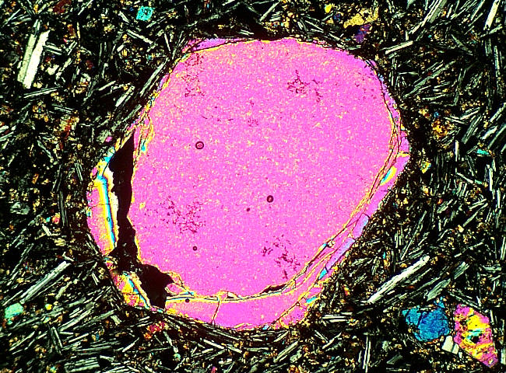
ii- Inequigranular
Porphyritic texture
consists of larger grains called phenocrysts, surrounded by a population of grains of significantly smaller size, the groundmass.
Notes:
Porphyritic textures originate in different ways: That is, they are polygenetic. Probably the most common origin for porphyritic aphanitic and vitrophyric textures involves a two-stage cooling history for the melt. An initial episode of slow cooling rate (small undercooling) yields few nuclei just below liquidus temperatures in a thermally insulated plutonic environment below the surface of the Earth
.

Slide 19
ii- Inequigranular
Seriate texture
refers to a situation where there is a continuous range in grain size of one or more mineral species from that of phenocryst to groundmass size, and in which crystals of progressively smaller sizes are increasingly numerous. This texture is commonly shown by plagioclase in some andesite porphyries.
Notes:
Seriate Phaneritic, inequigranular magmatic texture in
which grains range more or less continuously in size; contrast
bimodal size distribution in porphyritic texture.

Slide 20
IV-Intergrowth Texture
Poikilitic texture
is a general term describing a texture in which one or more mineral species may be partly or wholly enclosed by another mineral species. This texture indicates crystallization sequence of minerals in an igneous rock.

Slide 21
IV-Intergrowth Texture
Ophitic texture
refers to a situation where the dimensions of the augite crystals are substantially larger than those of the plagioclase.

Slide 22
IV-Intergrowth Texture
Myrmekitic texture
is an intergrowth of quartz and oligoclase occurring in small cauliflower-shaped.

Slide 23
VII- Textures referring to cavity and fillings:
These are a collection of textures, which feature either holes in the rock, or likely former holes which are now partly or completely filled with crystals.

Slide 24
VII- Textures referring to cavity and fillings:
i- Vesicular texture refers to a round, oval or elongates irregular holes (vesicles) formed by expansion of gas in magma.

Slide 25
VIII- Pyroclastic Texture
Pyroclastic Texture Is a collective of bits and pieces of the former coherent magma together with possible fragments of rock torn from the explosive conduit and vent, are collectively called pyroclasts

Slide 26
3- Mode of occurrence
plutonic
volcanic

Slide 27
4- Acidity
(ultra basic, or basic or intermediate or acidic)

Slide 28
5- Rock name

Slide 29
References:
Best, M. G. /2002 IGNEOUS AND METAMORPHIC PETROLOGY, San Francisco, , cl, Blackwell Publishing 730 pages
Blatt, H. and Tracy, R. J. / PETROLOGY: Igneous, Sedimentary, and Metamorphic, 3rd Edition, New York, 2006, cl, 529 pages
Ehlers, E. G. and Blatt, H. / PETROLOGY: IGNEOUS, SEDIMENTARY AND METAMORPHIC, San Francisco, 1982, cl, 732 pages,
Hughes, C. J. / IGNEOUS PETROLOGY, Amsterdam, 1982, cl, 551 pages,
Raymond, L. A. / PETROLOGY: The Study of Igneous, Sedimentary, and Metamorphic Rocks, Dubuque, 1995, cl, 742 pages,
Robin Gill (2010) Igneous Rocks and Processes a Practical Guide, Wiley-Blackwell, 428pages.
Williams H, Turner FJ, Gilbert CM. 1982. Petrography: An introduction to the study of rocks in thin section. New York, W.H. Freeman.

