Slide 1
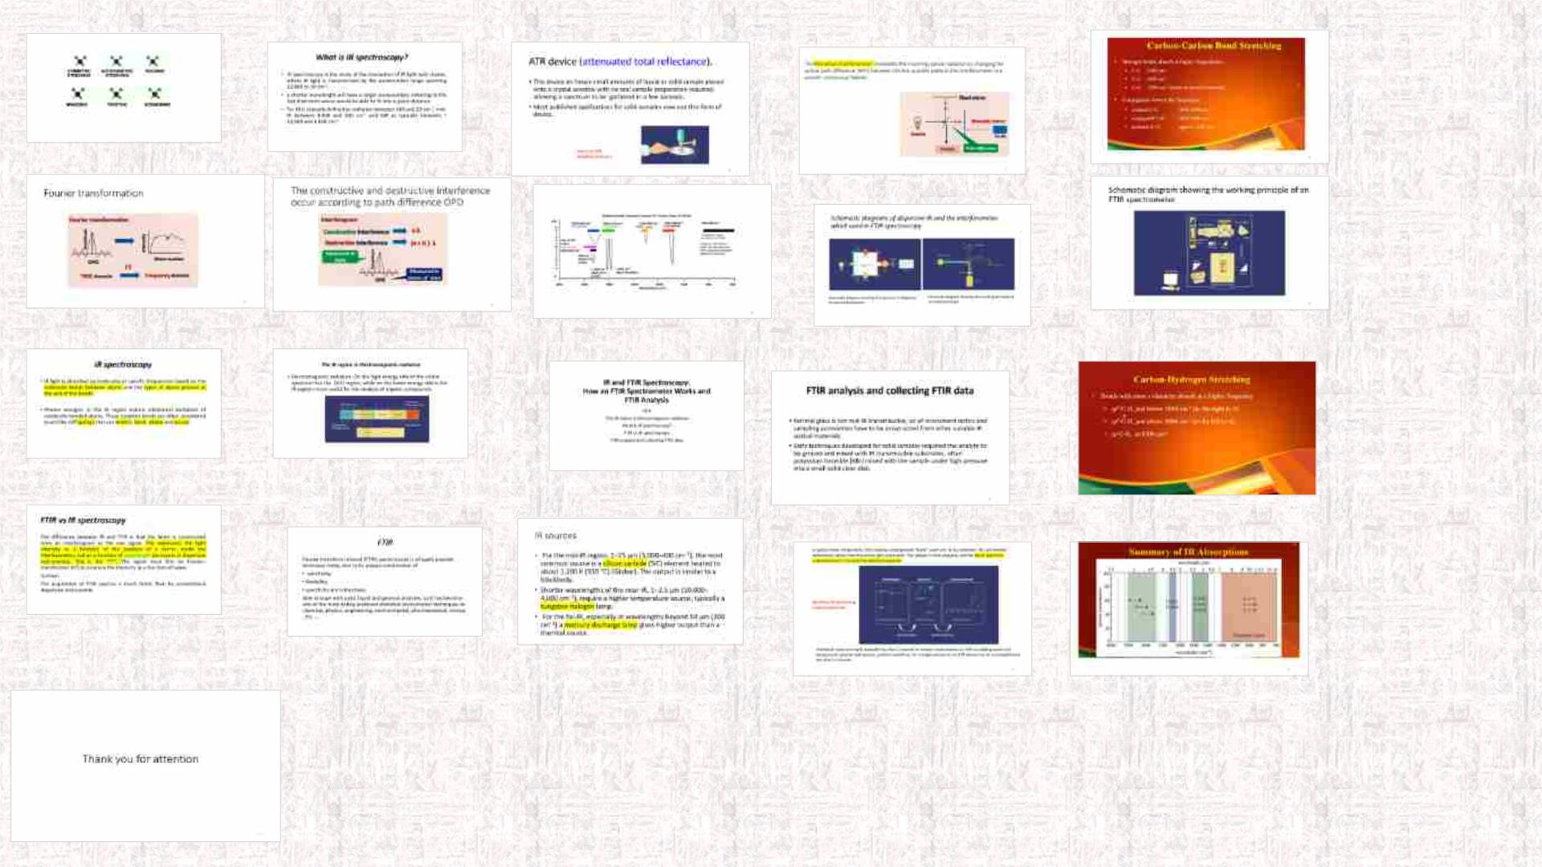

Slide 2

IR and FTIR Spectroscopy:
How an FTIR Spectrometer Works
and
FTIR Analysis
FTIR
The IR region in Electromagnetic radiation
What is IR spectroscopy?
FTIR vs IR spectroscopy
FTIR analysis and collecting FTIR data
2

Slide 3
FTIR
Fourier transform infrared (FTIR) spectroscopy is a hugely
popular technique today, due to its unique combination of
• sensitivity,
• flexibility,
• specificity and robustness.
Able to cope with solid, liquid and gaseous analytes, so it has
become one of the most widely practiced analytical instrumental
techniques in: chemical, physics, engineering, environmental,
pharmaceutical, clinical , etc. ….
3

Slide 4
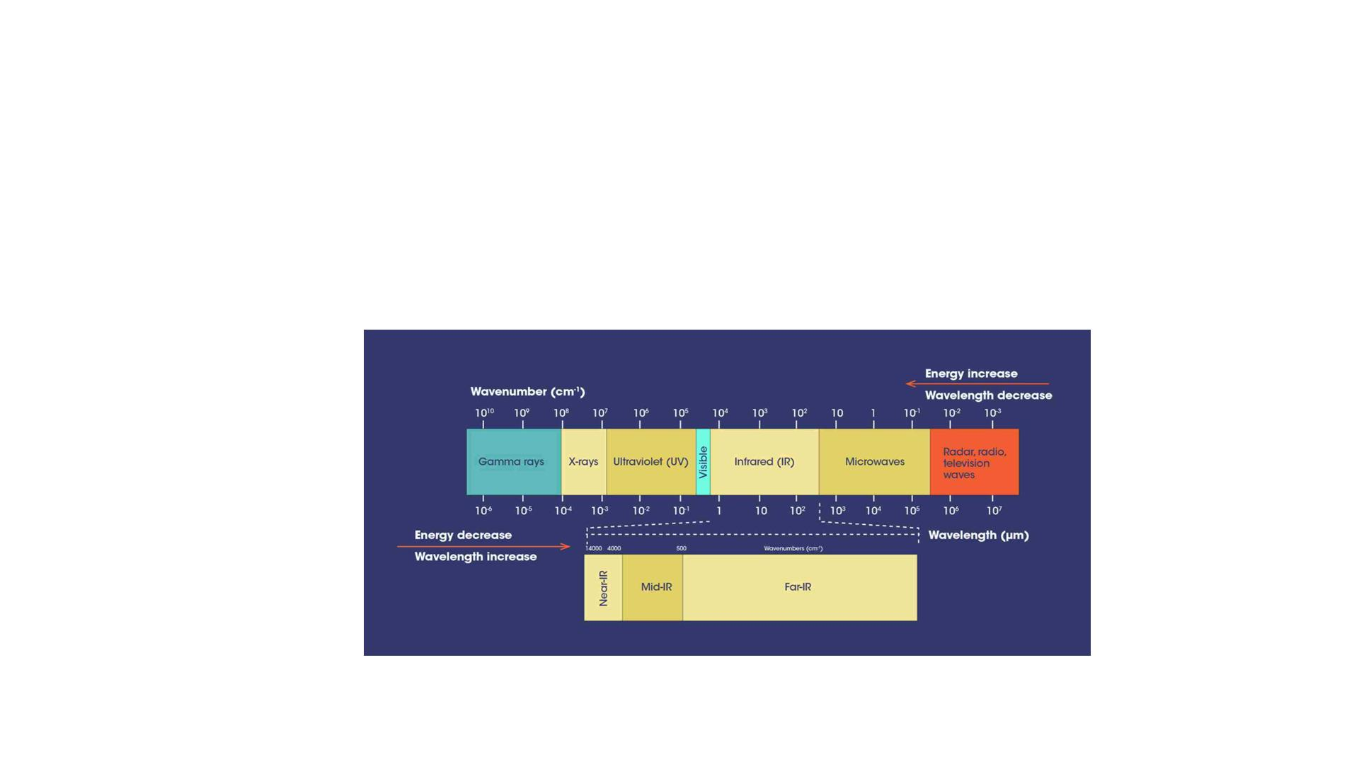
The IR region in Electromagnetic radiation
• Electromagnetic radiation .On the high-energy side of the visible
spectrum lies the (UV) region, while on the lower energy side is
the IR regions most useful for the analysis of organic
compounds.
4

Slide 5
What is IR spectroscopy?
• IR spectroscopy is the study of the interaction of IR light with
matter, where IR light is characterized by the wavenumber
range spanning 12,800 to 10 cm⁻¹.
• a shorter wavelength will have a larger wavenumber, referring
to the fact that more waves would be able to fit into a given
distance.
• Far-IR is typically defined as radiation between 500 and 20 cm⁻
¹, mid-IR between 4,000 and 500 cm⁻¹ and NIR as typically
between ~ 10,000 and 4,000 cm⁻¹.
5

Slide 6

IR spectroscopy
• IR light is absorbed by molecules at specific frequencies based
on the molecular bonds between atoms and the types of atoms
present at the end of the bonds.
• Photon energies in the IR region induce vibrational excitation of
covalently bonded atoms. These covalent bonds are often
considered to act like stiff springs that can stretch, bend, rotate
and scissor
6

Slide 7
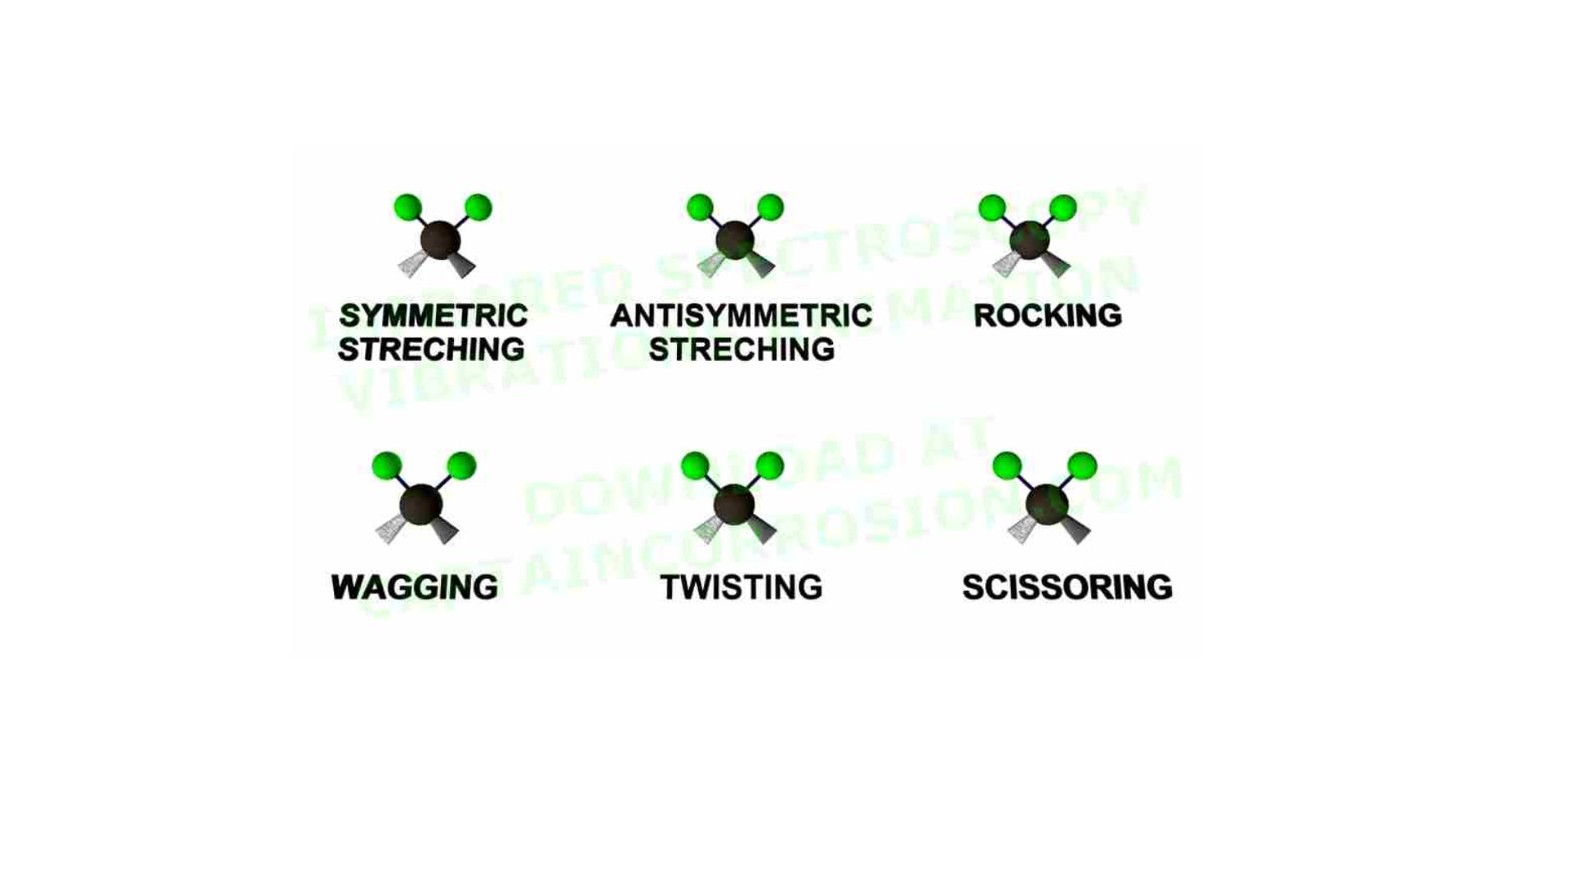
7

Slide 8

FTIR vs IR spectroscopy
The difference between IR and FTIR is that the latter is
constructed from an interferogram as the raw signal. This
represents the light intensity as a function of the position of a
mirror inside the interferometer, not as a function of wavelength
(as occurs in dispersive instruments). This is the “FT“. The signal
must first be Fourier-transformed (FT) to produce the intensity as
a function of wave
number.
The acquisition of FTIR spectra is much faster than by
conventional dispersive instruments.
8

Slide 9
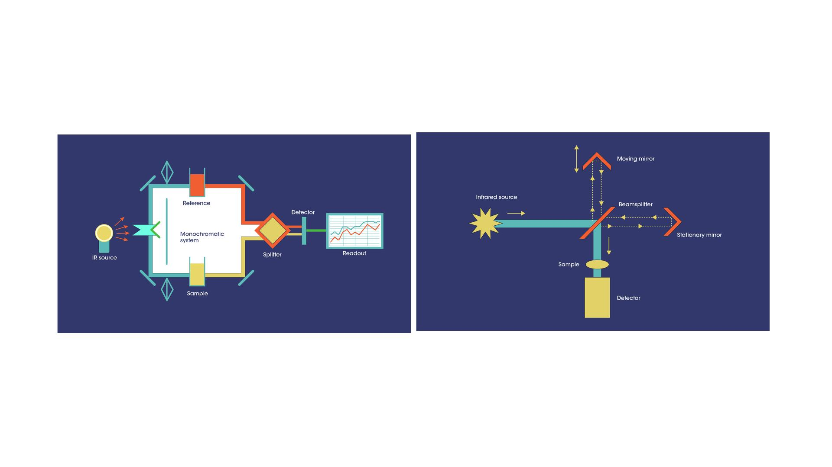
Schematic diagrams of dispersive IR and the interferometer
which used in FTIR spectroscopy
Schematic diagram showing the layout of a
dispersive IR spectrophotometer
Schematic diagram showing the working principle of
an interferometer

Slide 10

IR sources
• For the mid-IR region, 2−25 μm (5,000–400 cm⁻¹), the most
common source is a silicon carbide (SiC) element heated to
about 1,200 K (930 °C) (Globar). The output is similar to a
blackbody.
• Shorter wavelengths of the near-IR, 1−2.5 μm (10,000–4,000
cm⁻¹), require a higher temperature source, typically a
tungsten-halogen lamp.
• For the far-IR, especially at wavelengths beyond 50 μm (200
cm⁻¹) a mercury discharge lamp gives higher output than a
thermal source.
10

Slide 11
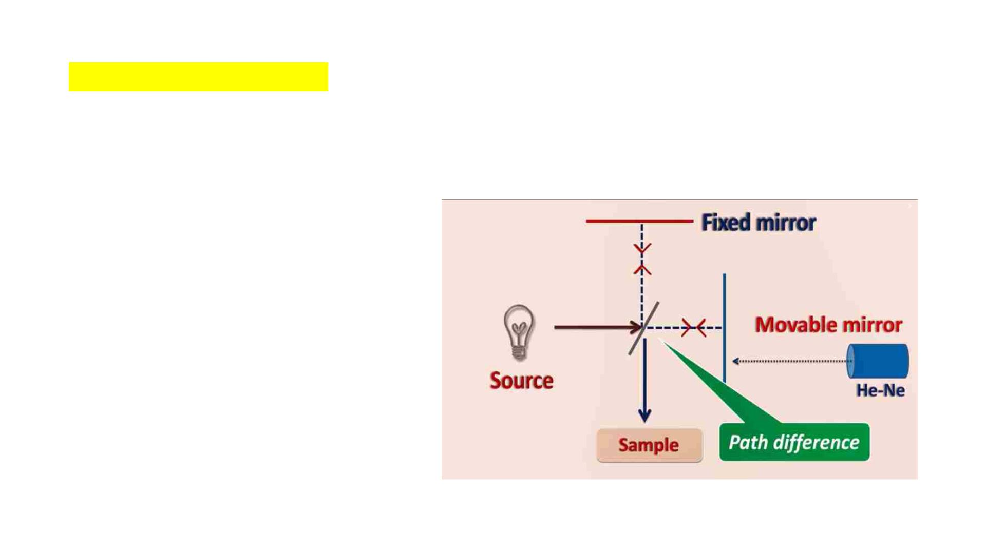
The Michelson interferometer modulates the incoming optical radiation by changing the
optical path difference (OPD) between the two possible paths in the interferometer in a
smooth continuous fashion.
11

Slide 12
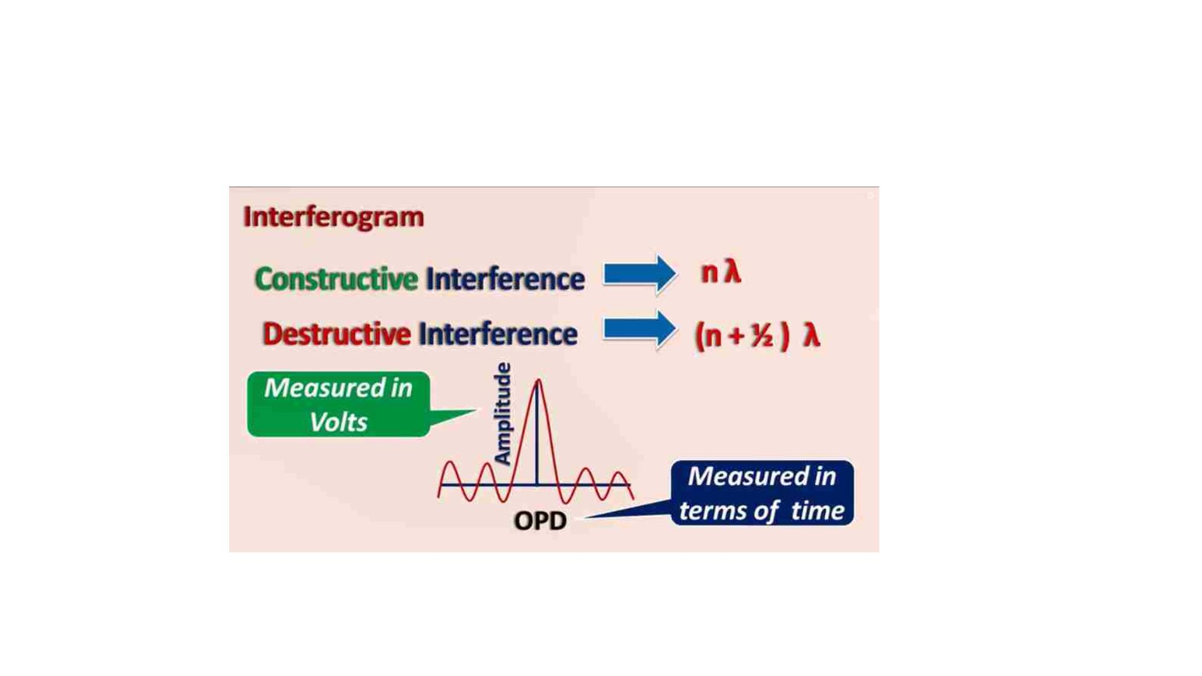
The constructive and destructive interference
occur according to path difference OPD
12

Slide 13
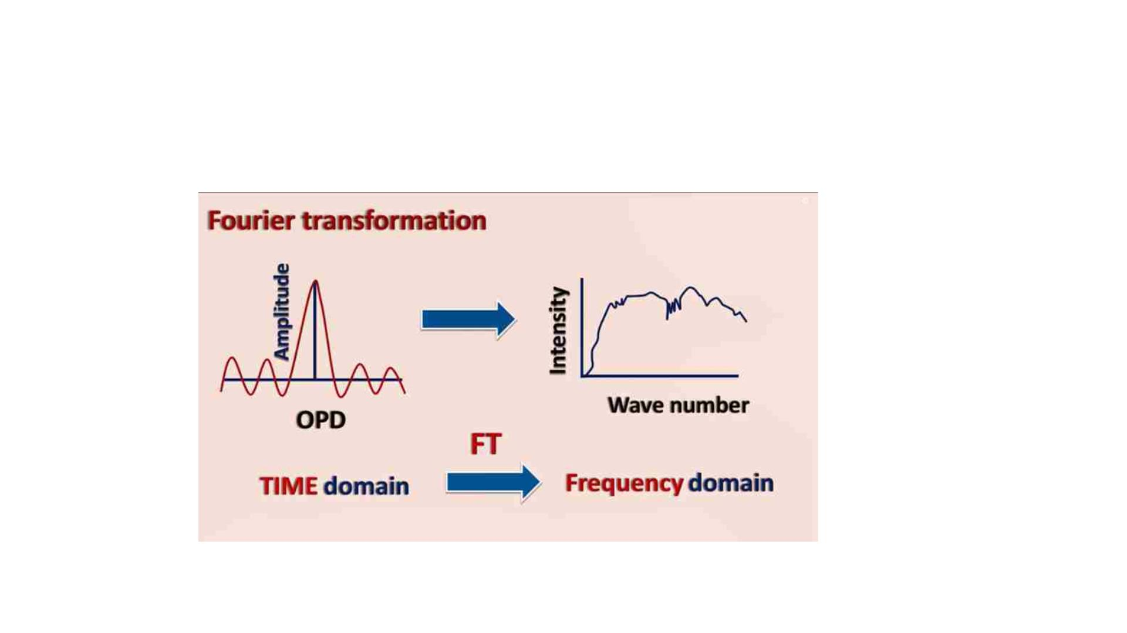
Fourier transformation
13

Slide 14
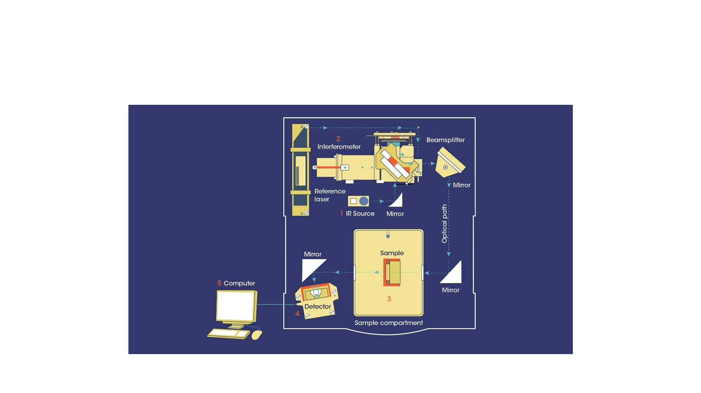
Schematic diagram showing the working principle
of an FTIR spectrometer
14

Slide 15
FTIR analysis and collecting FTIR data
• Normal glass is not mid-IR transmissible, so all instrument
optics and sampling accessories have to be constructed from
other suitable IR optical materials.
• Early techniques developed for solid samples required the
analyte to be ground and mixed with IR transmissible
substrates, often potassium bromide (KBr) mixed with the
sample under high pressure into a small solid clear disk.
15

Slide 16

ATR device (attenuated total reflectance).
• This device an house small amounts of liquid or solid sample
placed onto a crystal window with no real sample preparation
required, allowing a spectrum to be gathered in a few seconds.
• Most published applications for solid samples now use this form
of device.
Use of an ATR
sampling accessory
16

Slide 17
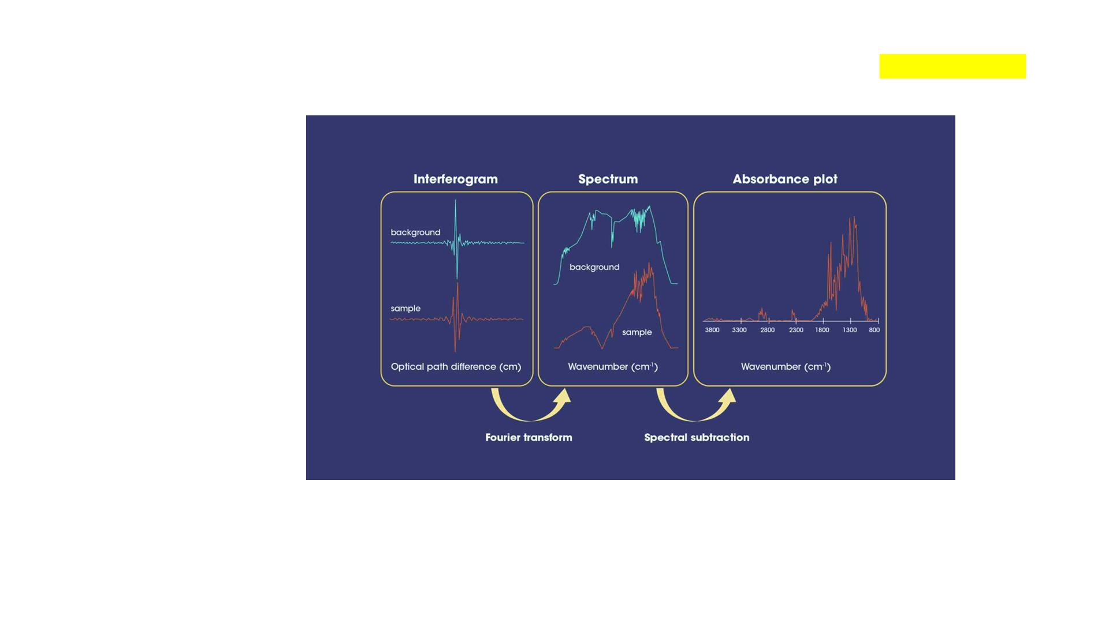
A typical mode of operation first requires a background “blank” spectrum to be collected. This will contain
absorbance values from the entire light beam path. The sample is then analyzed, and the blank spectrum
subtracted from it to yield the spectral responses
Workflow for producing
a typical spectrum
Individual scans are rapid, typically less than 1 second on modern instruments, so with co-adding scans
and background spectral subtraction, analysis workflows for a single sample on an ATR device can be
accomplished in
less than 2 minutes.
17

Slide 18
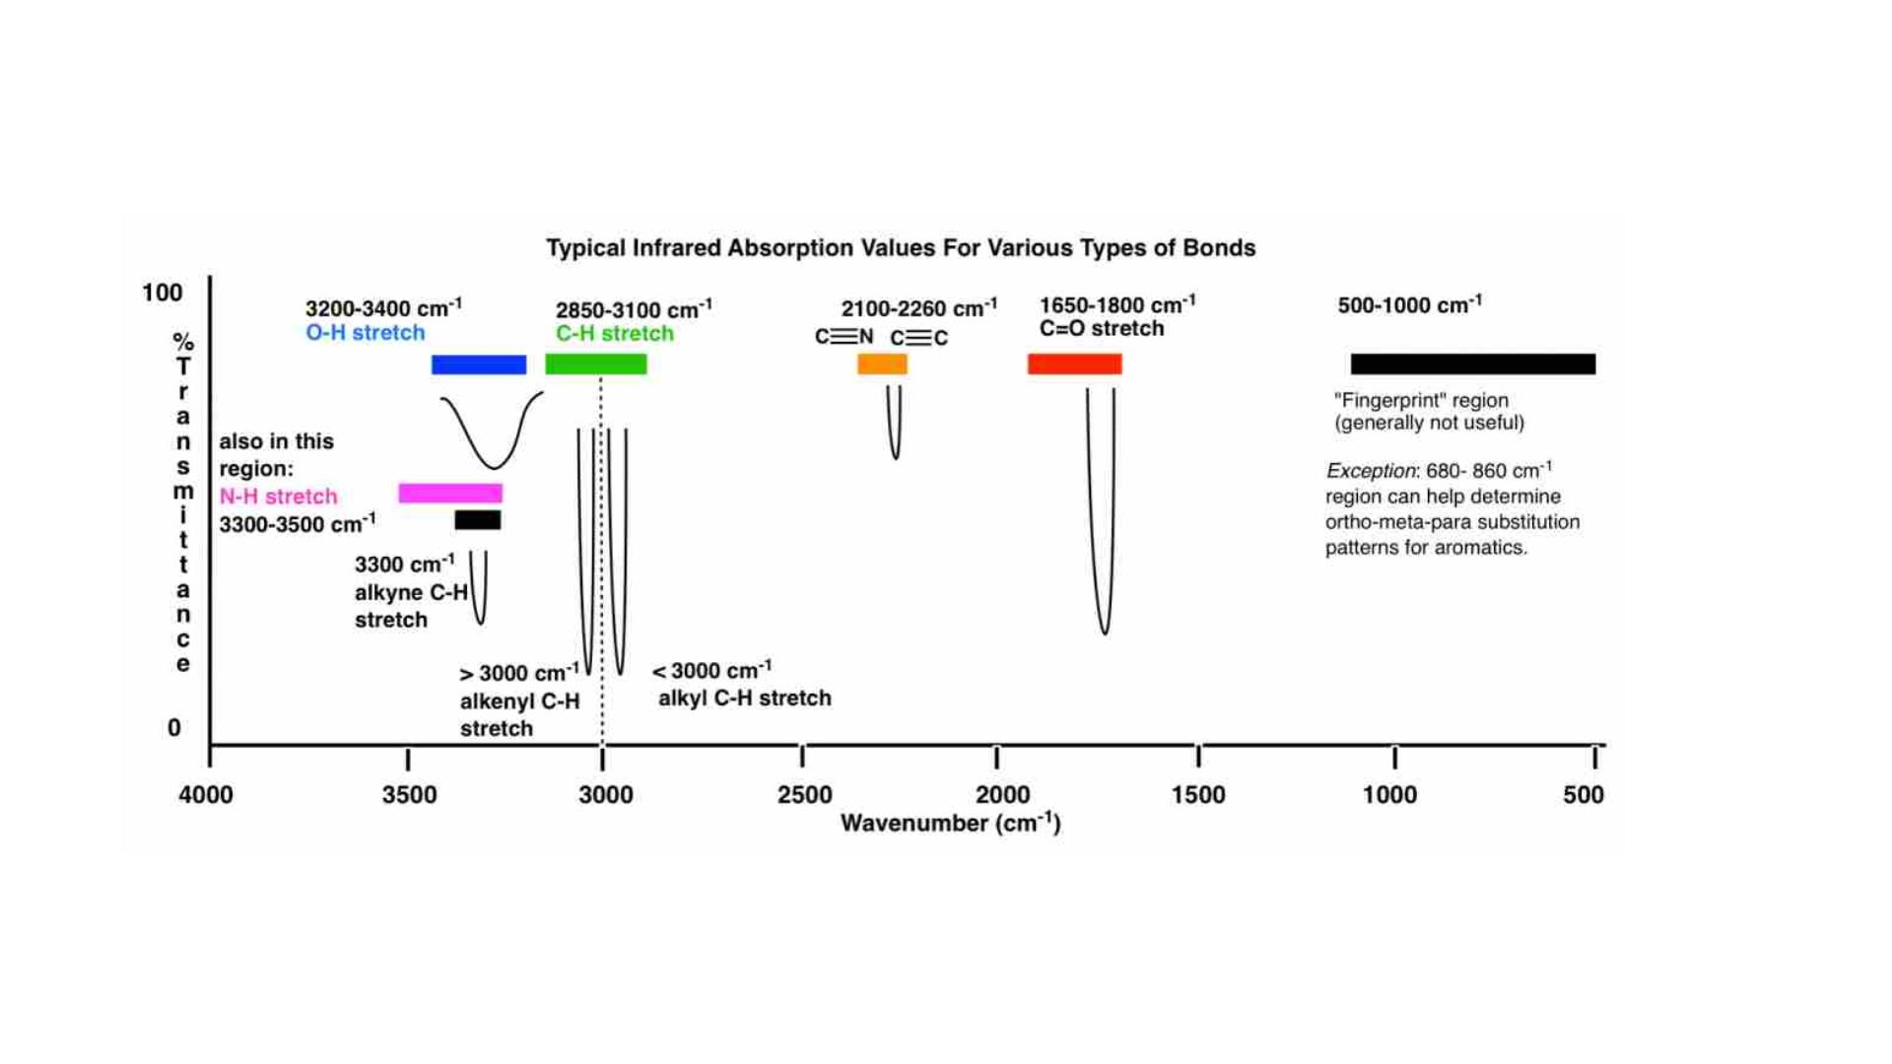
18

Slide 19
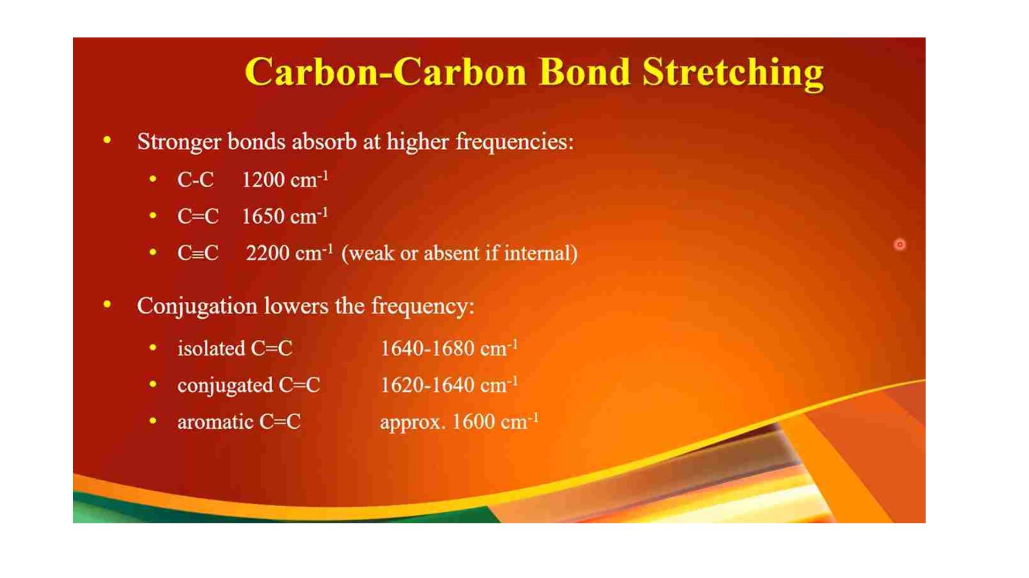
19

Slide 20
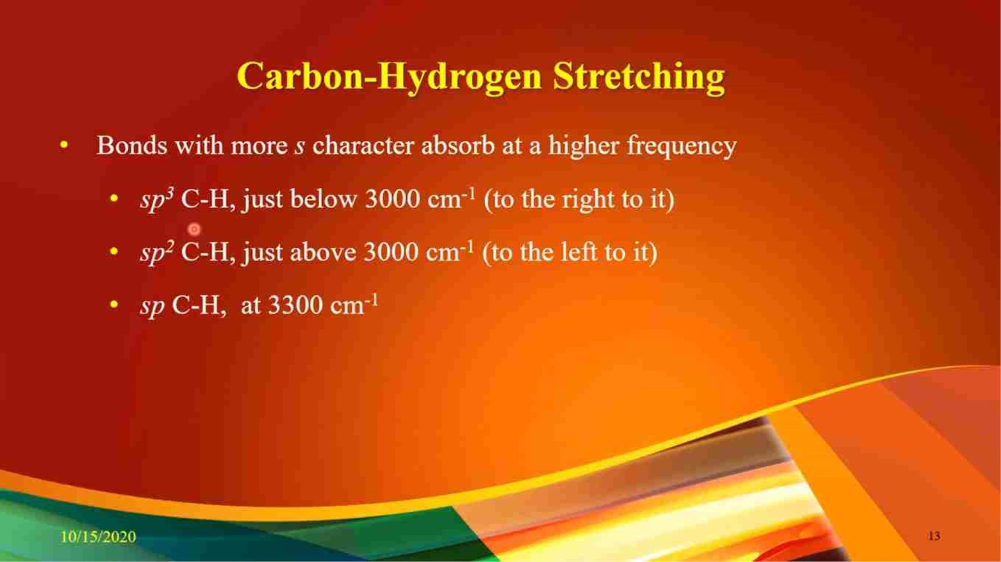

Slide 21
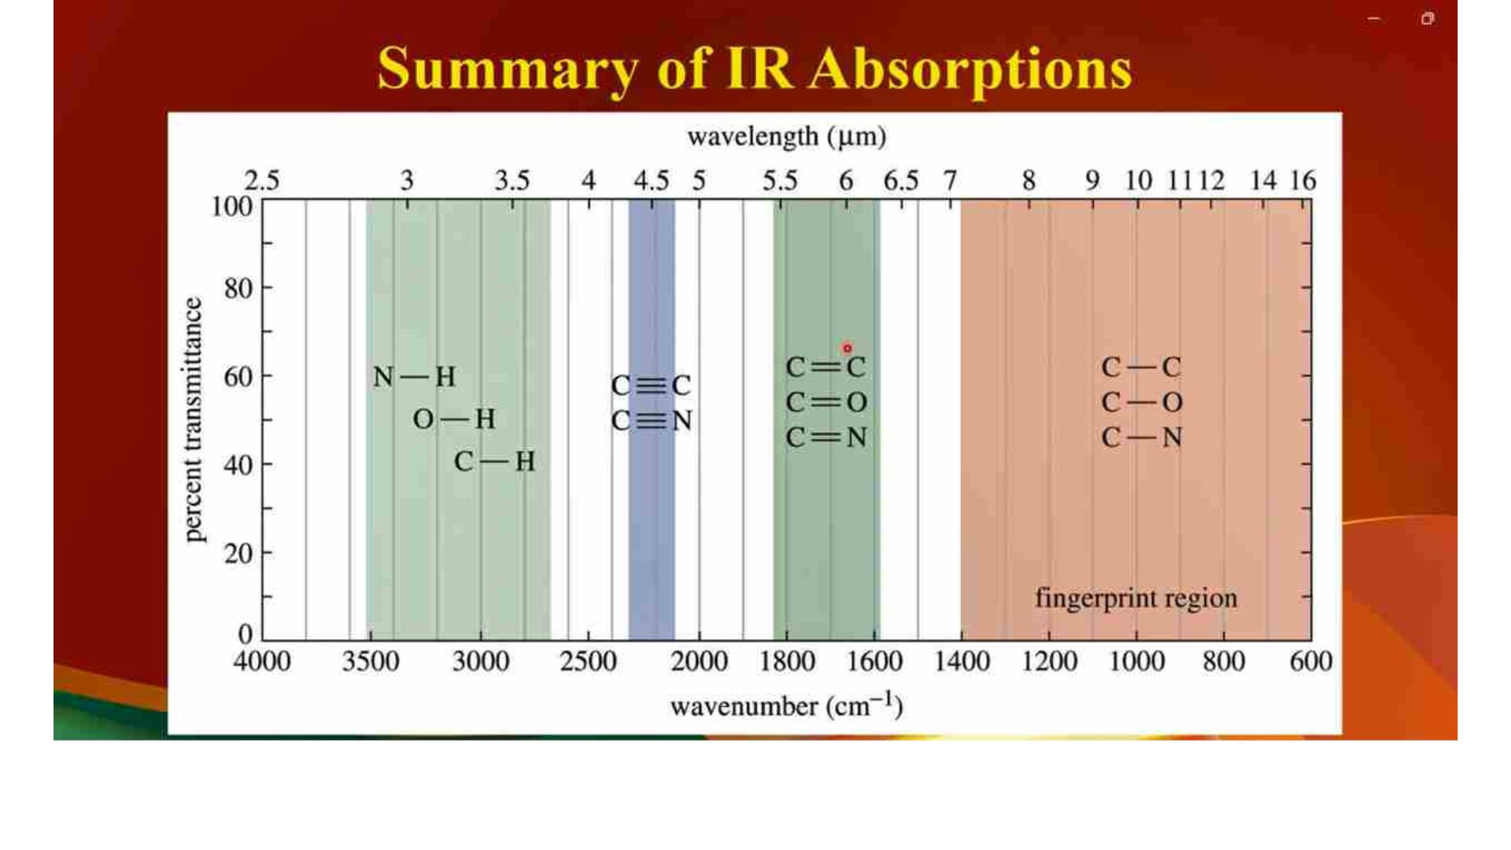
21

Slide 22
Thank you for attention
22

