Slide 1
Solution of Differential Equation by Finite Difference Method

Slide 2
Review
There are two types of differential equations,
Ordinary differential equations (ODE)
and partial differential equations (PDE).
an ODE is that in which all the derivatives are with respect to a single independent variable
PDEs are differential equations containing two or more independent variables,

Slide 3
Review
For many centuries scientists have been trying to solve differential equations.
Often it is difficult to solve these problems by hand or it might even be impossible.
Therefore we will now take a closer look at a very simple method to approximate partial differential equations (PDEs),
which is still used in the industry.

Slide 4
Finite Difference Method The Finite Difference Method consists of the following steps:
Step 1: Write down the PDE What is our problem description
Step 2 : Divide down the domain Our task is set to be finite dimensional.
Step3 : Approximate derivatives ; Insert finite difference approximations for derivatives into the PDE.
Step 4: Put together the linear system with finite difference stencil ;
Rewrite the PDE - that has been approximated with finite differences and discretized on a grid - as a linear equation system.

Slide 5
Finite Difference Method
Step 5: Solve the linear system
Step 6: Visualize the solution
We must answer the following questions: To begin with,
is our solution acceptable?
Secondly, how good is our approximate solution? (quantitative error estimation)
And finally, how quickly does our approximation converge to the analytic solution? (computational convergence)

Slide 6
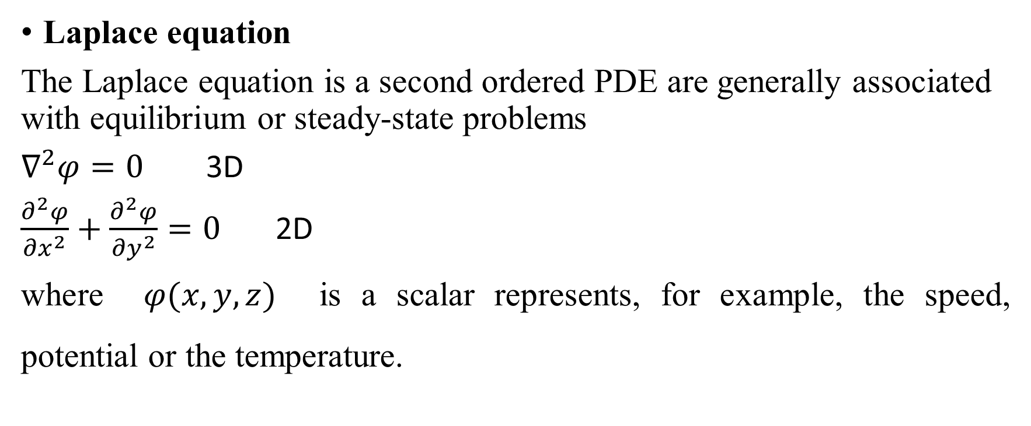
Important second-order PDEs
Laplace equation
The Laplace equation is a second ordered PDE are generally associated with equilibrium or steady-state prob­lems
$∇^{2}φ=0$ 3D
$\frac{∂^{2}φ}{{∂x}^{2}}+\frac{∂^{2}φ}{{∂y}^{2}}=0$ 2D
where $φ(x,y,z)$ is a scalar represents, for example, the speed, potential or the temperature.

Slide 7
Important second-order PDEs
Heat equation
$\frac{∂T}{∂t}=α∇^{2}T$ 3D
$\frac{∂T}{∂t}=α\left(\frac{∂^{2}T}{{∂x}^{2}}+\frac{∂^{2}T}{{∂y}^{2}}\right)$ 2D
The heat equation is a second order PDE describing how temperature $T(x,y,z,t)$ diffuses through a medium of thermal diffusivity $α$

Slide 8
Wave equation
The wave equation describes how the sound pressure $p$ propagates at speed $c_{0}$through a medium (at rest), and plays a role in acoustics, fluid mechanics, and quantum mechanics:
$\frac{1}{c_{0}^{2}}\frac{∂^{2}p}{∂^{2}t}+∇^{2}p=0$ 3D
$\frac{1}{c_{0}^{2}}\frac{∂^{2}p}{∂^{2}t}+\frac{∂^{2}p}{{∂x}^{2}}+\frac{∂^{2}p}{{∂y}^{2}}=0$ 2D

Slide 9
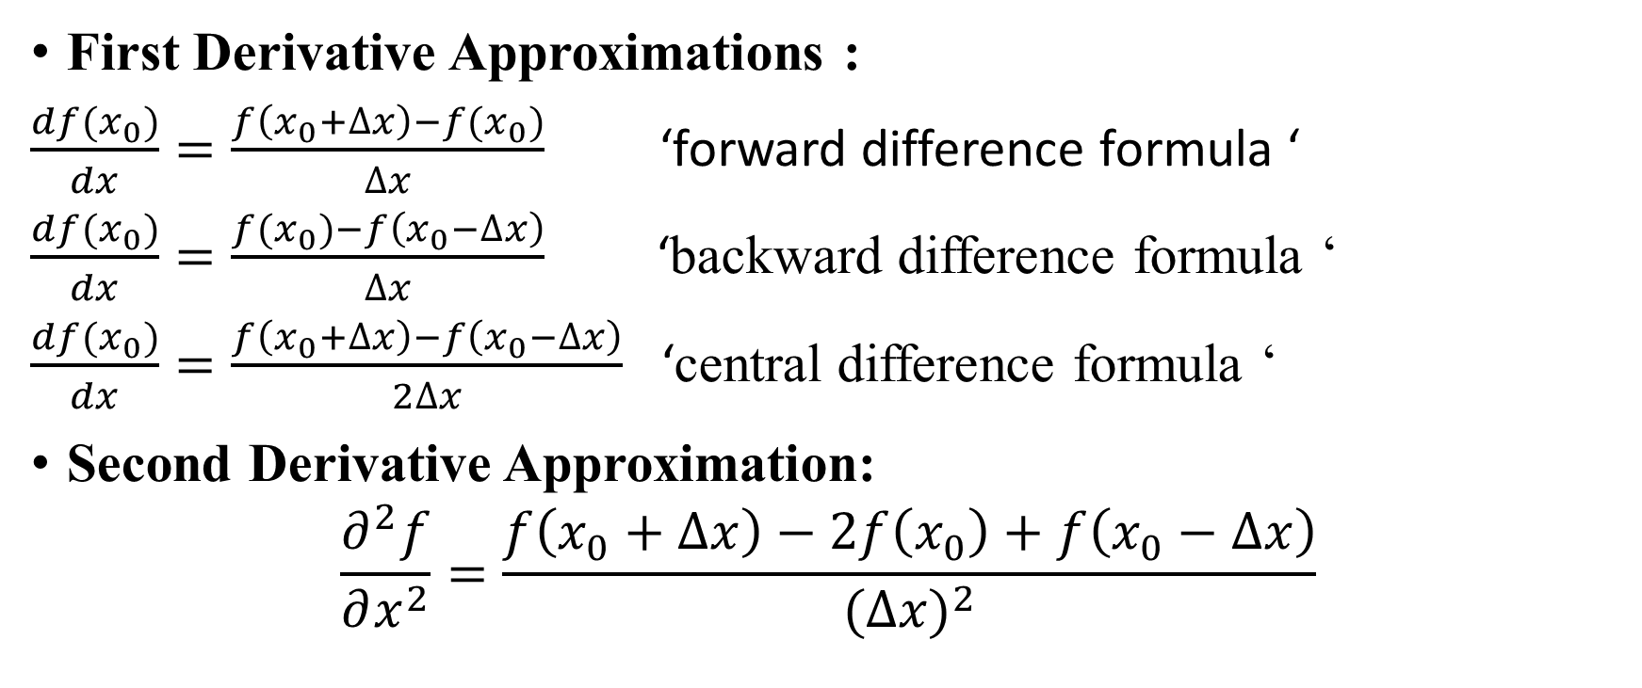
The Finite Difference Method( FDM ) Derivative approximation
First Derivative Approximations :
$\frac{df(x_{0})}{dx}=\frac{f\left(x_{0}+∆x\right)−f(x_{0})}{∆x}$ ‘forward difference formula ‘
$\frac{df(x_{0})}{dx}=\frac{f(x_{0})−f\left(x_{0}−∆x\right)}{∆x}$ ‘backward difference formula ‘
$\frac{df(x_{0})}{dx}=\frac{f\left(x_{0}+∆x\right)−f\left(x_{0}−∆x\right)}{2∆x}$ ‘central difference formula ‘
Second Derivative Approximation:
$$\frac{∂^{2}f}{∂x^{2}}=\frac{f\left(x_{0}+∆x\right)−2f\left(x_{0}\right)+f\left(x_{0}−∆x\right)}{({∆x)}^{2}}$$

Slide 10
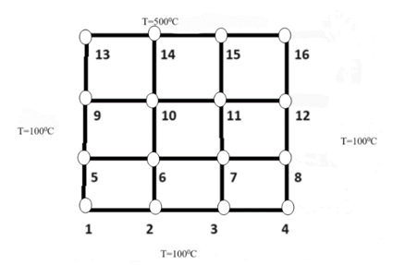

Model problem: Laplace equation
An aluminum plate ($2cm by 2cm$) placed according to following boundary . Use Laplace equation and FDM to estimate the temperature distribution at each point.

Slide 11
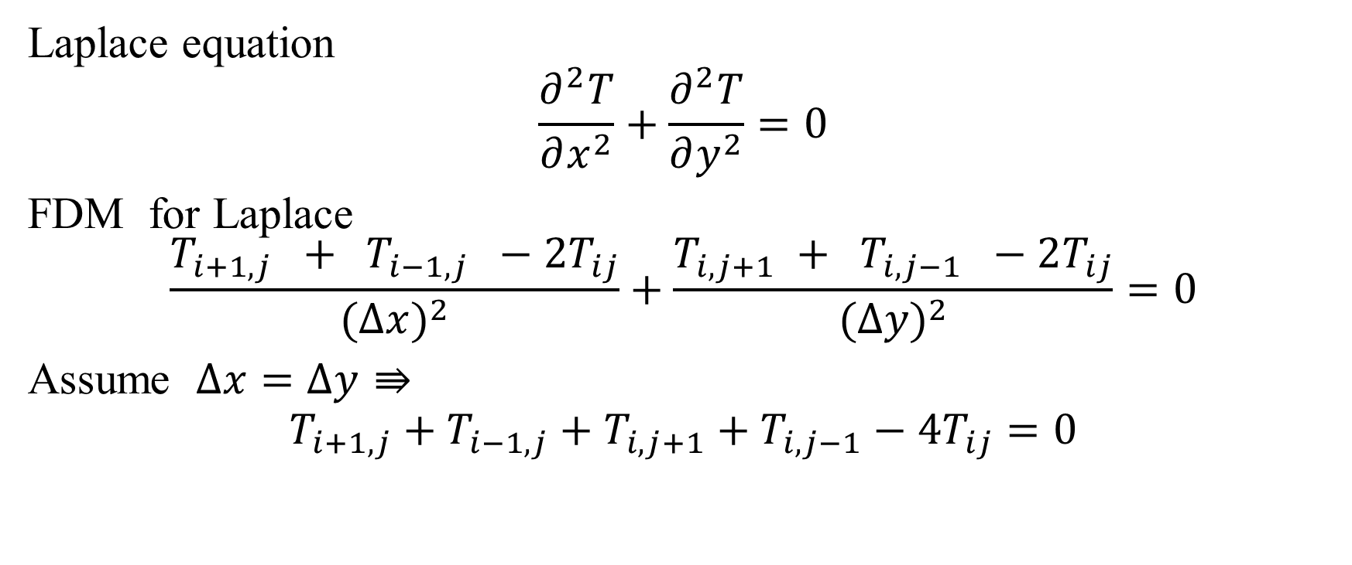
Laplace equation
$$\frac{∂^{2}T}{∂x^{2}}+\frac{∂^{2}T}{∂y^{2}}=0$$
FDM for Laplace
$$\frac{T_{i+1,j} + T_{i−1,j} −2T_{ij}}{({∆x)}^{2}}+\frac{T_{i,j+1} + T_{i,j−1} −2T_{ij}}{{(∆y)}^{2}}=0$$
Assume $∆x=∆y⇛$
$$T_{i+1,j}+T_{i−1,j}+T_{i,j+1}+T_{i,j−1}−4T_{ij}=0$$

Slide 12
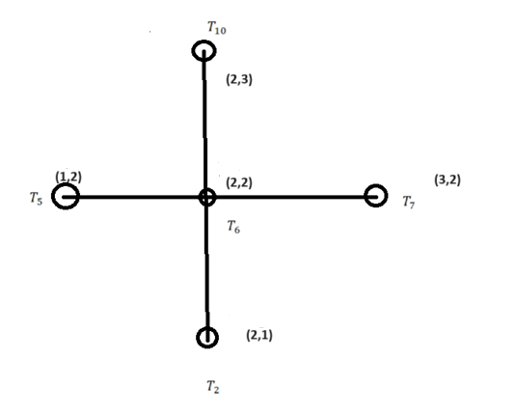
$$T_{i+1,j}+T_{i−1,j}+T_{i,j+1}+T_{i,j−1}−4T_{ij}=0$$

Slide 13
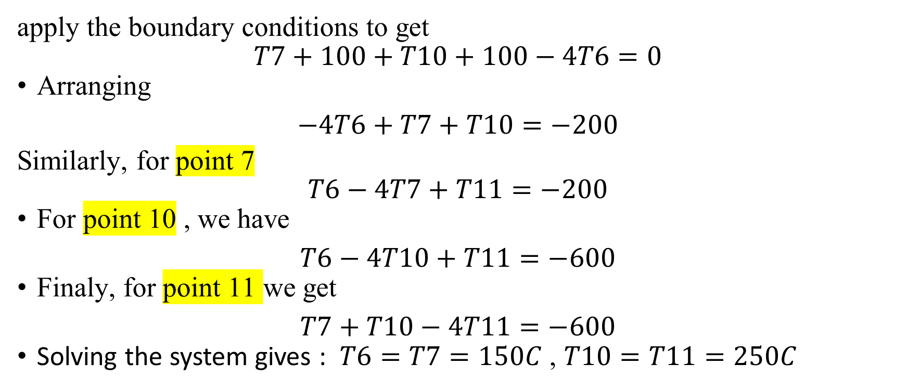
apply the boundary conditions to get
$$T7+100+T10+100−4T6=0$$
Arranging
$$−4T6+T7+T10=−200$$
Similarly, for point 7
$$T6−4T7+T11=−200$$
For point 10 , we have
$$T6−4T10+T11=−600$$
Finaly, for point 11 we get
$$T7+T10−4T11=−600$$
Solving the system gives : $T6=T7=150C$ , $T10=T11=250C$

