Slide 1
The two dimensional harmonic oscillator
Energy Considerations of Harmonic Oscillator
Example (4.7) Lissajous figure

Slide 2
Energy Considerations of Harmonic Oscillator
To calculate the potential energy integrate the following equations
$F_{x}=−∂V/∂x=−k_{1}x$
$F_{y}=−∂V/∂y=−k_{2}y$
$F_{z}=−∂V/∂z=−k_{3}z$
To get
$V(x,y,z)=\frac{1}{2}k_{1}x^{2}+\frac{1}{2}k_{2}y^{2}+\frac{1}{2}k_{3}z^{2}$ “nonisotropic oscillator $k_{1}≠k_{2}≠k_{3}$”
$V(x,y,z)=\frac{1}{2}k\left(x^{2}+y^{2}+z^{2}\right)=\frac{1}{2}kr^{2}$ “ isotropic oscillator $k_{1}=k_{2}=k_{3}$“

Slide 3
Energy Considerations of Harmonic Oscillator
The total energy in the isotropic case is :
$\frac{1}{2}mv^{2}+\frac{1}{2}kr^{2}=E$
Which is similar to that of the one-dimensional case

Slide 4
Example 4.7: A particle of mass m moves in two dimensions under the following potential energy function: $V(r)=\frac{1}{2}k\left(x^{2}+4y^{2}\right)$ . Find the resulting motion, given the initial condition at $t=0:x=a,y=0,$ $\overset{˙}{x}=0,\overset{˙}{y}=v_{0}$
Solution:
Step1 : find the force using the gradient of potential :
$\vec{F}=−\vec{∇}V=−kx\vec{i}−4ky\vec{j}=m\ddot{x}\vec{i}+m\ddot{y}\vec{j}$
Step2 : write the component differential equations :
$m\overset{¨}{x}+kx=0$ (1) $\overset{¨}{x}+ω_{x}^{2}x=0$ ; $ω_{x}=ω=(k/m)^{1/2}$
$m\overset{¨}{y}+4ky=0$ (2) $\overset{¨}{y}+ω_{y}^{2}y=0$ ; $ω_{y}=(4k/m)^{1/2}=2ω.$

Slide 5
$\overset{¨}{x}+ω_{x}^{2}x=0$ (1) x-motion $\overset{¨}{y}+ω_{y}^{2}y=0$ (2) y-motion , $ω_{y}=2ω_{x}$
Step3: write the general solution of Eq.(1) and Eq.(2)
$x=A_{1}cos⁡ωt+B_{1}sin⁡ωt$ (3)
$y=A_{2}cos⁡2ωt+B_{2}sin⁡2ω$ (4)
Step 4: find the velocity components from Eqs (3) and (4) derivation
$\overset{˙}{x}=−A_{1}ωsin⁡ωt+B_{1}ωcos⁡ωt$ (5)
$\overset{˙}{y}=−2A_{2}ωsin⁡2ωt+2B_{2}ωcos⁡2ωt$ (6)
Note : steps 3& 4 are essential to use the initial conditions

Slide 6
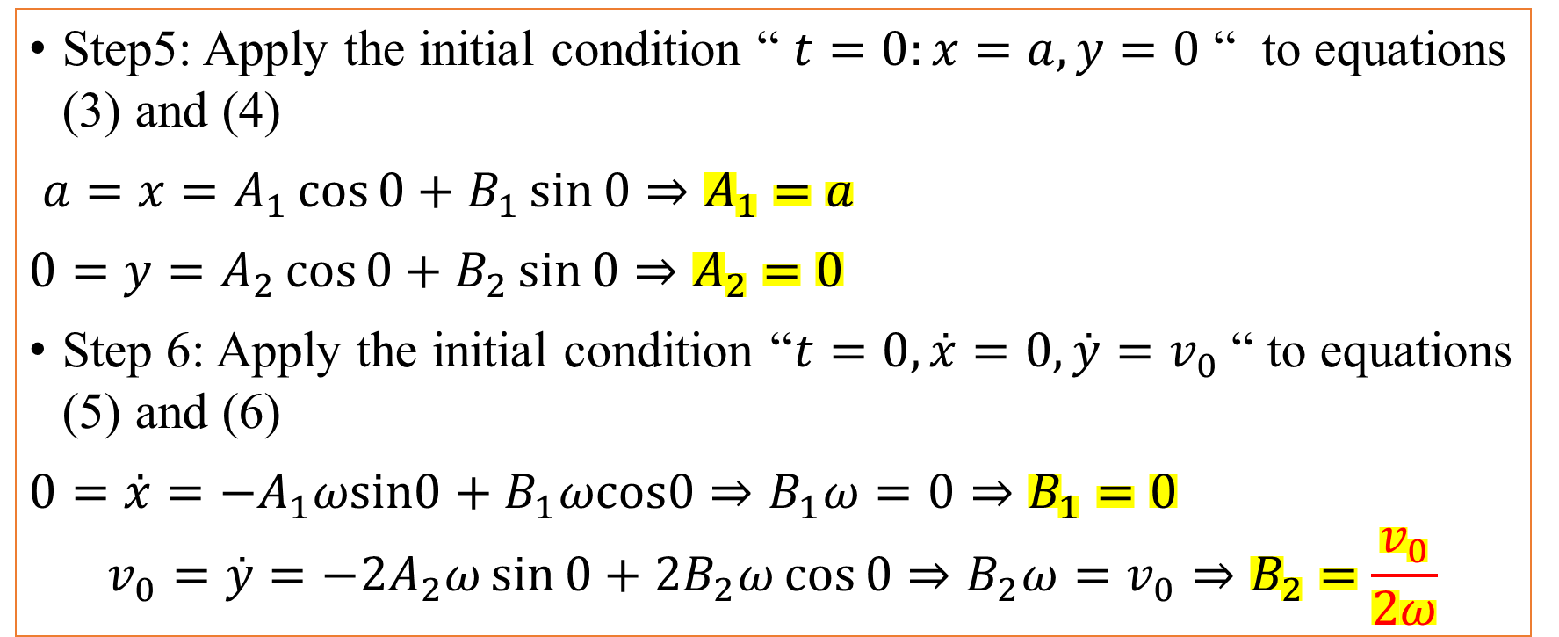
$x=A_{1}cos⁡ωt+B_{1}sin⁡ωt$ (3) , $y=A_{2}cos⁡2ωt+B_{2}sin⁡2ω$ (4) $\overset{˙}{x}=−A_{1}ωsin⁡ωt+B_{1}ωcos⁡ωt$ (5) , $\overset{˙}{y}=−2A_{2}ωsin⁡2ωt+2B_{2}ωcos⁡2ωt$ (6)
Step5: Apply the initial condition “ $t=0:x=a,y=0$ “ to equations (3) and (4)
$a=x=A_{1}\cos{0}+B_{1}\sin{0}⇒A_{1}=a$
$0=y=A_{2}\cos{0}+B_{2}\sin{0}⇒A_{2}=0$
Step 6: Apply the initial condition “$t=0, \overset{˙}{x}=0,\overset{˙}{y}=v_{0}$ “ to equations (5) and (6)
$0=\overset{˙}{x}=−A_{1}ωsin0+B_{1}ωcos0⇒B_{1}ω=0⇒B_{1}=0$
$$v_{0}=\overset{˙}{y}=−2A_{2}ω\sin{0}+2B_{2}ω\cos{0}⇒B_{2}ω=v_{0}⇒B_{2}=\frac{v_{0}}{2ω}$$

Slide 7
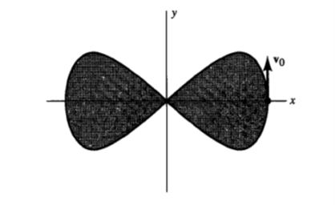
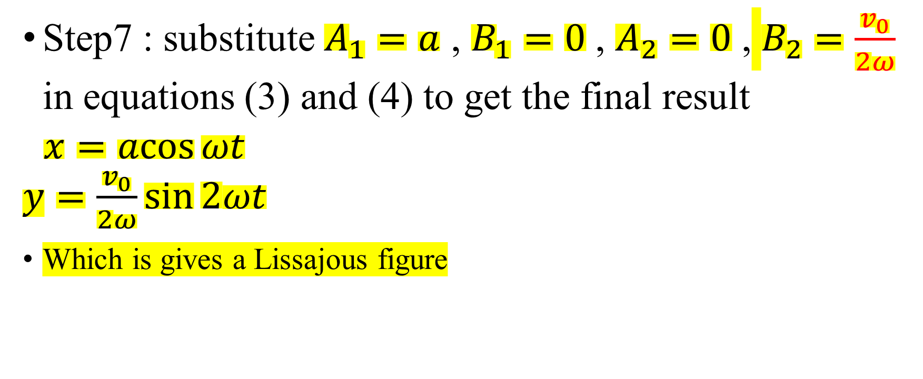
Step7 : substitute $A_{1}=a$ , $B_{1}=0$ , $A_{2}=0$ , $B_{2}=\frac{v_{0}}{2ω}$ in equations (3) and (4) to get the final result
$\begin{matrix}x=acos⁡ωt \\ y=\frac{v_{0}}{2ω}sin⁡2ωt\end{matrix}$
Which is gives a Lissajous figure

Slide 8
Homework 3.3
Solve example 4.1 by using
$x=A\cos\left(ωt+α\right)$
$$y=B\cos\left(2ωt+β\right)$$
Answer: $A=a, B=−\frac{v_{0}}{2ω}$ , $α=0, ∆=β=\frac{π}{2},$
$$x=a\cos{(ωt)},y=\frac{v_{0}}{2ω}\sin{(2ωt)}$$

