Slide 1
Constrained Motion of a Particle

Slide 2
Constrained Motion
When a moving particle is restricted geometrically in the sense that it must stay on a certain definite surface or curve, the motion is said to be constrained.
A piece of ice sliding around a bowl and a bead sliding on a wire are examples of constrained motion.
The constraint may be complete, as with the bead, or it may be one-sided, as with the ice in the bowl.

Slide 3
4.8.1 The Energy Equation for Smooth Constraints
The total force acting on a particle moving under constraint can be expressed as the vector sum of the net external force $\vec{F}$ and the force of constraint $\vec{R}$.
$\vec{R}$is the reaction of the constraining cause upon the particle.
The equation of motion may, therefore, be written
$m\frac{d\vec{v}}{dt}=\vec{F}+\vec{R}$
If we take the dot product with the velocity $\vec{v}$, we have

Slide 4
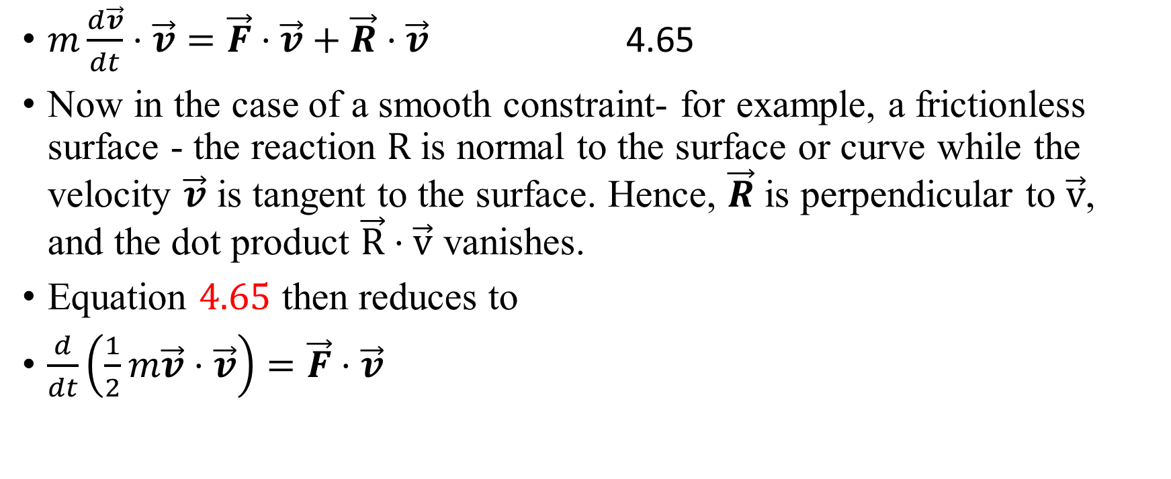
The Energy Equation for Smooth Constraints
$m\frac{d\vec{v}}{dt}⋅\vec{v}=\vec{F}⋅\vec{v}+\vec{R}⋅\vec{v}$ 4.65
Now in the case of a smooth constraint- for example, a frictionless surface - the reaction $R$ is normal to the surface or curve while the velocity $\vec{v}$ is tangent to the surface. Hence, $\vec{R}$ is perpendicular to $\vec{v}$, and the dot product $\vec{R}⋅\vec{v}$ vanishes.
Equation $4.65$ then reduces to
$\frac{d}{dt}\left(\frac{1}{2}m\vec{v}⋅\vec{v}\right)=\vec{F}⋅\vec{v}$

Slide 5
The Energy Equation for Smooth Constraints
Therefore, if F is conservative, we can integrate as in section 4.2, and we find that, its total energy remains constant, namely,
$\frac{1}{2}mv^{2}+V(x,y,z)= \text{constant} =E$
We might, of course, have expected this to be the case for frictionless constraints.

Slide 6
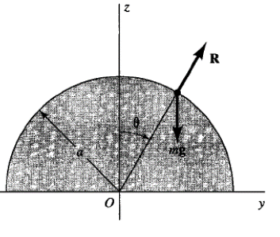
Example 4.9
A particle is placed on top of a smooth sphere of radius a. If the particle is slightly disturbed, at what point will it leave the sphere?
Solution:
The forces acting on the particle are
1. the downward force of gravity and
2. the reaction $\vec{R}$ of the spherical surface.
The equation of motion is
$md\vec{v}/dt=m\vec{g}+\vec{R}$

Slide 7
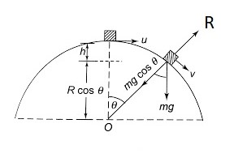
The potential energy is $mgz$
$\frac{1}{2}mv^{2}+mgz=E$
From the initial conditions $(v=0$ for $z=a$ ) we have $E=mga$, so, as the particle slides down, its speed is given by the equation
$v^{2}=2g(a−z)$
Now, if we take radial components of the equation of motion, we can write the force equation as
$−\frac{mv^{2}}{a}=−mgcosθ+R=−mg\frac{z}{a}+R$
Hence,
$$\begin{matrix} & R =mg\frac{z}{a}−\frac{mv^{2}}{a}=mg\frac{z}{a}−\frac{m}{a}2g\left(a−z\right) \\ & =\frac{mg}{a}\left(3z−2a\right)\end{matrix}$$
Thus, $R$ vanishes when $z=\frac{2}{3}a$, at which point the particle leaves the sphere.

Slide 8
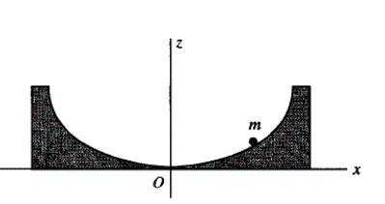
Example 4.10 Constrained Motion on a Cycloid
Consider a particle sliding under gravity in a smooth cycloidal trough, see the figure below , represented by the parametric equations
$$\begin{matrix}x=A(2φ+sin2φ) \\ z=A(1−cos2φ)\end{matrix}$$
$φ$ is the parameter
We want to study this motion

Slide 9
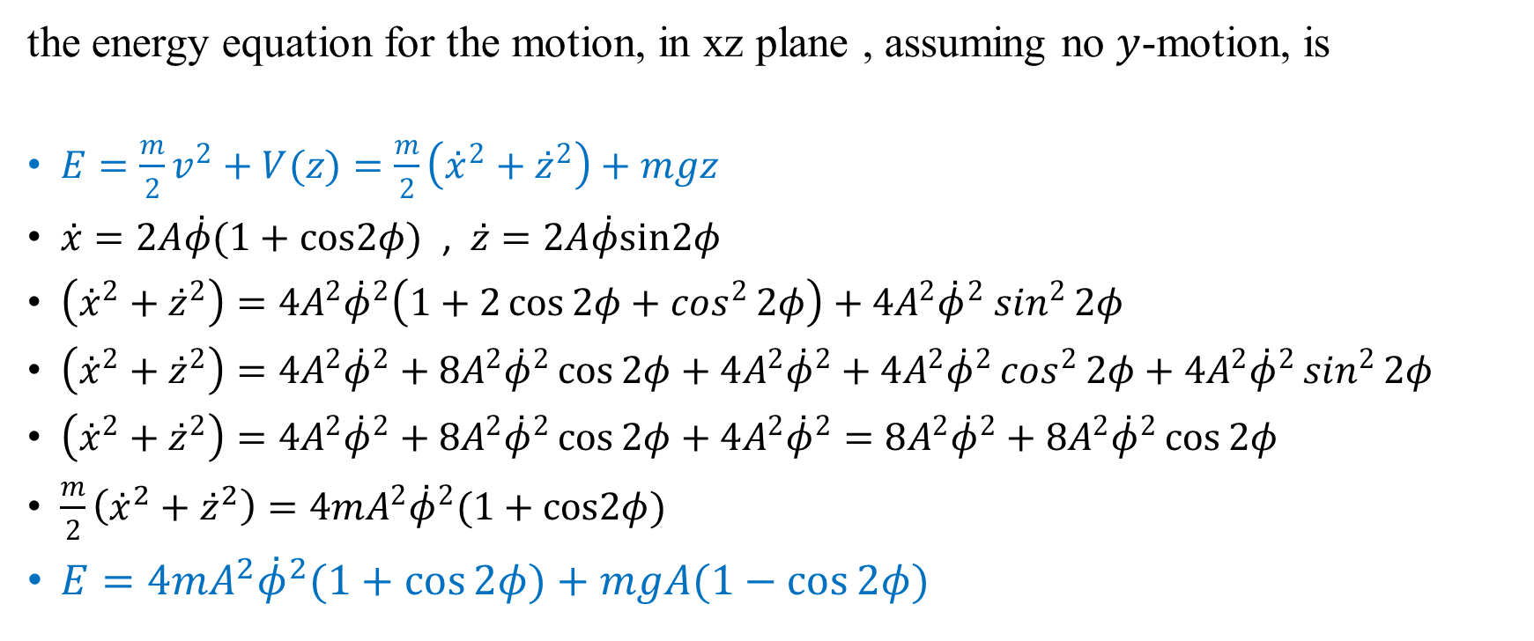
$\begin{matrix}x=A(2φ+sin2φ) \\ z=A(1−cos2φ)\end{matrix}$
the energy equation for the motion, in xz plane , assuming no $y$-motion, is
$E=\frac{m}{2}v^{2}+V(z)=\frac{m}{2}\left({\overset{˙}{x}}^{2}+{\overset{˙}{z}}^{2}\right)+mgz$
$\overset{˙}{x}=2A\overset{˙}{φ}(1+cos2φ)$ , $\overset{˙}{z}=2A\overset{˙}{φ}sin2φ$
$\left({\overset{˙}{x}}^{2}+{\overset{˙}{z}}^{2}\right)=4A^{2}{\overset{˙}{φ}}^{2}\left(1+2\cos{2φ}+\cos^{2}{2φ}\right)+4A^{2}{\overset{˙}{φ}}^{2}$ $\sin^{2}{2φ}$
$\left({\overset{˙}{x}}^{2}+{\overset{˙}{z}}^{2}\right)=4A^{2}{\overset{˙}{φ}}^{2}+8A^{2}{\overset{˙}{φ}}^{2}\cos{2φ}+4A^{2}{\overset{˙}{φ}}^{2}+4A^{2}{\overset{˙}{φ}}^{2}\cos^{2}{2φ}+4A^{2}{\overset{˙}{φ}}^{2}\sin^{2}{2φ}$
$\left({\overset{˙}{x}}^{2}+{\overset{˙}{z}}^{2}\right)=4A^{2}{\overset{˙}{φ}}^{2}+8A^{2}{\overset{˙}{φ}}^{2}\cos{2φ}+4A^{2}{\overset{˙}{φ}}^{2}=8A^{2}{\overset{˙}{φ}}^{2}+8A^{2}{\overset{˙}{φ}}^{2}\cos{2φ}$
$\frac{m}{2}\left({\overset{˙}{x}}^{2}+{\overset{˙}{z}}^{2}\right)=4mA^{2}{\overset{˙}{φ}}^{2}(1+cos2φ)$
$E=4mA^{2}{\overset{˙}{φ}}^{2}(1+cos⁡2φ)+mgA(1−cos⁡2φ)$

Slide 10
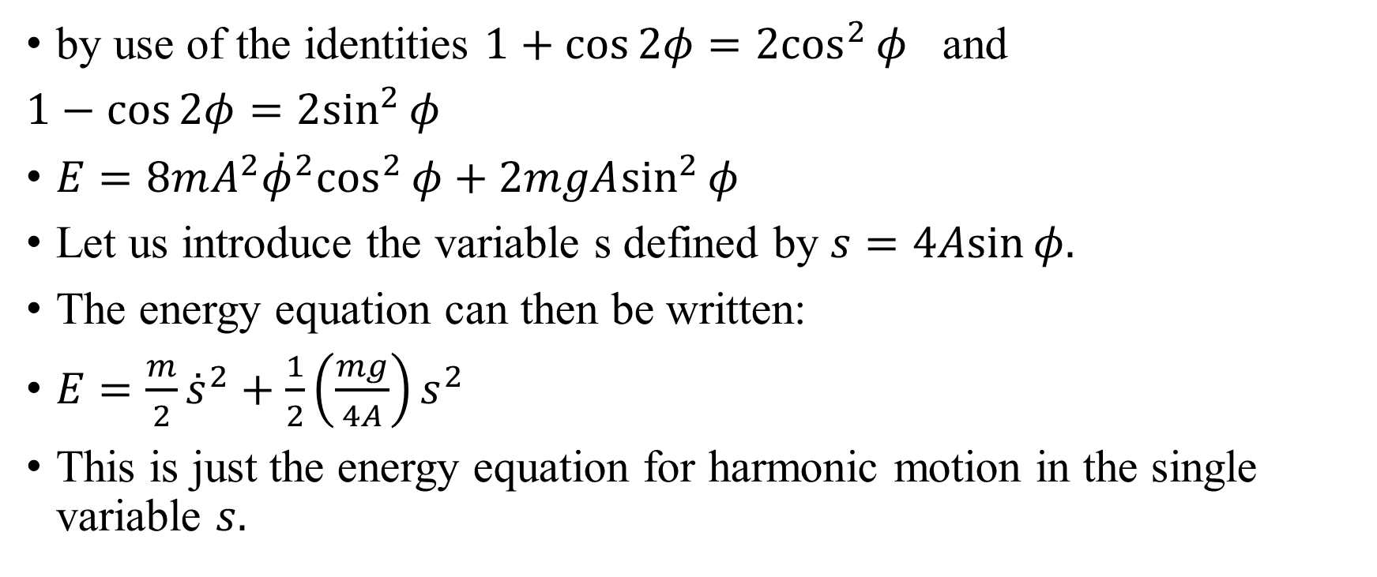
$E=4mA^{2}{\overset{˙}{φ}}^{2}(1+cos⁡2φ)+mgA(1−cos⁡2φ)$
by use of the identities $1+cos⁡2φ=2\cos^{2}⁡φ$ and
$1−cos⁡2φ=2\sin^{2}⁡φ$
$E=8mA^{2}{\overset{˙}{φ}}^{2}\cos^{2}⁡φ+2mgA\sin^{2}⁡φ$
Let us introduce the variable s defined by $s=4Asin⁡φ.$
The energy equation can then be written:
$E=\frac{m}{2}{\overset{˙}{s}}^{2}+\frac{1}{2}\left(\frac{mg}{4A}\right)s^{2}$
This is just the energy equation for harmonic motion in the single variable $s.$

Slide 11
constrained motion on a cycloid
Thus, the particle undergoes periodic motion whose frequency is independent of the amplitude of oscillation, unlike the simple pendulum for which the frequency depends on the amplitude. The periodic motion in the present case is said to be isochronous. (The linear harmonic oscillator under Hooke's law is, of course, isochronous.)
The Dutch physicist and mathematician Christiaan Huygens discovered the above fact in connection with attempts to improve the accuracy of pendulum clocks.
Though ingenious, the invention never found extensive practical use.

