Slide 1
Chapter Three Oscillations
Introduction
Linear Restoring Force: Harmonic Motion

Slide 2
Introduction
Examples of harmonic motion HM :
The small oscillations of a pendulum clock,
A child playing on a swing,
The swaying of a tree in the wind,
The vibrations of the strings on a violin.
The vibrations of the atoms and molecules that make up our bodies
The essential feature that all these phenomena have in common is periodicity, a pattern of movement or displacement that repeats itself over and over again

Slide 3
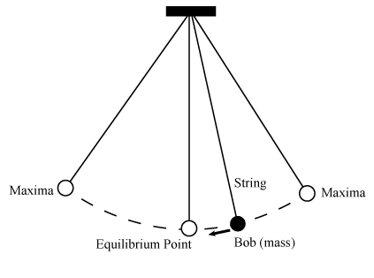
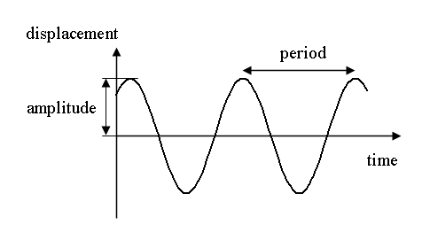
Horizontal displacement of a simple pendulum about equilibrium

Slide 4
SHM essential characteristics
Simple harmonic motion exhibits two essential characteristics
It is described by a second-order, linear differential equation with constant coefficients. Thus, the superposition principle holds
The period of the motion, or the time required for a particular configuration (not only position, but velocity as well) to repeat itself independent of the maximum displacement form equilibrium.
These features are true only if the displacements from equilibrium is very small

Slide 5
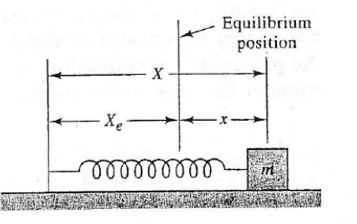
Linear Restoring Force: Harmonic Motion
One of the simplest models of a system executing simple harmonic motion SHM is a mass on a frictionless surface attached to a wall by means of a spring.
If the mass is pushed or pulled away from this position, the spring will be either compressed or stretched. It will then exert a force on the mass, which will always attempt to restore it to its equilibrium configuration.

Slide 6
SHM : an expression for the restoring force
In general, any potential energy function can be described approximately by a polynomial function of the displacement $x$ for displacements not too far from equilibrium.
$V\left(x\right)=a_{0}+a_{1}x+a_{2}x^{2}+a_{3}x^{3}+………+a_{n}x^{n}$
because only differences in potential energies are significant for the behavior of physical systems, the constant term $\left(a_{0}\right)$ in the above expressions may be taken to be zero.
We also say that the linear term ( $a_{1}x$ )in the above expression must be identically zero. This condition follows the fact that the first derivative of any function must vanish at minimum.

Slide 7
an expression for the restoring force
${\left(\frac{dV(x)}{dx}\right)}_{\text{min}}=0=a_{1}+2a_{2}x+……⇒a_{1}=0$
Thus, the approximating polynomial takes the form:
$V(x)=a_{2}x^{2}+a_{3}x^{3}+………+a_{n}x^{n}$
The potential energy function for the system of spring and mass must exhibit similar behavior of Morse function near the equilibrium position at $X_{e}$ dominated by a purely quadratic term.
$V(x)≈a_{2}x^{2}$

Slide 8
an expression for the restoring force
The springs restoring force is thus given by the familiar Hooke's law
$F(x)=−\frac{dV}{dx}=−2a_{2}x=−kx$
where $k=2a_{2}$ is the spring’s constant.
In fact, this is how we define small displacements from equilibrium, that is, those for which Hooke's law is valid or the restoring force is linear.
That the derived force must be a restoring one is a consequence of the fact that the derivative of the potential energy function must be negative for positive displacements from equilibrium and vice versa for negative ones.

Slide 9
The Differential Equation of SHM
Newton's second law of motion for the mass
$m\frac{dv}{dt}=−kx⟺m\overset{¨}{x}=−kx$ $⟺$ $m\overset{¨}{x}+kx=0$
$\overset{¨}{x}+\frac{k}{m}x=0$
It is a second-order, linear differential equation with constant coefficients. The principle of superposition holds for its solutions.
In fact, sines and cosines are the real solutions other functions, imaginary exponentials, are actually equivalent to sines and cosines and are easier to use in describing the more complicated systems

Slide 10
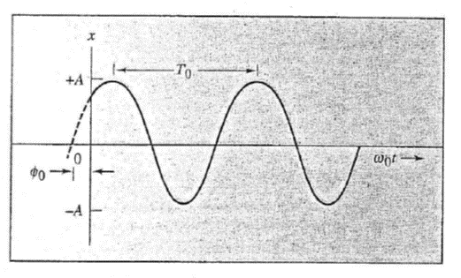
The general solution for SHM
A solution is given by:
$$x=Asin\left(ω_{0}t+φ_{0}\right)$$
$ω_{0}=\sqrt{\frac{k}{m}}$ is The angular frequency of the system

Slide 11
SHM Solution Features $x=Asin\left(ω_{0}t+φ_{0}\right)$
The SH motion exhibits the following features.
It is characterized by a single angular frequency $ω_{0}$. The motion repeats itself after the angular argument of the sine function $\left(ω_{0}t+φ_{0}\right)$ advances by $2π$ or after one cycle has occurred
$$\begin{matrix}ω_{0}\left(t+T_{0}\right)+φ_{0}=ω_{0}t+ω_{0}T_{0}+φ_{0}{=ω}_{0}t+2π+φ_{0} \\ ⇒T_{0}=\frac{2π}{ω_{0}}\end{matrix}$$
$T_{o}$ is called the period of the motion

Slide 12
SHM solution features
The motion is bounded; that is, it is confined within the limits $−A≤x≤ +A$ where $A$, the maximum displacement from equilibrium, is called the amplitude of the motion. It is independent of the angular frequency for SHM.
The phase angle $φ_{0}$ is the initial value of the angular argument of the sine function. It determines the value of the displacement $x$ at time $t=0$.
For example, at $t=0$ we have: $x(t=0)=Asin\left(φ_{0}\right)$

