Slide 1
Harmonic Oscillator
Examples
Effect of a Constant External Force on a Harmonic Oscillator

Slide 2
Example 3.1: Show that the solution of simple harmonic motion is given by equation $x=A sin\left(ω_{0}t+θ_{0}\right)$
$m\overset{¨}{x}+kx=0$ is the differential eq. of SHM
$\overset{¨}{x}+ω_{0}^{2}x=0$ ----------(1) after divided the above equation by $m$
where $ω_{0}^{2}=\frac{k}{m}$
Let $x=Ae^{qt}$------- (2) be the solution of equation (1) then
$\overset{°°}{x}=q^{2}Ae^{qt}$ ----------------------- (3)
By substituting EQs(2) and (3) in EQ.(1)
$\left(q^{2}+ω_{0}^{2}\right)Ae^{qt}=0$ ------------------(4)
$⟹\left(q^{2}+ω_{0}^{2}\right)=0$

Slide 3
Example 3.1
$⟹q=\sqrt{−ω_{0}}=±i\sqrt{ω_{0}}$
We have $x=Ae^{qt}$ , and the differential EQ. of SHM , Eq.(1), is second order hence we get two roots hence the general solution is
$x=A_{1}e^{iω_{0}t}+A_{2}e^{−iω_{0}t}$ --------( 5) where $A_{1}$ and $A_{2}$ are constants
Using $e^{iω_{0}t}=\cos{ω_{0}t+i\sin{ω_{0}t}}$ and
$e^{−iω_{0}t}=\cos{ω_{0}t−i\sin{ω_{0}t}}$ in eq.(5)
$x=A_{1}(\cos{ω_{0}t+i\sin{ω_{0}t}})+A_{2}(\cos{ω_{0}t−i\sin{ω_{0}t}})$
$x=\left(A_{1}+A_{2}\right)\cos{ω_{0}t}+i\left(A_{1}−A_{2}\right)\sin{ω_{0}t}$ ------- (6)

Slide 4
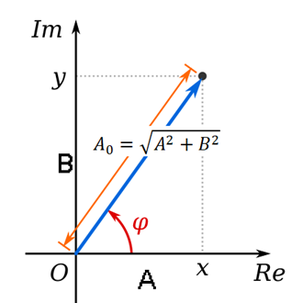
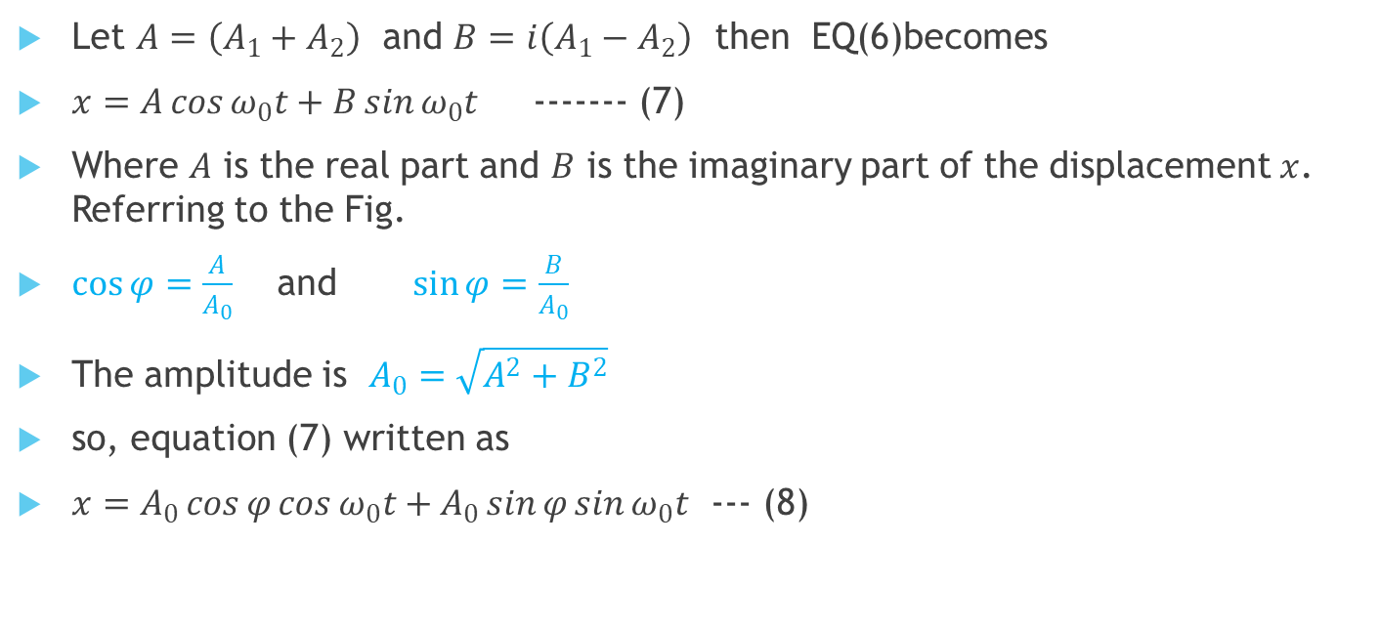
$x=\left(A_{1}+A_{2}\right)\cos{ω_{0}t}+i\left(A_{1}−A_{2}\right)\sin{ω_{0}t}$ --------------- (6)
Let $A=\left(A_{1}+A_{2}\right)$ and $B=i\left(A_{1}−A_{2}\right)$ then EQ(6)becomes
$x=A\cos{ω_{0}t}+B\sin{ω_{0}t}$ ------- (7)
Where $A$ is the real part and $B$ is the imaginary part of the displacement $x$. Referring to the Fig.
$\cos{φ=\frac{A}{A_{0}}}$ and $\sin{φ=\frac{B}{A_{0}}}$
The amplitude is $A_{0}=\sqrt{A^{2}+B^{2}}$
so, equation (7) written as
$x=A_{0}\cos{φ}\cos{ω_{0}t}+A_{0}\sin{φ}\sin{ω_{0}t}$ --- (8)

Slide 5

$x=A_{0}\cos{φ}\cos{ω_{0}t}+A_{0}\sin{φ}\sin{ω_{0}t}$--- (8)
$⇛ x=A_{0}\cos{(}ω_{0}t− φ)$ -------- (8)
The expression (8) can be also written as
$x=A_{0}\sin{(}ω_{0}t+θ_{0})$
where $θ_{0}=\frac{π}{2}− φ$

Slide 6
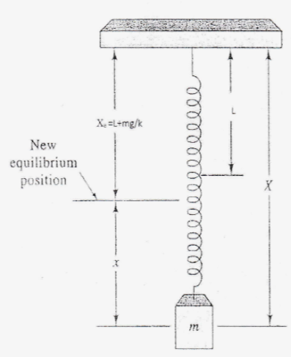
Effect of a Constant External Force on a Harmonic Oscillator
Suppose the same spring shown in Figure 3.5 is held in a vertical position, supporting the same mass $m$ , the positive direction is down. If $D$ is the amount of stretch over unstretched length $L$
then at equilibrium position the total force that
acting on the particle is zero
$\sum{F}=−kD+mg=0$ “at equilibrium position’
Hence $D=\frac{mg}{k}$

Slide 7
$D=\frac{mg}{k}$
Far from equilibrium by x
$F=−(x+D)k+mg=−\left(x+\frac{mg}{k}\right)k+mg$
$F=−kx−mg+mg=−kx$ -------- (1)
This is the same expression when the system is held horizontally, and the motion of the mass is SHM when the mass released.
The period of the harmonic oscillation is given by
$T_{0}=2π\sqrt{\frac{m}{k}}$ $=2π\sqrt{\frac{D}{g}}$

Slide 8
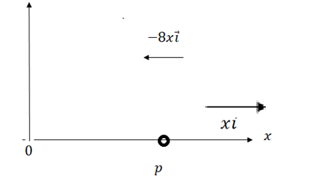
Example 3.2
A particle $P$ of mass $2$ moves along the $x$ axis attracted toward origin $O$ by a force whose magnitude is numerically equal to $8x$ [see the Figure below]. If it is initially at rest at $x=20$, find (a) the differential equation and initial conditions describing the motion,( $b$ ) the position of the particle at any time, (c) the speed and the velocity of the particle at any time and (d) the amplitude, period and frequency of the vibration.

Slide 9
Solution (a) $\overset{¨}{x}+ω_{0}^{2}x=0$
(a) The net force acting on particle is
$$F=−8x$$
Then by using the Newton's second law;
$$\begin{matrix}m\overset{¨}{x}=F \\ 2\overset{¨}{x}=−8x \\ \begin{aligned}\overset{¨}{x}+4x=0 ;…….. (1) \\ w_{0}^{2}=4⇒w_{0}=2\end{aligned}\end{matrix}$$
The initial conditions are: $x=20,\overset{˙}{x}=0,$ at $t=0$

Slide 10
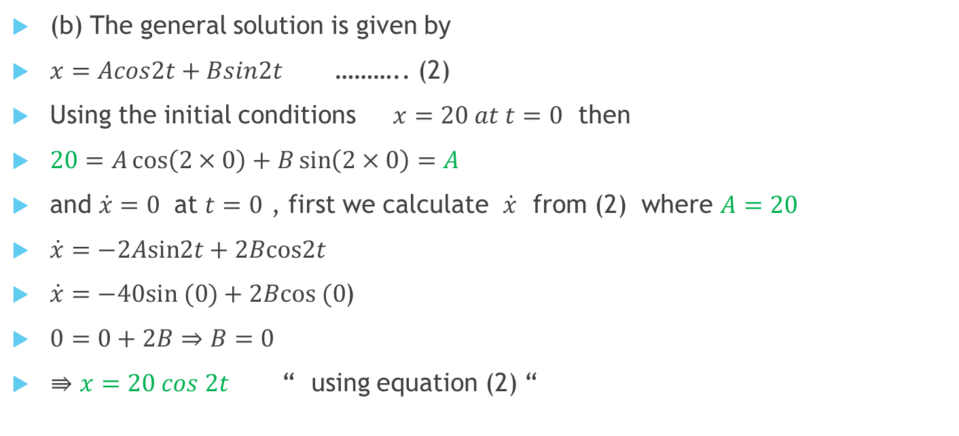
Solution(b) $x=A\cos{ω_{0}t}+B\sin{ω_{0}t}$ , $w_{0}=2$ , $x=20 at t=0$
(b) The general solution is given by
$x=Acos2t+Bsin2t$ ……….. (2)
Using the initial conditions $x=20 at t=0$ then
$20=A\cos\left(2×0\right)+B\sin\left(2×0\right)=A$
and $\overset{˙}{x}=0$ at $t=0$ , first we calculate $\overset{˙}{x}$ from (2) where $A=20$
$\overset{˙}{x}=−2Asin2t+2Bcos2t$
$\overset{˙}{x}=−40sin (0)+2Bcos (0$)
$0=0+2B⇒B=0$
$⇛x=20 cos 2t$ “ using equation (2) “

Slide 11

solution (c) & (d) $x=20 cos 2t$ , $w_{0}=2$
(c) The velocity is
$\vec{v}=\vec{i}\frac{dx}{dt}=−40\vec{i}sin(2t)$
the speed is
$v=40sin2t$ (d) The amplitude is
$A_{0}=\sqrt{A^{2}+B^{2}}=\sqrt{{20}^{2}+0^{2}}=20$ The period: $T=\frac{2π}{w_{0}}=\frac{2π}{2}=π$ and
the frequency: $f_{0}=\frac{1}{T}=\frac{1}{π}$

