Slide 1
Harmonic motion
Energy Consideration in Harmonic Motion
Turning points
The general solution of SHM
The average kinetic and potential energy for harmonic oscillator
Total energy

Slide 2
Energy Consideration in Harmonic Motion
Because the restoring force is only a function in position $x,(F=−kx)$, then one can obtain the potential energy function from well-known relation
$F=−\frac{dV}{dx}$
$−kx=−\frac{dV}{dx}$
$⇒V=\int{ }kxdx=\frac{1}{2}kx^{2}+V_{0}$
Let $V=0$ at equilibrium position where $x=0$ and $F=0$ , then $V_{0}=0$ , so
$$V=\frac{1}{2}kx^{2}$$

Slide 3
Energy Consideration in Harmonic Motion
The total energy is the sum of kinetic and potential energy:
$E=T+V$
$\begin{matrix}E=\frac{1}{2}m{\overset{˙}{x}}^{2}+\frac{1}{2}kx^{2} \\ E=\frac{1}{2}mv^{2}+\frac{1}{2}kx^{2}\end{matrix}$ ……………(A)
The speed of the particle “ Using Eq.(A)’’ is given by
$v=\sqrt{\frac{2}{m}\left(E−\frac{1}{2}kx^{2}\right)}$ 3.23

Slide 4
Energy Consideration in Harmonic Motion: Turning Points
In order to find out the total energy we put $v=0$ in equation (3.23) (turning points) at these points the particle reaches the maximum (or minimum) displacement from the origin point.
At turning points $x=±A_{0}$ where $A_{0}$ is the amplitude
$0=\sqrt{\frac{2}{m}\left(E−\frac{1}{2}kA_{0}^{2}\right)}$
$⇒E=\frac{1}{2}kA_{0}^{2}$
$v=\sqrt{\frac{2}{m}\left(\frac{1}{2}kA_{0}^{2}−\frac{1}{2}kx^{2}\right)}=\sqrt{\frac{k}{m}\left(A_{0}^{2}−x^{2}\right)}$

Slide 5
Energy Consideration in Harmonic Motion: The general solution of SHM
$v=ω_{0}\sqrt{\left(A_{0}^{2}−x^{2}\right)}$ 3.25
$\text{where} \text{we} \text{use} ω_{0}=\sqrt{\frac{k}{m}}\text{.}$
Equation (3.25) can be used to find out the general solution of SHM:
$$\begin{matrix}\frac{dx}{dt}=ω_{0}\sqrt{\left(A^{2}−x^{2}\right)} \\ \int{ }\frac{dx}{\sqrt{\left(A^{2}−x^{2}\right)}}=\int{ }ω_{0}dt \\ \sin^{−1}\frac{x}{A}=ω_{0}t+θ_{0} \\ ⇒x=Asin\left(ω_{0}t+θ_{0}\right)\end{matrix}$$

Slide 6
The average kinetic and potential energy for harmonic oscillator
The average value of kinetic energy $\left\langle T_{k}\right\rangle$ is given by
$$\left\langle T_{K}\right\rangle =\frac{1}{T_{0}}\int_{0}^{T_{0}}{ }T_{K}\left(t\right)dt$$
$$\left\langle T_{K}\right\rangle =\frac{1}{T_{0}}\int_{0}^{T_{0}}{ }\frac{1}{2}mv^{2}dt$$
where $T_{k}$ is the kinetic energy and $T_{0}$ is the period of the motion.
In order to evaluate the integral above, first we must express $T_{k}$ as a function of time:
$$\begin{matrix}x=A\sin\left(w_{0}t+θ_{0}\right) \\ v=Aw_{0}cos\left(w_{0}t+θ_{0}\right)\end{matrix}$$

Slide 7
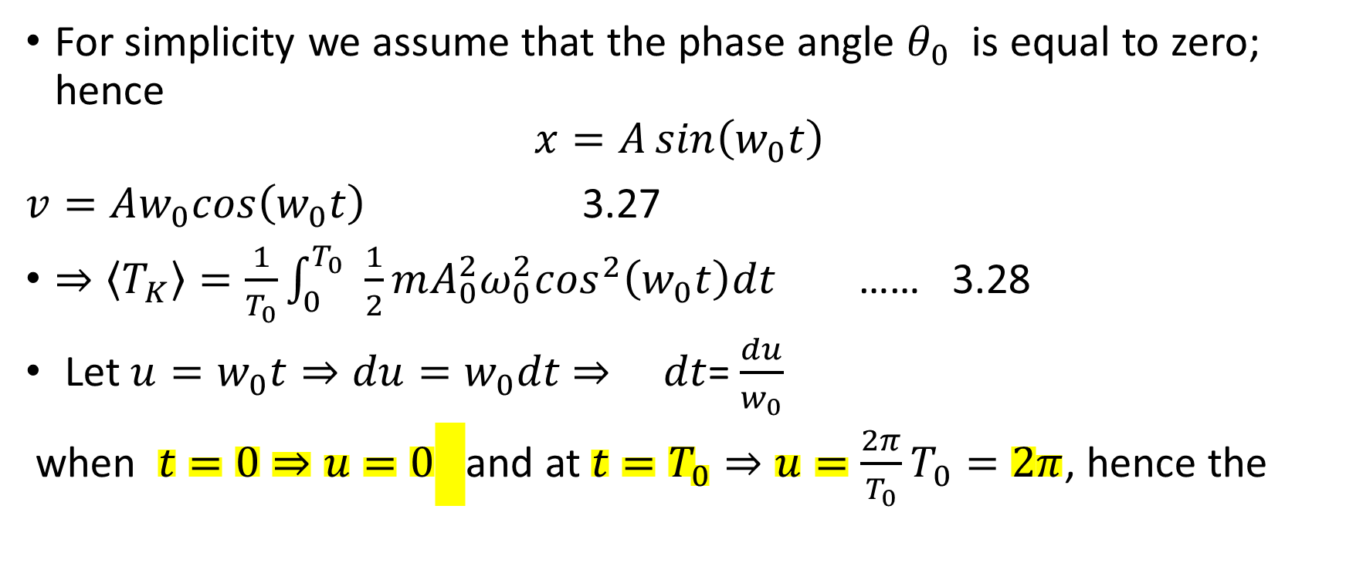
$\left\langle T_{K}\right\rangle =\frac{1}{T_{0}}\int_{0}^{T_{0}}{ }\frac{1}{2}mv^{2}dt$ The average value of kinetic energy
For simplicity we assume that the phase angle $θ_{0}$ is equal to zero; hence
$$x=A\sin\left(w_{0}t\right)$$
$v=Aw_{0}cos\left(w_{0}t\right)$ 3.27
$⇒\left\langle T_{K}\right\rangle =\frac{1}{T_{0}}\int_{0}^{T_{0}}{ } \frac{1}{2}mA_{0}^{2}ω_{0}^{2}\cos^{2}\left(w_{0}t\right)dt$ …… 3.28
$\text{Let} u=w_{0}t⇒du=w_{0}dt$ $⇒$ $dt$= $\frac{du}{w_{0}}$
when $t=0⇒u=0$ and at $t=T_{0}⇒u=\frac{2π}{T_{0}}T_{0}=2π$, hence the

Slide 8
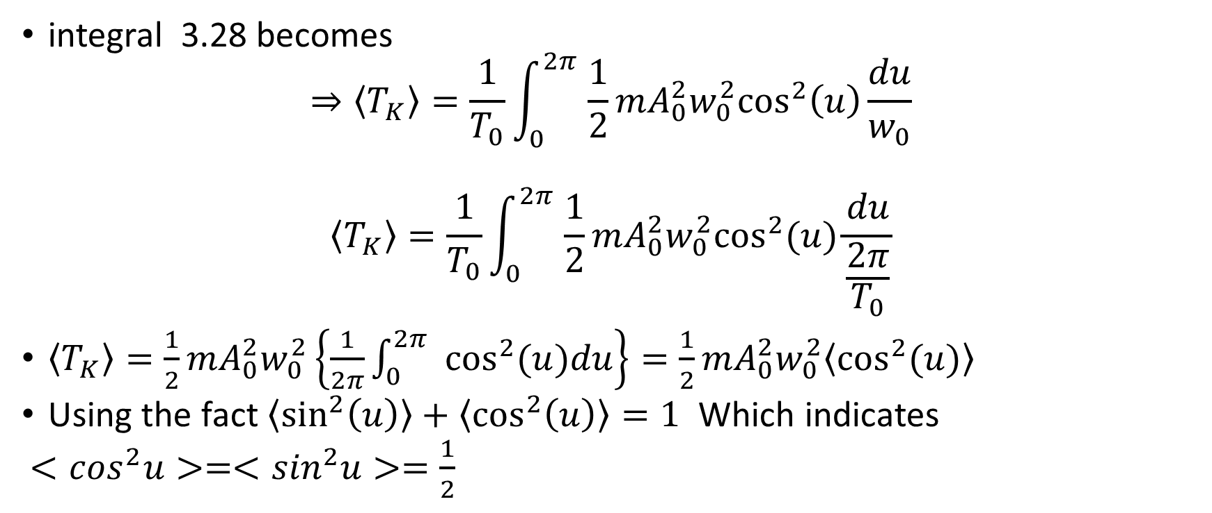
$\left\langle T_{K}\right\rangle =\frac{1}{T_{0}}\int_{0}^{T_{0}}{ } \frac{1}{2}mA_{0}^{2}ω_{0}^{2}\cos^{2}\left(w_{0}t\right)dt$ 3.28 The average value of kinetic energy of SHM
integral 3.28 becomes
$$⇒\left\langle T_{K}\right\rangle =\frac{1}{T_{0}}\int_{0}^{2π}{ } \frac{1}{2}mA_{0}^{2}w_{0}^{2}\cos^{2}\left(u\right)\frac{du}{w_{0}}$$
$$\left\langle T_{K}\right\rangle =\frac{1}{T_{0}}\int_{0}^{2π}{ } \frac{1}{2}mA_{0}^{2}w_{0}^{2}\cos^{2}(u)\frac{du}{\frac{2π}{T_{0}}}$$
$\left\langle T_{K}\right\rangle =\frac{1}{2}mA_{0}^{2}w_{0}^{2}\left\{\frac{1}{2π}\int_{0}^{2π}{ } \cos^{2}(u)du\right\}=\frac{1}{2}mA_{0}^{2}w_{0}^{2}\left\langle \cos^{2}(u)\right\rangle$
$\text{Using} \text{the} \text{fact} \left\langle \sin^{2}\left(u\right)\right\rangle +\left\langle \cos^{2}\left(u\right)\right\rangle =1$ Which indicates
$<\cos^{2}u>=<\sin^{2}u>=\frac{1}{2}$

Slide 9

$$\begin{matrix}\left\langle T_{K}\right\rangle =\frac{1}{4}mA_{0}^{2}w_{0}^{2} \\ \left\langle T_{K}\right\rangle =\frac{1}{4}mA_{0}^{2}\frac{k}{m}=\frac{1}{4}kA_{0}^{2}\end{matrix}$$

Slide 10
Average Potential Energy of SHM
The calculation of average potential energy is similar to previous calculations :
$V=\frac{1}{T_{0}}\int_{0}^{T_{0}}{ }V(t)dt$
$V=\frac{1}{2}kx^{2}$
$x=A_{0}sin\left(w_{0}t\right)$
$⇒V=\frac{1}{2}kA_{0}^{2}\sin^{2}\left(w_{0}t\right)$

Slide 11
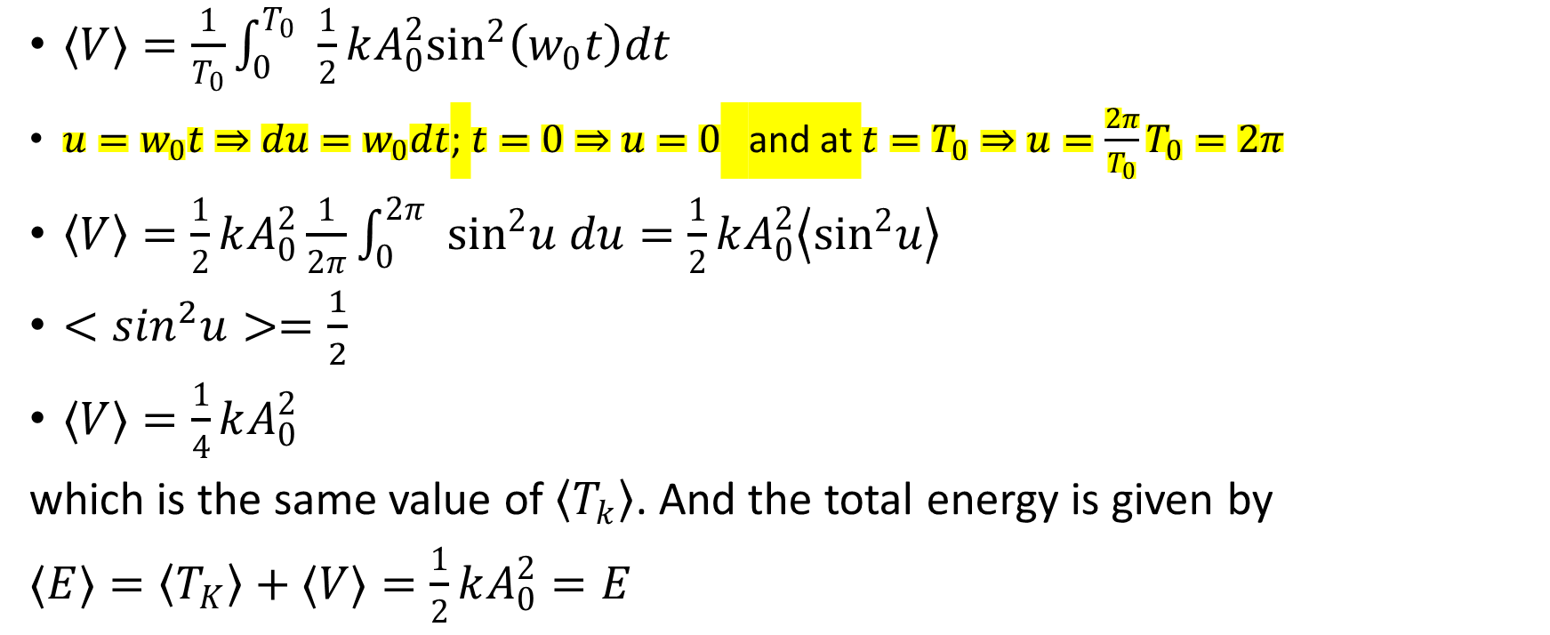
Average Potential Energy of SHM: The total energy
$⟨V⟩=\frac{1}{T_{0}}\int_{0}^{T_{0}}{ } \frac{1}{2}kA_{0}^{2}\sin^{2}\left(w_{0}t\right)dt$
$u=w_{0}t⇒du=w_{0}dt$; $t=0⇒u=0$ and at $t=T_{0}⇒u=\frac{2π}{T_{0}}T_{0}=2π$
$\left\langle V\right\rangle =\frac{1}{2}kA_{0}^{2}\frac{1}{2π}\int_{0}^{2π}{ } \sin^{2}u du=\frac{1}{2}kA_{0}^{2}\left\langle \sin^{2}u\right\rangle$
$<\sin^{2}u>=\frac{1}{2}$
$⟨V⟩=\frac{1}{4}kA_{0}^{2}$
which is the same value of $\left\langle T_{k}\right\rangle$. And the total energy is given by
$⟨E⟩=\left\langle T_{K}\right\rangle +⟨V⟩=\frac{1}{2}kA_{0}^{2}=E$

