Slide 1
Solved example
Lagrange Mechanics

Slide 2
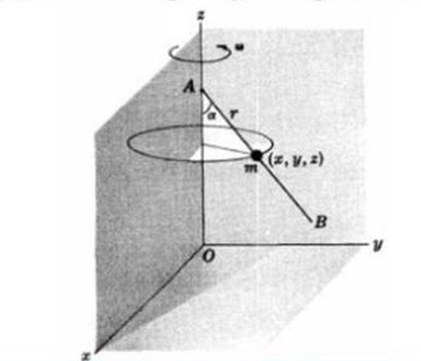
In Fig. 1, AB is a straight frictionless wire fixed at point A on a vertical axis OA such that AB rotates about OA with constant angular
velocity $ω$ . A bead of mass m is constrained to move on the wire.
(a) Set up the Lagrangian.
(b) Write Lagrange's equations.
(c) Determine the motion at any time.
Fig.1

Slide 3
Coordinate setup
(a) Let $r$ be the distance of the bead from point $A$ of the wire at time $t$.
The rectangular coordinates of the bead are then given by
$x=r\sin{α}\cos{ωt}$
$y=r\sin{α}\sin{ωt}$
$z=h−r\cos{α}$
where it is assumed that at$t = 0$ the wire is in the $xz$ plane and
that the distance from $O$ to $A$ is $h$.

Slide 4
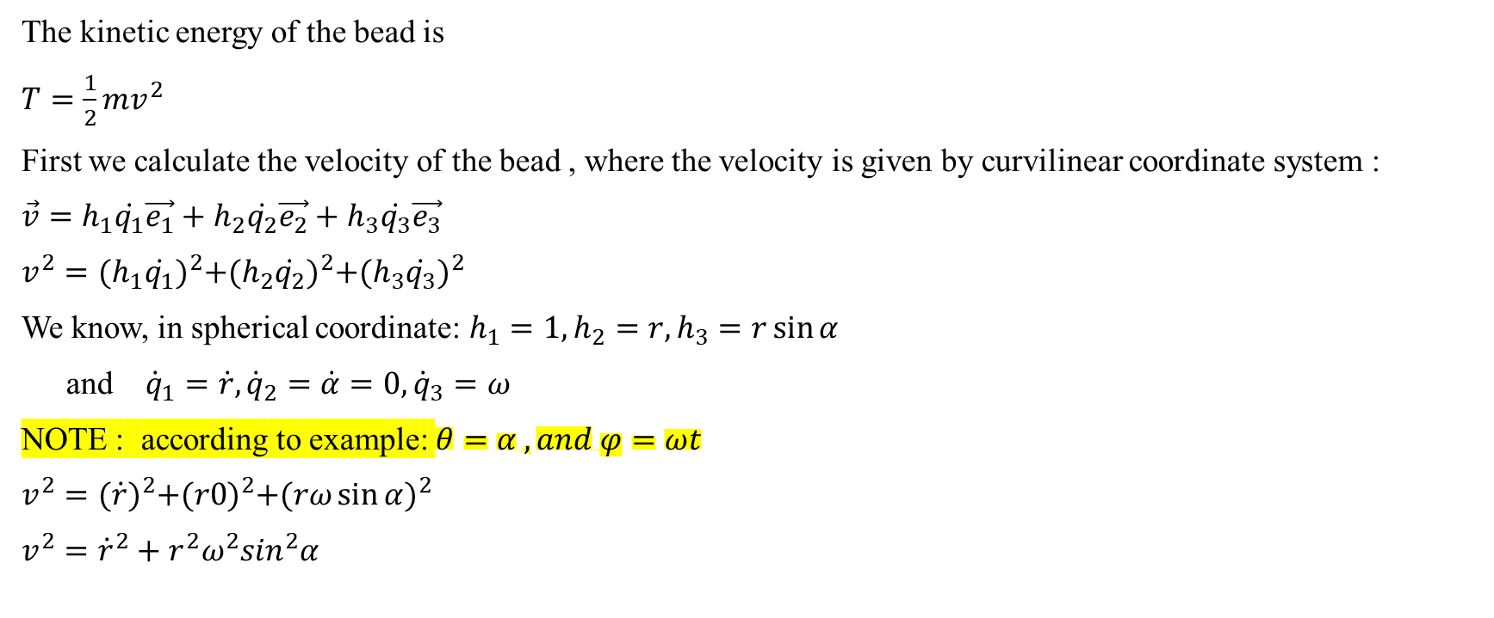
Calculating the kinetic and potential energy
The kinetic energy of the bead is
$T=\frac{1}{2}mv^{2}$
First we calculate the velocity of the bead , where the velocity is given by curvilinear coordinate system :
$\vec{v}=h_{1}\dot{q_{1}}\vec{e_{1}}+h_{2}\dot{q_{2}}\vec{e_{2}}+h_{3}\dot{q_{3}}\vec{e_{3}}$
$v^{2}={(h_{1}\dot{q_{1}})}^{2}+{(h_{2}\dot{q_{2}})}^{2}+{(h_{3}\dot{q_{3}})}^{2}$
We know, in spherical coordinate: $h_{1}=1, h_{2}=r, h_{3}=r\sin{α}$
and ${\dot{q}}_{1}=\dot{r}, {\dot{q}}_{2}=\dot{α}=0, {\dot{q}}_{3}=ω$
NOTE : according to example: $θ=α , and φ=ωt$
$v^{2}={(\dot{r})}^{2}+{(r0)}^{2}+{(rω\sin{α})}^{2}$
$v^{2}={\dot{r}}^{2}+r^{2}ω^{2}\sin^{2}α$

Slide 5
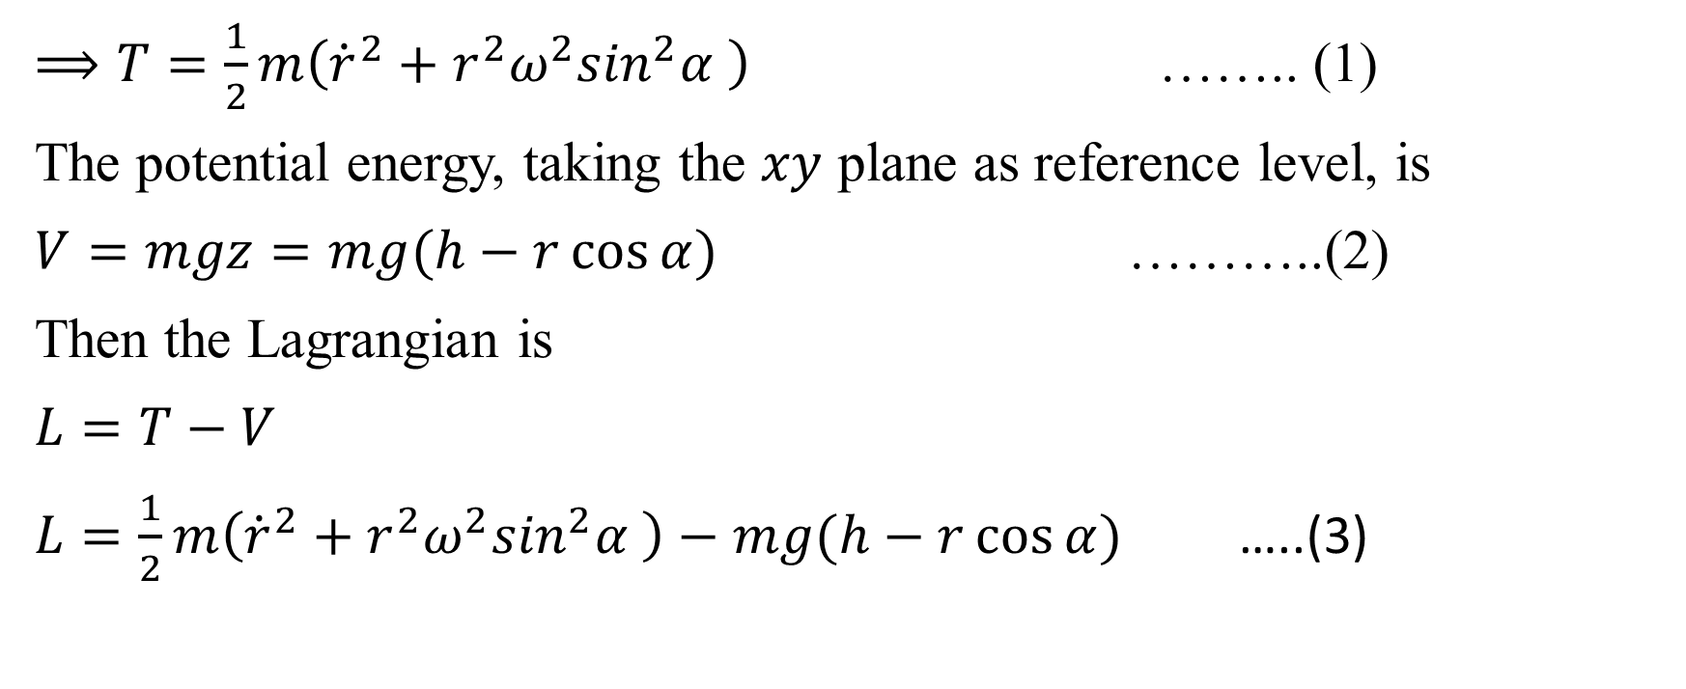
The Lagrangian
$⟹T=\frac{1}{2}m\left({\dot{r}}^{2}+r^{2}ω^{2}\sin^{2}α \right)$ …….. (1)
The potential energy, taking the $xy$ plane as reference level, is
$V=mgz=mg(h−r\cos{α})$ ………..(2)
Then the Lagrangian is
$L=T−V$
$L=\frac{1}{2}m\left({\dot{r}}^{2}+r^{2}ω^{2}\sin^{2}α \right)−mg(h−r\cos{α})$ …..(3)

Slide 6

(b) Lagrange equation NOTE : we have one degree of freedom and $r$ is the generalized coordinate
$\frac{∂L}{∂r}=mω^{2}r\sin^{2}α+mg\cos{α}$
$\frac{∂L}{∂\dot{r}}=m\dot{r}$
and Lagrange’s equation is
$\frac{d}{dt}\left(\frac{∂L}{∂\dot{r}}\right)=\frac{∂L}{∂r}$
$\frac{d}{dt}(m\dot{r})=mω^{2}r\sin^{2}α+mg\cos{α}$
$m\ddot{r}=mω^{2}{rsin}^{2}α+mg\cos{α}$
$∴\ddot{r}−ω^{2}r\sin^{2}α=g\cos{α}$ ……….. (4)

Slide 7
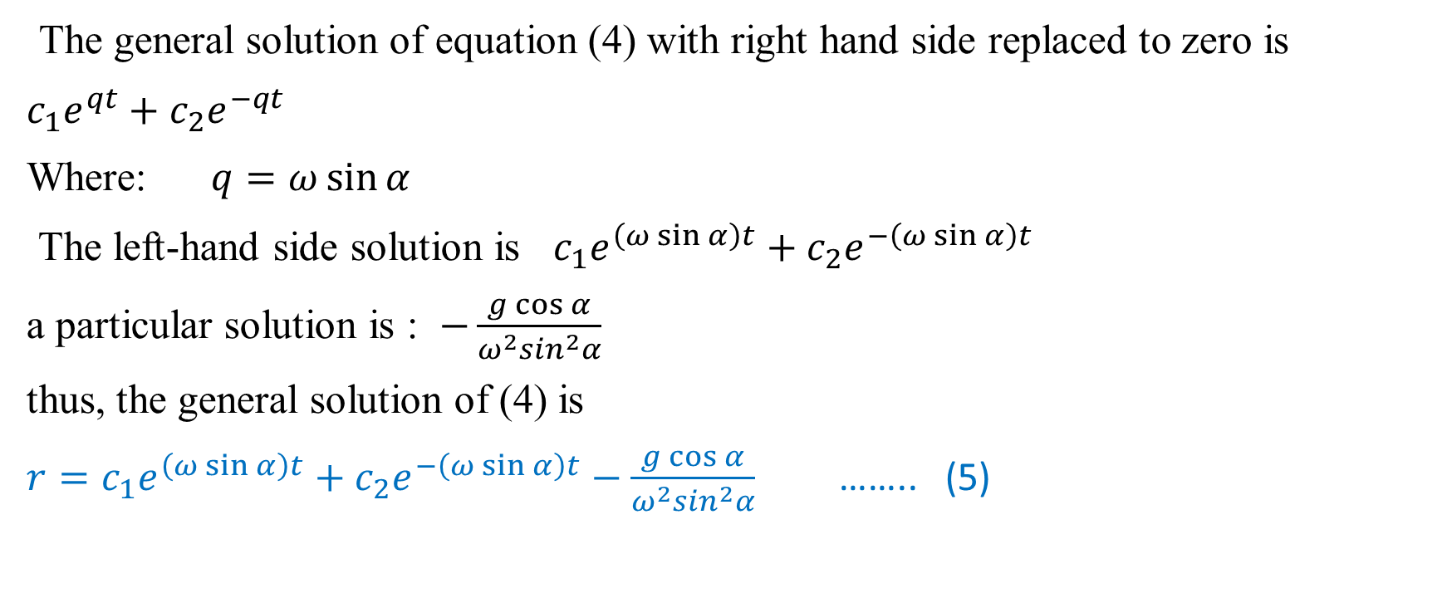
c) The general solution of $\ddot{r}−ω^{2}r\sin^{2}α=g\cos{α}$ …. (4)
The general solution of equation (4) with right hand side replaced to zero is
$c_{1}e^{qt}+c_{2}e^{−qt}$
Where: $q=ω\sin{α}$
The left-hand side solution is $c_{1}e^{\left(ω\sin{α}\right)t}+c_{2}e^{−\left(ω\sin{α}\right)t}$
a particular solution is : $−\frac{g\cos{α}}{ω^{2}\sin^{2}α}$
thus, the general solution of (4) is
$r=c_{1}e^{\left(ω\sin{α}\right)t}+c_{2}e^{−\left(ω\sin{α}\right)t}−\frac{g\cos{α}}{ω^{2}\sin^{2}α}$ …….. (5)

Slide 8
Hint 1: equation (1) can be also determined by (see page 298, Theoretical Mechanics, Murray R. Spiegel)

Slide 9
Hint 2: The result , equation (5) , can also be written in terms of hyperbolic functions as
$$r=c_{3}\cosh\left(ω\sin{α}\right)t+c_{4}\sinh\left(ω\sin{α}\right)t−\frac{g\cos{α}}{ω^{2}\sin^{2}α}$$

