Slide 1
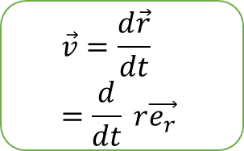
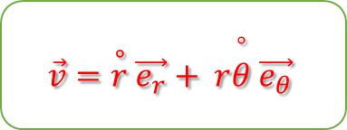
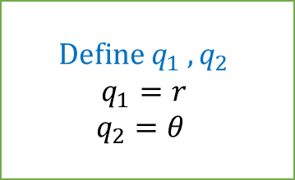
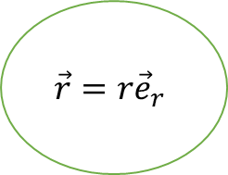
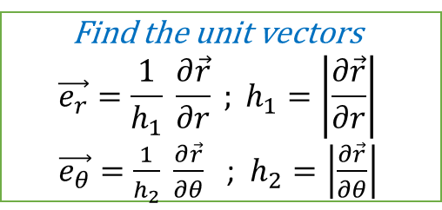
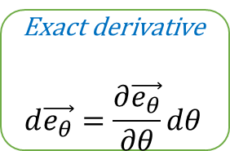
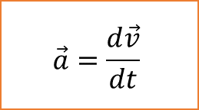
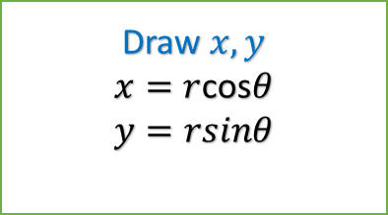
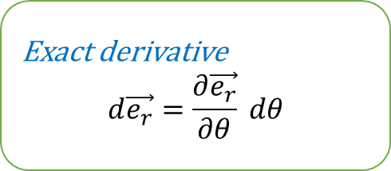
Define $q_{1} ,q_{2}$
$$q_{1}=r$$
$$q_{2}=θ$$
Flowchart:
How to calculated the velocity and acceleration in polar coordinate system
Draw $x,y$
$x=r$cos$θ$
$y=rsinθ$
Transformation equations
$$\vec{r}=\vec{i}x+\vec{j}y$$
$$\vec{r}=\vec{i}rcosθ+\vec{j}rsinθ$$
Find the unit vectors
$$\vec{e_{r}}=\frac{1}{h_{1}} \frac{∂\vec{r}}{∂r} ; h_{1}=\left|\frac{∂\vec{r}}{∂r}\right|$$
$\vec{e_{θ}}=\frac{1}{h_{2}} \frac{∂\vec{r}}{∂θ}$ ; $h_{2}=\left|\frac{∂\vec{r}}{∂θ}\right|$
$$\vec{r}=r{\vec{e}}_{r}$$
$$\vec{v}=\frac{d\vec{r}}{dt}=\frac{d}{dt} r\vec{e_{r}}$$
Exact derivative
$$d\vec{e_{r}}=\frac{∂\vec{e_{r}}}{∂θ} dθ$$
$$\vec{a}=\left(\overset{°°}{r}−r{\overset{°}{θ}}^{2}\right)\vec{e_{r}}+ \left(r\overset{°°}{θ}+2\overset{∘}{r}\overset{°}{θ}\right)\vec{e_{θ}}$$
Exact derivative
$$d\vec{e_{θ}}=\frac{∂\vec{e_{θ}}}{∂θ}dθ$$
$$\vec{a}=\frac{d\vec{v}}{dt}$$
$$\vec{v}=\overset{∘}{r} \vec{e_{r}}+ r\overset{°}{θ} \vec{e_{θ}}$$

