Slide 1

For 3rd year physics students
Edited by: Dr. Muhamad A. Hamad

Slide 2
ATOM
The smallest particle that the element can be reduced to and still retain its properties called ATOM
Atoms are the basic building blocks of all matter. EVERYTHING on Earth is made of atoms…even the air and your body.

Slide 4
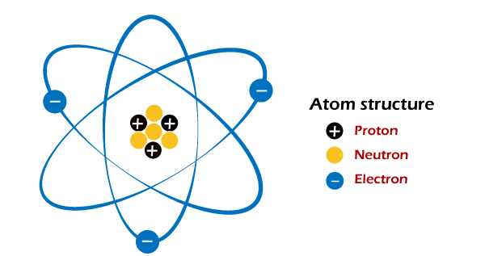
ATOMS ARE MADE FROM

Slide 5
MASS OF ATOM PARTICLES
Mass of protons and neutrons nearly are equal but the mass of electrons are 1840 times lighter than their mass

Slide 6
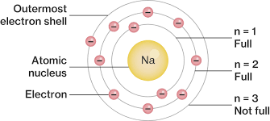
Shells
Electrons orbit in groups called shells
each shell can only hold a certain number of electrons in orbit. The first shell ,closest to the nucleus, cannot hold more than 2 electrons; the second shell cannot hold more than 8 electrons; the third no more than 18; the fourth, no more than 32, and so on.
The maximum number of electrons(Ne)that can exist in each shell of an atom can be calculated by Ne=2n²

Slide 7
electron shells

Slide 8
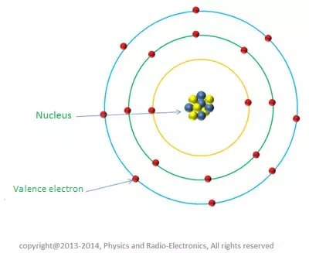
valence shell
The outer most shell of an atom is called the valence shell. The word valence is a Greek word meaning hook , the electrons in the outermost shell that enable atoms to join
The outer shell of any atom cannot hold any more than 8 electrons. This rule is important because it shows which atoms make up good conductors, Insulators, or semiconductors.

Slide 9
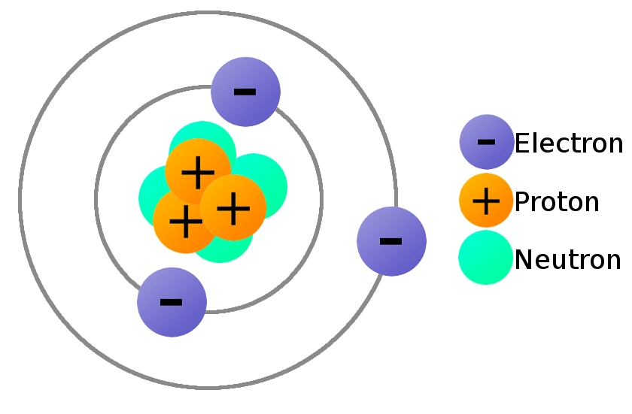
By which force all the parts of an atom are holds together?
It is the electromagnetic force of attraction between the positive protons in the nucleus and the negative electrons orbiting around the nucleus that holds the atom together.

Slide 10
Energy levels
Not all electrons have the same energy levels. Electrons that orbit close to the nucleus have less energy than those that orbit farther away. The farther the electron orbit from the nucleus, the grater the energy it contains.

Slide 11
Energy levels
The energy levels of electrons are labeled by principal quantum numbers (n) or shells.

Slide 12
Atomic number and mass number
Elements contain one or more of the same type of atom! All known elements can be found on the periodic table.
• Elements can be identified by their atomic number.
The atomic number is the number of PROTONS in the atoms of an element.
The mass number is the summation of the number of protons and neutron in the atoms.

Slide 13
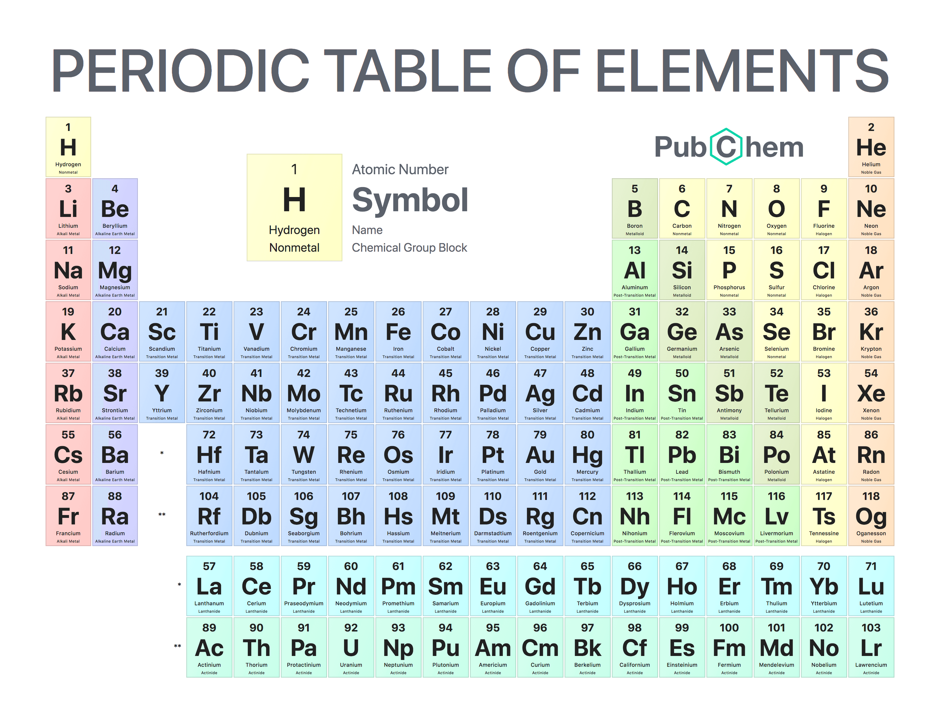

Slide 14
Identification of elements

Slide 15
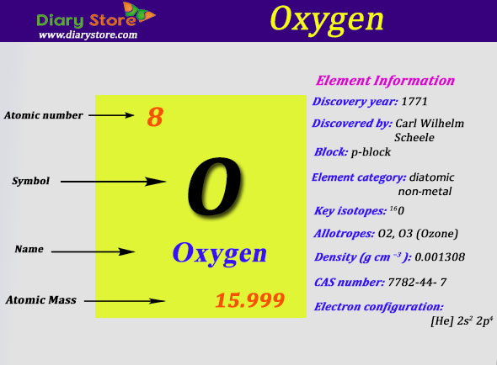

Slide 16
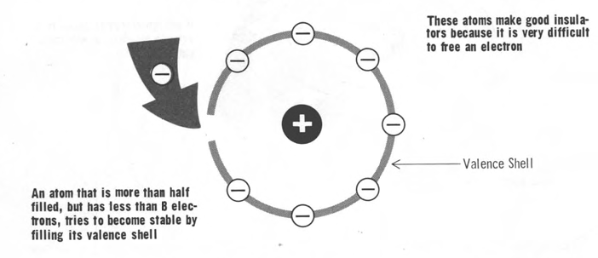
Stable and unstable atoms
The tendency of an atom to give up its valence electrons depends on chemical stability. When an atom is stable, it resists giving up electrons, and when it is unstable, it tends to give up electrons.

Slide 17
Stable and unstable atoms
The level of stability is determined by the number of valence electrons. Because the atom strives to have its outer or valence shell completely filled.

Slide 18
Stable and unstable atoms
Elements with 5 or more valence electrons make good insulator, since they tend to take on rather than give up electrons.
• Atoms with less than 4 valence electrons tend to give up their electrons to empty the valence shell; this would allow the next shell, which is already filled, to be the outer most shell. These atoms make the best electrical conductors.

Slide 19
Stable and unstable atoms
An atom with 8 valence electrons is completely stable, and will resist any sort of activity. These are the inert gases (atomic numbers 2, 10, 18, 36, 54and 86), and are the best insulators.
• Atoms with only1valence electrons are the best conductors.
• As you probably have gathered by now, semiconductors have 4 valence electrons, and are neither conductors nor good insulators.

Slide 20
Band Theory of Solids
Crucial to the conduction process is whether or not there are electrons in the conduction band.
In insulators the electrons in the valence band are separated by a large gap from the conduction band
in conductors like metals the valence band overlaps the conduction band, and in semiconductors there is a small enough gap between the valence and conduction bands that thermal or other excitations can bridge the gap.
With such a small gap, the presence of a small percentage of a doping material can increase conductivity dramatically.

Slide 21
Band Theory of Solids
An important parameter in the band theory is the Fermi level, the top of the available electron energy levels at low temperatures.
The position of the Fermi level with the relation to the conduction band is a crucial factor in determining electrical properties.

Slide 22
Energy band diagram
Actually, the energy required to release electrons falls in to the conduction band, and can be shown on energy band diagrams to indicate how easy or difficult it is to free an electron to start electrical conduction.

Slide 23
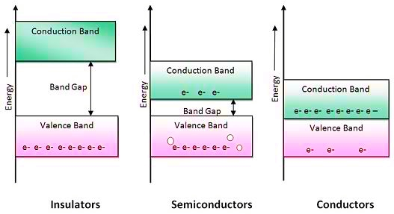
Energy band diagram

