Slide 1
Chapter Four : (Diode application)
INTRODUCTION
The diode ability to conduct current in one direction while blocking current in the other direction is essential to the operation of many types of circuits.
One circuit in particular is the ac rectifier, which is covered in this chapter. Other important applications are circuits such as diode limiters, diode clampers, and diode voltage multipliers.

Slide 2
CHAPTER OUTLINE
Half-Wave Rectifiers
Full-Wave Rectifiers
Power Supply Filters and Regulators
Diode Limiting and Clamping Circuits
Voltage Multipliers

Slide 3
After completing this section. you should be able to :
. Explain and analyze the operation of half-wave rectifiers
. Describe a basic dc power supply and half-wave rectification
. Determine the average value of a half-wave rectified voltage
. Discuss the effect of barrier potential on a half-wave rectifier output
. Define peak inverse voltage (PI V)

Slide 4
HALF-WAVE RECTIFIERS
Rectifiers are found in all dc power supplies that operate from an ac voltage source. A power supply is an essential part of each electronic system from the simplest to the most complex.
In this section, you will study the most basic type of rectifier, the half-wave rectifier.

Slide 5
HALF-WAVE RECTIFIERS
Rectifiers are found in all dc power supplies that operate from an ac voltage source. A power supply is an essential part of each electronic system from the simplest to the most complex. In this section, you will study the most basic type of rectifier, the half-wave rectifier.

Slide 6
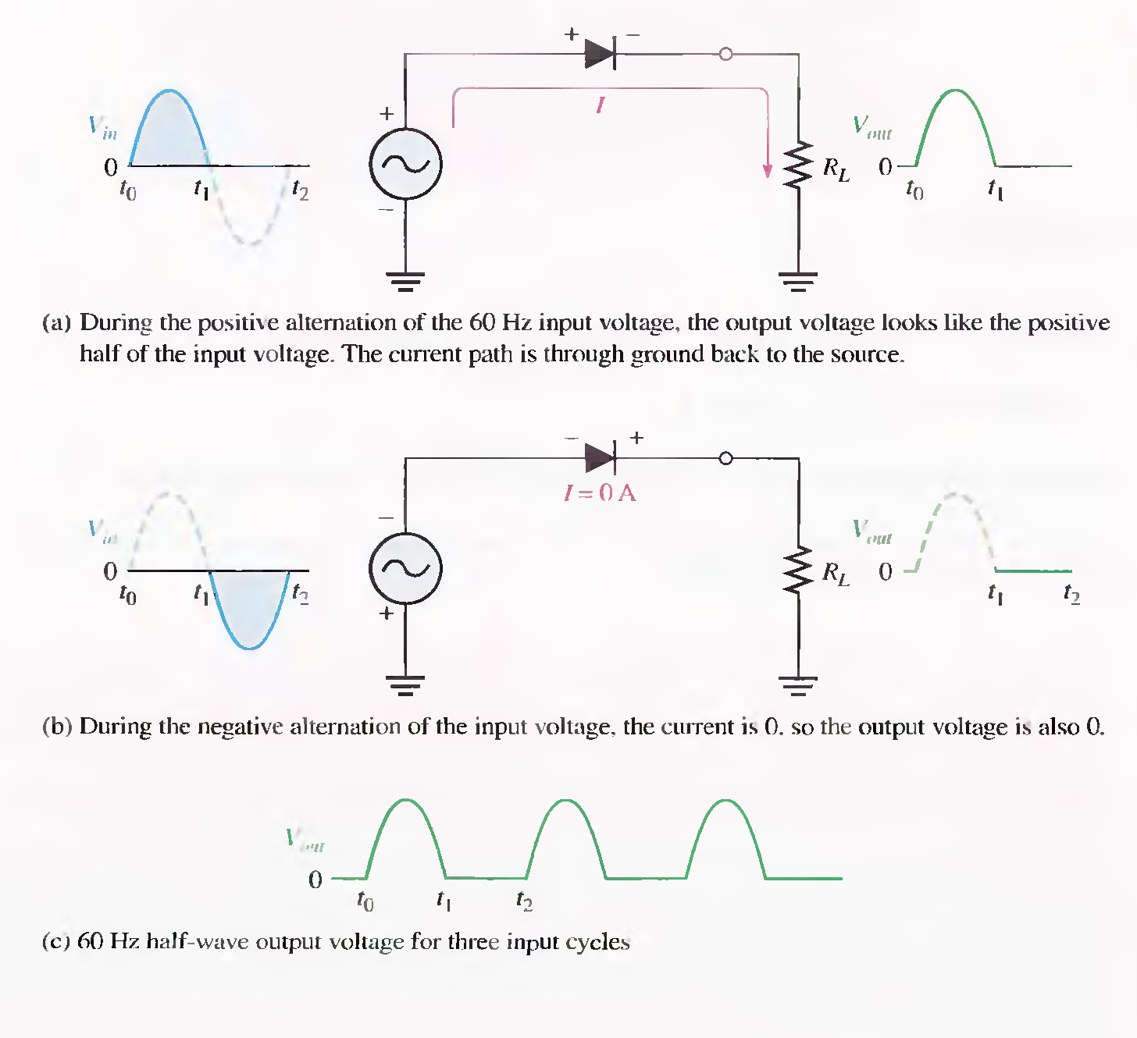
HALF-WAVE RECTIFIERS

Slide 7
In the interval the current given by in the interval
can be expressed as

Slide 8
by analogy, the term
represents the average or dc value of i in the interval
Thus, we have
Notes:
by analogy, the term

