Slide 1
Portfolio Management
Portfolio theory is built around the investor seeking to construct an efficient portfolio offers the highest return for a given level of the risk or the least amount of risk for a given level of return .

Slide 2
Return
Investments are made to earn a return , but to earn the return you must accept the possibility of loss . Portfolio theory is concerned with risk and return . Its purpose is to determine the contribution of risk and return that allows the investor to achieve the highest return for a given level of risk.
The expected return is the sum of anticipated dividends yield and capital gains or price appreciation.

Slide 3
Expected Return
The first source is the flow of income that may be generated by the investment. A saving account generates interest income. The second source of return is capital appreciation . If an investor buys stock and its price increases , the investor receives a capital gain . All investments offer the investors potential income and /or capital appreciation . Some investments , like the saving account offer only income .

Slide 4
Expected Return
Expected Return is summarized in following equitation :
E(g ). + E(r) = $\frac{E\left(D \right)}{p}$
Where :
E(r ) the expected return ( as a percentage )
E(D ) the expected dividends ( or interest in the case of debt instrument )
P the price of the asset
E( g ) the expected growth of the value of assets.

Slide 5
Example
If an investor buys a stock for $10 and expects to earn a dividend of $0.60 and sell the stock for $12 so there is a capital gain of 20 percent
{( $12-$10 ) / $10 } the expected growth.
E(r) = $\frac{\$0.60}{\$10}+ .20=.26$

Slide 6
Expected Return expressed as a probability
Probability theory measures or indicates the likelihood of something occurring. If you are certain that something will happen . The probability is 100 percent .the sum of all probabilities of the possible outcomes is 100 percent . The expected value ( the anticipated outcomes ) is the sum of each outcome multiplied by the probability of occurrences . For example an investor is considering purchasing a stock .

Slide 7
Expected Return
The possible returns and the investors estimate of their occurring are as follow :
Probability | Return
10 % | 3 %
45 % | 10 %
40 % | 12%
5 % | 20 %
100%

Slide 8
Expected Return
E( r ) =( 0.10 × .03) + ( 0.45 ×.10) +( 0.40 × .12 ) +( 0.05 ×0.20 )
= 0.003+ 0.045+ 0.048 +0.01
= 0.106= 10.6 %

Slide 9
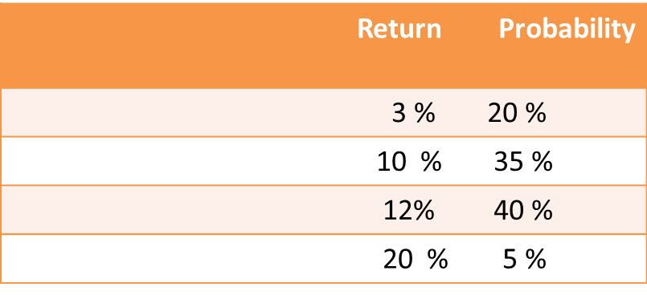
Example about Expected Return
The Expected Return ( E( r ) becomes
E( r) = ( 0.20 ×.03 ) +( 0.10 ×0.35 ) + ( 0.12 × 0.40 ) + ( 0.20 × 0.05)
= 0.006 + 0.035 + 0.048 +0.01 = 0.099 = 9.9 %

Slide 10
Sources of Risk
Risk refers to the uncertainty that the actual return the investor realize will differ from the expected return. The sources of this variability in returns are often differentiated into two type of risk : systematic and unsystematic risk.

Slide 11
The sources of Risk
Total Risk
B-Unsystematic Risk | A- Systematic Risk
1- Business Risk | 1- Market Risk
2- Financial Risk | 2- Interest rate Risk
 | 3- Reinvestment Risk
 | 4- Purchasing power risk
 | 5- Exchange Rate Risk

Slide 12
Market Risk
Market risk refers to the tendency of security price to move together. It may the price of all stocks fall as the market as a whole declines , that is the nature of market risk , Security prices do fluctuate and the investor must accept the risk associated with fluctuations While market risk is generally applied to stocks , the concept also applies to other assets , such as metal , real assets .

Slide 13
Interest Rate risk
Interest rate risk refers to the tendency of security prices especially fixed income securities to move inversely with changes in the rate of interest . The price of bonds and preferred stock depend on the current rate of interest . Rising interest rate decrease the current prices of fixed –income securities because current purchases require a competitive yield . The price of fixed –income securities fluctuate as fluctuate of interest rate.

Slide 14
Purchasing power risk
Purchasing power risk is the which refers to increase inflation in the economy. Inflation is the loss of purchasing power through a general rise in prices. if prices of goods and services increase , the real purchasing power of the investors assets and the income generated by them is reduced, thus purchasing power risk is the risk that inflation will erode ( decrease ) the buying power of the investors assets and income.

Slide 15
Exchange rate risk
Exchange rate risk refers to the currency risk associated with another currencies. Currencies trade daily , so exchange rate virtually all the times. the price of one currency in terms of another is the exchange rate, and currencies may be expressed in terms of each other :
Currency per U.S Dollar | U.S $ equivalent | Country
0.6971 | 1.4345 | Britain ( UK )

Slide 16
Exchange rate risk
The table shows that the dollar cost the British pound is $ 1.4345 , or that $ 1.00 buys 0.6971 pounds . The 0.6971 is derived by dividing $ 1 by the price of the pound : $1/$1.4345 = 0.6971 unit of the British currency .
Currencies trade daily , so exchange rate changes virtually all the time, if the dollar cost of the pound rises to $ 1.45 , that is a revaluation ( appreciation ).

Slide 17
Exchange rate risk
Revaluation refers to increase in the value of one currency relative to other currencies. It is also a decline or devaluation in the value of the dollar , since more dollars are necessary to purchase one pound. If the dollar prices of the pound fall to $1.40 that is a devaluation of the pound but a revaluation of the dollar.
Devaluation refers to a decrease in the value of one currency relative to other currencies.

Slide 18
Exchange rate risk
Exchange rate risk refers to the uncertainty associated with changes in the value of foreign currencies.

Slide 19
Unsystematic risk
Unsystematic risk refers to the risk associated with individual events that affect a particular security .unsystematic risk also referred to as diversifiable risk , depends on factors that are unique to the specific assets . For example, a firms earning may decline because of a strike . The sources of unsystematic risk may be subdivided into two general classification , business risk and financial risk.

Slide 20
Business risk
Business risk is refers to the risk associated with the nature of a business. Business risk is the risk associated with the nature of the company it self. Not all all businesses are equally risky. Drilling of new oil deposits is more risky than running a commercial bank. The chance of finding oil may be slim, and only one of many new wells may actually produce oil and earn a positive return.

Slide 21
Financial Risk
Financial risk refers that the risk associated with a firm sources of financing . Borrowing funds to finance a business may increase risk, because creditors require that the borrower meet certain terms to obtain the funds. The most common of these requirements is the paying of interest and repayment of principle. The creditor can ( an actually does ) demand collateral or restriction on dividend payments to shareholders.

Slide 22
Total ( portfolio ) risk
Portfolio Risk refers to the combination of systematic and unsystematic risk that the investor bears. Unsystematic risk may be significantly reduced through diversification.

Slide 23
Diversification
Diversification refers to the process of accumulating different securities to reduce the risk of loss. Diversification occurs when the investor purchase the securities of different firms in a different economic sectors and in different geographic regions. Buying the stock of five telecommunication companies is not considered diversification, because the events that affect one company tend to affect the others.

Slide 25
Questions for the chapter

