Slide 1
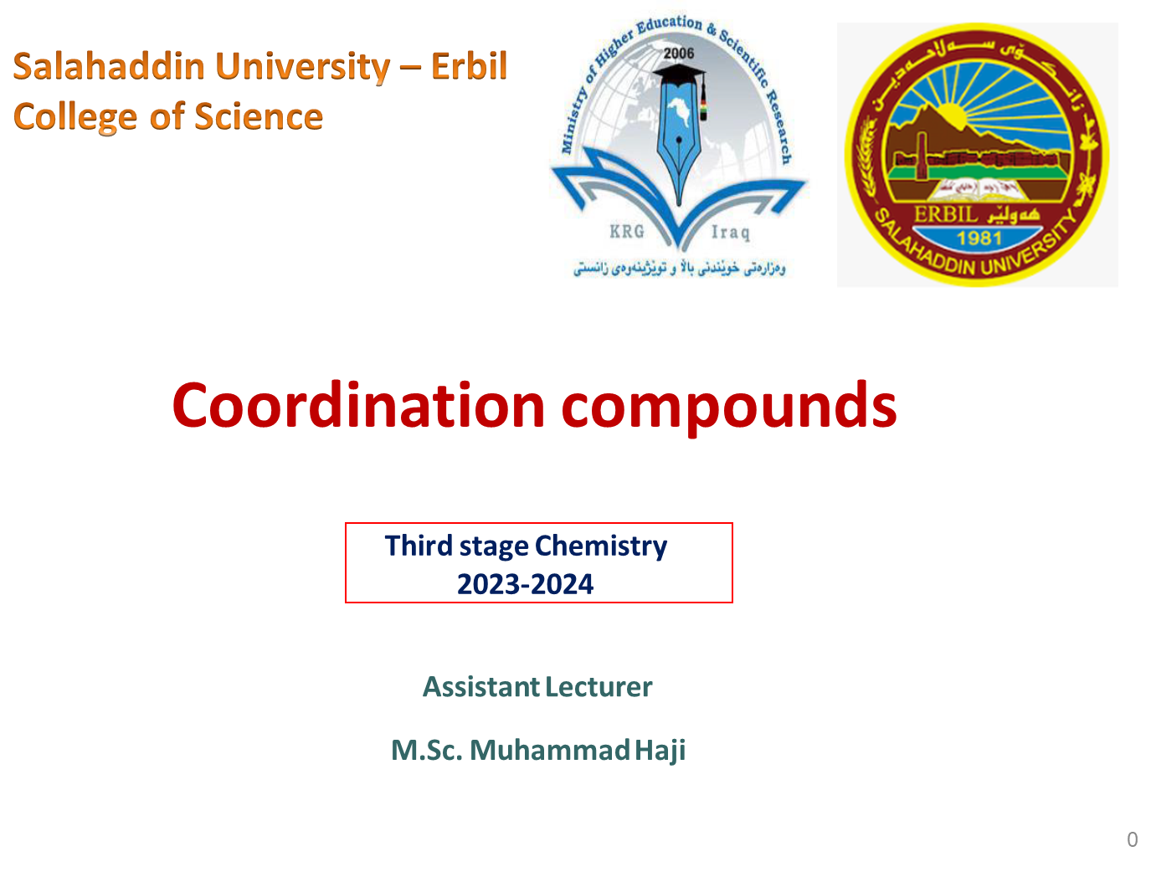

Slide 2

Q₁/Compare the electron configuration of d⁶ according CFT diagram for
both field states then calculate CFSE for weak field state.
Q₂/Calculate CFSE for [Fe(NH₃)₆]Cl₃ according Dq parameter. (At.No. Fe=26)
Q₃/Calculate CFSE for t₂g⁵eg² according Dq parameter, is it weak field or strong field?
Q₄/Compare the electron configuration of d⁵ according CFT diagram for
both field states then calculate CFSE for strong field
Q₅/Select the complex that has the largest value for Δo from each pair, and give a brief reason for your answer in each case.
(a) [Fe(CN)₆]³⁻ and [Fe(CN)₆]⁴⁻
(b) [Co(NH₃)₆]³⁺ and [Ru(NH₃)₆]³⁺
(c) [Co(CN)₆]⁴⁻ and [Co(H₂O)₆]²⁺
2

Slide 3
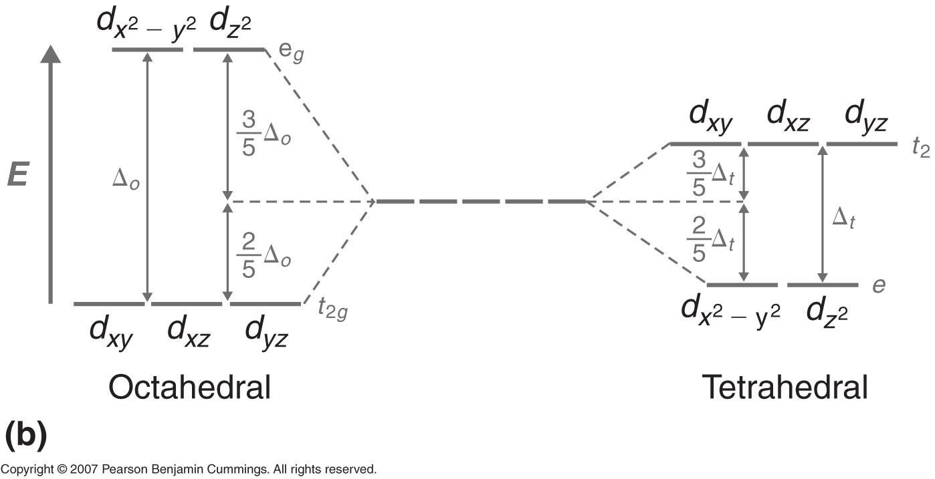
Crystal field diagrams for octahedral and tetrahedral complexes.
the splitting observed in a tetrahedral crystal field is opposite of splitting in octahedral complex.
3

Slide 4
Why tetrahedral complexes are always high-spin and paramagnetic in depended on the ligand field and why ∆_{t} = 4/9 ∆_{o} ?
Because in T.H complexes there is no direct interaction between ligand and
d-orbitals but t₂g orbitals which lie near the corner of the cube(at the edge) interact more than eg orbitals which lie at the center of cube so separation energy will be small and always smaller than pairing energy.P_{E}>∆_{t}.
∆_{t}=4/9 ∆₀ because
1- in T.H the central metal under effect of 4 ligands, while in O.h under 6 ligands.
2-in T.H complexes there is no direct interaction between t₂g and eg with ligands but in O.h eg lie on axis higher interaction produce more separation energy ∆₀.
4

Slide 5
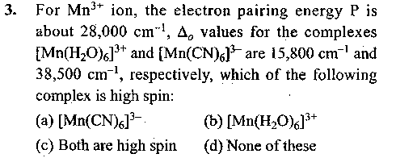
Q₁/Between [Mn(CN)₆]³⁻ and [Mn(CN)₆]⁴⁻ , [Co(CN)₆]³⁻ and [CoF₆]³⁻, [NiCl₄]²⁻
and [PdCl₄]²⁻, [Cu(NH₃)₆]²⁺ and [Cr(NH₃)₆]²⁺ Which is more likely to be high spin? Why?
At.No. Mn=25, Co=27, Ni=28, Pd=47, Cu=29, Cr=24.
Q₂/For the [Cr(H2O)₆]²⁺ ion the main pairing energy P is found to be 23500 cm⁻¹. The magnitude of Δo 13900 cm⁻¹. Calculate the CFSE for the complex in configurations corresponding to high spin or low spin states, which is more stable? ₂₄Cr
Q₃/a) using CFT, depict the electronic of the Rhodium (II)ion in an O.h field for
which the CFS Δo is less than the pairing energy P.
b) calculate the CFSE for the configuration in terms of Δo and P . ₄₅Rh
6

Slide 6
Q₄/determine the CFSE of d⁶ complex having Δo = 25000 cm⁻¹ and P=15000 _{cm}-1
Q₅/ Determine the configuration (in the form t₂g^{m}eg^{n} or eg^{m}t₂g^{n}, as appropriate), the number of unpaired electrons, and the ligand field stabilization energy as a multiple of Δo or ΔT for each of the following complexes using the spectrochemical series to decide, where relevant, which are likely to be strong‐field and which weak‐field.
(a)[Co(NH₃)₆]³⁺; (b) [Fe(OH₂)₆]²⁺; (c) [Fe(CN)₆]^{3–}; (d) [Cr(NH₃)₆]³⁺; (e) [W(CO)₆]; (f) [FeCl₄]^{2–} and (g) [Ni(CO)₄].
Q₆/calculate the CFSE for [Co(NH₃)₆]³⁺ , the pairing energy = 19150 cm⁻¹, and
the Δ magnitude =23000 cm⁻¹ , Co = 27.
7

Slide 7
Q₇/calculate CFSE [Cr(en)₃]³⁺ Δ= 21900 cm⁻¹.
Q₈/calculate the CFSE for [FeBr₄]²⁻ , Δo = 22500 cm⁻¹ and P=26000 cm⁻¹ , At.no. Fe=26.
Q₉/calculate the CFSE for electronic configuration e⁴t₂³.
Q₁₀/ Draw the crystal field splitting for the following complexes:
[Cr(H₂O)₆]³⁺ and [Cr(NH₃)₆]³⁺.
Q₁₁/ for which member of the following pairs of complexes would Δo be the
larger and why?
[CrF₆]³⁻ and [Cr(NH₃)₆]³⁺ ; [Fe(CN)₆]⁴⁻ and [Fe(CN)₆]³⁻
8

Slide 8
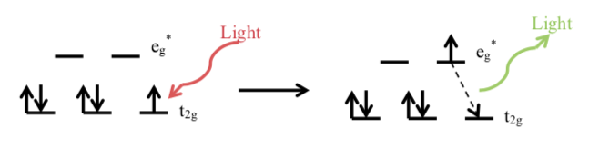
The Color of Complexes:
Very commonly for the first transition series, the energy corresponds to that of visible light, so that d-d transitions are the cause of the delicate colours of so many of the complexes.

Slide 9

















Black & White
When a sample absorbs light, what we see is the sum of the remaining colors that strikes our eyes.
If a sample absorbs all wavelength of visible light, none reaches our eyes from that sample.
Consequently, it appears black.
If the sample absorbs no visible light, it is white or colorless.

Slide 10
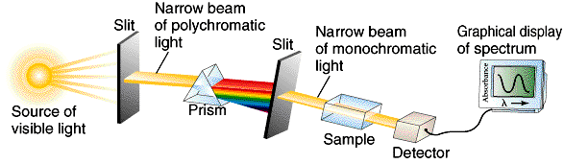
Light absorption Properties of Metal Complexes
Recording the absorption Spectrum

Slide 11

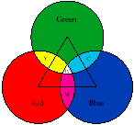
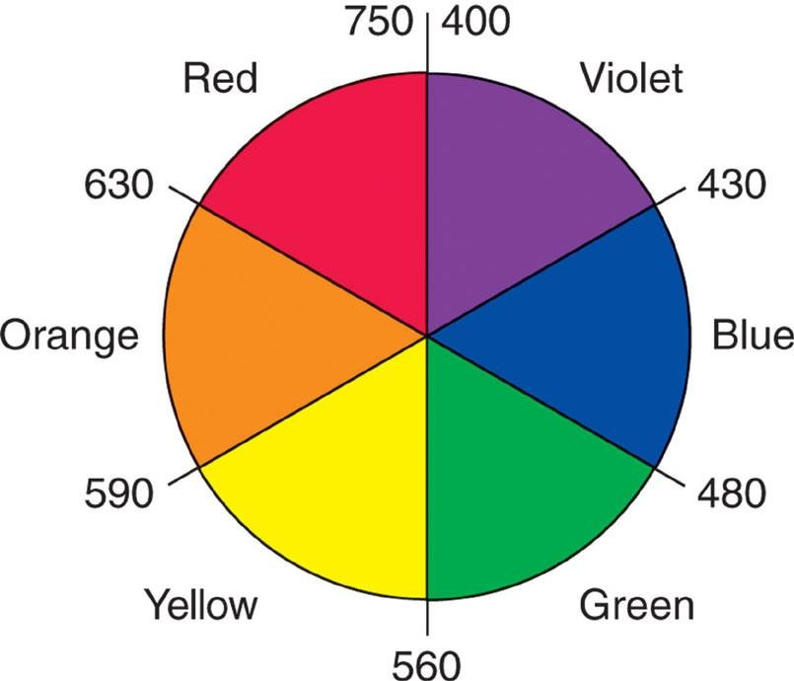
Colors & How We Perceive it
Artist color wheel showing the colors which are complementary to one
another and the wavelength range of each color.

Slide 12
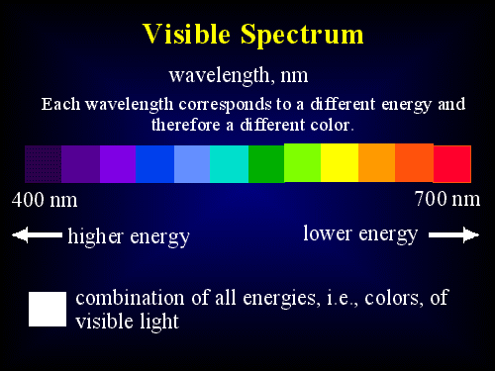
The energy of a photon of light is inversely proportional to its wavelength
E = hc = hυ
λ

Slide 13
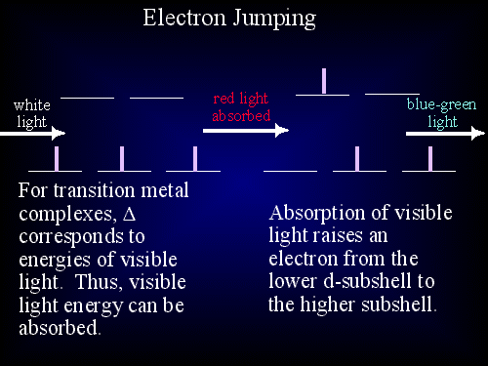

Slide 14
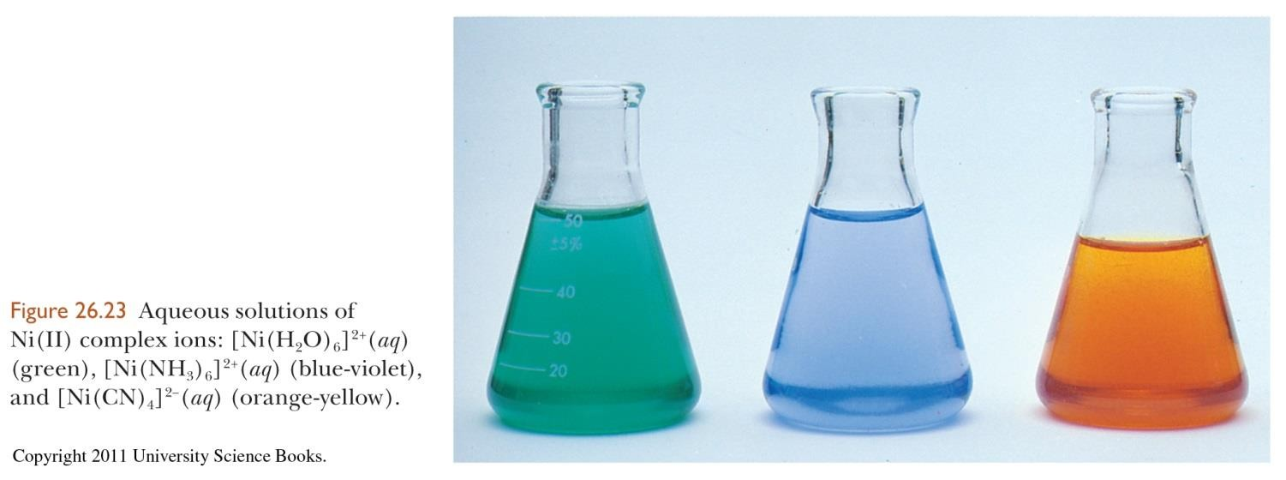
Colors of Transition Metal Complexes
CFT helps explain different colors observed for complexes.
A transition metal complex absorbs specific λ of light.
The color observed is complimentary to what was absorbed.

Slide 15
Charge Effect of Metal Ions
As the metal ion charge increases, the ligands are drawn closer to the metal ion because of its increased charge density.
As the ligands move closer, they cause greater splitting of the d orbitals, there by producing a larger Δ value.
The magnitude of Δ for a given ligand increases as the charge on the metal ion increases.
NH₃-Co⁺² (weak field) NH₃-Co⁺³ (strong field)

Slide 16

The spectrochemical series.
I⁻ < Cl⁻ < F⁻ < OH⁻ < H₂O < SCN⁻ < NH₃ < en < NO₂⁻ < CN⁻ < CO
WEAKER FIELD
STRONGER FIELD
SMALLER Δ
LARGER Δ
LONGER λ
SHORTER λ
As Δ increases, shorter wavelengths (higher energies) of light must be absorbed to excite electrons. For reference H₂O is considered a weak-field ligand.

Slide 17
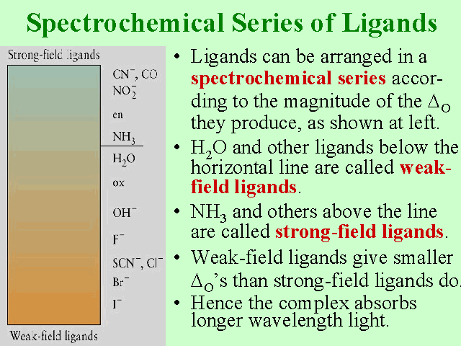

Slide 18
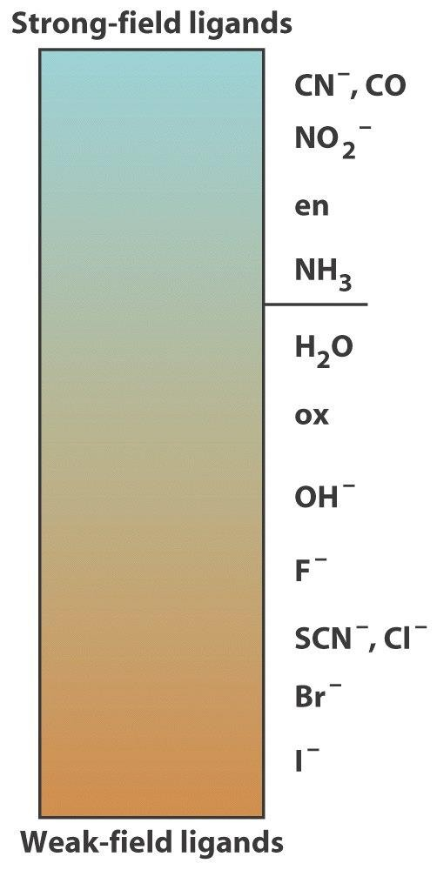
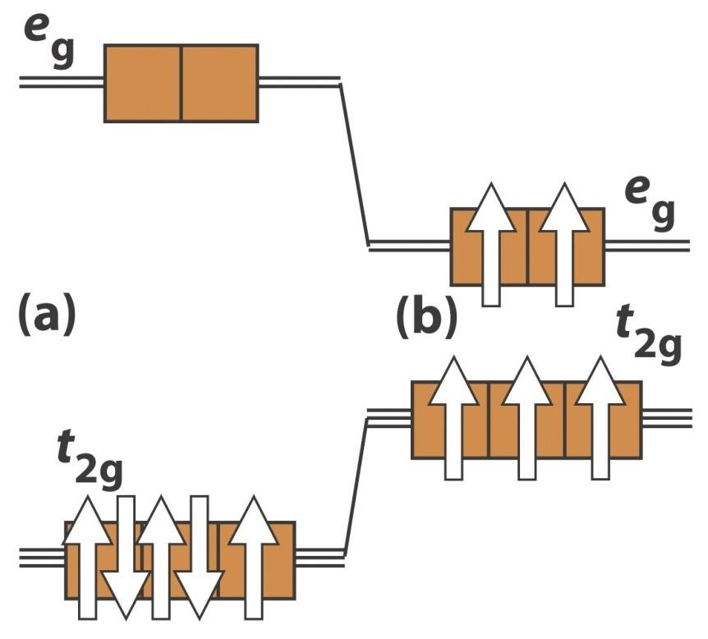
The spectrochemical series of color and magnetic properties: weak field
(red, high spin), strong field (violet, low spin)
Spectrochemical series
A d⁵ electron metal ion
Weak field Ligands (red, high spin)
Strong field Ligands (violet, low spin)

Slide 19
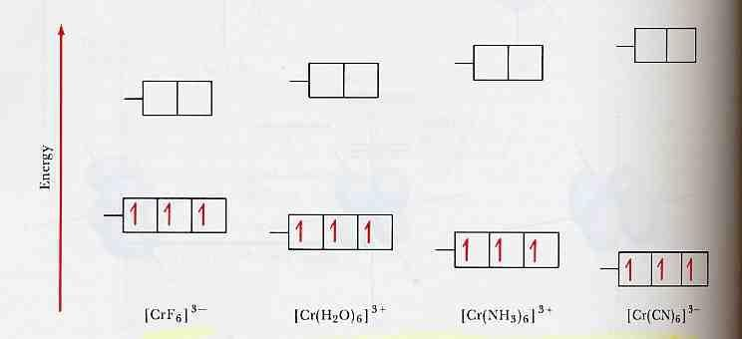
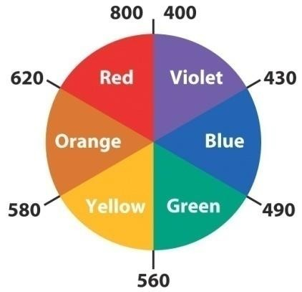
Color of complexes depend on the value of Δ₀ = hν = ΔE
Δ₀ = hν
“red absorption”
“violet
absorption”
“looks green”
“looks yellow

Slide 20



Crystal Field Splitting of d orbitals: high spin and low spin situations for a d⁵
metal (why are some complexes colorless?)
Color corresponds to the absorption of light an transitions between d orbitals for metals.
The transition for (b) is “spin
forbidden” because an
electron would need to “flip” its spin in being excited from a t orbital to a e orbital
Colorless or very weakly colored
Colored
Why?

Slide 21
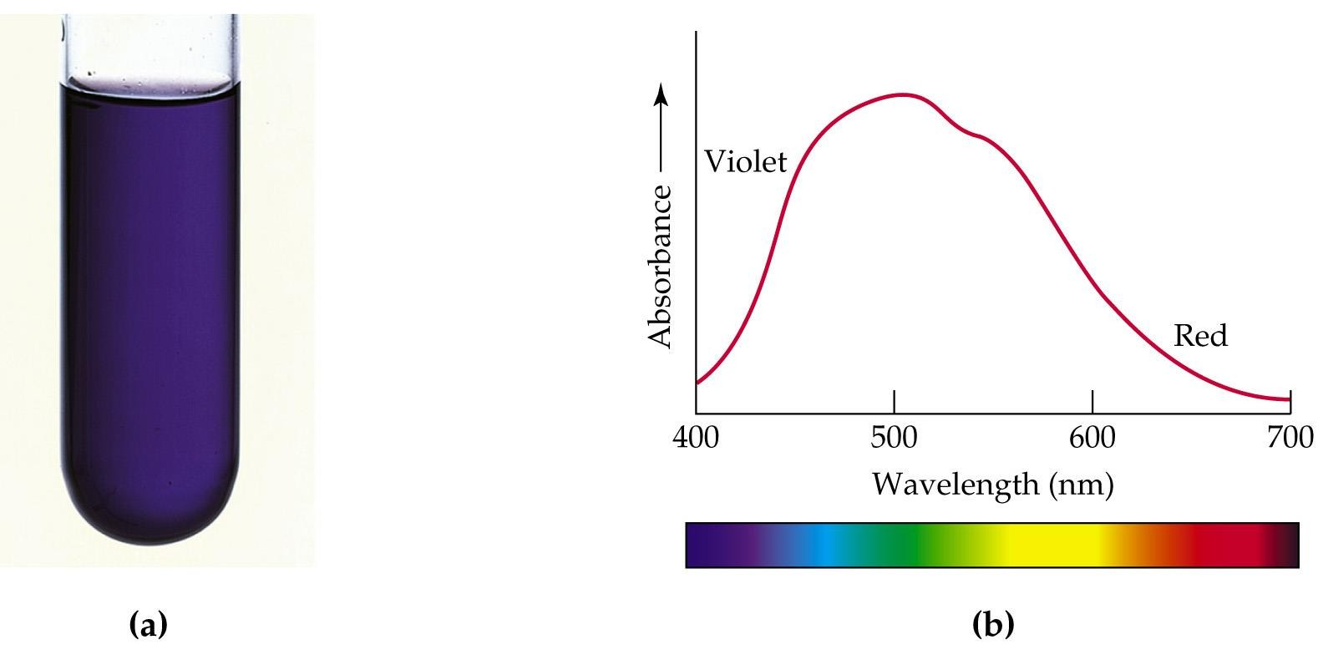
Hexaquotitanium (III) Solutions Appear Violet Due to
Absorption of Yellow and Green Light

Slide 22
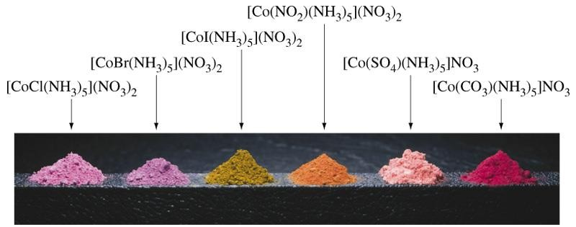
The Colors of Transition Metal Complexes can be Correlated
with the Ligands They Bind
These Complexes All Contain Co (III) and 5 NH₃
Absorbtion:
Co (III): 3d⁶: t_{2g}⁶ or t_{2g}⁴e ²
g
t ⁶ → t
5_{eg}1
or
2g 2g
⁴e ² → t ³eg³
^{t}2g g 2g

Slide 23
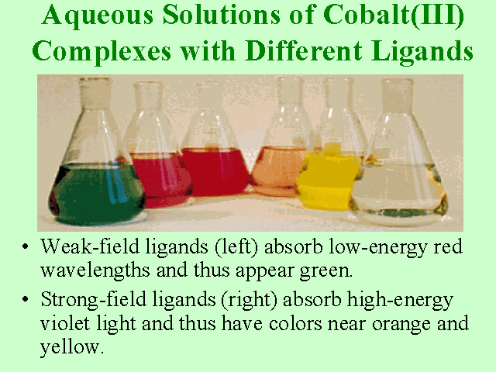

Slide 24
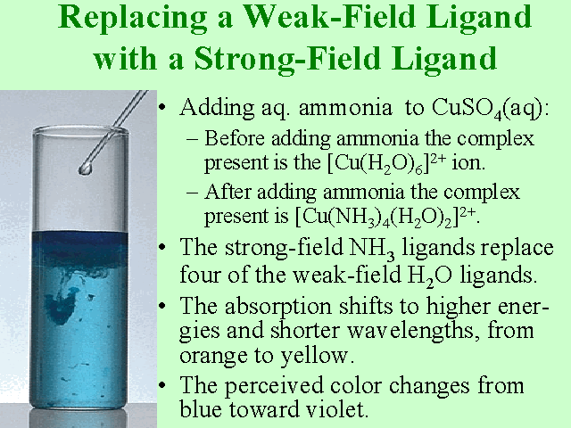

Slide 25
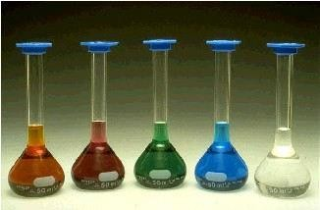
Complex Influence on Color
Compounds of Transition metal complexes solution.
[Fe(H₂O)₆]³⁺
[Co(H₂O)₆]²⁺ _{[Ni(H2O)6]}2+ _{[Cu(H O) ]}2+ 2+
2 6 [Zn(H₂O)₆]

Slide 26
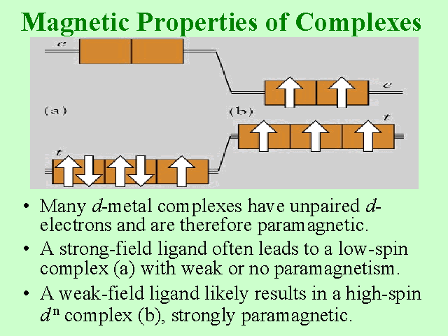

Slide 27
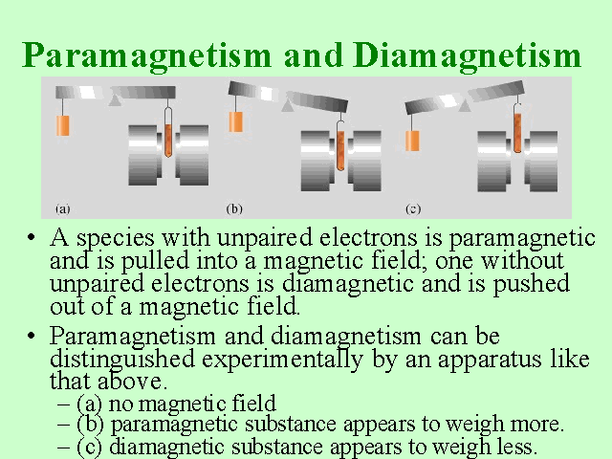

Slide 28
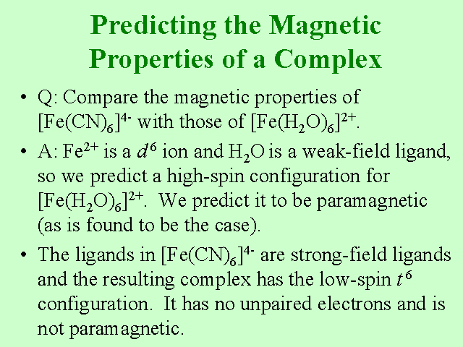

Slide 29
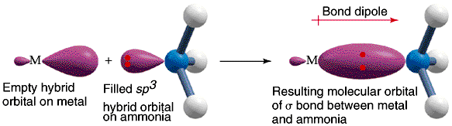
Crystal-Field Theory
Model explaining bonding for transition metal complexes
Originally developed to explain properties for crystalline material
Basic idea:
Electrostatic interaction between lone-pair electrons result in
coordination.

Slide 30
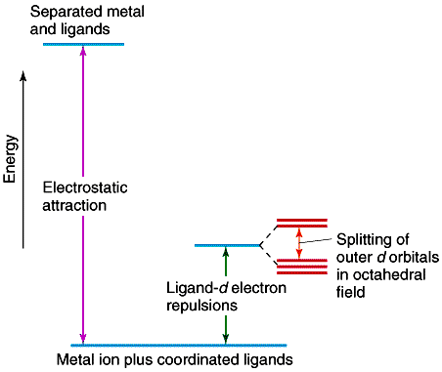
Energetics
CFT - Electrostatic between metal ion and donor atom
i
Separate metal and ligand high energy
Coordinated Metal - ligand stabilized
Destabilization due to
ligand -d electron repulsion
Splitting due to octahedral field.
ii
iv
iii

Slide 31
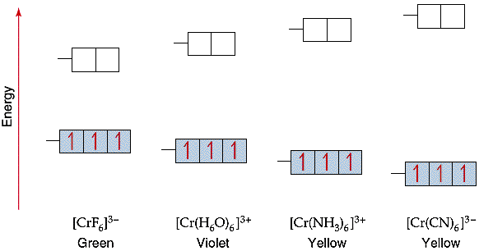
Magnitude of CF Splitting (Δ or 10Dq)
Color of the Complex depends on magnitude of Δ
1. Metal: Larger metal larger Δ
Higher Oxidation State larger Δ
2. Ligand: Spectrochemical series
Cl⁻ < F⁻ < H₂O < NH₃ < en < NO₂⁻ < (N-bonded) < CN
Weak field Ligand: Low electrostatic interaction: small CF splitting. High field Ligand: High electrostatic interaction: large CF splitting.
Spectrochemical series: Increasing Δ
42

Slide 32
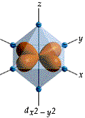
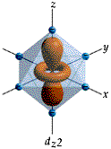
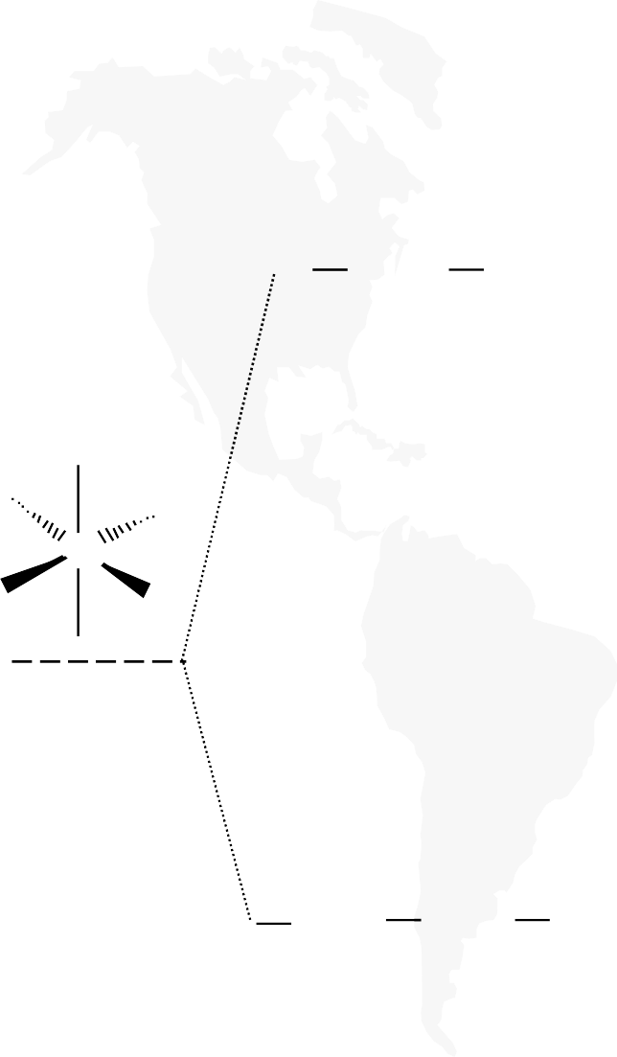
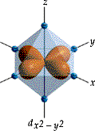
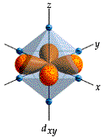
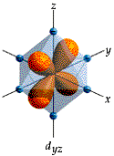
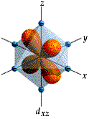
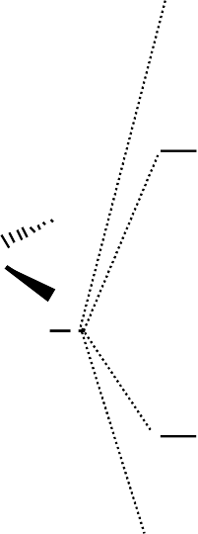
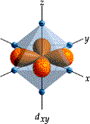

Octahedral, Tetrahedral & Square Planar
CF Splitting pattern for various molecular geometry
^{d}x2-y2 ^{d}z2
^{d}x2-y2
Octahedral
Tetrahedral d_{xy} dyz ^{d}xz
M
Square planar ^{dxy}
M
M
^{d}z2
^{d}x2-y2
^{d}z2
^{d}xz ^{d}yz
d
d
d
xy
yz
xz
Mostly d⁸
(Majority Low spin) Strong field ligands i.e., Pd²⁺, Pt²⁺, Ir⁺, Au³⁺
Pairing energy Vs. Δ
Small Δ 🡒
High Spin
05.06.01 10:59 PM
43
Weak field Δ < Pe Strong field Δ > Pe

Slide 33
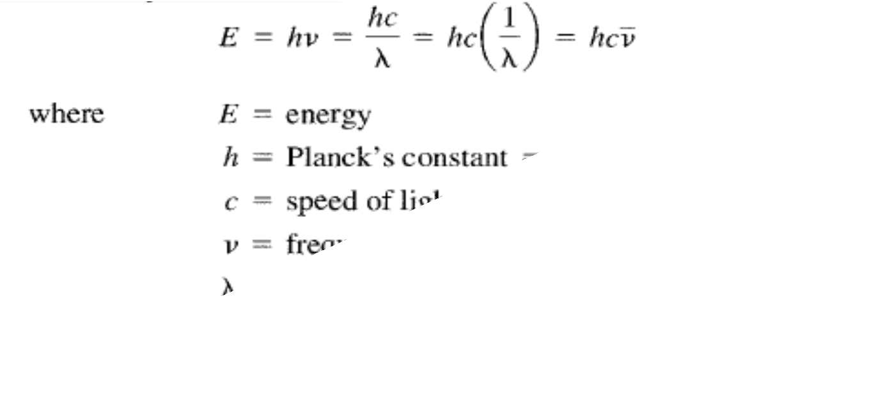

Slide 34
Q₁/What color expected for complex that absorbs light at 600 nm?
Q₂/What color expected for an octahedral complex appears if energy
Δo= 3.75 x 10⁻¹⁹ J, Plank const.= 6.626 x 10⁻³⁴ J.s, speed light = 3 x 10⁸ m/s .
Q₃/Would you expect a violet solution to be high spin or low spin? What about a red solution?
Q₄/There are two solutions , one which is yellow and another is violet. The solutions are [Cr(H₂O)₆]³⁺ and [Cr(CN)₆]³⁻ what are the colors of each solution?
Q₅/Calculate the octahedral crystal field splitting energy in KJ/mol for [Fe(CN)₆]⁴⁻,
if the wavelength of the most intensely absorbed light is 305 nm.

