Slide 1
Bond Theory
Third stage Chemistry 2023-2024
Assistant Lecturer
M.Sc. Muhammad Haji

Slide 2
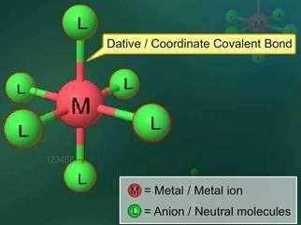
Coordination Chemistry
Introduction and Historical Development
Coordination Compounds , Metal Complexes or just Complexes . These are compounds that contain a central atom or ion, usually a metal surrounded by a cluster of ions or molecules. It may be a cation , anion or nonionic (neutral), depending on the sum of the charges of the central atom and the surrounding ions and molecules. In modern terminology, these compounds are called coordination compounds.
Coordination compounds (or) complexes compounds are a type o of addition compounds.

Slide 3
Applications of coordination compounds in life itself
In industria.
Extraction of metals. 3-Analytical chemistry.
Biological importance.
In medicine.
In electroplating.
For estimation of hardness of water.
In modifying the redox behavior of metal ions.

Slide 4
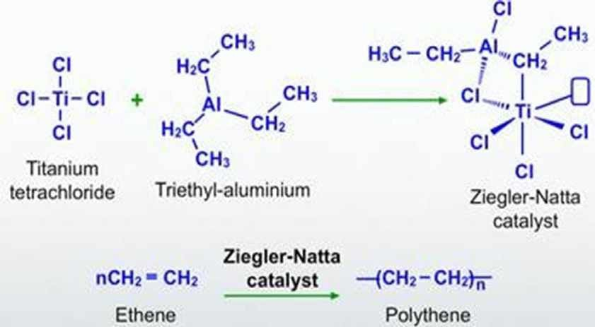
1-Chemical industry:
ex: Ziegler-Natta catalyst
The Ziegler-Natta catalyst is a complex made up of two different compounds: triethyl aluminium AlR₃ and titanium tetrachloride TiCl₄ . This catalyst for low pressure polymerization of ethylene is used to make polyethylene and polythenes with a high density. Each ethylene molecule is made up of two carbon atoms and four hydrogen atoms.

Slide 5
2-Extraction of metals:
Technique used for noble metals like Ag & Au.
Noble metals like silver and gold are extracted from their ore by the formation of cyanide complexes – sodium dicyanoargentate(I) and sodium dicyanoaurate (I).
Ag₂S + 4NaCN₂ 2Na[Ag(CN)₂] + Na₂S 2Na[Ag(CN)₂] + Zn Na₂[Zn(CN)₄] + 2Ag↓
or
Au₂S + 4NaCN₂ 2Na[Au(CN)₂] + Na₂S 2Na[Au(CN)₂] + Zn Na₂[Zn(CN)₄] + 2Ag↓

Slide 6
3- Analytical chemistry (Qualitative analysis):
Formation of coordination compounds/complex ions has important role in analytical chemistry. It is used for either separating or estimating only certain metal ion in the presence of other ions and as means of positively identifying certain unknown ions..
For ex. Ag⁺ + Cl⁻ AgCl (ppt. salt, which dissolves in excess of aqueous ammonia forming a clear solution which is a complex ion).
AgCl + 2NH₃ [Ag(NH₃)₂]⁺ (clear solution)
If to the clear solution is added an excess of HNO₃ the white ppt (AgCl). is formed again (due the equilibrium).
_{H}+
+ NH₃ → NH ⁺
4

Slide 7
4-Biological Importance:
Significant role in plant(chlorophyl-Mg) and animal Vitamin-B12(Vitamin B12, also known as cobalamin, is a water-soluble vitamin that is derived from animal products such as red meat, dairy, and eggs).
Haemoglobin, red pigment of blood that acts as the Oxygen carrier is a coordination compound of iron

Slide 8
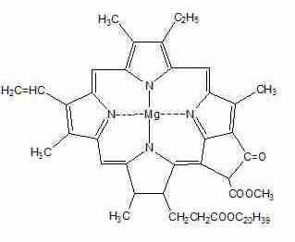
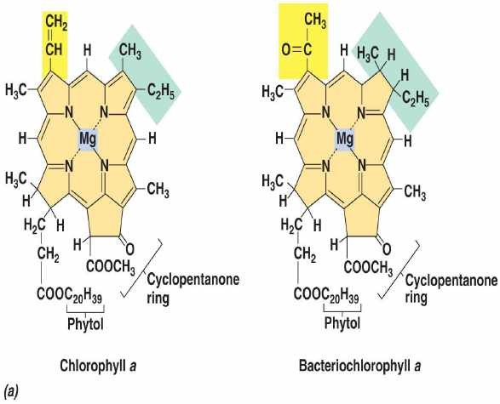
Chlorophyll which is vital to photosynthesis in plants is a
magnesium(II) complex ion.

Slide 9
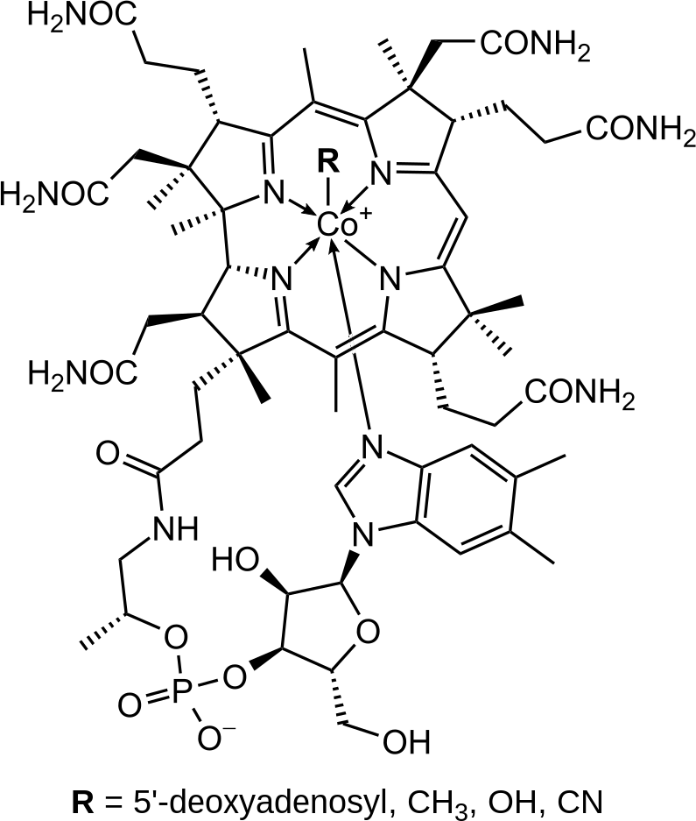
Your body needs vitamin B-12, also called cobalamin, to function normally play important roles in creating red blood cells and making DNA and RNA to help build cells. B- 12 also helps your nervous system function as it should.

Slide 10
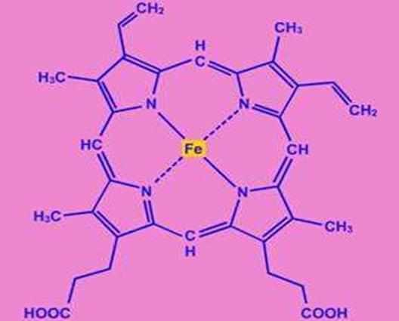
Hemoglobin carries oxygen to human and animal cells is an Fe²⁺ complex(Heme)
10

Slide 11
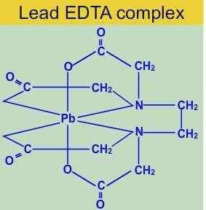
5-In medicine:
Coordination compounds such as platinum, palladium and ruthenium
complexes are anti-cancer drugs(Treatment of cancer – cisplatin
[PtCl₂ (NH₃)₂]), Allso many of the coordination compounds are anti-bacterial. The coordination compounds have been showed effective behavior against many diseases like Alzheimer's and malaria.
EDTA is used to treat lead poisoning.
11

Slide 12
6-In electroplating:
Complex ions used for electroplating of silver and gold are (Ag(CN)₂]⁻ and [Au(CN)₂]⁻ respectively.
For electroplating silver metal, the anode is a bar of silver metal and the electrolytes is a solution of silver cyanide in water and for electroplating gold the anode is a gold anode and the electrolyte is of gold cyanide. We know that the electroplating process uses an anode and a cathode. The metal dissolved from the anode can be plated onto the cathode.

Slide 13
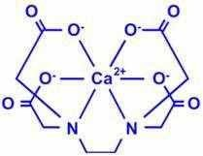
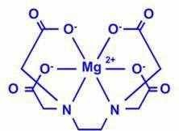
7 -Hardness of water:
The hardness of water is estimated by titration with the sodium salt of EDTA. During titration, the calcium and magnesium ions in hard water form the stable complexes, Calcium EDTA and Magnesium EDTA. Stability is different.

Slide 14
8-In modifying the redox behavior of metal ions:
The reaction in which the transfer of an electron from one atom to the other occurs and hence the oxidation state of some atoms change is called 'Redox reaction'. These reactions of transition metal complexes are divided into two classes on the basis of their mechanism :
Electron – exchange Process : In which the electron transfer results in no net chemical change. For example change of [Fe(CN)₆]³⁻ into [Fe(CN)₆]⁴⁻ or that of [Co(en)₃]³⁺ into [Co(en)₃]²⁺. These reactions have outer sphere electron-transfer mechanism and are followed only indirectly.
Those reactions which involve net chemical change as a result of electron transfer e.g. change of [Cr(NH₃)₅X]²⁺ into [Cr(H₂O)₆]²⁺ or that of [Cr(H₂O)₅Cl]²⁺ into [Cr(H₂O)₆]²⁺. These reactions follow inner sphere or bridge mechanism.

Slide 15
Use of CoCl₂ solution as invisible ink:
2[Co(H₂O)₆]Cl₂
ink(colorless when dilute)
Co[CoCl₄] + 12 H₂O
(blue)
what is written with this solution is not visible until the paper on which it is written is heated(because the H₂Ois driven off and the blue complex is formed.
Upon standing ,water is slowly taken up from the atmosphere and the original colorless complex is regenerated, which makes the writing again invisible.
These examples indicate that coordination compounds are common, but the nature of these compounds was not understood, until the beginning of the 20th century, therefore these compounds were referred to as complex compounds, this term still used.

Slide 16
Historical Development
Discovery: It is difficult to state exactly when the first metal complex was discovered.
Perhaps the earliest one on record is Prussian blue , KCN.Fe(CN)₂ .Fe(CN)₃ ,by the artist᾿s colour maker Dresbach, in Berlin at the beginning of 18th century.
however, the date usually cited is that of the discovery of hexamine cobalt(III) chloride. CoCl₃.6NH₃ by Tassaret (1798) this discovery marks the real beginning of coordination chemistry.
Although Tassert᾿s discovery was accidental, he realized that there was something new and certainly no accident,

Slide 17
Tassaert’s experimental observations could not be explained on the basis of the chemical theory available at that time. It was necessary to understand how CoCl₃ and NH₃ each a stable compound of presumably saturated valence, could combine to make yet another very stable compound.
The answer was not to be found until approximately 100 years later.
Preparation and Properties
The preparation of metal complexes generally involves the reaction between a salt and some other molecule or ion. At first each compound was named after the chemist who originally prepared it as shown in the Table below :

Slide 18
Compound | Name | Present formula
PtCl₂ KCl.C₂H₄ | Zeises’ salt | K[Pt(C₂H₄)Cl₃]
Co(NO₂)₃.KNO₂.2NH₃ | Erdman’s salt | K[Co(NH₃)₂(NO₂)₄]
Since many of the compounds are colored the next scheme was to
name compounds on the basis of colour.
Compound | Colour | Name
CoCl₃.6NH_{3 *} | Yellow | Luteocobaltic chloride
CoCl₃.5NH₃ | purple | Purpureocobaltic chloride
CoCl₃.4NH₃ | Green | Praseocobaltic chloride
CoCl₃.4NH₃ | Violet | Violeocobaltic chloride
IrCl₃.6NH_{3 *} | White | luteoirridic chloride
*This compound called luteo because it contains six NH₃

Slide 19
The chloroammine complexes of Co³⁺ and those of Cr³⁺ not only exhibit a spectrum of colours but also differ in the reactivity of their chlorides.
For ex: addition of AgNO₃ solution to a freshly prepared solution of CoCl₃.6NH₃ results in the immediate pptn. of all three chloride ions. CoCl₃.6NH₃ + AgNO₃ → 3AgCl
CoCl₃.5NH₃ + AgNO₃ → 2AgCl only two chlorides ppt.
These observations suggest that in CoCl₃.5NH₃ and CoCl₃.4NH₃ there are two different kinds of chlorides.
One type is perhaps similar to that in NaCl and is readily ppt, whereas the other types held more firmly and does not ppt.

Slide 20
Another kind of experiment provides useful information about the number of ions present in solutions of different complexes.
The greater the number of ions in a solution, the greater,is the electrical conductivity of the solution.
One other important early observation was that certain complexes exist in two different forms having the same chemical composition.
Ex: green and violet form of CoCl₃.4NH₃.
Isomers: compounds having the same chemical formula but different structures.
Several hypothesis and theories were proposed to account for all of these experimental facts among these are:
20

Slide 21
1-Blomstrand-Jorgensen Chain Theory(1869):
The concept of the tetra valency of carbon and the formation of carbon- carbon chains in organic compounds was already well recognized.
Because it was felt that elements had only one type of valence,
Blomst. And his student Jorgensen suggested ,there could be only three bonds to cobalt(III) in it’s complexes, therefore a chain structure was used to account for the addition of six NH₃ molecules in CoCl₃.6NH₃ (I).
The three chlorides are separated by some distance from cobalt
therefore believed to precipitate readily as AgCl on addition of Ag⁺
Cl– attached to NH₃ may be dissociated
NH₃
Cl
NH₃ NH₃ NH₃ Cl
NH₃ Cl
Co
NH₃

Slide 22
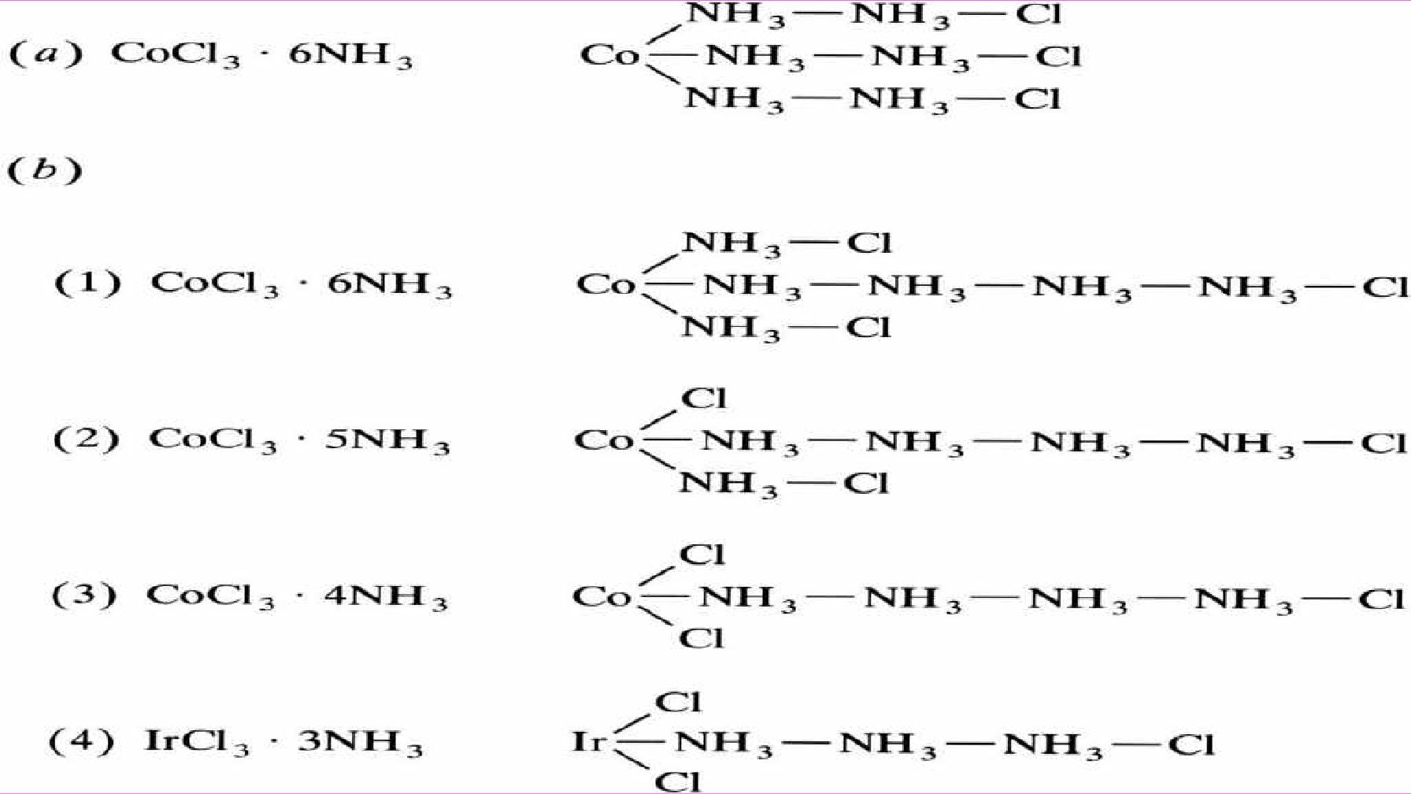
The second compound CoCl₃.5NH₃ (b) 2
One chloride is attached directly to cobalt, so it was expected that this is the one that does not ionize and does not ppt. as
AgCl.

Slide 23
The 3rd Compound CoCl₃.4NH₃ (b)3:
Is also in accord with experiments that show two chlorides are held more firmly than the third ,therefore it is expected that only one chloride will be ppt. upon addition of Ag⁺ .
The 4th Compound CoCl₃.3NH₃ (b) 4:
One would predict that the chlorides would behave as they do in CoCl₃.4NH₃ (b) 3 , Jorgensen did not succeed in preparing the last compound ,but made instead the analogous iridium complex IrCl₃.3NH₃ .The solution of this compound did not conduct current nor did give a pptn. upon addition of AgNO₃ . Thus Jorgensen had succeeded in showing that his chain theory could not be correct.

Slide 24
Werner’s Theory:
Alfred Werner (1866-1919), age 26: Alfred Werner proposed Werner’s theory of coordination compounds in 1898, which explains the structure of coordination compounds.
Nobel prize for Chemistry, 1913. Addition of 6 mol NH₃ to CoCl_{3(aq)}
Conductivity studies
Precipitation with AgNO3

Slide 25
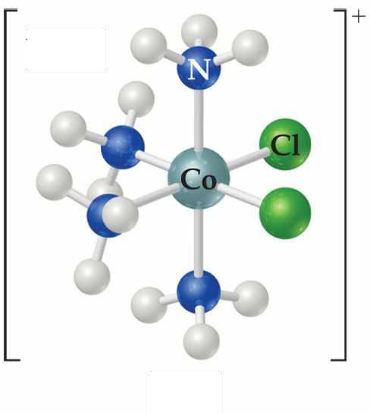
Alfred Werner suggested in 1893 that metal ions exhibit what he called primary and secondary valences.
Primary valences were the oxidation number for the metal (3+ on the cobalt at the right).
Secondary valences were the coordination number, the number of atoms directly bonded to the metal (6 in the complex at the right).
Primary valences always satisfied by negative ions while secondary valence satisfy by either negative ions or neutral molecules.

Slide 26
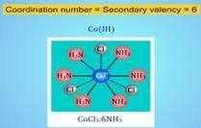
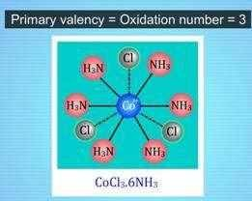
The central metal and the ligands directly bonded to it make up the coordination sphere of the complex.
In CoCl₃ ∙ 6 NH₃, all six of the ligands are NH₃ and the 3 chloride ions are outside the coordination sphere.
NH₃
3+
H₃N H₃N
NH₃
NH₃
Co
NH₃

Slide 27
In CoCl₃ ∙ 5 NH₃ the five NH₃ groups and one chlorine are bonded to the cobalt, and the other two chloride ions are outside the sphere.
Thus one chloride ion must serve the dual function of satisfying both primary and secondary valence.
Such a chloride is not readily precipitate from solution by Ag⁺ ion The other two chlorides which lie outside of coordination sphere readily ppt. upon addition of Ag⁺ ion .The formula is [Co(NH₃)₅Cl]Cl_{2 .}
Werner proposed putting all molecules and ions within the sphere in brackets and those “free” anions (that dissociate from the complex ion when dissolved in water) outside the brackets.

Slide 28
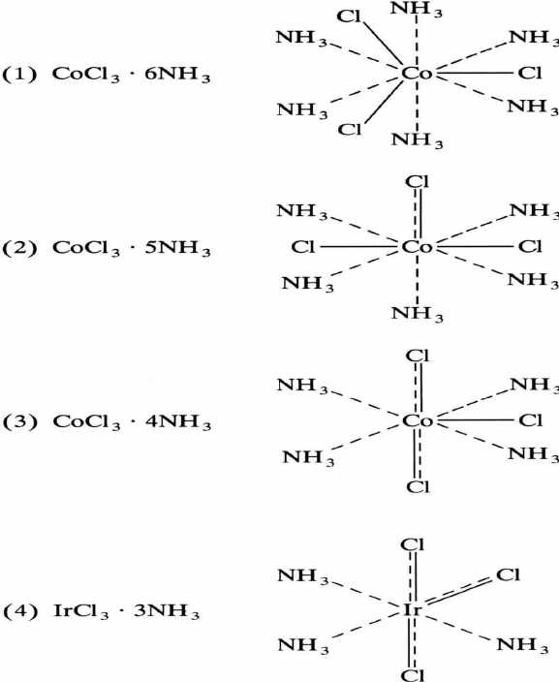
Some chloride ions must do double duty and help satisfy the both of primary valence and secondary valence.

Slide 29
As a result of Werner’s Experiment, when AgNO₃ (silver nitrate) was mixed with CoCl₃.6NH₃, all three chloride ions were transformed to AgCl (silver chloride). But when AgNO₃ was combined with CoCl₃.5NH₃, the result was the formation of two moles of AgCl.
A further result of combining CoCl₃.4NH₃ with AgNO₃ was the formation of
one mole of AgCl.
Upon addition of AgNO₃ the chlorides which lie outside of the coordination sphere would precipitated.
Compound Moles of ions Moles of AgCl(s)
“CoCl₃ 6NH₃”
.
“CoCl₃ 5NH₃”
.
“CoCl₃ 4NH₃”
.
“CoCl₃ 3NH₃”
.
4 3
3 2
2 1
0 0

Slide 30
Werner’s Theory limitations.
It is unable to explain the magnetic, colour, and optical features exhibited by coordination compounds in their natural state.
It was unable to provide an explanation for why all elements do not form coordination compounds.
It was unable to describe the directional properties of bonds in coordination compounds because of this limitation.
This theory is unable to explain the stability of the complex in any way.
The nature of complexes could not be explained by this idea.
30

Slide 31
Coordination Compounds and its Structure:
Werner’s original hypothesis was that coordination compounds are produced because the central atoms have the ability to make coordinate or secondary bonds in addition to valence or normal bonds, and that this is the reason why coordination compounds are generated. Following the development of the concept that all covalent bonds are made up of electron pairs shared between atoms in the 1920s, it became possible to give a thorough account of coordinate bonding in terms of electron pairs. Gilbert N. Lewis, a physical chemist from the United States, is credited with popularizing the concept. According to Lewis’s definition, when one of the atoms contributes both electrons to the link, such as the boron-nitrogen bond created when the chemical boron trifluoride (BF₃) reacts with ammonia, the bond is known as a coordinate bond.

Slide 32
Coordination Compounds Characteristics
Due to the fact that coordination compounds reveal chemical bonding and molecular structure as well as the useful qualities and distinctive chemical nature of specific coordination compounds, coordination compounds have been extensively explored. Complexes, or the general class of coordination compounds, as they are frequently referred to, are a diverse and large group of chemicals. The compounds in this category might be made up of electrically neutral molecules or of positively or negatively charged species, depending on their composition (which are ions).

Slide 33
Coordination Chemistry
Definitions
Coordination compounds
NH₃
3+
H₃N H₃N
NH₃
NH₃
Co
3Cl– (counterion)
NH₃
H
ligand
(coordination sphere)
N
M
H
H
N forms a coordinate covalent bond to the metal

Slide 34
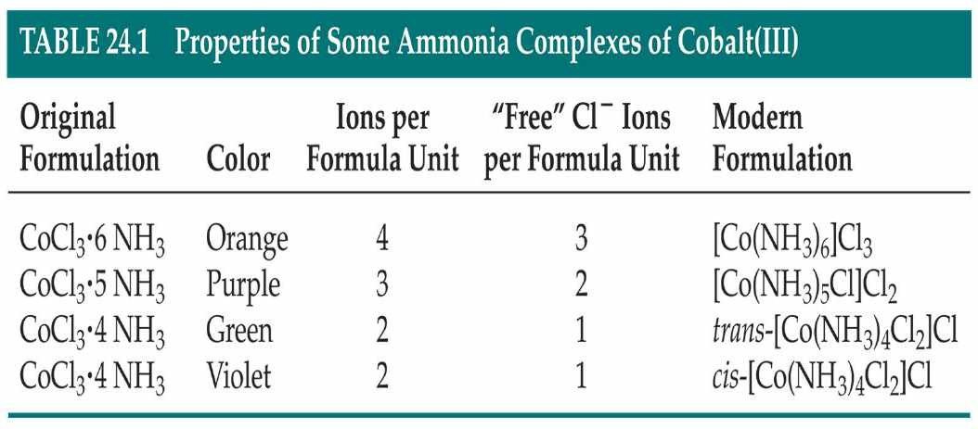

Slide 35
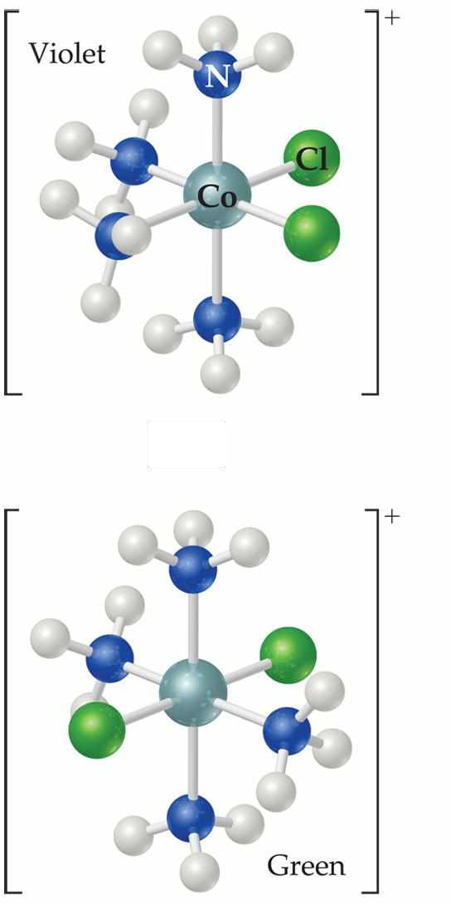
Werner’s Theory
This approach correctly predicts there would be two forms of CoCl₃ ∙ 4 NH₃.
The formula would be written [Co(NH₃)₄Cl₂]Cl.
One of the two forms has the two chlorines next to each other.
The other has the chlorines opposite each other.

Slide 36
Metal-Ligand Bond
This bond is formed between a Lewis acid and a Lewis base.
The ligands (Lewis bases) have nonbonding electrons.
The metal (Lewis acid) has empty orbitals.

Slide 37
Ligands
The molecule or ions which are coordinated to the metal atom or ion.
Eg. K₄[Fe(CN)₆], the 6 cyanide group coordinated by Fe²⁺ and are the ligands.
Ligand can be negative ions, positive ions or neutral molecules.
Ligand are Lewis base.
Central metal atom or ion is Lewis acid.

Slide 38
Common Ligands:
Monodentate ligands:
Contains only one donor atom
Examples: H₂O, NH₃, CN⁻ , SCN⁻ , X⁻ ( halide ions ) , CO, O²⁻
Bidentate ligands:
Contains two donor atoms
Examples: Oxalate ion (ox) C₂O ²⁻, ethylenediamine (en)
H₂NCH₂CH₂NH₂
4
3-Polydentate ligands:
Contains more than two donor atoms
Example: ethylenediaminetetraacetate ion (EDTA⁴⁻)

Slide 39
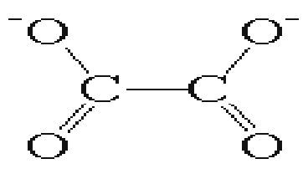
oxalate (ox)
ethylenediamine(en)
diethylenetriamine(dien)
triethylenetetraamine(trien)

Slide 40
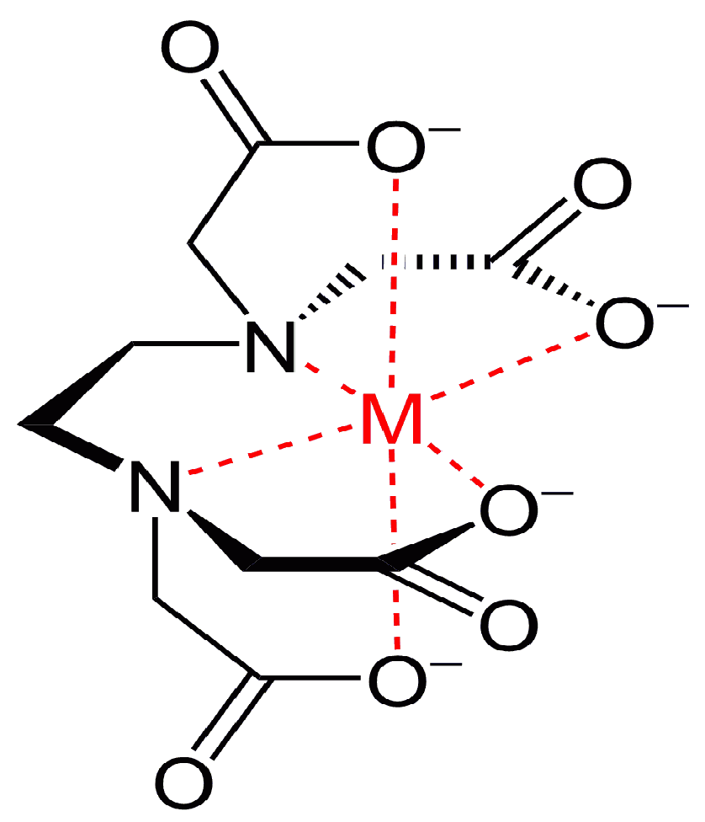
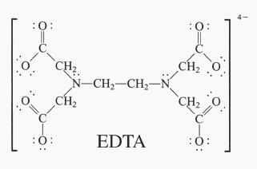
Polydentate ligand (EDTA)
It contains six donor atoms
Coordination number : 6
40

Slide 42
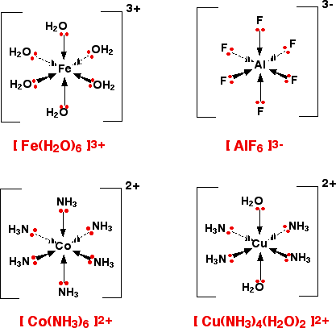
Complex ion
A complex ion has a metal ion at its Centre with a number of other molecules
or ions surrounding it.

Slide 43
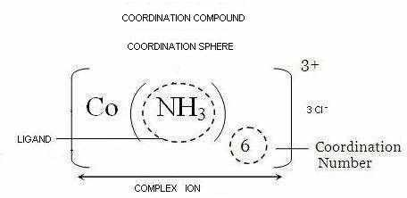
Coordination sphere ion
oxidation no.

Slide 44
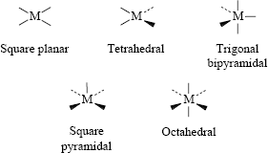
The spatial arrangement of ligand atoms, directly attached to the central atom/ion.

Slide 45
Nomenclature of coordination compounds : IUPAC rules
The cation is named first in ionic compounds, then the anion.
Nonionic compounds are given a one-word name.
The following rules pertain to the names of ligands.
The ligands are named first and the central atom last.
Ligands are named in alphabetical order by their root name.
Neutral ligands are named the same as the molecule, except
for a few such as H₂O (aqua) and NH₃ (ammine), which have
special names.
d. Anionic ligands are named by adding –o to the stem of the usual name, such as chloro for Cl⁻ and sulfato for SO₄^{2-.} (Note that in 2004 it was recommended that anionic ligands will end with -ido so that chloro would become chlorido, etc. )
e. The name of each ligand is preceded by a Latin prefix (di-, tri-
tetra-, penta-, hexa- etc.) if more than one of that ligand Is
bonded to the central atom. For example, the ligands in [PtCl₄]²⁻
are named tetrachloro, and the ligands in [Co(NH₃)₄Cl₂]⁺ are
named tetraamminedichloro.

Slide 46
If the ligand is polydentate, as in ethylenediamine, the number of
ligands bonded to the central atom is indicated by the corresponding Greek prefixes(bis-, tris-, tetrakis-, pentakis-,
hexakis-, etc.). For example, the ligands in [Co(en)₃]³⁺ are named
trisethylenediamine. A Greek prefix is also used when a Latin prefix forms a part of the name of the ligand, as in triethylamine, [N(CH₃)₃.] In this case, the ligand name is enclosed in parentheses.
For example, the ligands in [Co(N(CH₃)₃)₄]²⁺are named
tetrakis(trimethylamine).
For a cationic complex ion or a nonionic compound, the central
atom is given its ordinary name followed by its oxidation number Roman numerals, enclosed in parentheses. For example, [Cr(H₂O)₅Cl]²⁺ is named pentaaquachlorochromium(III) ion, and
[Cr(NH₃)₃Cl₃] is name triaminetrichlorochromium (III).
5. For anionic complex ions, the suffix –ate is added to the name of
the central atom, followed by the oxidation number in Roman
numerals, enclosed in parentheses. For example, [Cr(CN)₆]³⁻ is
name hexacyanochromate (III) ion.

Slide 47
Examples for anionic ligands
Bromide (Br⁻) becomes bromo
Chloride (Cl⁻) becomes chloro
Hydroxide (OH⁻) becomes hydroxo
Oxide (O²⁻) becomes oxo
Nitrite (NO₂ ) becomes nitrito (M-O bond) or nitro (M-N bond)
-
2-
Carbonate (CO₃ ) becomes carbonato
Thiosulfate (S₂O ²⁻) becomes thiosulfato
3

Slide 48
Nomenclature of coordination compounds : IUPAC rules
Cation named before anion for ionic compounds; When naming complexes:
Ligands are named first alphabetically
Metal atom ion is named last
Coordination state given in Roman numerals follows in parentheses
Name of anionic ligands end with suffix -o
Change | -ide to | -o
Change | -ite to | -ito
Change | -ate to | -ato

Slide 49
Neutral ligands referred to by their usual names Example: ethylenediamine
Exceptions
Water, H₂O = aqua Ammonia, NH₃ = ammine
Carbon monoxide, CO = carbonyl
Number of each type of ligand in a complex is indicated by prefix di-.2, tri-. 3, tetra-. 4, penta-.5,
If the name of the ligand begins with/ contains a prefix,
bis-.2, tris-. 3, tetrakis-.4, pentakis-.5, hexakis-.6

Slide 50
When there is more than one of a particular ligand, number is specified by di, tri, tetra, penta, hexa, and so forth. when confusion might result, the prefixes bis, tris and tetrakis are employed
e.g. bis(ethylenediamine).
negative (anionic) complex ions always end in the suffix (ate).
aluminum -----> aluminate chromium -----> chromate manganese ------> manganate cobalt ------> cobaltate
50

Slide 51
For some metals the -ate is appended to the Latin system always appears with the common English name for the element such as the following elements.
iron ----> ferr ------> ferrate copper ---> cupra -----> cuprate lead ----> plumb -----> plumbate silver ---> argent ----> argentate gold ---> aur ----> aurate
tin ----> stann -----> stannate
the oxidation number of the metal in the complex is written in roman numerals within parentheses following the name of the metal

Slide 52
Examples of complexes derived from common ligands
Ligand | Complex | IUPAC name
Water | [Cr(OH₂)₆]³⁺ | Hexaaquachromium(III) ion
Halide Ammonia Cyanide | K[FeCl₄] [Ag(NH₃)₂]⁺ [Ni(CN)₄]²⁻ | Potassium tetrachloroferrate(III) Diamminesilver(I) ion Tetracyanonickelate(II) ion

Slide 53
Examples of complexes derived from common ligands
Ligand | Complex | IUPAC name
pyridine | [Ru(py)₄Cl₂ ] | dichlorotetrapyridineruthenium(II).
Ethylene diamine | [Co(en)₃]³⁺ | Tris(ethylenediamine)cobalt(III) ion
Bipyridine (bipy) | [Ru(bipy)₃]³⁺ | Tris(bipyridyl)ruthenium(III) ion
 | -

Slide 54
Formula of coordination compound
[CoCl(NH₃)₅]Cl₂
Name of coordination compound
Pentaamminechlorocobalt(ΙΙΙ)chloride
Sodium amminebromochloronitro-N- platinate(ΙΙ)
Na[PtBrCl(NO₂)(NH₃)]
K₂[Ni(CN)₄]
Potassium tetracyanonickelate(ΙΙ)
(NH₄)₃[Fe(CN)₆]
Ammonium hexacyanoferrate(III)
[Ag(NH₃)₂][Mn(H₂O)₂(C₂O₄)₂] Diamminesilver(I)diaquadioxalatomanganate
(III)

Slide 55
Correct formulae of coordination compounds(metal complexes
Correct formulae
[CoBr₂(en)(H₂O)₂]NO₃ [CoBr₂(H₂O)₂(en)]NO₃
In a coordination formula, the central atom is listed first.
The formally anionic ligands appear next, listed in alphabetical order according to the first symbols of their formula. The neutral ligands follow, also in alphabetical order, according to the same principle. The formula of the entire coordination entity, whether charged or not, is enclosed in square brackets.
If the coordination entity is negatively charged, the formula is preceded by
the cation formula. K[FeCl₄] potassium tetrachloroferrate
When ligands are polyatomic, their formulae are enclosed in parentheses. Ligand abbreviations are also enclosed in parentheses.

Slide 56
1. In naming the entire complex, the name of the cation is given first and the anion second (just as for sodium chloride), no matter whether the cation or the anion is the complex species.
In the complex ion, the name of the ligand or ligands precedes that of
the central metal atom. (This procedure is reversed from writing formulae.)
_{[Co(en)3]Cl3} tris(ethylenediamine)cobalt(III) chloride
Ligand names generally end with 'o' if the ligand is negative ('chloro' for Cl⁻, 'cyano' for CN⁻, 'hydro' for H⁻) Note that in 2004 it was recommended that anionic ligands will end with -ido so that chloro would become chlorido, etc. and unmodified if the ligand is neutral ('methanamine' for MeNH₂).
Special ligand names are 'aqua' for water, 'ammine' for ammonia, 'carbonyl' for CO, 'nitrosyl' for NO.
[Fe(CO)₅] Pentacarbonyl iron(0)

Slide 57
[NiCl₂(pph₃)₂] dichlorobis(triphenylphosphine)nickel(II).
4. A Greek prefix (mono, di, tri, tetra, penta, hexa, etc.) indicates the number of each ligand (mono is usually omitted for a single ligand of a given type). If the name of the ligand itself contains the terms mono, di, tri, eg triphenylphosphine, then the ligand name is enclosed in parentheses and its number is given with the alternate prefixes bis, tris, tetrakis instead.
Again, one would use diamine, for (NH₃)₂, but bis(methylamine), for (NH₂Me)₂, to make a distinction from dimethylamine. (Note that this ambiguity does not arise if the preferred IUPAC name, methenamine, is used instead of methylamine).
There is no elision of vowels or use of a hyphen, e.g. in tetraamine and similar names. Some texts suggest that if a ligand is "complicated" then use the bis, tris multipliers. What constitutes "complicated" is not spelled out however, so a simpler approach is to use them if the name of the ligand is three or more syllables long!

Slide 58
A Roman numeral or a zero in parentheses is used to indicate the oxidation state of the central metal atom.
If the complex ion is negative, the name of the metal ends in 'ATE' for example, ferrate, cuprate, nickelate, cobaltate, etc.
If more than one ligand is present in the species, then the ligands are named in alphabetical order regardless of the number of each. For example, NH₃ (ammine) would be considered an 'a' ligand and come before Cl⁻ (chloro).

Slide 59
Some additional notes
Some metals in anions have special names
B - Borate Au - Aurate Ag - Argentate Fe - Ferrate
Pb - Plumbate Sn - Stannate Cu - Cuprate
Use of brackets or enclosing marks
Square brackets are used to enclose a complex ion or neutral coordination species.
Examples:
[Co(en)₃]Cl₃
note that it is not necessary to enclose the halogens in brackets.
[Co(NH₃)₃(NO₂)₃] K₂[CoCl₄]

Slide 60
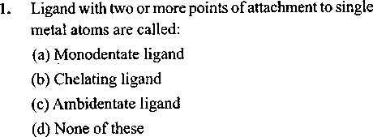
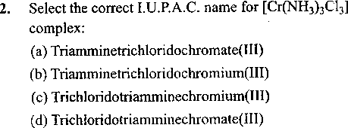
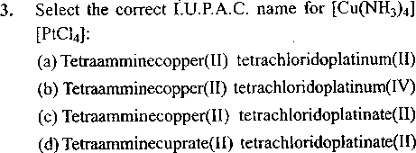
60

Slide 61
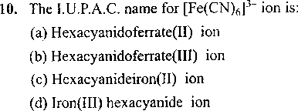
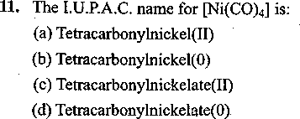

Slide 62
