Slide 1
Chapter Two
Hydration of Cement
2-1 Hydration of Cement
The chemical reactions that take place between cement and water is referred as hydration of cement. On hydration certain products are formed these products have cementing or adhesive value.
•Theory of Solid state (Water attacks cement compounds converting the compounds into hydration products starting from the surface and proceeding to the interior with time
Hydration of cement compounds with water at the first time
Continuing of hydration with time

Slide 2
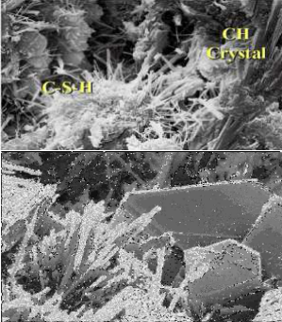
2-2 Hydration of Silicates
Both C₃S and C₂S react with water to produce an amorphous calcium silicate hydrate known as C–S–H gel which is the main ‘glue’ which binds the sand and
aggregate particles together in concrete. The reactions are summarized below:
2C₃S + 6H → C₃S₂H₃ + 3Ca(OH)₂
100 + 24 → 75 + 49
2 C₂S + 4 H → C₃S₂H₃ + Ca (OH)₂
100 + 21 → 99 + 22
CH
C-S-H
Microstructure of cement grain showing CSH and Ca(OH)₂.

Slide 3
2-3 Hydration of Aluminates
→In the absence of soluble calcium sulfate (Gypsum), C₃A reacts rapidly with water , the final form of the reaction is :
C₃A + 6 H →
100 + 40 →
C₃AH6 (cubic crystals-The stable form)
140
This is rapid and highly exothermic reaction , will lead to rapid (quick ) setting of cement
→If finely ground gypsum is blended with the C₃A prior to mixing with water then the initial reactions are controlled by the formation of a protective layer of ettringite on the surface of the C₃A crystals. Formation of Ettringite prevent quick reaction of C₃A with water and delay the setting of cement.
C A + CSH₂ + 26H → C₆AS H
(Ettringite- C₃A · 3CaSo₄ . 32H)
(Monosulfate)
2C₃ A + C₆AS₃ H₃₂ + 4H = 3C₄AS̅H₁₂

Slide 4
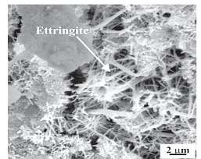
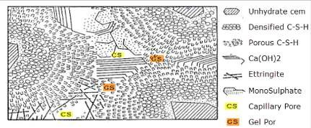
SEM , formation of Ettringite
schematic diagram of the structure of hydrated cement paste.
C4AF
Hydration of C₄AF :
C₄AF + 10H + 2CH = C₆AFH₁₂
And react with gypsum to produce ettringite but with a slower rate than C₃A
→Many studies have shown that the hydration of C₄AF (or more correctly the C₂A– C₂F solid solution) is analogous to that of C₃A but proceeds more slowly. Reaction rate is variable depends on Al/Fe ratio but generally is slow

Slide 5
2-4 Setting and Hardening of Cement
The term setting refers to the solidification of the plastic cement paste.
The initial set :The beginning of solidification, marks the point in time When the paste has become unworkable. Accordingly, concrete placement, compaction, and finishing operations are difficult beyond this stage.
The paste does not solidify suddenly; it requires considerable time to become fully rigid
The final set: The time taken to solidify completely which should not be too long in order to avoid delays in the construction process .
False Set: If too high a level of dehydrated gypsum (CaSO4 ) is present, then crystals of gypsum crystallize from solution and cause a plaster or false set. if mixing continues, or is resumed, the initial level of workability is restored
Dormant period (induction time): The period when the hydration rate became very slower because of the formation of a protective layer on the surface of unhydrated particles of dry cement (C3A particles) preventing flash set of cement.

Slide 6
Flash (Quick) set: When cement compounds reacts with water , at the beginning C₃A react rapidly and if there is no gypsum in cement paste (an inadequate supply soluble calcium sulfate) , then quick set will happen.
Hardening : The phenomenon of strength gain with time , this because hydration of C₃S starts at the final set and the reaction continues rapidly for several weeks, filling void spaces in the paste with reaction products results in a decrease of porosity and permeability and an increase in strength
2-5 Heat of Hydration
The hydration of Portland cement involves exothermic reactions, i.e. they release heat. The heat release is advantageous in cold weather and in precast operations where the temperature rise accelerates strength development and speeds up the production process. However, in large concrete pours the temperature rise, and in particular the temperature difference between the concrete core and the surface can generate stresses which result in ‘thermal cracking.
Heat of hydration depends on :
Fineness of Cement
Chemical composition of cement

Slide 7
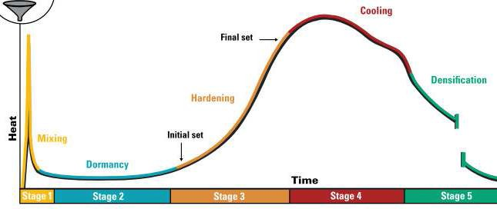
Heat of hydration at the given ages (cal /gm)
Compound | 3 days | 90 days | 13 years
C₃S | 58 | 104 | 122
C₂S | 12 | 42 | 59
C₃A | 212 | 311 | 324
C₄AF | 69 | 98 | 102
Joule/gram/hour
Joule/gram/hour=0.008 calories/ounce/hour Heat of Hydration of cement showing five stages

Slide 8
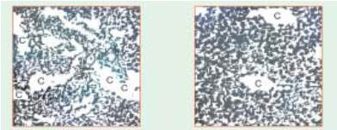
2-6 Structure of the Cement Paste
Fresh cement paste is a plastic mass consisting of water and cement. With the lapse of time, the hardening paste consists of hydrates of various compounds, unhydrated cement particles and water. With further lapse of time the quantity of unhydrated cement left in the paste decreases and the hydrates of the various compounds increase. Some of the mixing water is used up for chemical reaction, and some water occupies the gel-pores and the remaining water remains in the paste causes capillary pores. After a month the hydrated paste can be considered to be consisting of about 85 to 90% of hydrates of the various compounds and 10 to 15 per cent of unhydrated cement. The capillary pores may have been fully filled with water or partly filled with water or may be fully empty depending upon the age and the ambient temperature and humidity conditions.
Structure of the paste
The dark color: Gel
Small gap within the gel: Gel pores
C: Capillary pores

Slide 9
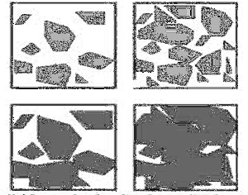
Figure, shows the effect of w/c ratio before and after hydration
Before hydration
After hydration
Water/cement ratio 0.6
Water/cement ratio 0.5

Slide 10
2-7 Development of Strength of Cement Compounds
C₃S readily reacts with water and produces more heat of hydration. It is responsible for early strength of concrete. A cement with more C₃S content is better for cold weather concreting. The quality and density of calcium silicate hydrate formed out of C₃S is slightly inferior to that formed by C₂S. The early strength of concrete is due to C₃S.
C₂S hydrates rather slowly. It is responsible for the later strength of concrete. It produces less heat of hydration and less Calcium hydroxide. The calcium silicate hydrate formed is rather dense and its specific surface is higher.
C₃A: The hydrated aluminates do not contribute anything to the strength of concrete. On the other hand, their presence is harmful to the durability of concrete particularly where the concrete is likely to be attacked by sulphates. But it is useful because it acts as flux decrease the temperature inside the kiln required for clinker.

Slide 11
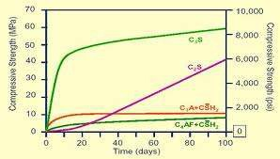
C₄AF:. A hydrated calcium ferrite of the form C₃FH₆ is comparatively more stable. This hydrated product also does not contribute anything to the strength.
But acts as flux. The hydrates of
C₄AF
show a comparatively higher
resistance to the attack of sulphates than the hydrates of calcium aluminates.
Development of strength of cement compounds

