Slide 1
Lab. no. 4
Salahaddin University- Erbil
College of Science
Department of Geology
Reflection from a single horizontal layer
3rd Class geology
2019-2020
Muhammad A. Salaee
MSc. In Applied Geophysics
Email: muhammed.ahmad@su.edu.krd

Slide 2
t-x Diagram
Time (sec)
S. P.
Distance (m)
g

Slide 3
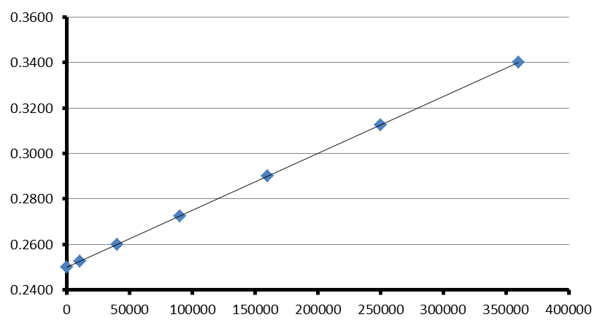
t $\text{2}$-x $\text{2}$ Diagram
$$(t_{2})\text{2}$$
$time$ t² (sec² )
$$(t_{1})\text{2}$$
$$(d_{1})\text{2}$$
$$(d_{2})\text{2}$$
$$Distance X\text{2}(m^{2})$$
$slope=\frac{(∆t\text{2})}{(∆d\text{2})}=\frac{{(t}_{2}\text{2})−{(t}_{1}\text{2})}{{(d}_{2}\text{2})−{(d}_{1}\text{2})}$
$Velocity= \frac{1}{\sqrt{slope}}$
$Depth= \frac{V∗t_{o}}{2}$

