Slide 1
Lab. no. 1
Salahaddin University- Erbil
College of Science
Earth sciences & Petroleum
Seismic method
Interval velocity (Vi)
Average velocity (Va)
Earth Sciences & Petroleum Department
2023-2024
Muhammad A. Salaee
MSc. In Applied Geophysics
Email: muhammed.ahmad@su.edu.krd

Slide 2
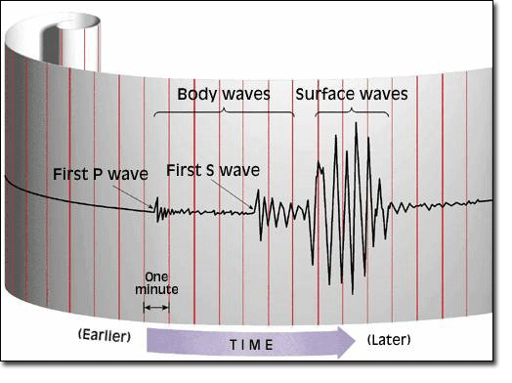
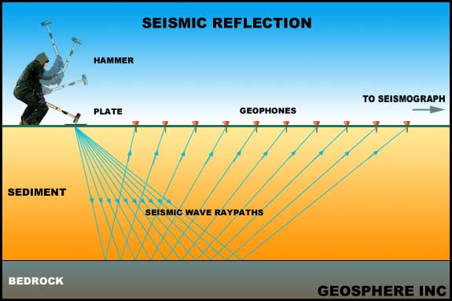
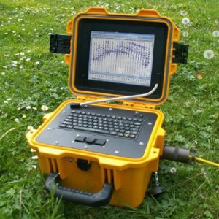
What we need:
1- shoot point
2- detectors (Geophones)
3- Seismogram

Slide 3
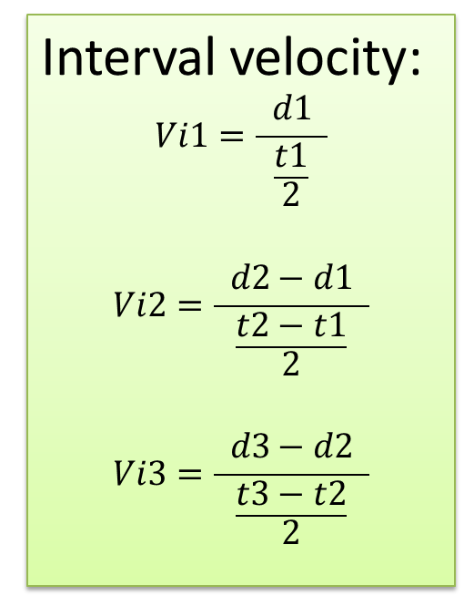
Interval velocity (Vi)
S. P.
Geophone
$$Velocity=\frac{Distance}{Time}$$
Interval velocity:
$$Vi1=\frac{ d1 }{\frac{t1}{2}}$$
$$Vi2=\frac{ d2−d1 }{\frac{t2−t1}{2}}$$
$$Vi3=\frac{ d3−d2 }{\frac{t3−t2}{2}}$$
d1
V1
d2
V2
d3
V3

Slide 4
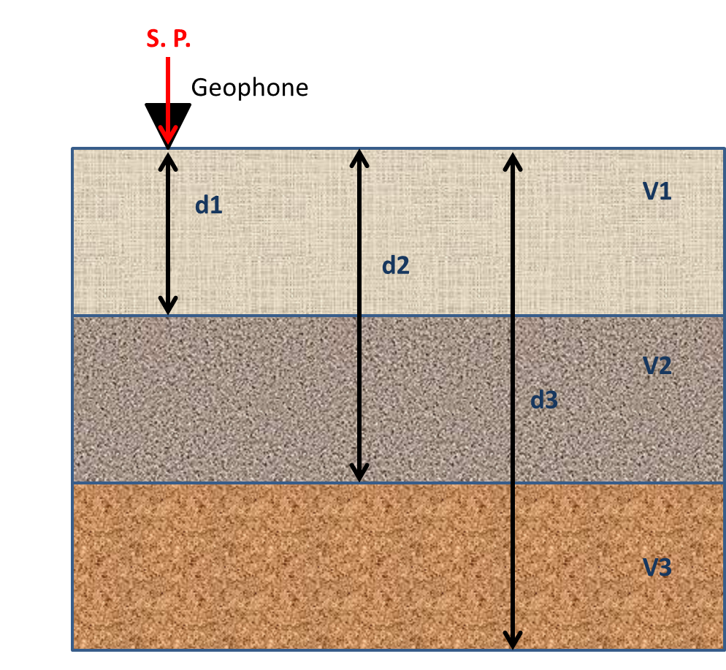
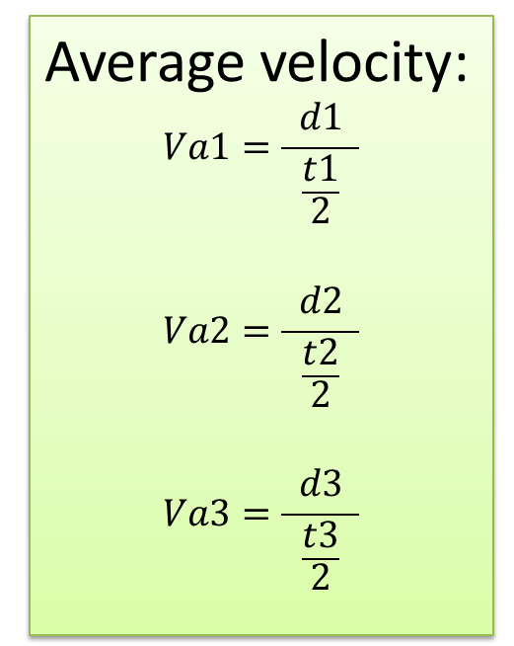
Average velocity (Va)
$$Velocity=\frac{Distance}{Time}$$
Average velocity:
$$Va1=\frac{ d1 }{\frac{t1}{2}}$$
$$Va2=\frac{ d2 }{\frac{t2}{2}}$$
$$Va3=\frac{ d3 }{\frac{t3}{2}}$$

Slide 5
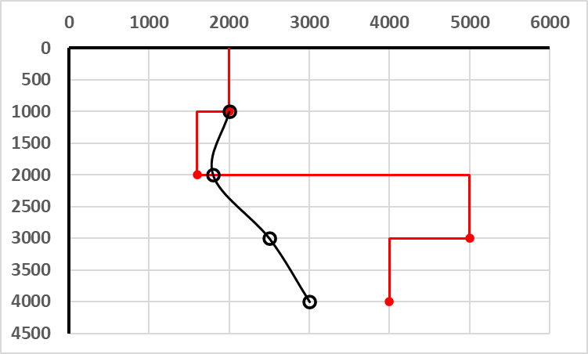
Velocity (m/s)
Interval Velocity
Depth (m)
Average Velocity

