Slide 1
Anaerobic bacteria
Lab 16

Slide 2
Anaerobic Bacteria
Anaerobic bacteria or anaerobes are bacteria that do not need oxygen to live. In humans, these bacteria generally live in the gastrointestinal tract, but they may also be found in other places outside the body, including in the soil and water, in foods, and in animals. Some anaerobes are beneficial to humans, but others can cause illnesses. Characteristics of an anaerobic bacterial infection are bad-smelling pus, the formation of abscesses, and the destruction of tissue.

Slide 3
Anaerobic Bacteria
The Bacteroides genus is an example of anaerobic bacteria that is both beneficial and harmful. In the gastrointestinal tract, species from this genus aid digestion, but when in other areas of the body, they can cause sinus thrombosis, pneumonia, and meningitis.

Slide 4
Anaerobic Bacteria
On the basis of oxygen requirements, bacteria can be divided into following different categories:
Obligate anaerobes: need an oxygen-free environment to live. They cannot grow in places with oxygen, which can sometimes damage and destroy them e.g. Clostridium spp.
Obligate aerobes: they have an obligate requirement to oxygen for aerobic respiration e.g. Pseudomonas spp.

Slide 5
Anaerobic Bacteria
3. Microaerophilic: grow best in the presence of small amount of oxygen e.g. Campylobacter spp.
4. Aerotolerant bacteria: do not use oxygen to live, but can exist in its presence e.g. Streptococcus spp.
5. Facultative anaerobes: use fermentation to grow in places without oxygen, but use aerobic respiration in places with oxygen e.g. Enterobacteriaceae.

Slide 6
Anaerobic Bacteria
Culturing anaerobes:
Since normal microbial culturing occurs in atmospheric air, which is an aerobic environment, the culturing of anaerobes poses a problem. Therefore, a number of techniques are employed by microbiologists when culturing anaerobic organisms:
1- Brewer anaerobic jar: is widely used method, includes excluding oxygen by adding a Gaspack containing sodium bicarbonate and sodium borohydride.

Slide 7
Anaerobic Bacteria
Constituents of gas-pack sachets:
1. Sodium borohydride - NaBH4
2. Sodium bicarbonate - NaHCO3
3. Citric acid - C3H5O(COOH)3
4. Cobalt chloride - CoCl2 (catalyst)

Slide 8
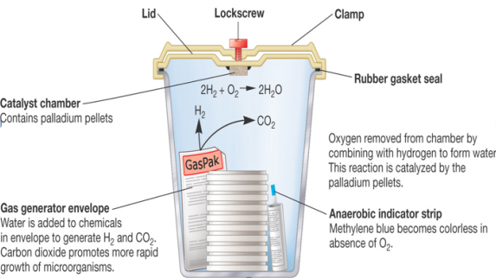
Brewer anaerobic jar

Slide 9
Candle Jar

Slide 10
Anaerobic Bacteria
2. Anaerobic Incubator, air is evacuated from the chamber and can be replaced with CO₂ or N_{2.}
3. Use of anaerobic cabinet/glove box allows conventional bacteriological techniques e.g. replica plating, antibiotic sensitivity testing etc. to be carried out anaerobically. The glovebox filled with nitrogen or the use of other specially sealed containers.

Slide 11
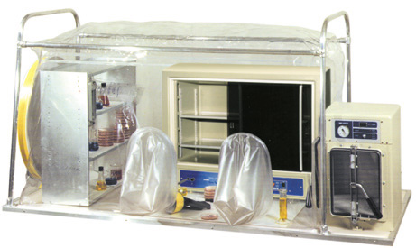
Anaerobic cabinet/glove box

Slide 12
Anaerobic Bacteria
4. Using reducing media which contain a reducing agent that chemically combine with oxygen e.g: Thioglycollate broth, contains sodium thioglycollate which combines with oxygen and reduces it from the medium.

Slide 13
Anaerobic Bacteria
Aerobic and anaerobic bacteria can be identified by growing them in liquid culture (Thioglycollate broth):
Obligate aerobic (oxygen-needing) bacteria gather at the top of the test tube in order to absorb maximal amount of oxygen.
2. Obligate anaerobic bacteria gather at the bottom to avoid oxygen.

Slide 14
Anaerobic Bacteria
3. Facultative bacteria gather mostly at the top, since aerobic respiration is the most beneficial one; but, as lack of oxygen does not hurt them, they can be found all along the test tube.
4. Microaerophiles gather at the upper part of the test tube but not at the top. They require oxygen but at a low concentration.
5. Aerotolerant bacteria are not affected at all by oxygen, and they are evenly spread along the test tube.

Slide 15
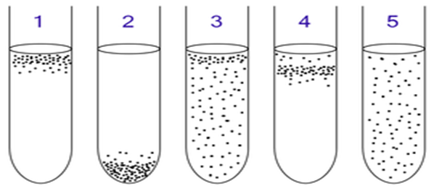

Slide 16
NEXT LAB
Pure culture

