Slide 1
Cell Biology Lab1
Introduction to cell

Slide 2
Brief information about the cell
Cells are the basic unit of life, every living thing, from the tiniest bacterium to the largest Whale is made of one or more cells. The organisms are existing as a unicellular (Organisms that exist as single cells) or multicellular (organisms that are made up of groups of cells working together).

Slide 3
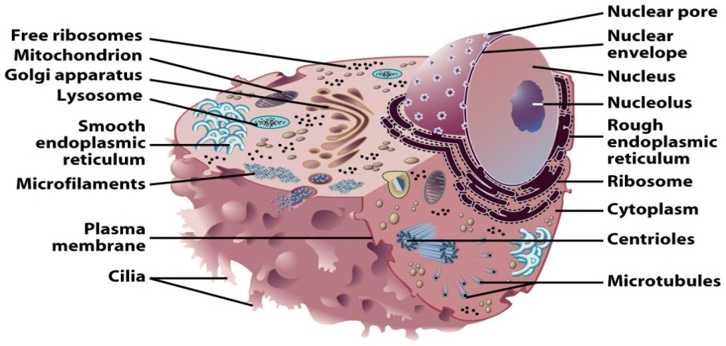
Cell structure and internal organization
Animal cell

Slide 4
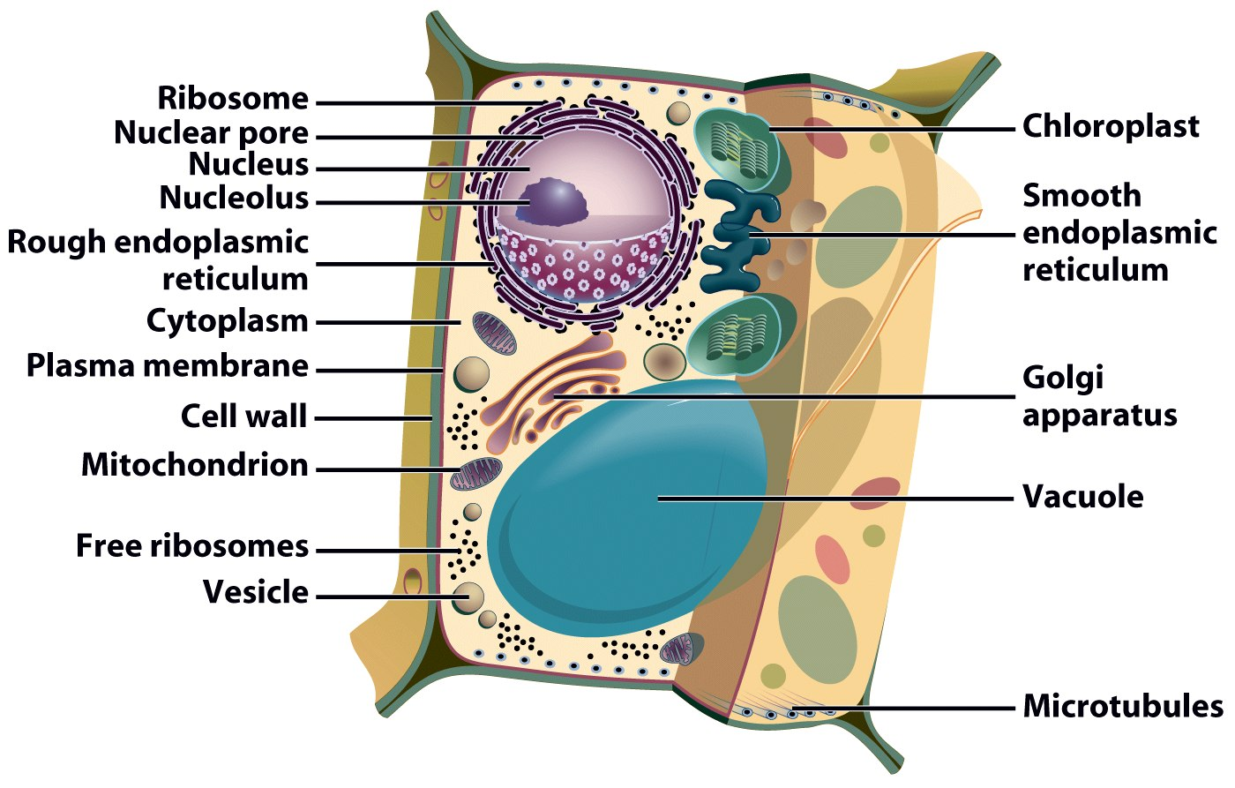
Plant cell

Slide 5
Determination of the cell shape
Cell shape changes are mediated by proteins of the cytoskeleton (microfilaments, microtubules and intermediate filaments)

Slide 6
Cytoskeleton
The cytoskeleton is an interconnected system of protein fibers and tubes that extends throughout the cytosol.

Slide 7
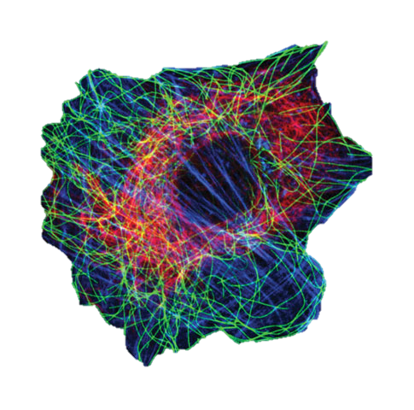
The cytoskeleton has three distinct elements
Microfilaments, the thinnest class of the cytoskeletal fibers.
Microtubules are the thickest of the cytoskeletal fiber.
Intermediate filaments (these are sized in between the other two).

Slide 8
Did prokaryotes have the cytoskeleton?

Slide 9
Prokaryotes, and the Eukaryotes.
All living things are divided into two major groups these two groups are the Prokaryotes, and the Eukaryotes.

Slide 10
Cell shape
Not all cells are alike. Even cells within the same organism show a number of diversity in size, shape, and internal organization

Slide 11
Pleomorphism
Is the ability of some cells to alter their shape or size in response to environmental conditions. This property is seen in many bacteria and fungi.

Slide 12
Importance of different shapes of plant cells:
Extension of root hair cells help in both adhesion and absorption of water and ions.
Shapes of xylem and phloem allow them to transport water and food respectively.
Shape of guard cell help in gaseous exchange.

Slide 13
Role of different shapes of animal cells:
Shape of neuron helps it to transport signals.
Shape of RBCs helps them to flow through blood and protect them from pressure in the blood.
Cuboidal, columnar shaped cells help epithelial tissues to protect the internal part of our body.
Shape of the muscle fibers help in muscle contraction.

Slide 14
Different shapes of cell:
Rod shape (bacteria)
Spherical shape (bacteria)
Oval shape (yeast)
Rectangular (onion or plant)
Columnar shaped cell (epithelium)
Elongated in shape (skeletal muscle)
Fusiform in shape (smooth muscle)
Thread like in shape (neuron)
Star shape (osteocyte)
Polyhedral shape (hepatocyte)

