Slide 1
Department of Biology College of Science Salahaddin University - Erbil Cytogenetics– 2nd Course
Human Chromosome Nomenclature
Academic Year: 2022/2023

Slide 2
INTRODUCTION
Advancements in methodology and discovery of the diploid human chromosome number invigorated further research in human cytogenetics.
The eventful years that followed witnessed the birth of a new specialty—human cytogenetics—which provided answers to many intriguing phenomena in medicine.
Little was known at the time that human cytogenetics would form the backbone of present-day “human genetics,” providing answers to questions regarding human reproduction, behavior, aging, and disease while generating knowledge that could be applied to the treatment and prevention of many disorders.

Slide 3
The discovery of the chromosomal etiology of Down syndrome, Turner syndrome, Klinefelter syndrome, Edwards syndrome, and Patau syndrome further added to the knowledge that variations from the normal diploid chromosome number and structure can cause severe phenotypic malformations and mental impairment.
The need for guidelines and standardization of terminology thus became imperative.
At a conference held in Denver, CO, 14 attendees from different countries argued for 3 days. In the end, they agreed upon guidelines for describing human chromosomes and chromosome abnormalities.
This historic document is called the Denver Conference (1960): A Proposed Standard System of Nomenclature of Human Mitotic Chromosomes.

Slide 4
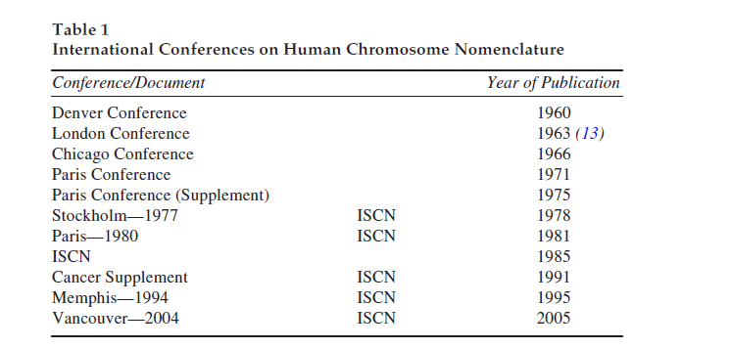

Slide 5
HUMAN CHROMOSOMES
Of the 46 chromosomes in a normal human somatic cell, 44 are autosomes and 2 are sex chromosomes. The autosomes are designated as pairs 1–22.
The numbers are assigned in descending order of the length, size, and centromere position of each chromosome pair.
In a normal female the sex chromosomes are XX, and in a normal male, they are XY.
Notes:
Until the advent of certain specialized staining techniques, arbitrary identification of individual
chromosome pairs was based on the size and position of the centromere (4). Variability in the centromere
position of different chromosomes allowed them to be classified into three basic categories.
A chromosome with its centromere in the middle is metacentric, one with the centromere closer to
one end is sub-metacentric, and one with the centromere almost at one end is acrocentric (see Fig. 3).
Based on decreasing relative size and centromere position, a karyotype comprised of seven groups
labeled A through G was devised. The X chromosome belonged to the third or “C” group, whereas
the Y was often placed separately. Although still used occasionally, these letter group names are now
considered obsolete.

Slide 6
Until the advent of certain specialized staining techniques, arbitrary identification of individual chromosome pairs was based on the size and position of the centromere . Variability in the centromere position of different chromosomes allowed them to be classified into three basic categories.
A chromosome with its centromere in the middle is metacentric,
one with the centromere closer to one end is sub-metacentric,
and one with the centromere almost at one end is acrocentric

Slide 7
Based on decreasing relative size and centromere position, a karyotype comprised of seven groups labeled A through G was devised. The X chromosome belonged to the third or “C” group, whereas the Y was often placed separately.

Slide 8
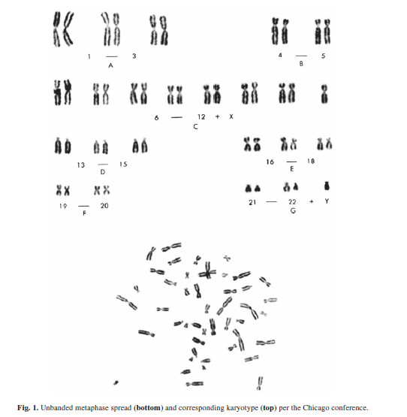

Slide 9
Chromosome Banding and Identification
When chromosome preparations are treated with dilute solutions of proteolytic enzymes (trypsin, pepsin, etc.) or salt solutions (2X SSC) and treated with a chromatin stain such as Giemsa, alternating dark and light stained demarcations called bands appear along the length of each chromosome.
The banding patterns produced are specific for each chromosome pair, thus enabling the identification not only of individual chromosomes but also of regions within each chromosome.
Methods commonly used to produce these discriminative banding patterns include Giemsa or G-banding, quinacrine mustard or Q-banding, reverse or R-banding and constitutive heterochromatin or C-banding, each with its own uniqueness.

Slide 10
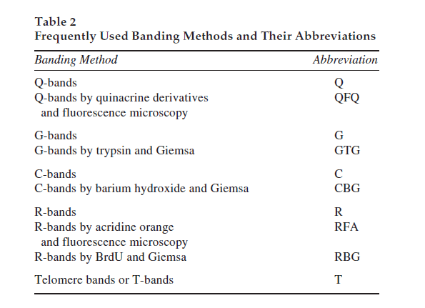

Slide 11
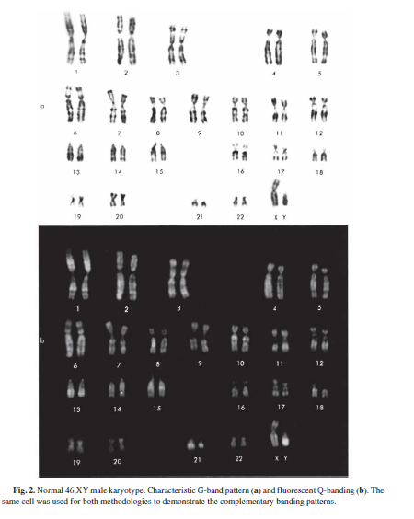

Slide 13
+

Slide 14
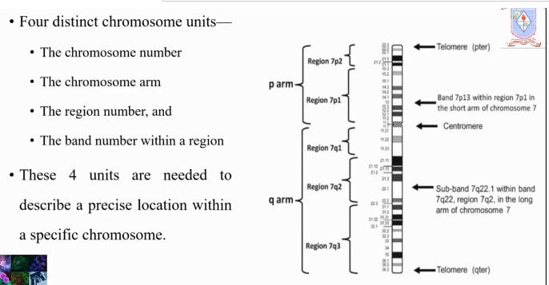

Slide 16
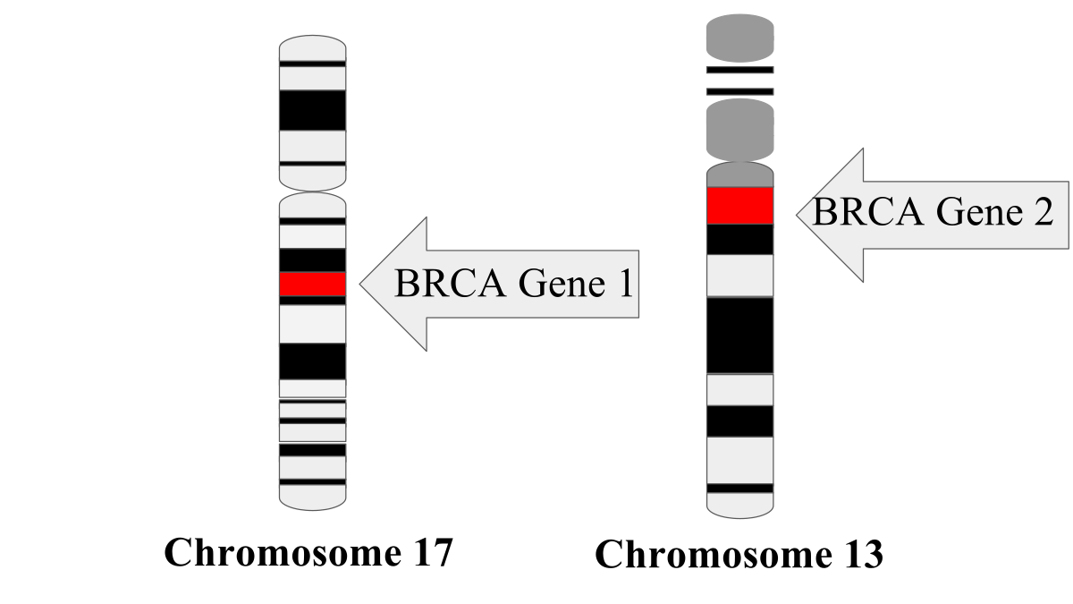

Slide 17
Karyotype Descriptions
Karyotype descriptions follow certain basic rules. When designating a karyotype, the first item specified is the total number of chromosomes, including the sex chromosomes present in that cell, followed by a comma and the sex chromosomes in that order.
Thus, a normal female karyotype is written as 46,XX and a normal male karyotype as 46,XY. The characters are contiguous, without spaces between items.

Slide 18
Chromosome abnormalities, when present, follow the sex chromosome designation using abbreviations or symbols denoting each abnormality Sex chromosome abnormalities are described first, followed by autosomal changes in numerical order.
For each chromosome described, numerical changes are listed before structural abnormalities.

Slide 19
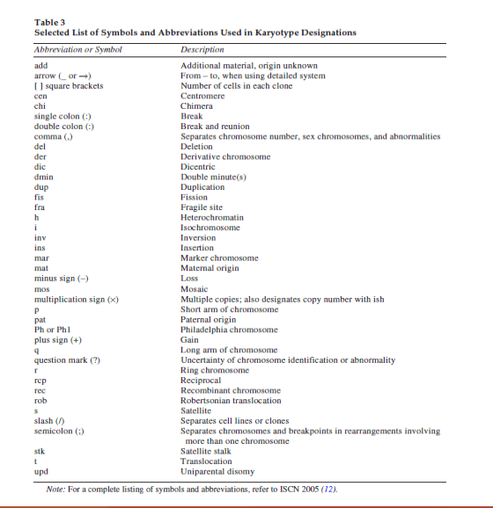

Slide 20
