Slide 1
PRIMER DESIGN CRITERIA

Slide 2
Primer
Are short stretches of DNA that target unique sequences and help identify a unique part of genome — let's say, a gene. Primers are usually 18 to 25 nucleotides long. They can be synthesized in a special lab, and are used in many different ways.

Slide 3
Criteria's for Primer designing
Primer Length: It is generally accepted that the optimal length of PCR primers is 18-22 bp. This length is long enough for adequate specificity and short enough for primers to bind easily to the template at the annealing temperature.

Slide 4
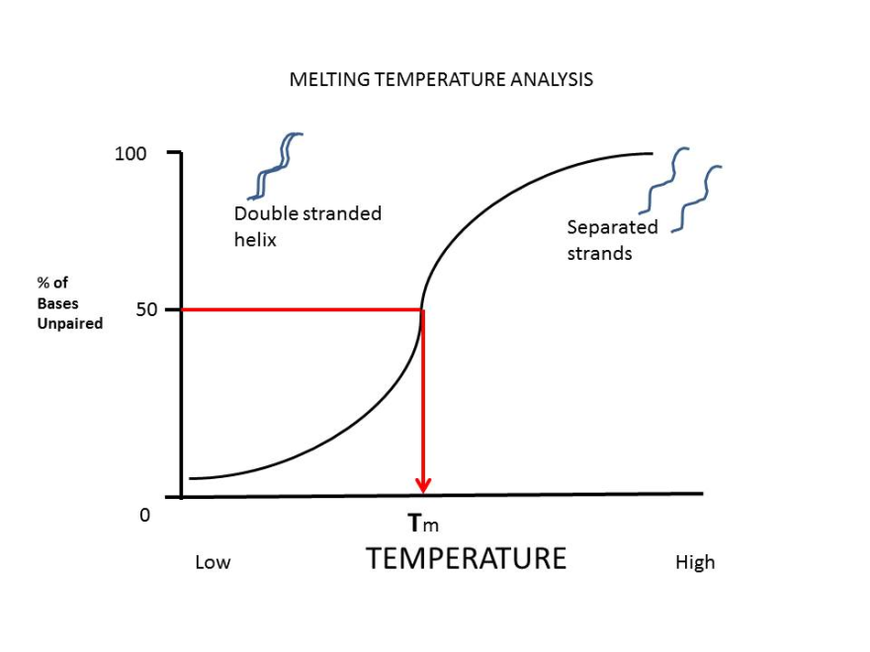
Criteria's for Primer designing
Primer Melting Temperature: Primer Melting Temperature (T_{m}) by definition is the temperature at which one half of the DNA duplex will dissociate to become single stranded and indicates the duplex stability. Primers with melting temperatures in the range of 52-58 ºC generally produce the best results. Primers with melting temperatures above 65ºC have a tendency for secondary annealing. The GC content of the sequence gives a fair indication of the primer T_{m}.
The formula for primer Tm calculation:
Tm = [4 x (G + C) + 2 x (A + T)] °C.
e.g. primer composition :GACTGCGTTAGGATTGGC; count the number of G+C and A+T and enter into the formula.
Hence, Tm = [4 (10)+ 2 (8)] °C = (40+16) °C = 56°C

Slide 5
Criteria's for Primer designing
Primer Annealing Temperature: The primer melting temperature is the estimate of the DNA-DNA hybrid stability and critical in determining the annealing temperature. Too high T_{a} will produce insufficient primer-template hybridization resulting in low PCR product yield. Too low T_{a} may possibly lead to non-specific products caused by a high number of base pair mismatches,. Mismatch tolerance is found to have the strongest influence on PCR specificity.
T_{a} = 0.3 x T_{m}(primer) + 0.7 T_{m} (product) – 14.9
where, T_{m}(primer) = Melting Temperature of the primers
T_{m}(product) = Melting temperature of the prod
OR
T_{a} = T_{m}(primer) – 5 °C

Slide 6
Criteria's for Primer designing
GC Content: The GC content (the number of G's and C's in the primer as a percentage of the total bases) of primer should be 40-60%.
GC Clamp: The presence of G or C bases within the last five bases from the 3' end of primers (GC clamp) helps promote specific binding at the 3' end due to the stronger bonding of G and C bases. More than 3 G's or C's should be avoided in the last 5 bases at the 3' end of the primer.

Slide 7
Criteria's for Primer designing
Primer Secondary Structures: Presence of the primer secondary structures produced by intermolecular or intramolecular interactions can lead to poor or no yield of the product. They adversely affect primer template annealing and thus the amplification. They greatly reduce the availability of primers to the reaction.
Hairpins: It is formed by intramolecular interaction within the primer and should be avoided.

Slide 8
Criteria's for Primer designing
Self Dimer: A primer self-dimer is formed by intermolecular interactions between the two (same sense) primers, where the primer is homologous to itself. Generally a large amount of primers are used in PCR compared to the amount of target gene. When primers form intermolecular dimers much more readily than hybridizing to target DNA, they reduce the product yield.
Cross Dimer: Primer cross dimers are formed by intermolecular interaction between sense and antisense primers, where they are homologous.

Slide 9
Primer Design using Software

