Slide 1
Technology of Soft Drinks and Fruit Juices
There are four primary sectors of the global commercial beverage market (Figure 1):
First, Hot drinks, such as tea, coffee and hot malt-based products;
Second, Milk drinks, including white drinking milk and flavored milk products;
Third, Soft drinks, a sector with five main subcategories
Bottled water;
Carbonated soft drinks;
Dilutables, also known as squash and including powders, cordials and syrups;
100% fruit juice, and nectars with 25–99% juice content;
Still drinks, including ready-to-drink (RTD) teas, sports drinks and other noncarbonated
products with less than 25% fruit juice;
Fourth, Alcoholic drinks, including beer, wine, spirits, cider, sake and flavoured alcoholic beverages –sometimes referred to as pre-mixed spirits.

Slide 2
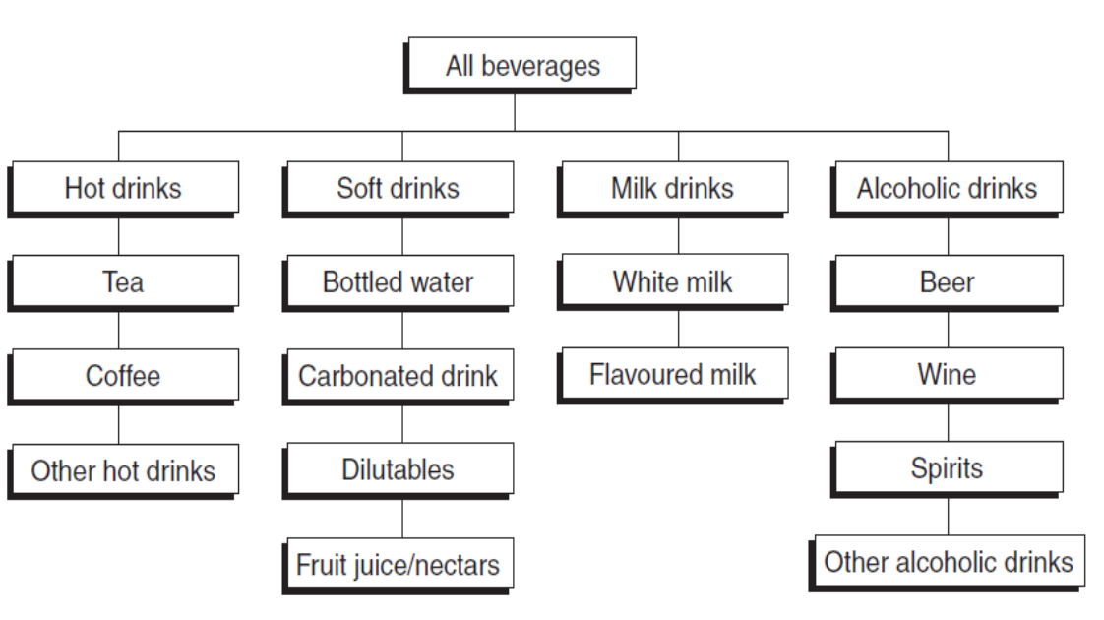
(Figure 1) Beverage sectors and segments.
Source: Zenith International.

